Slide 1
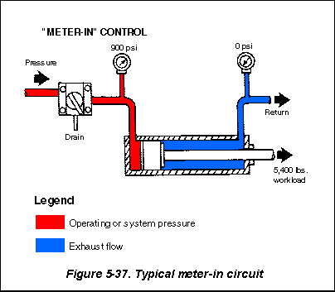
PNEUMATIC CIRCUITS

Slide 2
Working of SINGLE acting cylinder
SINGLE ACTING CYLINDER, SPRING RETURNED
A
1
2
3/2 DC VALVE
P
R
MUFFLER(AIR EXHAUST)
AIR RECEIVER
COMPRESSOR
FRL UNIT

Slide 3
Working of DOUBLE acting cylinder
DOUBLE ACTING CYLINDER
A
B
1
2
4/2 DC VALVE
P
R
AIR RECEIVER
COMPRESSOR
FRL UNIT

Slide 4
PILOT CONTROL SINGLE ACTING CYLINDER
IMPULSE CIRCUIT
A
SINGLE ACTING CYLINDER, SPRING RETURNED
B
PILOT SIGNAL (COMPRESSED AIR)
MAIN
3/2 DC VALVE
2
PUSH BUTTON OPERATED 3/2 DCV (START VALVE)
1
R
P
MUFFLER
1
2
R
P
COMPRESSOR
AIR RECEIVER
FRL UNIT

Slide 5
PILOT CONTROL DOUBLE ACTING CYLINDER
IMPULSE CIRCUIT
A
SINGLE ACTING CYLINDER, SPRING RETURNED
B
PILOT SIGNAL (COMPRESSED AIR)
MAIN
4/2 DC VALVE
2
PUSH BUTTON OPERATED 3/2 DCV (START VALVE)
1
P
R
MUFFLER
1
2
R
P
COMPRESSOR
AIR RECEIVER
FRL UNIT
5

Slide 6
Working of PILOT CONTROLLED UNIDIRECTIONAL AIR MOTOR
A
UNIDIRECTIONAL AIR MOTOR
BUTTON OPERATED 3/2 DC VALVE
PILOT OPERATED 3/2 DC VALVE
1
2
2
P
R
MUFFLER(AIR EXHAUST)
P
R
AIR RECEIVER
COMPRESSOR
FRL UNIT
MOISTURE SEPARATOR
IMPULSE CIRCUIT
6

Slide 7
Working of PILOT CONTROLLED BIDIRECTIONAL AIR MOTOR
A
BUDIRECTIONAL AIR MOTOR
BUTTON OPERATED 3/2 DC VALVE
PILOT OPERATED 3/2 DC VALVE
1
2
2
P
R
MUFFLER(AIR EXHAUST)
P
R
AIR RECEIVER
COMPRESSOR
IMPULSE CIRCUIT
FRL UNIT
MOISTURE SEPARATOR
7
7

Slide 8
SPEED CONTROL OF SINGLE acting cylinder
SINGLE ACTING CYLINDER, SPRING RETURNED
A
FLOW CONTROL VALVE WITH CHECK VALVE
1
2
3/2 DC VALVE
P
R
MUFFLER(AIR EXHAUST)
AIR RECEIVER
COMPRESSOR
FRL UNIT
8

Slide 9
SPEED CONTROL OF DOUBLE acting cylinder
DOUBLE ACTING CYLINDER
A
B
FLOW CONTROL VALVE WITH CHECK VALVE (2)
1
2
4/2 DC VALVE
P
R
AIR RECEIVER
COMPRESSOR
FRL UNIT
9

Slide 10
SPEED CONTROL OF BIDIRECTIONAL AIR MOTOR
BUDIRECTIONAL AIR MOTOR
A
1
2
4/2 DC VALVE
P
R
MUFFLER(AIR EXHAUST)
FRL UNIT
AIR RECEIVER
COMPRESSOR
MOISTURE SEPARATOR
10
10
10

Slide 11
SEQUENCING OF DOUBLE ACTING CYLINDER WITH UNIDIRECTIONAL AIR MOTOR
UNIDIRECTIONAL AIR MOTOR
DOUBLE ACTING CYLINDER
A
B
LIMIT SWITCH
3/2 DC SOLENOID VALVE
P
R
4/2 DC VALVE
START
MUFFLER
FRL UNIT
COMPRESSOR

Slide 12
TIME DELAY CIRCUIT
DOUBLE ACTING CYLINDER
3/2 ROLLER OPERATED DC VALVE
A
B
TIME DELAY VALVE
Y
Z
P
R
4/2 DC VALVE
MUFFLER
FRL UNIT
COMPRESSOR

Slide 13
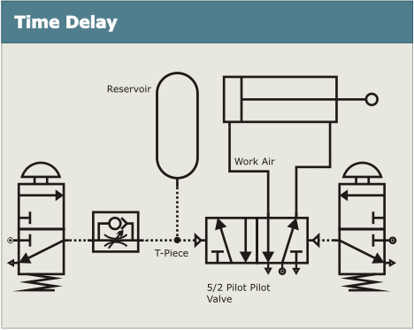

Slide 14
Time delay circuits
A time delay in a peumatic circuit provides a delay between the operation of a valve and the movement of a piston. Time delays are achieved by connecting a unidirectional-flow control valve and a reservoir in series. A pneumatic circuit with a time delay is shown in the diagram and explained below.

Slide 15
The time-delayed pneumatic circuit works like this:
When the push-button on the three-port valve on the left is pressed, the air flow is restricted by the unidirectional-flow control valve and slowly enters the reservoir.
The pressure builds in the reservoir slowly, causing the time delay.
Only when the pressure in the reservoir is high enough will it operate the five-point valve, triggering the release of air and causing the piston to outstroke.
When the push button is pressed on the second three-port valve (on the right), the five-point valve will switch, triggering the release of air and causing the piston to instroke.

Slide 16
The length of the time delay can be altered using an adjustable unidirectional-flow control valve.
Do not confuse time delay with speed control. Time delay prevents the piston operating for a particular time period. Speed control reduces the speed of the piston's instroke or outstroke.

Slide 17
THANKS !!!
DOUGHTS, QUERIES WELCOMED.

