Slide 1
Expt 1
STUDY OF GENERALIZED MEASUREMENT SYSTEM & ITS COMPONRNT WITH EXAMPLE OF BOURDON PRESSURE GAUGE.

Slide 2
FUNDAMENTAL MESURING PROCESS
STANDARD
MEASURAND
PROCESS OF COMPARISION
RESULT
INPUT
OUTPUT

Slide 3
TRANDUCED SIGNAL (ANALOGOUS TO INPUT
ANALOGOUS DRIVING SIGNAL
SENSOR TRANSUCER
SIGNAL CODITIONER
MEASURAND
INDICATOR
RECORDER
PROCESSOR
CONTROLLER
AUXILLARY POWER (NOT ALWAYS REQUIRED
AUXILLARY POWER (USUALLY REQUIRED
GENERALIZED MEASUREMENT SYSTEM

Slide 4
GENERAL ARRANGEMENT CONSISTS THREE STAGES
STAGE I A DETECTOR TRANDUCING OR SENSOR STAGE
STAGE II SIGNAL CONDITIONING STAGE
STAGE III TERMINATING OR READ OUT STAGE

Slide 5
STAGE I A DETECTOR TRANDUCING OR SENSOR STAGE
FUNCTION IS TO DETECT OR SENSE THE MEASURAND IDEALLY, IT SHOULD BE INSENSITIVE TO EVERY OTHER POSSIBLE INPUT.
E.G. * IF IT IS A PRESSURE PICKUP, IT SHOULD INSENSATIVE TO ACCELERATION
*IF IT IS A STRAIN GAUGE ,. IT SHOULD INSENSATIVE TO TEMP.
* IF IT IS A LINEAR ACCELEROMETER,. IT SHOULD INSENSATIVE TO ANGULAR ACCELERATION

Slide 6
PRIMARY SENSING ELEMENTS OPERATON IT PERFORMS
1.MECHANICAL TYPE
CONTACTING SPINDLE, PIN, FINGER ----- DISPLACEMENT TO DISPLACEMENT
2. ELASTIC MEMBER
A] LOAD CELLS
1. TENSION/COMPRESSION
2. BENDING --- FORCE TO LINEAR DISPLACEMENT
3. TORSION --- FORCE TO ANGULAR DISPLACEMENT
B] PROVING RING
C] HELICAL SPRING --- FORCE TO LINEAR DISPLACEMENT
D] BOURDON TUBE
BELLOWS
DIAPHRAGMS --- PRESSURE TO DISPLACEMENT
E] LIQUID COLUMN

Slide 7
3. MASS:
PENDULUM -- FORCE TO DISPLACEMENT AND
GRAVITATIONAL ACCELERATION TO FREQUENCY
4. THERMAL
THERMOCOUPLE -- TEMP. TO ELECTRIC CURRENT
BIMATERIAL OR MERCURY IN GLASS --- TEMP. TO DISPLACEMENT
THERMISTER ----- TEMP. TO RESISTANCE CHANGE
CHEMICAL COMPOSITION ----- TEMP. TO CHEMICAL CHANGE
5. HYDRPNEUMATIC
STATIC
FLOAT ----- FLUID LEVEL TO DISPLACEMENT
HYDROMETER ----- SP.GR. TO RELATIVE DISPLACEMENT
DYNAMIC
ORIFICE, VENTURI, PITOT ---- FLUID VELOCITY TO PRESSURE CHANGE
VANES --- VELOCITY TO FORCE
TURBINES ---- LINEAR TO ANGULAR VELOCITY.

Slide 8
STAGE II SIGNAL CONDITIONING STAGE
PURPOSE IS TO MODIFY THE TRANDUCED INFORMATION, SO THAT IT IS ACCEPTABLE TO THE TERMINATING STAGE.
IT MAY BE PERFORMING THE BASIC OPERATIONS SUCH AS FILTERING, INTERGRATION, DIFFERENTIATING OT TELEMETERING AS REQUIRED.
INCREASE EITHER AMPLITUDE (AMPLIFIER) OR POWER OF THE SIGNAL OR BOTH.

Slide 9
SECONDARY TRANSDUCER OR SIGNAL CONDITIONING
THEY GET INPUT FROM THE OUTPUT OF PRIMARY TRANSDUCER.
DISPLACEMENT OF END A OF THE SPRING FORMS A MOVING CONTACT.
FLEXIBLE CABLE
VOLTMETER
SPRING
A
R
SUPPLY
W
WEIGHT
SECONDARY TRANSDUCER EG. POTENTIOMETER

Slide 10
IT CONVERTS THE DISPALCEMENT DUE TO FORCE WEIGHT, INTO VARYING VOLTAGE ( AS PER THE CHANGE IN RESISTANCE VALUE OF POTENTIOMETER.
DISPALCEMENT -------CHANGE IN RESISTANCE --- CHANGE IN VOLTAGE
EG. IN BOURDON TUBE.
LINEAR DISPLACEMENT CONVERTED IN ANGULAR DISPLACEMENT
RACHET AND PINION, GEARING ETC. IN BOURDON TUBE.

Slide 11
STAGE III TERMINATING OR READ OUT STAGE
PROVIDES THE INFORMATION SOUGHT IN THE FORM COMPREHENSIBLE TO ONE OF THE HUMAN SENSE OR TO A CONTROLLER.
PRESENTED AS
A RELATIVE DISPLACEMENT SUCH AS MOVEMENT OF INDICATING HAND, DISPLACEMENT OF OSCILLOSCOPE TRACE ETC.
IN DIGITAL FORM E.G. AUTOMOBILE ODOMETER, VOLTMETER, AMMETER. ETC.

Slide 12
STAGE I -SENSOR TRANDUCER
EXAMPLES ARE ---
MECHANICAL:
EG. CONTACTING SPINDLE, SPRING, ELASTIC DEVICES, DIAPHRAGMS,
BOURDON TUBE FOR PRESSURE,
PROVING RING FOR FORCE
EXAMPLES ARE ---
HRDRAULIC-PNEUMATIC
EG. BUOYANT FLOAT, VENTURY,ORIFICE,VANE, PROPELLER
OPTICAL:
PHOTOGRAPHIC FILM,
PHOTOELECTRIC CELL.
STAGE II- SIGNAL CONDITIONING
GEARING, CRANKS, SLIDES, CONNECTING LINKS, CAMS.
PIPING, VALVES, PLENUM CHAMBERS
MIRROR, LENSES, OPTICAL FIBERS, OPTICAL FILTERS

Slide 13
STAGE I -SENSOR TRANDUCER
ELECTRICAL:
RESISTANCE, CAPACITANCE,
PIEZOELECTRIC CRYSTALS,
THERMOCOUPLE ETC.
STAGE II- SIGNAL CONDITIONING
AMPLIFYING OR ATTENUATING SYSTEMS, FILTERS,
TELEMETERING SYSTEMS,
INTEGRATED CIRCUIT SYSTEMS.

Slide 14
STAGE III TERMINATING-READ OUT
INDICATORS
MOVING POINTER AND SCALES, LIGHT BEAM AND SCALES, ELECTRON BEAM AND SCALE, ELECTRON BEAM AND SCALE (CRO), LIQUID COLUMN.
DIGITAL TYPES:
ALPHANUMERIC READ OUTS.
RECORDERS:
DIGITAL PRINTING, DIRECT PHOTOGRAPHY, MAGNETIC RECORDING
PROCESSORS:
VARIOUS TYPES OF COMPUTING SYSTEMS, FEED READ OUT OR RECORDING DEVICES AND/OR CONTROLLING SYSTEMS.
CONTROLLERS : ALL TYPES

Slide 15
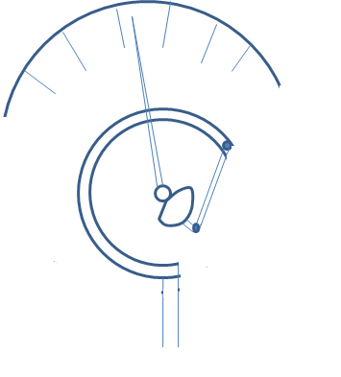
CALIBRATED SCALE
POINTER
CIRCULAR TUBE OF ELLIPTICAL C/S
RACHET AND PINION
CONNECTED TO PRESSURE PIPE
BOURDON TUBE PRESSURE GAUGE

Slide 16
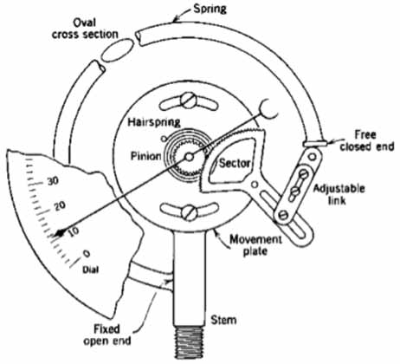
BOURDON TUBE PRESSURE GAUGE

Slide 17
GENERALIZED MEASUREMENT SYSTEM APPLIED TO
BOURDON TUBE PRESSURE GAUGE.
CIRCULAR TUBE: SERVES AS PRIMARY DETECTOR-TRANSDUCER.
CHANGING PRESSURE INTO NEAR LINEAR DISPLACEMENT
LINKAGE- GEAR ARRANGEMENT :
SERVES AS SECONDARY TRANSDUCER
LINEAR TO ROTARY MOTION AND AS AN AMPLIFIER. YIELDING MAGNIFIED OUTPUT
POINTER OVER CALIBRATED SCALE OR MOVING HAND :
SERVES AS A READ OUT DEVICE.

Slide 18
BOURDON TUBE
MECHANICAL LINKAGE
GEARING
POINTER AND DIAL
PRIMARY SENSING ELEMENT
VARIABLE CONVERSION ELEMENT
DATA TRANSMISSION ELEMENT
VARIABLE MANIPULATION ELEMENT
DATA PRESENTATION ELEMENT
P
PRESSURE
FORCE
DISPLACEMENT
LINEAR TO ANGULAR MOTION
BOURDON PRESSURE GAUGE MEASUREMENT SYSTEM

Slide 19
THANKS !!!

