Slide 1
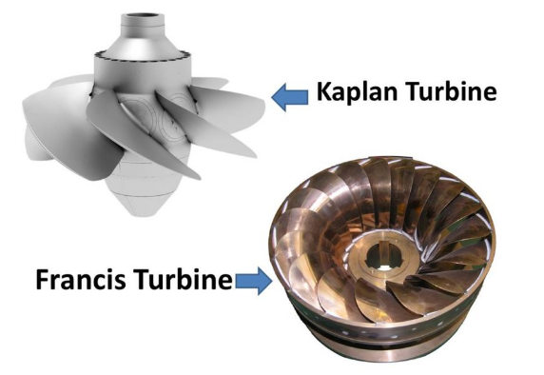
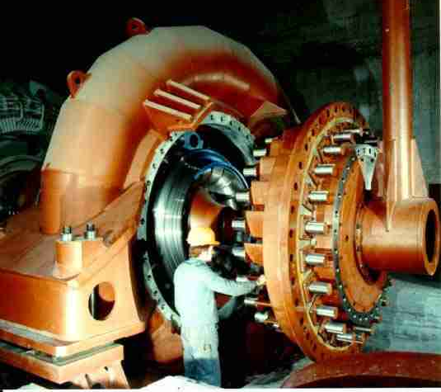
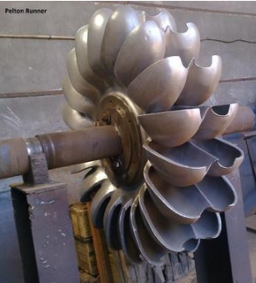
HYDRAULIC TURBINES
Francis Turbine
Pelton wheel runner

Slide 2
HYDRAULIC TURBINES
HYDRAULIC TURBINES MAY BE DEFINED AS
PRIME MOVERS THAT TRANSFORM THE KINETIC ENERGY OF THE FALLING WATER INTO MECHANICAL ENERGY OF ROTATION AND WHOSE PRIMARY FUNCTION IS TO DRIVE A ELECTRIC GENERATOR.
Hydraulic energy mechanical energy electric energy

Slide 3
The main components of a hydroelectric system may be classified into two groups:
– THE HYDRAULIC SYSTEM COMPONENTS
TURBINE,
THE ASSOCIATED CONDUITS-LIKE PENSTOCKS,
TUNNEL AND SURGE TANK
AND ITS CONTROL SYSTEM.
– THE ELECTRIC SYSTEM COMPONENTS
THE SYNCHRONOUS
GENERATOR
AND ITS CONTROL SYSTEM.

Slide 4
HYDRAULIC TURBINES ARE GENERALLY CLASSIFIED AS
--based upon energy utilization
Impulse Turbine – Pelton, Turgo turbine
Reaction Turbine – Francis, Kaplan and Propeller turbine
--Based on flow direction, they are further classified as:
Tangential Flow
Radial Flow
Axial Flow
Mixed Flow
-- based on head available
high head
Low head
Medium head
-- based on specific speed
low specific speed
high specific speed

Slide 5
IMPULSE TURBINE e.g. Pelton wheel
THE FLOW ENERGY TO THE IMPULSE TURBINES IS
COMPLETELY CONVERTED TO KINETIC ENERGY BEFORE
TRANSFORMATION IN THE RUNNER.
THE IMPULSE FORCES BEING TRANSFERRED BY THE
DIRECTION CHANGES OF THE FLOW VELOCITY VECTORS
WHEN PASSING THE BUCKETS CREATE THE ENERGY
CONVERTED TO MECHANICAL ENERGY ON THE TURBINE
SHAFT.
THE FLOW ENTERS THE RUNNER FROM JETS SPACED AROUND
THE RIM OF THE RUNNERS.
THE JET HITS MOMENTARILY ONLY A PART OF THE
CIRCUMFERENCE OF THE RUNNER.

Slide 6
REACTION TURBINE: e.g. Francis turbine
IN THE REACTION TURBINES TWO EFFECTS CAUSE THE ENERGY TRANSFER FROM THE FLOW TO THE MECHANICAL ENERGY ON THE TURBINE SHAFT:
FIRSTLY, IT FOLLOWS FROM A DROP IN PRESSURE FROM INLET TO OUTLET
OF THE RUNNER. THIS IS DENOTED AS THE REACTION PART OF THE ENERGY
CONVERSION.
SECONDLY, THE CHANGES IN THE DIRECTIONS OF THE FLOW VELOCITY
VECTORS THROUGH THE RUNNER BLADE CHANNELS TRANSFER IMPULSE
FORCES. THIS IS DENOTED AS THE IMPULSE PART OF THE ENERGY
CONVERSION.
THE PRESSURE FROM INLET TO OUTLET OF THE RUNNERS IS OBTAINED
BECAUSE THE RUNNERS ARE COMPLETELY FILLED WITH WATER.

Slide 7
PELTON WHEEL
INVENTED BY PELTON IN 1890.
THE PELTON TURBINE IS A TANGENTIAL FLOW IMPULSE TURBINE.
THE PELTON WHEEL IS MOST EFFICIENT IN HIGH HEAD APPLICATIONS.
POWER PLANTS WITH NET HEADS RANGING FROM 200 TO 1,500 M.
THE LARGEST UNITS CAN BE UP TO 200 MEGAWATTS.
PELTON TURBINES ARE BEST SUITED FOR HIGH HEAD AND LOW FLOW SITES.
DEPENDING ON WATER FLOW AND DESIGN, PELTON WHEELS CAN OPERATE WITH HEADS AS SMALL AS 15 METERS AND AS HIGH AS 1800 METERS.
AS THE HEIGHT OF FALL INCREASES, LESS VOLUME OF WATER CAN GENERATE SAME POWER.

Slide 8
MATERIAL OF PELTON TURBINE :
CASE : FABRICATED CARBON STEEL TO BS EN 10025:1993 S275JR
RUNNER: CAST STAINLESS BS3100 GRADE 425 C11
SHAFT SEAL: CAST GUNMETAL LABYRINTH TYPE SEAL
BEARINGS: ROLLING ELEMENT OR SLEEVE TYPE
SPEAR / : STAINLESS STEEL INTERNAL COMPONENTS HOUSED IN A CARBON
NEEDLE VALVE STEEL FABRICATED OR CAST BRANCH PIPE
DEFLECTOR : STAINLESS STEEL PLATE
THE MATERIAL OF THE RUNNER AND BUCKETS ARE CHOSEN ACCORDING TO THE HEAD, STRESSES, CONTENT OF SAND IN THE WATER AND OTHER STRAIN FACTORS. FOR THE LARGE TURBINES THE MAIN STRAIN FACTORS ARE CAVITATIONS, SAND EROSION AND CYCLE FATIGUE

Slide 9
PELTON TURBINE SPECIFICATIONS :
GROSS HEAD : 1748 M
NET HEAD : 1625 M
JET VELOCITY : 177 M/S
POWER : 18.6 MW
SPEED : 500
JET DIAMETER : 94.2 MM
PITCH DIAMETER
OF THE WHEEL : 3.319M

Slide 10
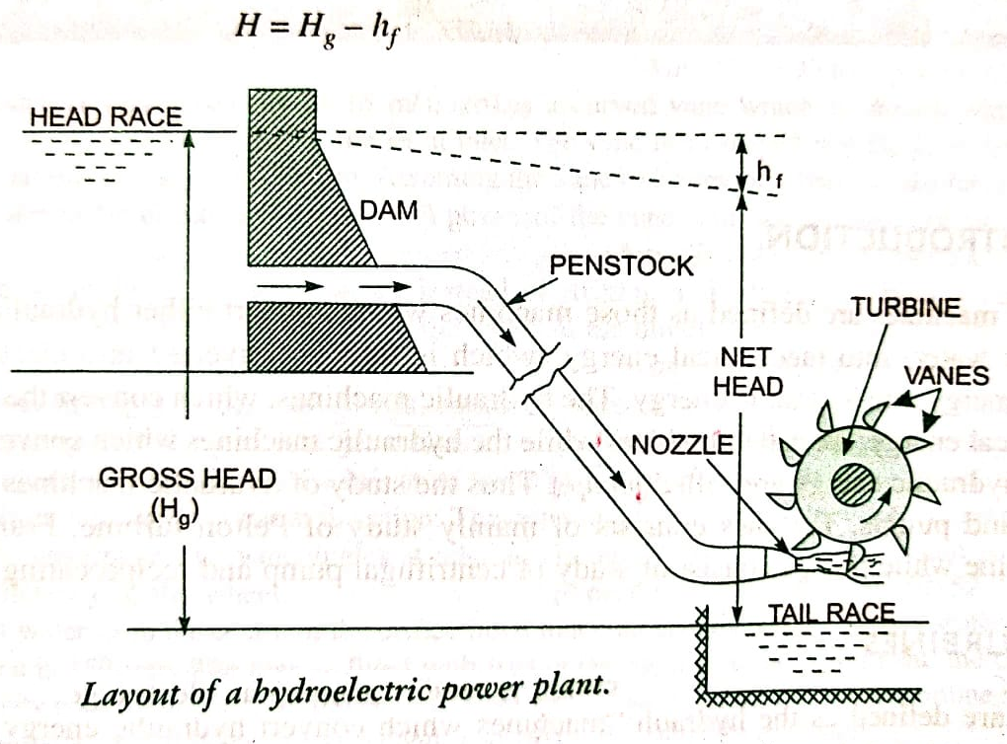
PELTON WHEEL
SPEAR

Slide 11
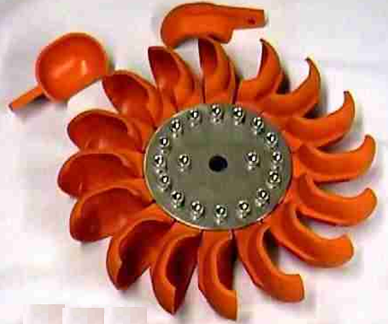
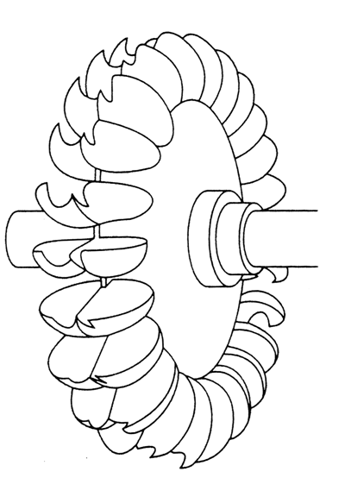
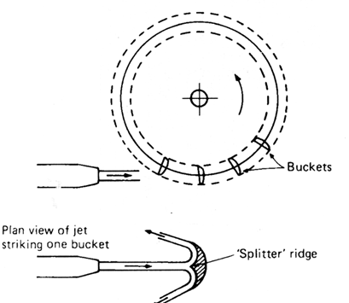
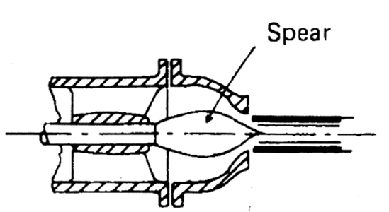
PELTON WHEEL
Runner wheel
High head low discharge
tangential flow
used kinetic energy of
fluid
NET HEAD : 1625 M

Slide 12
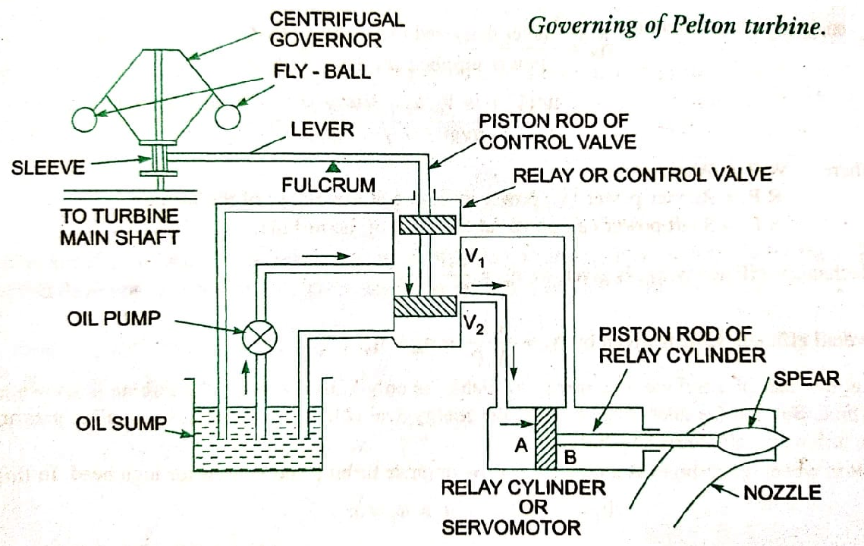

Slide 13
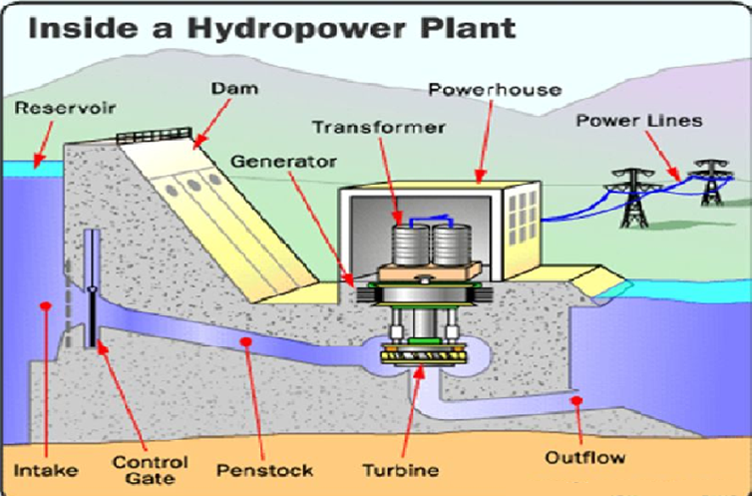

Slide 14
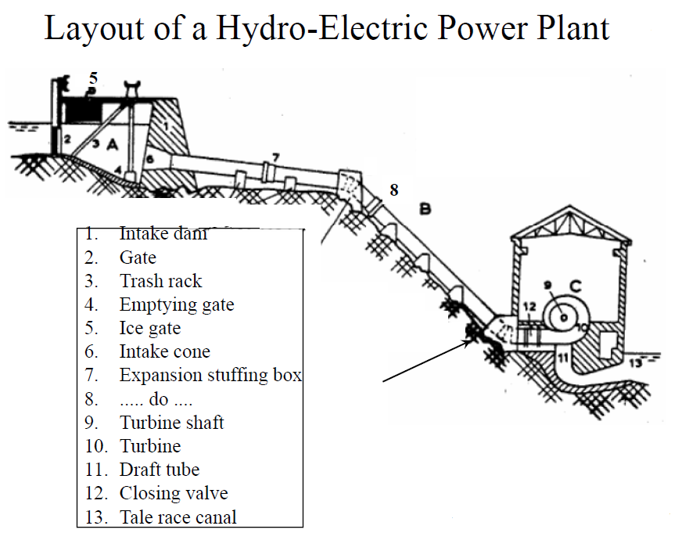
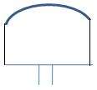
REACTION TURBINE-
FRANCIS TURBINE
Surge tank
hf
Net head
GROSS HEAD

Slide 15
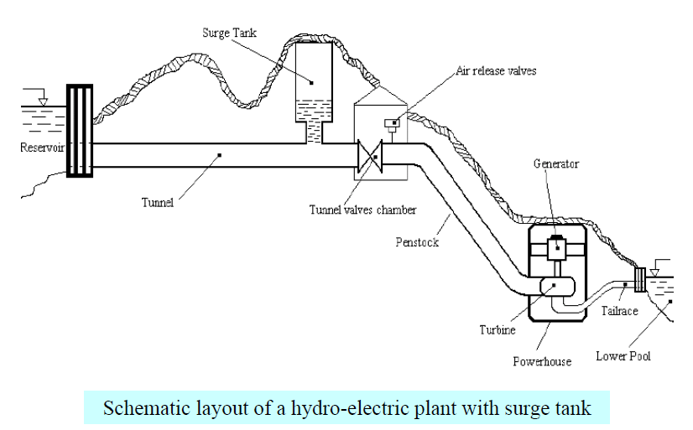

Slide 16
Necessity of Surge Tank
The water compressibility effect produces traveling waves of pressure
and is usually called water hammer.
The water hammer is characterized by a sudden high-pressure rise caused
by stopping the flow too rapidly. The wave propagation speed is around
1200 m/s.
In those plants where distance between the forebay or reservoir and the
turbine is quite large, a surge tank is usually utilized.
The function of this tank is to hydraulically isolate the turbine from
deviations in the head produced by the wave effects in the conduits.
Some surge tanks include an orifice whose function is to dampen and
absorb the energy of the hydraulic oscillations

Slide 17
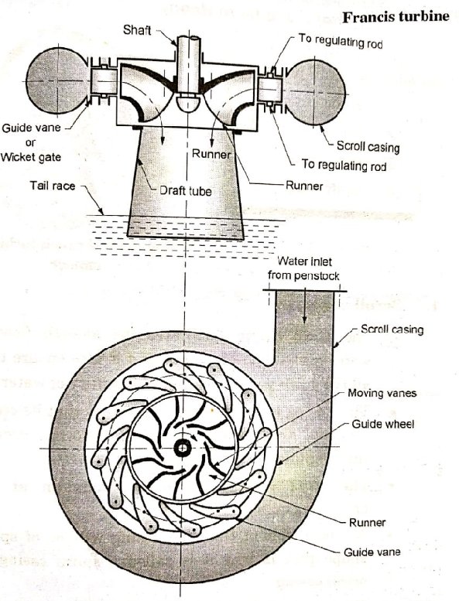
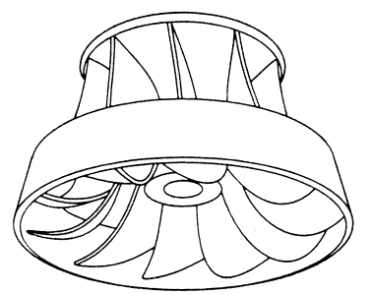
FRANCIS TURBINE
Runner of francis turbine

Slide 18
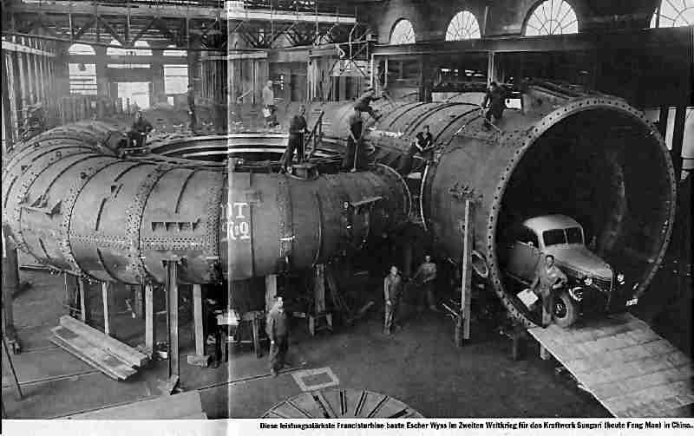
Francis turbine
Large spiral casing

Slide 19
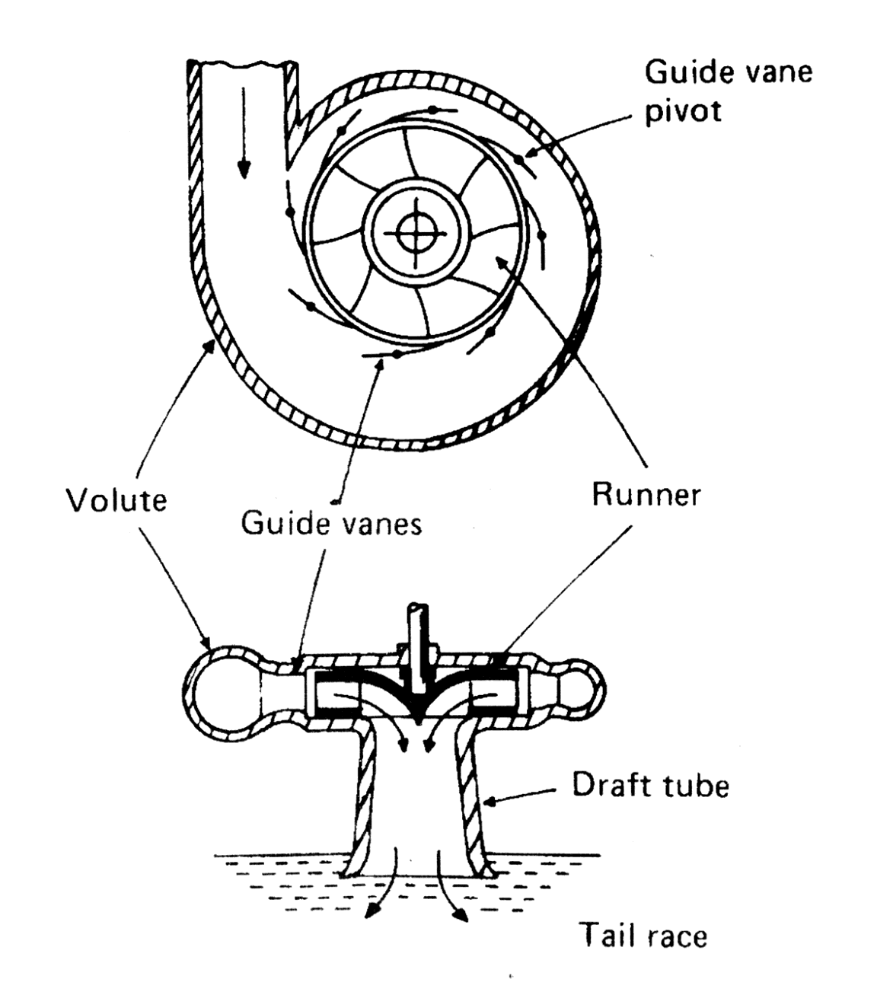
Francis turbine
Francis turbine is a reaction turbine.
Uses pressure energy of water
flow is radially inward and axially
outward i.e. mixed flow
requires draft tube
HEADS RANGING FROM 20 TO 750 M

Slide 20
FRANCIS TURBINE
THE FRANCIS TURBINE IS A REACTION TURBINE, WHICH MEANS THAT
THE WORKING FLUID CHANGES PRESSURE AS IT MOVES THROUGH THE
TURBINE, GIVING UP ITS ENERGY.
• THE INLET IS SPIRAL SHAPED. THE GUIDE VANES DIRECT THE WATER
TANGENTIALLY TO THE RUNNER CAUSING THE RUNNER TO SPIN.
• THE GUIDE VANES (OR WICKET GATE) MAY BE ADJUSTABLE TO ALLOW
EFFICIENT TURBINE OPERATION FOR A RANGE OF WATER FLOW
CONDITIONS.
• POWER PLANTS WITH NET HEADS RANGING FROM 20 TO 750 M

Slide 21
FRANCIS TURBINE-SPECIFICATION
HEAD: 454 M
POWER: 47.1 MW
SPEED : 750 RPM

Slide 22
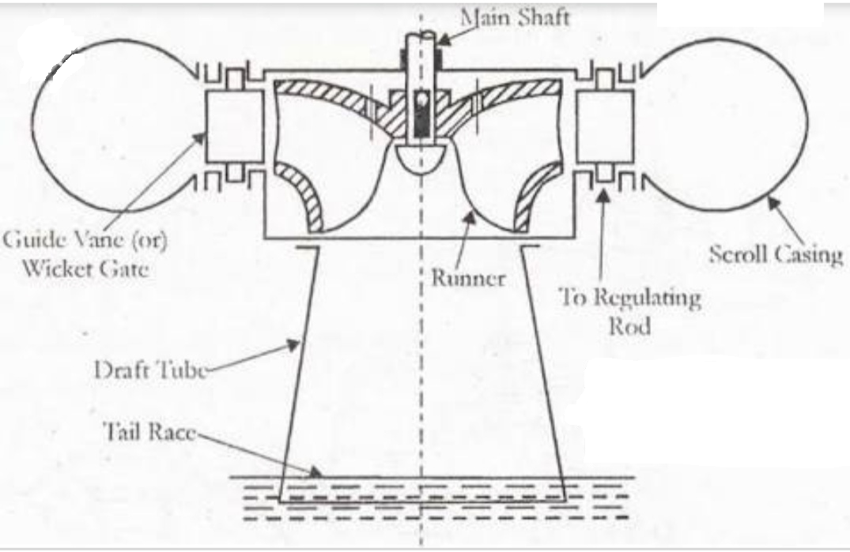
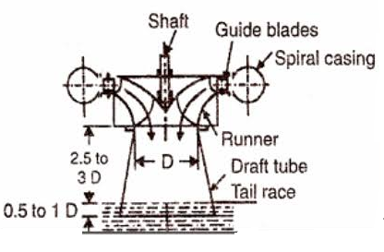
FRANCIS TURBINE

Slide 23
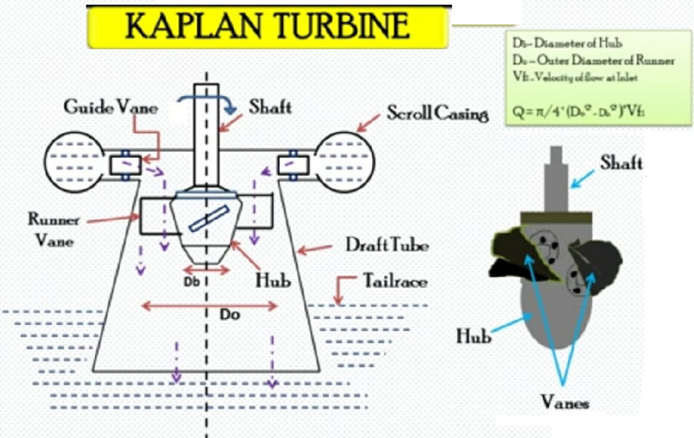

Slide 24
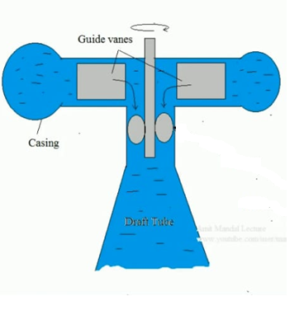
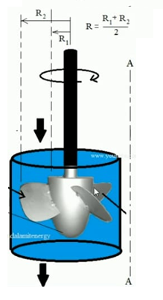
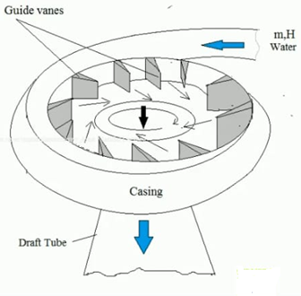
KAPLAN TURBINE
RUNNER
It is a reaction turbine
Axial flow type
Low head and high flow
HEADS RANGING FROM 10 TO 70 M.

Slide 25
KAPLAN TURBINE
THE KAPLAN TURBINE IS A PROPELLER-TYPE / AXIAL FLOW WATER
TURBINE THAT HAS ADJUSTABLE BLADES.
IT WAS DEVELOPED IN 1913 BY THE AUSTRIAN PROFESSOR, VIKTOR
KAPLAN.
THE KAPLAN TURBINE WAS AN EVOLUTION OF THE FRANCIS TURBINE.
ITS INVENTION ALLOWED EFFICIENT POWER PRODUCTION IN LOW
HEAD APPLICATIONS THAT WAS NOT POSSIBLE WITH FRANCIS
TURBINES.
KAPLAN TURBINES ARE NOW WIDELY USED THROUGHOUT THE WORLD
IN HIGH-FLOW, LOW-HEAD POWER PRODUCTION.
POWER PLANTS WITH NET HEADS RANGING FROM 10 TO 70 M.

Slide 26
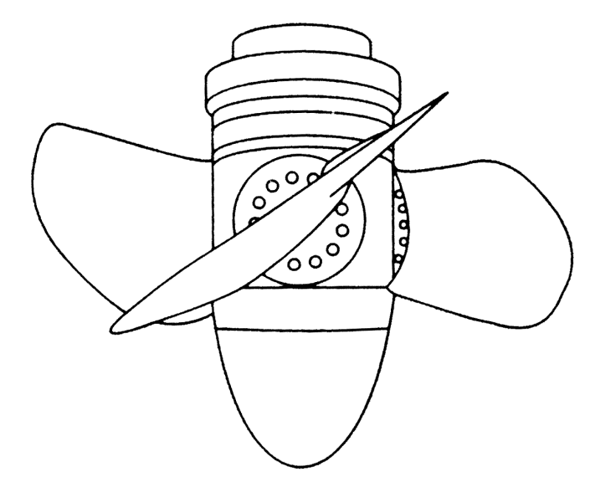
KAPLAN TURBINE SPECIFICATION:
HEAD : 24.7 M
SPEED : 94.7 RPM
POWER : 59 MW
Kaplan runner

Slide 27
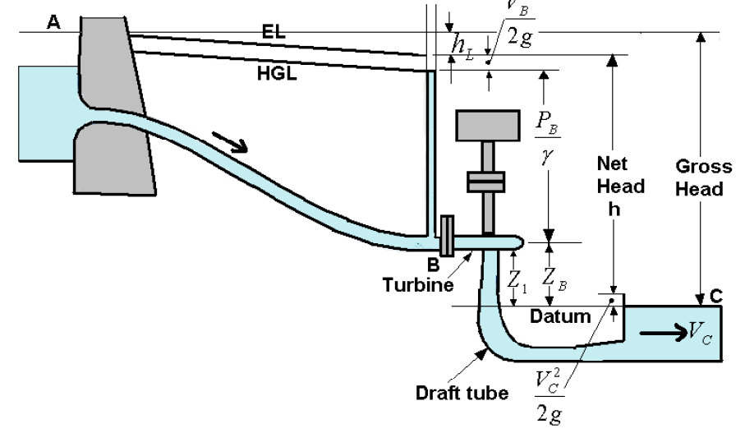
DRAFT TUBE
DRAFT TUBE INCRESES NET HEAD OF TURBINE

Slide 28
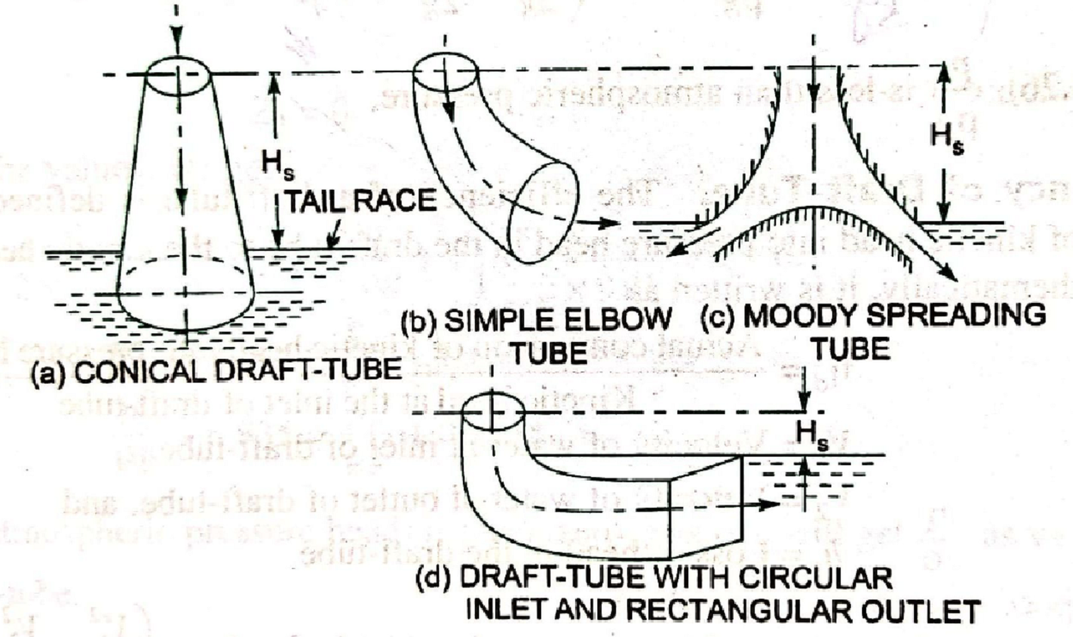
TYPES OF DRAFT TUBE
Conical draft tube
Simple elbow tube
Moody spreading tube
Draft tube with circular inlet and rectangular outlet.

Slide 29
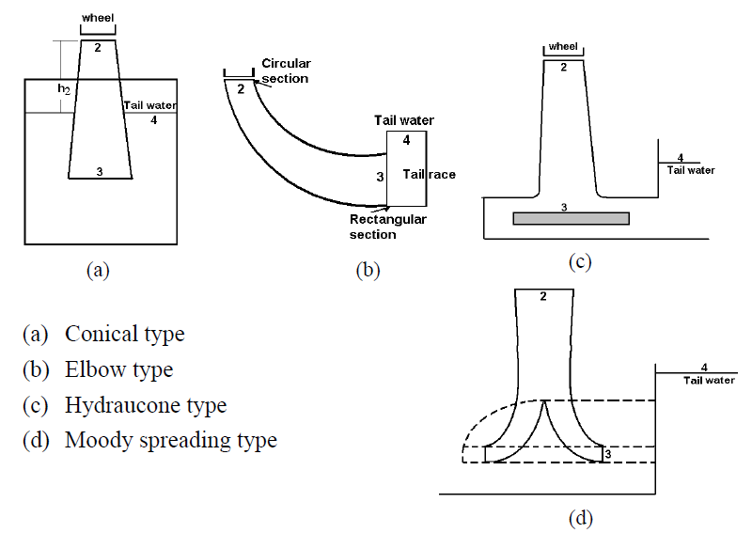
TYPES OF DRAFT TUBE

Slide 30
DRAFT TUBE :
IN A REACTION TURBINE, WATER LEAVES THE RUNNER WITH REMAINING KINETIC ENERGY. TO RECOVER AS MUCH OF THIS ENERGY AS POSSIBLE, THE RUNNER OUTLET IS CONNECTED TO A DIFFUSER, CALLED DRAFT TUBE.
THE DRAFT TUBE CONVERTS THE DYNAMIC PRESSURE (KINETIC ENERGY) INTO STATIC PRESSURE.
2. DRAFT TUBE PERMITS A SUCTION HEAD TO BE ESTABLISHED AT THE RUNNER EXIT, THUS MAKING IT POSSIBLE FOR PLACING THE WHEEL AND CONNECTING MACHINERY AT A LEVEL ABOVE THAT OF WATER IN THE TAIL RACE UNDER HIGH WATER FLOW CONDITIONS OF RIVER, WITHOUT LOSS OF HEAD.
3. TO OPERATE PROPERLY, REACTION TURBINES MUST HAVE A SUBMERGED DISCHARGE.

Slide 31
DRAFT TUBE :
4. THE WATER AFTER PASSING THROUGH THE RUNNER ENTERS THE DRAFT TUBE, WHICH DIRECTS THE WATER TO THE POINT OF DISCHARGE.
5. THE AIM OF THE DRAFT TUBE IS ALSO TO CONVERT THE MAIN PART OF THE KINETIC ENERGY AT THE RUNNER OUTLET TO PRESSURE ENERGY AT THE DRAFT TUBE OUTLET.
6. THIS IS ACHIEVED BY INCREASING THE CROSS SECTION AREA OF THE DRAFT TUBE IN THE FLOW DIRECTION.
7. IN AN INTERMEDIATE PART OF THE BEND, HOWEVER, THE DRAFT TUBE CROSS SECTIONS ARE DECREASED IN THE FLOW DIRECTION TO PREVENT SEPARATION AND LOSS OF EFFICIENCY.

Slide 32
CAVITATION
CAVITATION IS A TERM USED TO DESCRIBE A PROCESS, WHICH INCLUDES NUCLEATION, GROWTH AND IMPLOSION OF VAPOUR OR GAS FILLED CAVITIES.
THESE CAVITIES ARE FORMED INTO A LIQUID WHEN THE STATIC PRESSURE OF THE LIQUID FOR ONE REASON OR ANOTHER IS REDUCED BELOW ITS VAPOUR PRESSURE AT THE PREVAILING TEMPERATURE.
WHEN CAVITIES ARE CARRIED TO HIGH-PRESSURE REGION, THEY IMPLODE VIOLENTLY.
• CAVITATION IS AN UNDESIRABLE EFFECT THAT RESULTS IN PITTING, MECHANICAL VIBRATION AND LOSS OF EFFICIENCY.
• IF THE NOZZLE AND BUCKETS ARE NOT PROPERLY SHAPED IN IMPULSE TURBINES, FLOW SEPARATION FROM THE BOUNDARIES MAY OCCUR AT SOME OPERATING CONDITIONS THAT MAY CAUSE REGIONS OF LOW PRESSURE AND RESULT IN CAVITATION.

Slide 33
• THE TURBINE PARTS EXPOSED TO CAVITATION ARE THE RUNNERS, DRAFT TUBE CONES FOR THEFRANCIS AND KAPLAN TURBINES AND THE NEEDLES, NOZZLES AND THE RUNNER BUCKETSOF THE PELTON TURBINES.
MEASURES FOR COMBATING EROSION AND DAMAGE UNDER CAVITATION CONDITIONS INCLUDE…
IMPROVEMENTS IN HYDRAULIC DESIGN
PRODUCTION OF COMPONENTS WITH EROSION RESISTANT MATERIALS .
ARRANGEMENT OF THE TURBINES FOR OPERATIONS WITHIN GOOD
RANGE OF ACCEPTABLE CAVITATION CONDITIONS.

Slide 34
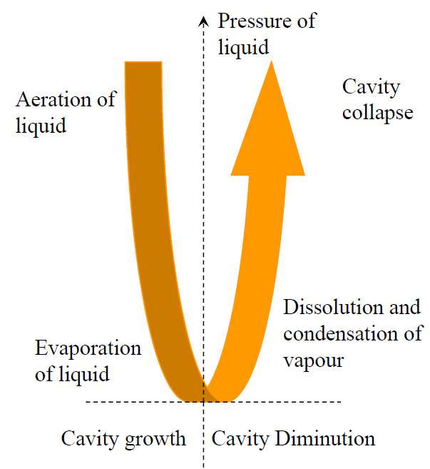
PROCESS OF CAVITATION

Slide 35
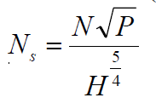
SPECIFIC SPEED :
• IT IS DEFINED AS THE SPEED OF A TURBINE WHICH IS IDENTICAL IN SHAPE, GEOMETRICAL DIMENSIONS, BLADE ANGLES, GATE OPENING ETC., WITH THE ACTUAL TURBINE BUT OF SUCH A SIZE THAT IT WILL DEVELOP UNIT POWER WHEN WORKING UNDER UNIT HEAD
• THIS IS THE SPEED AT WHICH THE RUNNER OF A PARTICULAR DIAMETER WILL DEVELOP KW (1 HP) POWER UNDER 1 M (1 FT) HEAD.

Slide 36
THE SPECIFIC SPEED IS AN IMPORTANT FACTOR GOVERNING THE SELECTION OF THE TYPE OF RUNNER BEST SUITED FOR A GIVEN OPERATING RANGE.
THE IMPULSE (PELTON) TURBINES HAVE VERY LOW SPECIFIC SPEEDS RELATIVE TO KAPLAN TURBINES.
THE SPECIFIC SPEED OF A FRANCIS TURBINE LIES BETWEEN THE IMPULSE AND KAPLAN TURBINE.

Slide 37
SELECTION OF TURBINES
Turbine Head Specific Speed
Pelton Wheel >300 m 8.5-30 (Single Jet)
30-51 (2 or More)
Francis Turbine 50-450 m 51-255
Kaplan Turbine Up to 60 m 255-860

Slide 38
PELTON WHEEL FRANCIS TURBINE KAPLAN TURBINE

Slide 39
Impulse Turbine | Reaction Turbine
1. In impulse turbine only kinetic energy is used to rotate the turbine. | 1. In reaction turbine both kinetic and pressure energy is used to rotate the turbine.
2. In this turbine water flow through the nozzle and strike the blades of turbine. | 2. In this turbine water is guided by the guide blades to flow over the turbine.
3. All pressure energy of water converted into kinetic energy before striking the vanes. | 3. In reaction turbine, there is no change in pressure energy of water before striking.
4. The pressure of the water remains unchanged and is equal to atmospheric pressure during process. | 4. The pressure of water is reducing after passing through vanes.

Slide 40
IMPULSE REACTION
5. Water may admitted over a part of circumference or over the whole circumference of the wheel of turbine. | 5. Water may admitted over a part of circumference or over the whole circumference of the wheel of turbine.
6. In impulse turbine casing has no hydraulic function to perform because the jet is at atmospheric pressure. This casing serves only to prevent splashing of water. | 6. Casing is absolutely necessary because the pressure at inlet of the turbine is much higher than the pressure at outlet. It is sealed from atmospheric pressure.
7. This turbine is most suitable for large head and lower flow rate. Pelton wheel is the example of this turbine. | 7. This turbine is best suited for higher flow rate and lower head situation.

Slide 41
 |  | Francis turbine | Kaplan turbine
According to type of flow |  | Francis turbine is radial flow turbine but in case of modern Francis turbine water enters radially and leaves the turbine axially which is called as mixed flow turbine. | Kaplan turbine is axial flow turbine i.e. water enters and leaves the turbine runner both in axial direction.
Efficiency |  | Efficiency of Francis turbine is less as compare to Kaplan turbine | Efficiency of Kaplan turbine is higher than Francis turbine
Losses |  | Friction losses are higher | Less friction losses as compare to Francis turbine
Size |  | The size of Francis turbine is quite large as compare to Kaplan turbine | Kaplan turbine compact in cross sectional area

Slide 42
FRANCIS KAPLAN
Vanes | Large number of vanes in runner, generally the number of vanes are 16 to 24 | Kaplan turbine is compact in size so the numbers of vanes are also less; generally the number of vanes is 4 to 8.
Type of shaft | The direction of shaft is may be vertical or horizontal as per requirement. | The direction of shaft is always in vertical direction because it is axial flow turbine.
Head available | Francis turbine requires medium range of water head i.e. it generally varies from 100-600 meters | Kaplan turbine works on very low head, the requirement of head is generally 100 meters.
Flow rate | As it is works in medium head therefore it requires medium flow rate. | Kaplan turbine requires high flow rate of water.

Slide 43
FRANCIS KAPLAN
Specific speed |  | Francis turbine works on medium range of specific speed i.e. the specific speed varies from 60 to 300. | Kaplan turbine requires high value of specific speed because it is works on low head. Generally the range of specific speed varies from 600-1000.
Governing mechanism |  | Fancies turbine has simple governing mechanism. | The governing mechanism of Kaplan turbine is quite complicated in construction and working.
Runner vanes |  | Francis turbine has fixed runner vanes on the shaft | Kaplan turbines vanes are adjustable i.e. we can easily adjust the runner vanes as per our requirements.

Slide 44
THANKS !!!

