Slide 1
COMPONENTS
OF
PNEUMATIC SYSTEMS
A
R
P

Slide 2
TOPIC TO BE STUDIED--------
COMPONENTS OF PNEUMATIC SYSTEMS
AIR COMPROSSERS: POSITIVE DISPLACEMENT
AND DYNAMIC TYPE
FRL UNIT: FILTER, REGULATOR, LUBRICATOR.
VALVES: FLOW CONTROL, PRESSURE CONTROL,
DIRECTIONAL CONTROL VALVES.
ACTUATORS: LINEAR AND ROTATY(AIR MOTOR)
ACCESSORIES: PIPES, JOINTS,SEALS, MUFFLER, ETC.

Slide 3
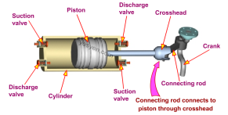
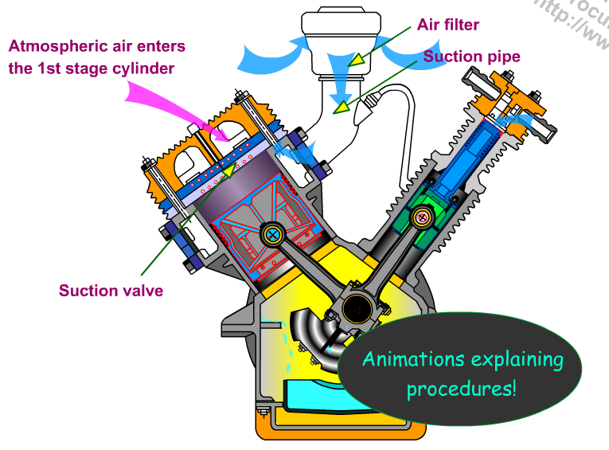
COMPRESSORS
POSITIVE DISPLACEMENT TYPE AND ROTODYNAMIC TYPE

Slide 4
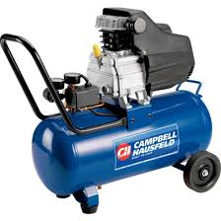
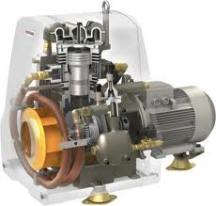
AIR COMPRESSORS:
COMPRESSOR DRIVEN BY
ELECTRIC MOTOR DRIVEN/ENGINE DRIVEN /TUBINE DRIVEN
ELECTRIC MOTOR
PISON

Slide 5
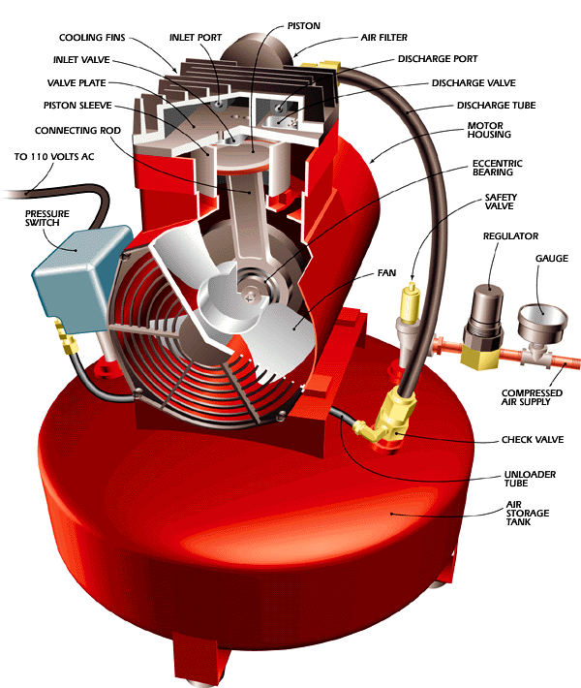
AIR COMPRESSOR

Slide 6
SYMBOL OF AIR COMPRESSOR
AIR RECEIVER
M
M-FOR MOTOR DRIVEN
E- FOR ENGINE DRIVEN
T- FOR TURBINE DRIVEN

Slide 7
AIR COMPROSSERS:
BROADLY CLASSIFIED AS
POSITIVE DISPLACEMENT TYPE
DYNAMIC COMPRESSORS OR TURBO COMPRESSORS
POSITIVE DISPLACEMENT TYPE-
IN THIS DEFINITE VOLUME OF AIR IS COMPRESSED. NATURALLY VOLUME OF AIR REDUCES AND ITS PRESSURE IS INCREASED.
POINTS TO BE DISCUSSED---
COMPARE RECIPROCATING ENGINE AND COMPRESSOR
DIFFERENT STROKE, SUCTION ,COMPRESSION ETC.
4 BAR MECHANISM I.E PISTON,CYLINDER, CONNECTING ROD AND CRANK.
INLET AND OUTLET PORTS.

Slide 8
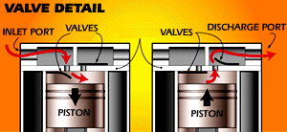
INLET AND DISCHARGE PORTS OF COMPSR.

Slide 9
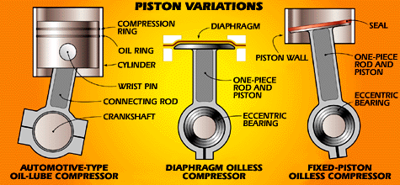
CONNECTING ROD, CRANK, PISTON AND CYLINDER OF COMPSR.

Slide 10
THESE ARE USED FOR RELATIVELY HIGH PRESSURE ( ABOVE 10 BAR)
AND FOR LOW VOLUME OF AIR (BELOW 10000 M3/HR).
SCREW COMPRESSORS (IT IS POSITIVE DIS. TYPE) ARE USED FOR MEDIUM PRESSURE (BELOW 10 BAR) AND RELATIVELY HIGH VOLUMS. ( ABOVE 10000 M3/HR )
OTHER POSITIVE DIS. TYPES ARE-
DIAPHRAGM COMPRESSORS
LOBE COMPRESSORS (ROOTS BLOWER)
SLIDING VANE COMPRESSORS

Slide 11
DYNAMIC COMPRESSORS OR TURBO COMPRESSORS:
IN THESE ROTATING IMPELLERS IMPART VELOCITY AND PRESSURE TO THE FLOW OF AIR HANDLED.
THESE ARE USED WHEN LARGE VOLUME OF AIR WITH LOW PRESSURE IS REQUIRED.
E.G. BLOWERS, HAIR DRIER ETC.
FAMOUS BRANDS IN COMPRESSORS..
ELGI,
ATLAS COPCO,
INGERSOL RAND ETC.

Slide 12
CLASSIFICATION OF A COMPRESSORS:
COMPRESSORS
POSITIVE DISPLACEMENT TYPE DYNAMIC COMPRESSORS
RECIPROCATING ROTORY CENTRIFUGAL AXIAL
PISTON DIAPHRAGM
LOBE ROOTS BLOWER LIQUID RING SLIDING VANE SCREW
MONO SCREW TWIN SCREW.

Slide 13
The compressors are also classified based on other aspects like
Number of stages - (single-stage, 2-stage and
multi-stage),
Cooling method and medium - (Air cooled, water
cooled and oil-cooled),
Drive types - ( Engine driven, Motor driven,
Turbine driven, Belt, chain, gear
or direct coupling drives),
Lubrication method - (Splash lubricated or forced
lubrication or oil-free compressors).
Service Pressure - (Low, Medium, High)

Slide 14
[A] POSITIVE DISPLACEMENT COMPRESSORS
FOLLOWING TYPES TO BE STUDIED
RESIPROCATING OR PISTON COMPRESSORS:
1. SINGLE ACTING
2. DOUBLE ACTING
3. TWO STAGE SINGLE ACTING
2. SCREW COMPRESSORS: MONO SCREW AND TWIN SCREW
3. ROTARY VANE COMPRESSOR ( SLIDING VANE )
4. TWIN LOBE COMPRESSOR( ROOTS BLOWER)

Slide 15
[B] DYNAMIC COMPRESSORS OR TURBO COMPRESSORS
FOLLOWING TYPES TO BE STUDIED
1. CENTRIFUGAL TYPE
2. AXIAL TYPE COMPRESSORS
SELECTION CRITERIA FOR COMPRESSORS:
PRESSURE REQUIREMENT OF PNEUMATIC CKT.
VOLUME OF AIR REQUIRED
COMPRESSOR CONFIGURATION (SPACE AVAILABILITY ETC)

Slide 16
SELECTION CRITERIA:
PRESSURE:
10 TO 15 BAR - MULTI STAGE RECIPROCATING COMPRESSOR.
7 TO 10 BAR – SEREW COMPRESSORS
3 TO 7 BAR - SINGLE OR TWO STAGE RECIPROCATING COMPR.
UPTO 3 BAR – VANE COMPRESSOR.
UPTO 2 BAR - LOBE COMPRESSOR.
VOLUME REQUIRED-
BELOW 5000 M3/HR - RECIPROCATING COMPRESSOR.
ABOUT 5000 M3/HR – CENTRIFUGAL OR AXIAL COMPRESSORS
ABOUT 10000 M3/HR - SCREW COMPRESSORS
ABOEW 10000 M3/HR - VANE OR LOBE COMPRESSORS
COMPRESSOR CONFIGURATION:
FOR LIMITED SPACE GENERALLY V TYPE RECIPROCATING COMPRESSOR IS BEST CHOICE. AND SEPARATE ROOM AS IT MAKES MORE NOISE.

Slide 17
DOUBLE ACTING RECIPROCATING COMPRESSOR
OBSERVE DIFFERENT PARTS

Slide 18
Reciprocating Air Compressors
Reciprocating air compressors are positive displacement machines, meaning that they increase the pressure of the air by reducing its volume. This means they are taking in successive volumes of air which is confined within a closed space and elevating this air to a higher pressure. The reciprocating air compressor accomplishes this by a piston within a cylinder as the compressing and displacing element.
Single-stage and two-stage reciprocating compressors are commercially available.

Slide 19
Reciprocating In-line Compressors:
These are most commonly used compressors with varying pressure ranges. These are simple in design with almost very little automation. The cylinders of various stages are found in a straight line when seen from top. These compressors are commonly direct driven by electric motors or diesel engines. Refer the attached diagram of the reciprocating in-line compressors.

Slide 20
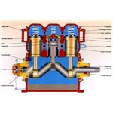
Reciprocating In-line Compressors:

Slide 22
“V”-Shaped Compressors:
These are usually air cooled compressors with concentric valves mounted on each cylinder head unit. The compressor has different units displaced usually by 90 degrees, may or may not be connected to same crank pin on the crank shaft. Higher capacity compressors are water cooled. Better torque and balancing is achieved by displacing the units by certain angle.

Slide 23
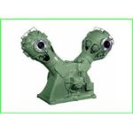
“V”-Shaped Compressors:

Slide 24
V-TYPE CROSS HEAD COMPRESSOR

Slide 25
Single-Acting Compressors:
These are usually reciprocating compressors, which has piston working on air only in one direction. The other end of the piston is often free or open which does not perform any work. The air is compressed only on the top part of the piston. The bottom of the piston is open to crankcase and not utilized for the compression of air.

Slide 26
Double-Acting Compressors:
These compressors are having two sets of suction/intake and delivery valves on both sides of the piston. As the piston moves up and down, both sides of the piston is utilized in compressing the air. The intake and delivery valves operate corresponding to the stroke of the compressor. The compressed air delivery is comparatively continuous when compared to a single-acting air compressor. Thus both sides of the pistons are effectively used in compressing the air.

Slide 27
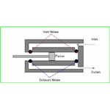
Double-Acting Compressor:

Slide 28
TWO STAGE RECIPROCATING COMPRESSOR WITH INTERCOOLER.
INTERCOOLER
COMPRESSED AIR OUT
ATM. AIR IN
FILTER
COOLED COMPRESSED AIR IN
FINS
HIGH PRESSURE AIR OUT
INLET VALVE
FIRST STAGE COMPRESSION
SECOND STAGE COMPRESSION
CRANK CASE
CONNECTING ROD
OIL FOR LUBRICATION
FLY WEIGHT

Slide 29
IN FIRST STAGE THE PRESSURE IS INCREASED FROM ATMOSPHERIC PRESSIRE E.G. ATM. PRESSURE TO 3 BAR.
IN INTER COOLER THIS COMPRESSED AIR IS COOLED , THIS COOLED COMPRESED AIR IS SUPPLIED TO SECOND STAGE COMPRESSION. WHERE PRESSURE FROM 3 BAR IS RISED TO 7 BAR. THE HIGH PRESSURE AIR GOES TO RECEIVER.
INTERCOOLER IS A HEAT EXCHANGER , IT COOLES THE AIR, IT ALSO REDUCES THE VOLUME OF AIR AND THERE IS ENERGY SAVING IN SECOND STAGE. IT IS A CYLINDER HAVING FINS TO INCREASE SURFACE AREA TO DESSIPATE HEAT FROM AIR. SOME TIMES INTERCOOLER IS WATER COOLED.

Slide 30
Rotary Screw Compressors :
Rotary air compressors are positive displacement compressors. The most common rotary air compressor is the single stage helical or spiral lobe oil flooded screw air compressor. These compressors consist of two rotors within a casing where the rotors compress the air internally. There are no valves. These units are basically oil cooled (with air cooled or water cooled oil coolers) where the oil seals the internal clearances.

Slide 31
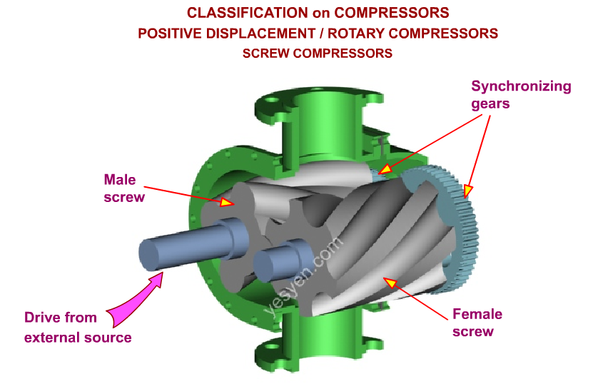

Slide 32
Since the cooling takes place right inside the compressor, the working parts never experience extreme operating temperatures. The rotary compressor, therefore, is a continuous duty, air cooled or water cooled compressor package.

Slide 33
Rotary screw air compressors are easy to maintain and operate. Capacity control for these compressors is accomplished by variable speed and variable compressor displacement. For the latter control technique, a slide valve is positioned in the casing.
As the compressor capacity is reduced, the slide valve opens, bypassing a portion of the compressed air back to the suction.

Slide 34
Advantages of the rotary screw compressor include smooth, pulse-free air output in a compact size with high output volume over a long life.
The oil free rotary screw air compressor utilizes specially designed air ends to compress air without oil in the compression chamber yielding true oil free air. Oil free rotary screw air compressors are available air cooled and water cooled and provide the same flexibility as oil flooded rotaries when oil free air is required.

Slide 35
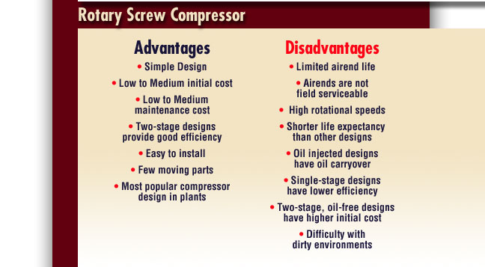

Slide 36
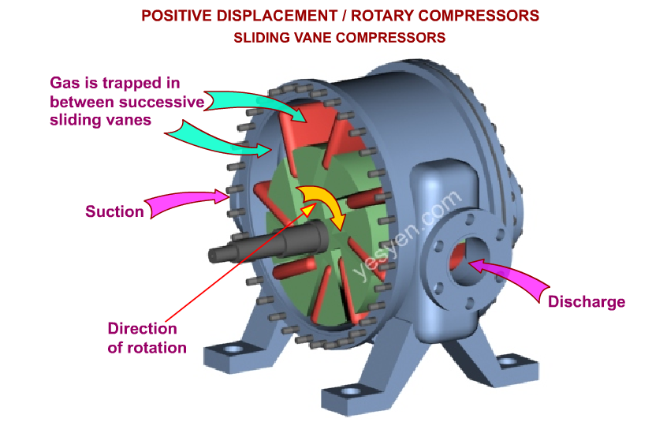
VANE TYPE COMPRESSOR

Slide 37
VANE TYPE COMPRESSOR
WHEN ROTOR STARTS ROTATING , ALL VANES FLOWS OUT FROM CENTRE DUE TO CENTRIFUGAL FORCE AND TOUCHES THE INSIDE SURFACE OF THE CASING. PARTIAL VACCUM IS CREATED AT INLET PORT AND AIR RUSHES IN THIS COMPARTMENT . THE TRAPPED AIR CARRIED OUT TO DELIVERY PORT. DUE TO REDUCTION IN AREA AIR GETS COMPRESSED AND GOES OUT.

Slide 39
LOBE COMPRESSOR

Slide 40
LOBE COMPRESSOR
IT CONSISTS TWO MESHING LOBES DRIVEN BY TIMING GEARS HENCE NO NEED OF LUBRICATION, BUT TIMING GEARS MUST HAVE LUBRICATION SYSTEM. AND CONSISTS CASING, BOTH ARE MACHINED WITH CLOSE TOLERANCE. AIR IS ENTRAPPED BETWEEN INNER SURFACE OF CASING AND OUTER SURFACE OF LOBES. COMPRESSION IS VERY MINOR.
COMPRESSION RATION =
VOLUME OF INLET AIR
THIS RATIO IS ABOUT 1.7 FOR THIS COMPRESSOR.
VOLUME OF OUTLET AIR

Slide 41
DYNAMIC COMPRESSORS: (CENTRIFUGAL AND AXIAL TYPE)
Centrifugal Compressors :
The centrifugal air compressor is a dynamic compressor which depends on transfer of energy from a rotating impeller to the air.
Centrifugal compressors produce high-pressure discharge by converting angular momentum imparted by the rotating impeller (dynamic displacement). In order to do this efficiently, centrifugal compressors rotate at higher speeds than the other types of compressors.

Slide 42
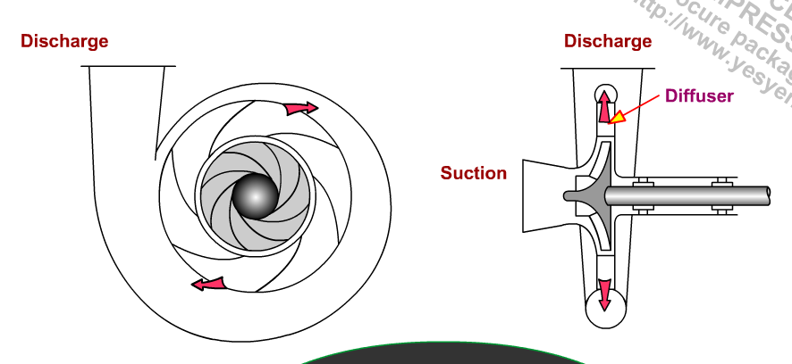
Centrifugal Compressors :

Slide 43
These types of compressors are also designed for higher capacity because flow through the compressor is continuous.
Adjusting the inlet guide vanes is the most common method to control capacity of a centrifugal compressor. By closing the guide vanes, volumetric flows and capacity are reduced.
The centrifugal air compressor is an oil free compressor by design. The oil lubricated running gear is separated from the air by shaft seals and atmospheric vents.

Slide 44
CENTRIFUGAL COMPRESSORS ARE CALLED AS BLOWER. IT RUNS AT A SPEED OF 50000 RPM.
AS IMPELLER ROTATES WITH HIGH SPEED, IT IMPARTS KINETIC ENERGY TO AIR. THE HIGH VELOCITY AIR PASSES THROUGH SPECIAL SHAPED CASING, WHICH INCREASES ITS PRESSURE.
THIS AIR IS NOT STORED IN AIR TANK, INSTEAD IT IS DIRECTLY USED.

Slide 46
AXIAL COMPRESSOR :
THESE ARE USED FOR VERY HIGH DISCHARGE OF AIR UPTO 50000 M3/MIN. BUT PRESSURE IS VERY MINOR, ABOUT 1 BAR.
A SERIES OF BLADES ARE FIXED ON SHAFT. AND THE ASSEMBLY IS ENHOUSED IN CASING.
AS SHAFT ROTATES WITH HIGH SPEED, LARGE VOLUME OF AIR IS TRANSFFERED FROM INPUT TO OUTPUT SIDE.

Slide 47
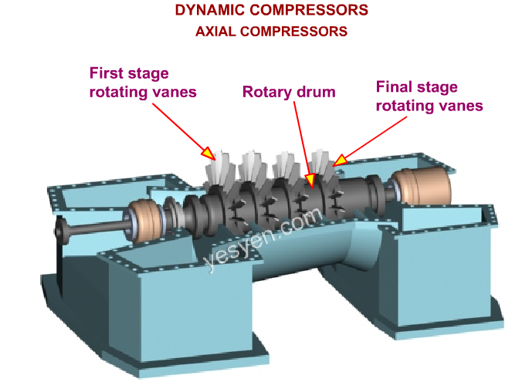

Slide 48
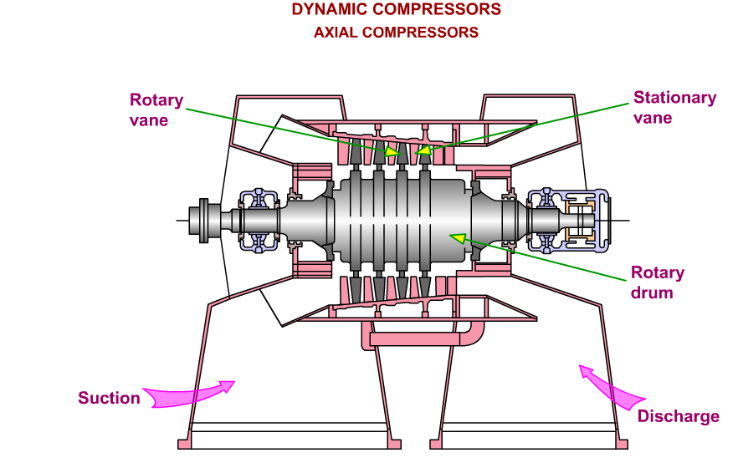

Slide 49
FOR OTHER TYPES HIT THE LINKS SHOWN BELOW
YYClassComp\YYClassComp.exe
YYTourComp\YYTourComp.exe

Slide 50
AIR RECEIVER OR AIR TANK :
An air receiver is essential to every compressed air system to act as a buffer and a storage medium between the compressor and the consumption system. There are in principal two different air receivers in a compressed air system:
PRIMARY receiver - located near the compressor, after the after-cooler but before filtration and drying equipment
SECONDARY receivers - located close to points of larger intermittent air consumptions

Slide 51
AIR RECEIVER
PRESSURE GAUGE
AIR INLET PIPE
SAFETY VALVE
OUTLET PIPE
DISH END
WATER DRAIN
REMOVABLE ACCESS COVER

Slide 52
MAIN FUNCTIONS OF AIR RECEIVERS ARE-
IT PROVIDES RESERVE STORAGE TO COMPRESSED AIR
IT SMOOTHENS OUT THE PULSATION IN FLOW FROM
RECIPROCATING COMPRESSOR
IT HELPS TO COOL THE AIR
IT HELPS TO CONDENSE THE MOISTURE IN THE AIR.

Slide 53
MOISTURE SEPARATOR:
AS PER THE HUMIDITY, CONTENTS OF MOISTURE ARE PRESENT IN AIR. ON COASTAL AREAS MORE HUMID ATMOSPHERE IS OBSERVED.
COMPRESSED AIR IS PASSED OVER CHEMICAL DRYERS. THESE ARE HYGROSCOPIC CHEMICALS. (IT HAS PROPERTY TO ABSORB MOISTURE) . TABLE SALT IS HYGROSCOPIC CHEMICAL.
SOME CHEMICAL DRYERS (DESICCANTS) ARE SOLID, WHEN THEY ABSORB MOISTURE THEY BECOMES LIQUID. THEY ARE KNOWN AS DELIQUESCENT DRYERS. THESE ARE SALT BASED ANE UREA BASED.
ANOTHER WAY TO REMOVE MOISTURE IS TO HEAT THE AIR.DUE TO HEATING THE MOISTURE EVAPORATES. BUT IT IS RARELY USED.

Slide 54
WATER TRAP:
COMPRESSED AIR IN
DRY COMPRESSED AIR OUT
WATER TRAP DRUM
DROPPING MOISTURE PARTICLES
ON-OFF VALVE
COLLECTED WATER REMOVAL TAP

Slide 55
WATER TRAP:
FUNCTION OF WATER TRAP IS TO SEPARATE THE MOISTURE PARTICLES FROM THE COMPRESSED AIR.
THE AIR ENTERS THROUGH INLET PIPE. BUT WHEN IT ENTERS INTO DRUM IT CHANGES ITS DIRECTION BY 90⁰
DUE TO THIS ABRUPT CHANGE IN DIRECTION MOISTURE PARTICLES DROPS AT BOTTOM DUE TO INERTIA AND THE WATER IS AT BOTTOM.

Slide 56
AIR RECEIVER

Slide 57
The maximum capacity of the compressor in a well designed systems always exceed the maximum mean air consumption of the system (maximum mean air consumption is the mean air consumption over some reasonable time).
Since the maximum capacity of an air compressor also always exceed the minimum air consumption in the system - the compressor must modulate its capacity during normal work, often by using primitive strategies as on/off modulating or more advanced strategies as frequency drives and inverters. Primitive modulating strategies cause more pressure variations in compressed air systems than more advanced strategies.

Slide 58
In addition, the air consumption vary due to the process supported. In shorter periods the demand for compressed air may even exceed the maximum capacity of the compressor. In fact, it is common in well designed systems not to design the compressor for the maximum peek loads.
Air receivers in compressed air systems serves the important purposes of
equalizing the pressure variation from the start/stop and modulating sequence of the compressor
storage of air volume equalizing the variation in consumption and demand from the system
In addition the receiver serve the purpose of
collecting condensate and water in the air after the compressor

Slide 59
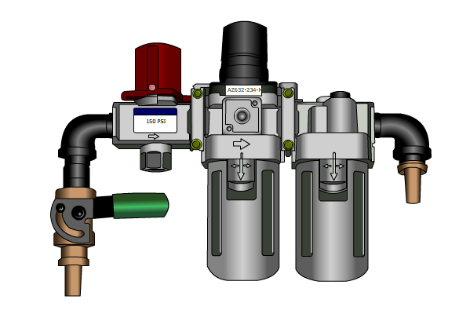
FRL UNIT

Slide 60
FRL UNIT :
FRL SYMBOL USE IN CKT.
FRL SYMBOL
INLET
REGULATOR
FILTER
LUBRICATOR

Slide 61
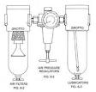
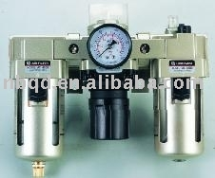
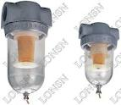
FRL UNIT ANOTHER TYPE

Slide 62
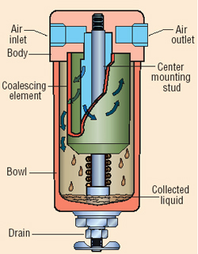
FILTER
FILTER SYMBOL

Slide 63
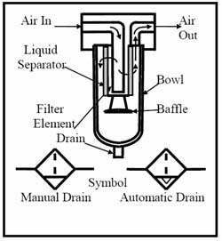
FILTER

Slide 64
A pneumatic filter is a device which removes contaminants from a compressed air stream. This can be done using a number of different techniques, from using a "media" type that traps particulates, but allows air to pass through to a venturi, to a membrane that only allows air to pass through.

Slide 65
It is now common to have various stages of filtration employed in a filter-regulator-lubricator form factor, usually with the different filter housings connected. Air filtration applications are diverse and include end-user sectors such as cleanroom environments, biomedical, analytical instrumentation, food processing, marine and aviation, agriculture, manufacturing, food and beverage packaging and a host of other uses.

Slide 66
Primary filters
Typical commercial pneumatic filters will remove particles as small as 5 micrometres from the air. The filters protect pneumatic devices from damage that would be caused by these contaminants. These contaminants include lubricant particles ejected by the compressor, dirt particles, small water droplets or aerosols, and even oil vapor and dust particles

Slide 67
Secondary filters & Membrane Air Dryers
Secondary filters are used for a variety of applications and can remove particles as small as 50 nanometres in size. These secondary filters can remove fumes, odors, vapor, mist, moisture, oil, and tiny particles from the air stream.

Slide 68
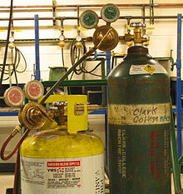
Pressure regulator
SYMBOL OF REGULATOR

Slide 69
A pressure regulator is a valve that automatically cuts off the flow of a liquid or gas at a certain pressure. Regulators are used to allow high-pressure fluid supply lines or tanks to be reduced to safe and/or usable pressures for various applications.
Gas pressure regulators are used to regulate the gas pressure and are not appropriate for measuring flow rates. Flowmeters, Rotometers or Mass Flow Controllers should be used to accurately regulate gas flow rates.

Slide 70
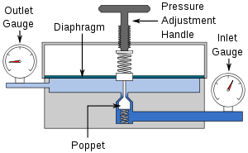
Single-stage pressure regulator
OPENING CAN BE VARIED TO REGULATE PRESSURE

Slide 71
In the pictured single-stage regulator, a diaphragm is used with a poppet valve to regulate pressure. As pressure in the upper chamber increases, the diaphragm is pushed upward, causing the poppet to reduce flow, bringing the pressure back down. By adjusting the top screw, the downward pressure on the diaphragm can be increased, requiring more pressure in the upper chamber to maintain equilibrium. In this way, the outlet pressure of the regulator is controlled.

Slide 72
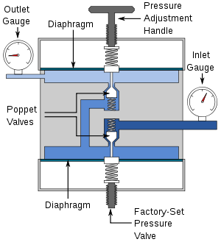
two-stage pressure regulator

Slide 73
A pressure regulator's primary function is to match the flow of gas through the regulator to the demand for gas placed upon the system. If the load flow decreases, then the regulator flow must decrease also. If the load flow increases, then the regulator flow must increase in order to keep the controlled pressure from decreasing due to a shortage of gas in the pressure system.

Slide 74
A pressure regulator includes a restricting element, a loading element, and a measuring element:
The restricting element is a type of valve. It can be a globe valve, butterfly valve, poppet valve, or any other type of valve that is capable of operating as a variable restriction to the flow.
The loading element applies the needed force to the restricting element. It can be any number of things such as a weight, a spring, a piston actuator, or more commonly the diaphragm actuator in combination with a spring.
When the actuator is forced against an expansion disk, the force is distributed among the pressure walls. This allows the gas to flow at the proper rate and not to be continually vaporized and diluted.
The measuring element determines when the inlet flow is equal to the outlet flow. The diaphragm is often used as a measuring element because it can also serve as a combine element.

Slide 75
LUBRICATOR:
SYMBOL OF LUBRICATOR
THE LUBRICATOR IS A DEVICE WHICH MIXES MIST OR FINE SPRAY OF LUBRICATING OIL INTO COMPRESSED AIR. WHICH ENTERS INTO PNEUMATIC EQUIPMENTS AND OIL PARTICLES THE SLIDING/ROTATING PARTS OF EQUIPMENT. I.E. VALVE PARTS AND ACTUATOR OR MOTOR PARTS.
IF OIL IS NOT MIXED WITH AIR THE PARTS MAY RUST AND SYSTEM WILL BE INEFFICIENT OR FAILED.

Slide 76
FINE SPRAY (MIST) IS OBTAINED BY VENTURY EFFECT
COMPRESSED AIR IN
AIR WITH LUB. OIL MIST
THROAT SECTION
OIL TANK

Slide 77
ACTUAL LUBRICATOR
OIL CONTROL
DRY AIR IN
LUBRICATED AIR OUT
OIL TUBE
TRANSPERANT PLASTIC BOWL
DRAIN PLUG

Slide 78
LUBRCATOR WORKING:
DRY AIR COMES IN WITH PRESSURE . THE VACCUM IS CREATED AT THROAT SECTION. THE LUB. OIL RUSHES TO THE THROAT SECTION THROUGH OIL PICKUP TUBE AND FINE DROPLETS OF LUBRICANT OIL MIXED WITH DRY AIR. THIS AIR GOES TO PNEMATIC CIRCUIT.

Slide 79
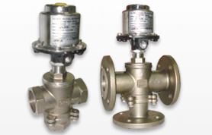
VALVES
DC VALVES
FLOW CONTROL VALVES
PRESSURE REGULATING/CONTROL

Slide 80
DIRECTION CONTROL VALVES
2/2 DC VALVE
A
POSITION 1 PORT P IS NOT CONNECTED WITH CYLINDER PORT A
P
A
POSITION 1
P AND A ARE CONNECTED
P

Slide 81
2/2 POPPET VALVE
12
12
1
2
1
2
OPEN POSITION
CLOSED POSITION

Slide 82
DIRECTION CONTROL VALVES
3/2 DC VALVE
A
POSITION 1 PORT P IS NOT CONNECTED WITH CYLINDER PORT A
R
P
A
POSITION 1
P AND A ARE CONNECTED
R
P
82

Slide 83
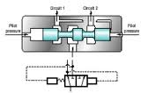
3/2 DC valves

Slide 84
4/2 DC VALVE (SEAT AND POPPET TYPE)
A
B
1
2
BEFORE PRESSING BUTTON
P
R
ACTUATED POSITION
A
B
A
B
P
P
R
R

Slide 85
5/2 DC VALVE (SPOOL TYPE)
A
B
1
2
P
A
B
CYLINDER PORT A &B
RESERVOIR PORT R1 &R2
PUMP PORT P
R1
R2
POSITION 1
R1
P
R2
A
B
CLICK TO CHANGE POSITION
POSITION 2
R1
P
R2

Slide 86
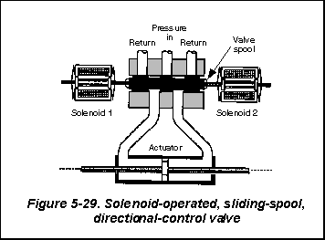
5/2 DC VALVE SOLENOID OPERATED

Slide 87
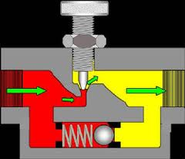
FLOW CONTROL VALVES-
flow control valve WITH CHECK VALVE
FLUID IN
FLUID OUT
NO FLOW
FREE FLOW

Slide 88
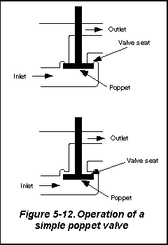
POPPET VALVE

Slide 89
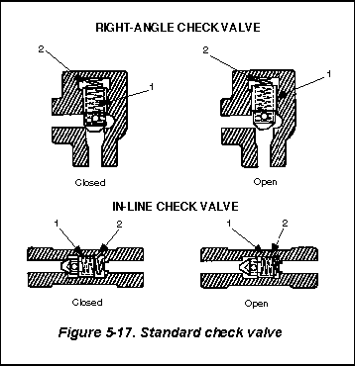
CHECK VALVE

Slide 90
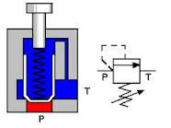
PRESSURE VALVES:
pressure relief valve as an unloading valve
WHEN PRESSURE IN THE SYSTEM EXCEEDS, THE POPPET GETS LIFTED AND PORT P GETS CONNECTED TO TANK PORT, AND EXCESS PRESSURE RELEASED.

Slide 91
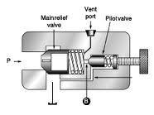
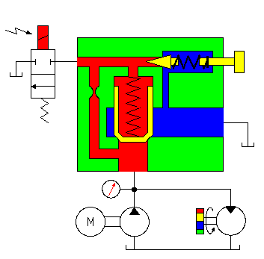
pilot operated pressure relief valve

Slide 92
The pilot operated pressure relief valve can also be applied as an unloading valve. Normally the 2/2-direction control valve is activated and the opening pressure of the main valve is determined by the pilot valve. If the 2/2-direction control valve is NOT activated the pressure at the upper side of the main valve will become zero. The pressure at the bottom side of the main valve will open the main valve: the pressure needed to do this will be about 3 bar (almost zero). From that moment on the majority of the flow will be drained towards the reservoir by the main valve.

Slide 93
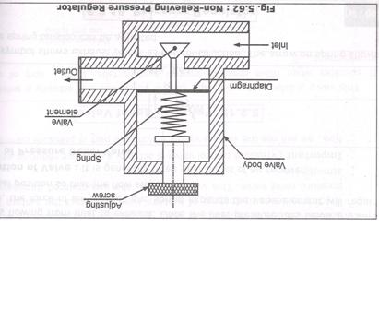
NON – RELIEVING PRESSURE REGULATOR

Slide 94
WHEN OUTLET PRESSURE IS TOO HIGH, BACK PRESSURE FORCES THE DIAPHRAGM IN UPWARD DIRECTION THERE BY REDUCING THE AIR FLOW FROM INPUT TO OUTLET.
IF OUTLET PRESSURE IS TOO LOW, THEN SPRING WILL FORCE DOWN THE FEXIBLE DIAGPHRAGM AND VALVE ELEMENT MOVE DOWNWARD AND THERE BY CAUSING ACCELETATION OF AIR FLOW FROM INLET TO OUTLET.
HERE AIR IS NOT VENTED FROM REGULATOR BODY HENCE IT IS CALLED NON RELIEVING PRESSURE REGULATOR. INSTEAD AIR VENTS THROUGH CONSUMER OR LOAD. THIS HAPPENS WHEN OUTLET PRESSURE IS TOO HIGH.

Slide 95
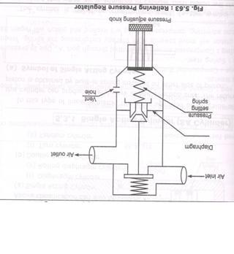
RELIEVING PRESSURE REGULATOR:

Slide 96
WHEN OUTLET PRESSURE EXCEEDS, BACK PRESSURE ACTS ON DIAPHRAGM, IT MOVES DOWNWARD, AND MORE OPENING IS CREATED, FROM WHICH AIR ESCAPES THROUGH VANE HOLE, AT THIS TIME THE UPPER SPRING CUTS OFF INLER AIR SUPPLY.
WHEN OUTLET PRESSURE IS LOW, THEN OPENING PASSAGE TO VENT HOLE IS RESTRICTED, NO FLOW OR VERY SMALL FLOW AS PER SETTING GOES TO VENT HOLE. AND AS PER SETTING SUPPLY FROM INLET TO OUTLET IS CONTINUED.
VENT HOLE IS SHOWN ON VALVE BODY. EXCESS AIR IS VENTED OUT THROUGH VALVE ONLY.HENCE IT IS CALLED AS RELIEVING PRESSURE REGULATOR.

Slide 97
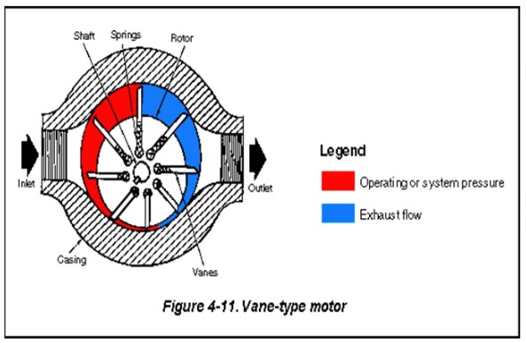
AIR MOTORS
VANE MOTOR
GEROTOR MOTOR
TURBINE MOTOR
LOBE MOTOR
AXIAL MOTOR

Slide 98
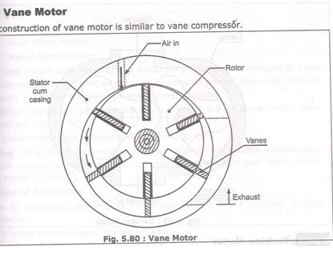
AIR MOTORS:
ACTUATORS ROTARY TYPE
VANE MOTOR

Slide 99
ROTARY ACTUATORS
Air Motors:
These are highly durable, corrosion resistant and high performance air motors. It includes vane type air motors and piston type air motors. In the vane type, the operation of air motors is as follows: On the entrance of air in the air motor, the former forces the sliding vanes out of the eccentric mounted rotor. Then, an extended shaft provided on the rotor, spins to complete the work. The piston type air motors are widely used in various applications where high torque and flexibility in the operation are required. We can customize our air motors as per the specifications provided by our customers.

Slide 100
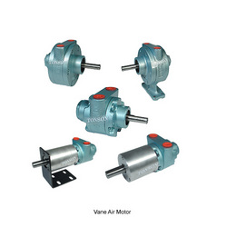
Vane Type Air Motors
Vane Air Motors TONSON Air Motors are known for their rugged construction and reliability. Air Motors come in seven basic models up to 9.5 HP. Motor speeds are variable from 300 - 10000 RPM. Choose from Face, Foot, Flange and NEMA 56 C Standards.
Air Powered Gear Motors are available in right-angle and in-line models offering a maximum torque range of 8 - 587 NM. Gear ratio available from 10:1 to 60 :1 single reduction gear reducers.

Slide 101
FEATURES
Variable Speed
No Electrical Sparking
Cool Running
Compact & Portable
Will not burn out
How Air Motor Operates: When compressed Air enters an Air Motor, it forces the sliding vanes out of the eccentric mounted rotor. An extended shaft on the rotor spin to perform the work.

Slide 102
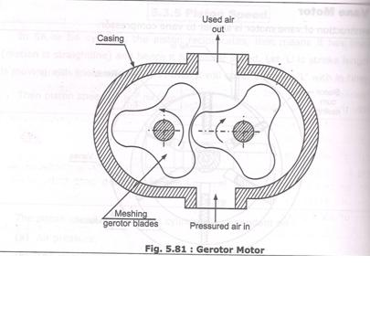
GEROTOR MOTOR

Slide 104
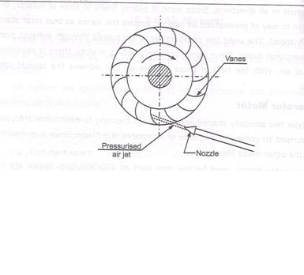
TURBINE MOTOR
IN THIS TYPE OF AIR MOTOR, LIGHT WEIGHT IMPELLER HAVING CURVED VANES IS USED. PRESSURED AIR IS PASSED THROUGH NOZZLE. THE IMPACT OF JET ROTATE THE IMPELLER .
THESE ARE HIGH SPEED LOW TORQUE MOTORS.
SIMPLE IN CONSTRUCTION.
TURBINE MOTOR

Slide 106
Piston Type Air Motors
Piston Air Motors TONSON's patented high precision distinctive radial piston design delivers high torque without high levels of air consumption and air loss as compared to typical vane type air motors. Piston Motors are well balanced. Piston Motors have three, five or six pistons providing for even torque at all speeds and smooth delivery of power with each revolution in either direction of rotation. This type of motor operates at a much slower speed than a vane-type motor because of the weight resulting from its reciprocating parts. Free Speed is usually 3000 rpm or less. Maximum horse power is usually developed at 1000 rpm or less.

Slide 107
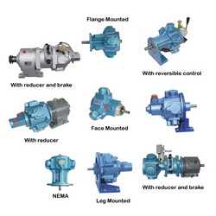
Piston Air Motors
FEATURES
Low Air Consumption
High Torque Output
Variable Speed
Cool & Continuous Running
No Electrical Spark
Reversible
APPLICATION - Stirrer, Agitators, Motor Drive, Turn Table etc. where High Torque and flexibility in operation is needed.
Request a Quote

Slide 108
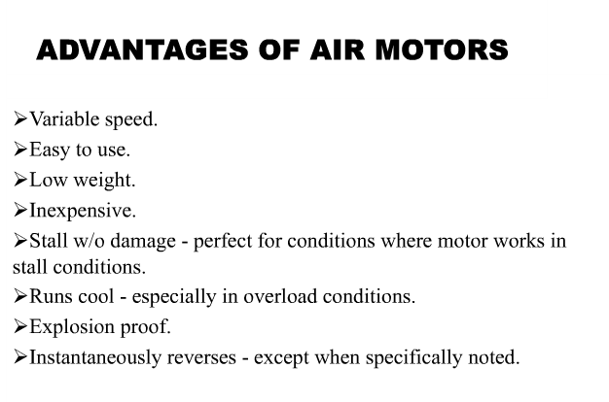

Slide 109
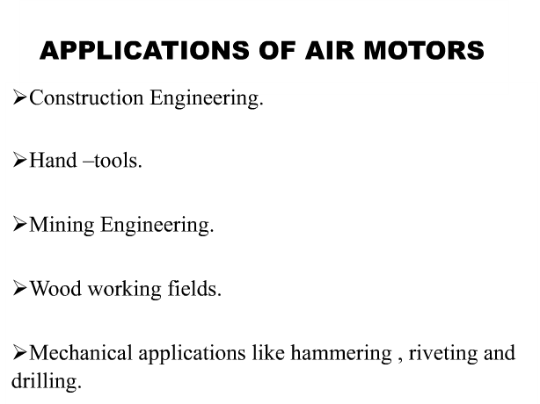

Slide 110
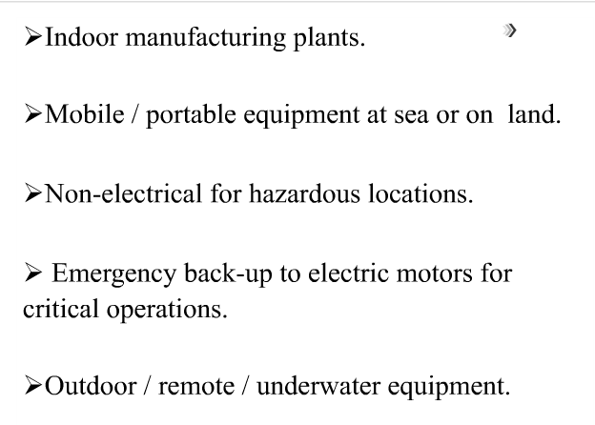

Slide 111
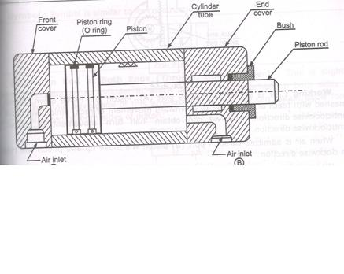
ACTUATORS LINEAR
SINGLE ACTING AND DOUBLE ACTINGCYLINDERS.
DOUBLE ACTING CYLINDER
TWO PORTS , BOTH ACTS AS INLET AND OUTLET ALTERNATELY .
PISTON, PISTON RINGS, CYLINDER HAVE SURFACE FINISH AND CLOSE TOLERANCE.
BUSH AND SEALS, O RING SEAL.
FRONT COVER, PISTON ROD ETC.

Slide 112
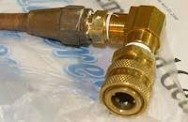
PNEUMATIC ACCESSORIES

Slide 113
ACCESSORIES
PIPE LINES
FITTINGS
HOSES
CONNECTORS
SEALS ETC

Slide 114
PIPE MATERIALS
MATERIAL PRESSURE
STAINLESS STEEL---------2500 TO 4500 BAR
GI PIPE ----------- 1000 BAR
COPPER PIPES -----------200 BAR
AL PIPES -----------125 BAR
POLYTHELENE -----12-15 BAR
NYLON ---------7 – 10 BAR
VINYL --------------- 8-10 BAR
RUBBER -------------- 3 TO 7 BAR

Slide 115
FITTINGS USED IN PNEUMATIC SYSTEM
BELL MOUTH TUBE FITTING ( FLARED FITTING )
COMPRESSION TYPE FITTING ( FERRULE FITTING)
SCREWED CONNECTIONS
QUICK CONNECTIONS

Slide 116
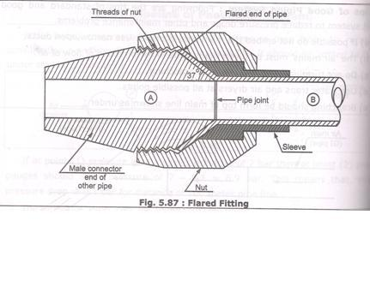
FLARED FITTING
PIPE A AND B ARE JOINED WITH FLARED FITTING

Slide 117
THE END PIPE B IS FLARED (MADE IN CONICAL SHAPE) BY USING FLARING TOOL. FLARING ANGLE IS 37 DEGREES TO 45 DGREES.
TO PIPE A MALE CONNECTOR IS FITTED. THEN NUT IS TIGHTENED ON IT BY USING PACKING SLEEVE.
BY LOOSING NUT, PIPES CAN BE DISCONNECTED.

Slide 118
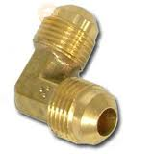
FLARED FITTING
Flare fittings are a type of compression fitting used with metal tubing, usually soft steel and ductile (soft) copper, though other materials are also used. Tube flaring is considered to be a type of forging operation,^{[1]} and is usually a cold working procedure. During assembly, a flare nut is used to secure the flared tubing's tapered end to the also tapered fitting, producing a pressure-resistant, leak-tight seal. Flared connections offer a high degree of long-term reliability and for this reason are often used in mission-critical and inaccessible locations.
FLARE NUT OBSERVE TAPERD PORTION.

Slide 119
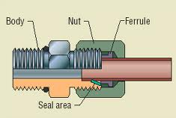
FLARELESS FITTING OR FERRULE FITTING
NO TAPER IS GIVEN ON PIPE ENDS. BUT FERRULE IS USED FOR LEAKPROOF JOINTS.

Slide 120
FERRULE FITTING

Slide 121
FERULE OF BRASS OR NYLON
TO AVOID FLARING OF PIPE ENDS( TO MADE CONICAL) FLARELESS JOINTS LIKE FERRULE FITTINGS ARE USED IN PNEUMATICS.

Slide 122
FERRULE FITTING
FERRULE IS A FLEXIBLE MEMBER LIKE RUBBER MADE UP OF NYLON OR BRASS.
IN THIS JOINT NUT AND FERRULE ARE PLACED ON TUBE AND OTHER ENDWHICH IS TO BE JOINED IS INSERTED ALONG WITH SOCKET. BUT IS TIGHTENED IN SOCKET THREADING.
THE FERRULE ELEMENT WILL OCCUPY ENTIRE SPACE AND MAKES PERFECT SEAL AS WELL AS PERFECT JOINT.

Slide 123
ACCESSORIES REQUIRED FOR FITTING
DIFFERENT CONNECTORS

Slide 124
NUT
HOSE USED IN PNEUMATIC SYSTEM

Slide 125
CONNECTORS
QUICK CONNECTOR
SEAL O RING TYPE

Slide 126
HOSE AND CONNECTOR

Slide 129
THANKS !!

