Slide 1
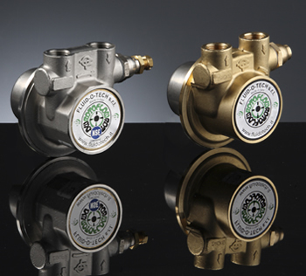
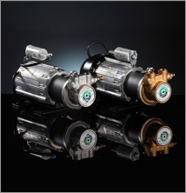
FLUID PUMP

Slide 2
Pump:
Hyd. pump converts mechanical energy into hydraulic energy by pushing the hyd. Fluid into the system.
It receives energy from prime mover ( electric motor or engine) and imparts it to fluid.

Slide 3
CLASSIFCATION
Based on principle of operation:
1.hydrostatic pump (positive
displacement type)
2. hydrodynamic pump (non-positive
displacement type)

Slide 4
POSITIVE DISPLACEMENT PUMP:
DELIVERS FIXED VOLUME OF FLUID IN EACH CYCLE.
PUMPING VOLUME CHANGES FROM MAXIMUM TO MINIMUM.
PUMPING ELEMENT EXPANDS FROM A SMALL VOLUME TO A LARGE VOLUME AND AGAING CONTRACTED TO SMALL VOLUME.
USED WHERE PRESSURE REQUIREMENT IS PRIME CONSIDARATION.
HIGH AND LOW PRESSURE AREAS FOR SUCTION AND DELIVERY ARE SEPARATED SO THAT FLUID CAN NOT LEAK BACK.

Slide 5
SINCE THE VOLUME PER CYCLE IS FIXED, VOLUME OF FLUID PUMPED IS THE FUNCTION OF NO. OF CYCLES PER UNIT TIME.
Eg. GEAR, VANE, SCREW, PISTON PUMPS ETC.
ALSO KNOWN AS HYDROSTATIC POWER GENERATORS.
ADVANTAGES:
WIDELY USED IN HYD. SYSTEMS.
GENERATE HIGH PRESSURE.
SMALL IN SIZE.
HIGH POWER TO WEIGHT RATIO.
RELATIVELY HIGH VOLUMETRIC EFFICIENCY.
GREATER FLEXIBILITY i.e. GOOD PERFORMANCE UNDER VARYING SPEED AND PRESSURE REQUIREMENTS.

Slide 6
MOSTLY USED FOR HIGH PRESSURE AND LOW VOLUMES.
PRESSURE UPTO 1000 BAR AND
VOLUME UPTO 800 LIT/MIN.
THEY HAVE LESS NO. OF MOVING PARTS.
NO NEED OF BALANCING.
LESS MAINTENANCE
VOLUME OF FLUID PUMPED IS DEPENDENT ON SPEED OF THE RATATING MEMBER AND DELIVERY PRESSURE.

Slide 7
PRESSURE AND FLOW RATES OF DIFF. PUMPS:-
PUMP TYPE PRESSURES BAR VOLUME LIT/MIN
EXTERNAL GEAR 100-300 400
INT. GEAR 350-400 450
FIXED VANE 125-175 200
VARIABLE VANE 75-125 150
SCREW PUMP 60-175 7500
IN LINE AXIAL PISTON 700 1000
BENT AXIS AND SWASH PLATE 700 800
RADIAL PISTON 1000 2000

Slide 8
NON-POSITVE DISPLACEMENT OR
ROTODYANMIC PUMPS :
IN THIS FLUID CAN BE DISPALCED AND TRANSFERRED USING THE INERTIA OF THE FLUID.
DISCHARGE DEPENDS ON PRESSURE ON DELIVERY SIDE.
THERE MAY BE A CHANCE OF SLIP.
E.G. CENTRIFUGAL PUMP, AXIAL FLOW AND RADIAL FLOW PUMPS.
USED FOR LOW PRESSURE AND HIGH VOLUMES.
PRESSURE UPTO 40 BAR AND
VOLUME UPTO 8000 LIT/MIN.

Slide 9
2. Based on displacement:
1. constant displacement pump
2. variable displacement pump
3. Based on construction:
1. gear type pumps
1.external gear pump
2.internal gear pump

Slide 10
2. vane type pumps:
1.constant displacement type
2.variable displacement type
3. piston type pumps:
1.radial piston type
2.axial piston type (swash plate
and bent axis type)
4. Screw type pump
5. ball piston type

Slide 11
Fixed
displacement type
External gear pump
Internal gear pump
Vane type pump
Geroter pump
Screw pump
Variable displacement type
Variable delivery
vane pump
Radial piston pump
Swash plate type
axial piston pump
Bent axis type axial
piston pump

Slide 12
Selection of hyd. Pumps:
Factors affecting selection of pumps:
pressure:
120 to 200 bar – external gear and vane pumps have this range.
100 to 140 bar – internal gear pumps
Up to 500 bar- piston pumps

Slide 13
2. Flow:
volume of fluid is considered unit cu.m/sec
or liters/sec
3. speed:
speed may be limited by the ability of a pump to fill without cavitation.
4. Efficiency
5. Fluid compatibility
pump and fluid must compatible.
6. Pressure to weight ratio
7.Operating environment
8.Cost.

Slide 14
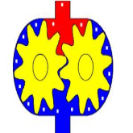
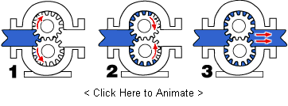
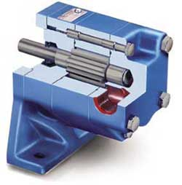
External Gear Pumps
Pressure up to 300 bar
*Casing
*Driving and
driven gear
*Inlet and outlet ports

Slide 15
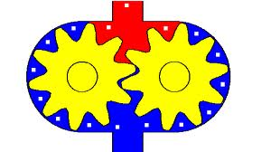
outlet
Driven gear
Driving gear
casing
inlet
External gear pump

Slide 16
External gear pumps are similar in pumping action to internal gear pumps in that two gears come into and out of mesh to produce flow. However, the external gear pump uses two identical gears rotating against each other -- one gear is driven by a motor and it in turn drives the other gear. Each gear is supported by a shaft with bearings on both sides of the gear.

Slide 17
1. As the gears come out of mesh, they create expanding volume on the inlet side of the pump. Liquid flows into the cavity and is trapped by the gear teeth as they rotate.
2. Liquid travels around the interior of the casing in the pockets between the teeth and the casing -- it does not pass between the gears.
3. Finally, the meshing of the gears forces liquid through the outlet port under pressure.

Slide 18
Because the gears are supported on both sides, external gear pumps are quiet-running and are routinely used for high-pressure applications such as hydraulic applications. With no overhung bearing loads, the rotor shaft can't deflect and cause premature wear.

Slide 19
Advantages
High speed
High pressure
No overhung bearing loads
Relatively quiet operation
Design accommodates wide variety of materials.
Disadvantages
Four bushings in liquid area
No solids allowed
Fixed End Clearances

Slide 20
Applications
Common external gear pump applications include, but are not limited to:
Various fuel oils and lube oils
Chemical additive and polymer metering
Chemical mixing and blending (double pump)
Industrial and mobile hydraulic applications (log splitters, lifts, etc.)
Acids and caustic (stainless steel or composite construction)
Low volume transfer or application

Slide 21
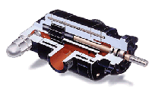
Materials Of Construction
Externals (head, casing, bracket) - Iron, ductile iron, steel, stainless steel, high alloys, composites (PPS, ETFE)
Internals (shafts) - Steel, stainless steel, high alloys, alumina ceramic
Internals (gears) - Steel, stainless steel, PTFE, composite (PPS)
Bushing - Carbon, bronze, silicon carbide, needle bearings
Shaft Seal - Packing, lip seal, component mechanical seal, magnetically-driven pump
A composite external gear pump performs well in corrosive liquid applications.

Slide 22
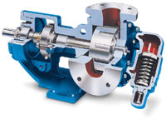
INTERNAL GEAR PUMPS
Figure 1. Internal gear pumps are ideal for high-viscosity liquids, but they are damaged when pumping large solids.

Slide 23
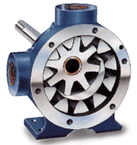
Different parts
Outlet
Pressure 350 bar
Inlet port
internal gear or idler gear
External gear or rotor gear
crescent

Slide 24
The crescent internal gear pump has an outer or rotor gear that is generally used to drive the inner or idler gear (Figure 1). The idler gear, which is smaller than the rotor gear, rotates on a stationary pin and operates inside the rotor gear. The gears create voids as they come out of mesh and liquid flows into the pump. As the gears come back into mesh, volumes are reduced and liquid is forced out the discharge port.

Slide 25
Liquid can enter the expanding cavities through the rotor teeth or recessed areas on the head, alongside the teeth. The crescent is integral with the pump head and prevents liquids from flowing to the suction port from the discharge port.

Slide 26
The rotor gear is driven by a shaft supported by journal or antifriction bearings. The idler gear contains a journal bearing rotating on a stationary pin in the pumped liquid. Depending on shaft sealing arrangements, the rotor shaft support bearings may run in pumped liquid. This is an important consideration when handling an abrasive liquid and can wear out a support bearing.

Slide 27
Internal gear pumps are made to close tolerances and are damaged when pumping large solids. These pumps can handle small suspended particulate in abrasive applications, but gradually wear and lose performance. Some performance loss is restored by adjusting the pump end clearance. End clearance is the closeness of the rotor gear to the head of the pump.

Slide 28
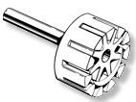
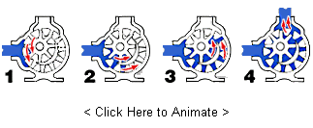
WORKING OF INTERNAL GEAR PUMP

Slide 29
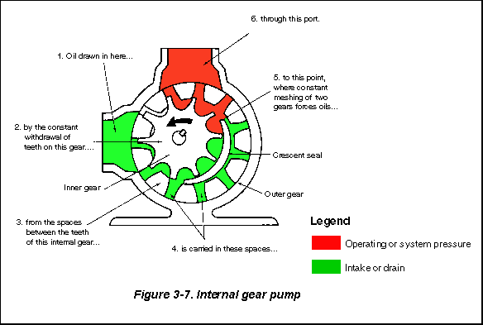

Slide 30
The internal gear pump is non-pulsing, self-priming, and can run dry for short periods. They're also bi-rotational, meaning that the same pump can be used to load and unload vessels. Because internal gear pumps have only two moving parts, they are reliable, simple to operate, and easy to maintain.

Slide 31
1. Liquid enters the suction port between the rotor (large exterior gear) and idler (small interior gear) teeth. The arrows indicate the direction of the pump and liquid.
2. Liquid travels through the pump between the teeth of the "gear-within-a-gear" principle. The crescent shape divides the liquid and acts as a seal between the suction and discharge ports.

Slide 32
3. The pump head is now nearly flooded, just prior to forcing the liquid out of the discharge port. Intermeshing gears of the idler and rotor form locked pockets for the liquid which assures volume control.
4. Rotor and idler teeth mesh completely to form a seal equidistant from the discharge and suction ports. This seal forces the liquid out of the discharge port.

Slide 33
Advantages
Only two moving parts
Only one stuffing box
Non-pulsating discharge
Excellent for high-viscosity liquids
Constant and even discharge regardless of pressure conditions
Operates well in either direction
Can be made to operate with one direction of flow with either rotation
Low NPSH required
Single adjustable end clearance
Easy to maintain
Flexible design offers application customization

Slide 34
Disadvantages
Usually requires moderate speeds
Medium pressure limitations
One bearing runs in the product pumped
Overhung load on shaft bearing.

Slide 35
Applications
Common internal gear pump applications include, but are not limited to:
All varieties of fuel oil and lube oil
Resins and Polymers
Alcohols and solvents
Asphalt, Bitumen, and Tar
Polyurethane foam (Isocyanate and polyol)
Food products such as corn syrup, chocolate, and peanut butter
Paint, inks, and pigments
Soaps and surfactants
Glycol

Slide 36
Materials Of Construction / Configuration Options
Externals (head, casing, bracket) - Cast iron, ductile iron, steel, stainless steel, Alloy 20, and higher alloys.
Internals (rotor, idler) - Cast iron, ductile iron, steel, stainless steel, Alloy 20, and higher alloys.
Bushing - Carbon graphite, bronze, silicon carbide, tungsten carbide, ceramic, colomony, and other specials materials as needed.
Shaft Seal - Lip seals, component mechanical seals, industry-standard cartridge mechanical seals, gas barrier seals, magnetically-driven pumps.
Packing - Impregnated packing, if seal not required.

Slide 37
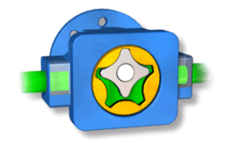
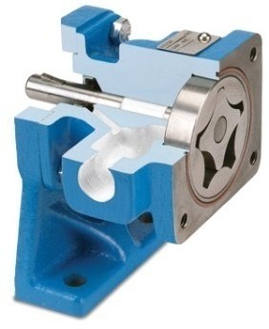
Gerotor pump pressure 120 bar
Inner gerotor 4 teeth
Outer gerotor 5 teeth

Slide 38
Gerotor pumps are internal gear pumps without the crescent. The rotor is the internal (drive) gear shown below in gray, and the idler is the external (driven) gear, shown below in orange. They are primarily suitable for clean, low pressure applications such as lubrication systems or hot oil filtration systems, but can also be found in low to moderate pressure hydraulic applications.

Slide 39
How Gerotor Pumps Work
1. Liquid enters the suction port between the rotor (gray gear) and idler (orange gear) teeth.
2. Liquid travels through the pump between the teeth of the "gear-within-a-gear" principle. The close tolerance between the gears acts as a seal between the suction and discharge ports.

Slide 40
3. Rotor and idler teeth mesh completely to form a seal equidistant from the discharge and suction ports. This seal forces the liquid out of the discharge port.

Slide 41
Advantages
High Speed
Only two moving parts
Only one stuffing box
Constant and even discharge regardless of pressure conditions
Operates well in either direction
Quiet operation
Can be made to operate with one direction of flow with either rotation
Disadvantages
Medium pressure limitations
Fixed clearances
No solids allowed
One bearing runs in the product pumped
Overhung load on shaft bearing

Slide 42
Applications
Common gerotor pump applications include, but are not limited to:
Light fuel oils
Lube oil
Cooking oils
Hydraulic fluid

Slide 43
Materials Of Construction / Configuration Options
Externals (head, casing) - Cast iron
Internals (rotor, idler) - Steel
Bushing - Carbon graphite, bronze, and other materials as needed
Shaft Seal - Lip seals, component mechanical seals
Packing - Not commonly used for gerotor pumps

Slide 44
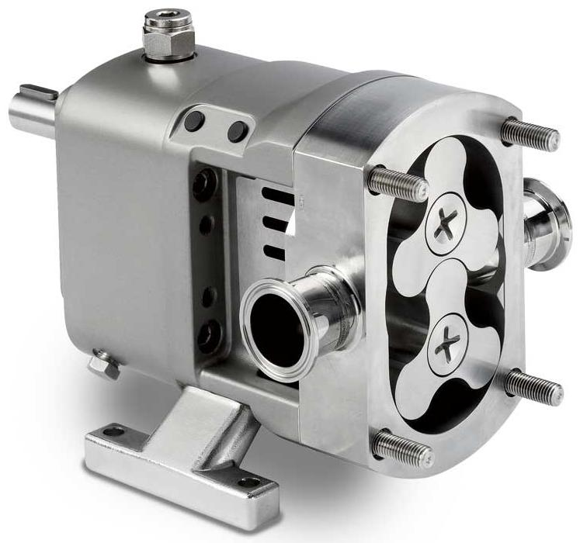
Lobe Pumps
Lobe pumps are used in a variety of industries including, pulp and paper, chemical, food, beverage, pharmaceutical, and biotechnology. They are popular in these diverse industries because they offer superb sanitary qualities, high efficiency, reliability, corrosion resistance, and good clean-in-place and sterilize-in-place (CIP/SIP) characteristics.

Slide 45
Lobe Pumps
Lobe
Used when more quantity of oil is required at low pressure.

Slide 46
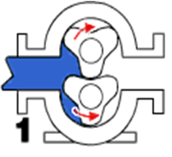
Lobe pumps are similar to external gear pumps in operation in that fluid flows around the interior of the casing. Unlike external gear pumps, however, the lobes do not make contact. Lobe contact is prevented by external timing gears located in the gearbox. Pump shaft support bearings are located in the gearbox, and since the bearings are out of the pumped liquid, pressure is limited by bearing location and shaft deflection.

Slide 47
1. As the lobes come out of mesh, they create expanding volume on the inlet side of the pump. Liquid flows into the cavity and is trapped by the lobes as they rotate.
2. Liquid travels around the interior of the casing in the pockets between the lobes and the casing -- it does not pass between the lobes.
3. Finally, the meshing of the lobes forces liquid through the outlet port under pressure.

Slide 48
Lobe pumps are frequently used in food applications because they handle solids without damaging the product. Particle size pumped can be much larger in lobe pumps than in other PD types. Since the lobes do not make contact, and clearances are not as close as in other PD pumps, this design handles low viscosity liquids with diminished performance. Loading characteristics are not as good as other designs, and suction ability is low. High-viscosity liquids require reduced speeds to achieve satisfactory performance. Reductions of 25% of rated speed and lower are common with high-viscosity liquids.

Slide 49
Advantages
Pass medium solids
No metal-to-metal contact
Superior CIP/SIP capabilities
Long term dry run (with lubrication to seals)
Non-pulsating discharge
Disadvantages
Requires timing gears
Requires two seals
Reduced lift with thin liquids

Slide 50
Applications
Common rotary lobe pump applications include, but are not limited to:
Polymers
Paper coatings
Soaps and surfactants
Paints and dyes
Rubber and adhesives
Pharmaceuticals
Food applications (a sample of these is referenced below)

Slide 51
Food and cosmetic products capable of being pumped by lobe rotor pumps.
Alcohol Apple purée Apricots Baby food Batter Beans Beer
Cheese whey Cherries Chicken paste Chili con carne Chocolate Chutney Cockles Coconut oil Cod oil
Tea Tomato ketchup Tomato paste Toothpaste Vaseline Vegetables Vinegar Water Wines Yeast Yogurt

Slide 52
Materials Of Construction
Externals (head, casing) - Typically 316 or 316L stainless steel head and casing
Externals (gearbox) - Cast iron, stainless steel
Internals (rotors, shaft) - Typically 316 or 316L stainless steel, non-galling stainless steel
Shaft Seal - O-rings, component single or double mechanical seals, industry-standard cartridge mechanical seals

Slide 53
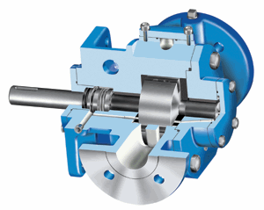
Vane Pumps
While vane pumps can handle moderate viscosity liquids, they excel at handling low viscosity liquids such as LP gas (propane), ammonia, solvents, alcohol, fuel oils, gasoline, and refrigerants.

Slide 54
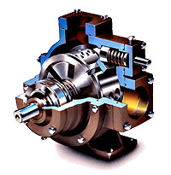
Vane pumps are available in a number of vane configurations including sliding vane (left), flexible vane, swinging vane, rolling vane, and external vane.
Vane pumps are noted for their dry priming, ease of maintenance, and good suction characteristics over the life of the pump. Moreover, vanes can usually handle fluid temperatures from -32°C / -25°F to 260°C / 500°F and differential pressures to 15 BAR / 200 PSI (higher for hydraulic vane pumps).

Slide 55
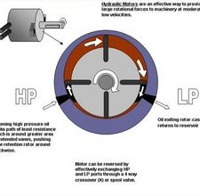
Low pressure side
High pressure side
Vane pump

Slide 56
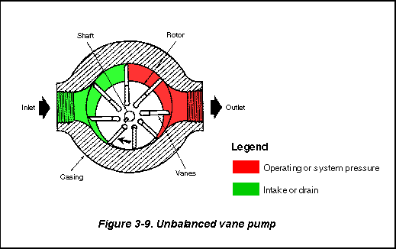

Slide 57
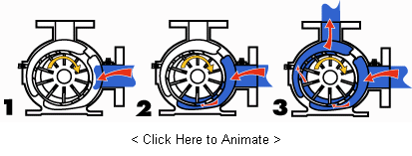
How Vane Pumps Work
Driving rotor with slots for vanes
Sliding vanes
Cam ring to constrain outward movement of vanes
Housing with inlet and outlet ports.

Slide 58
1. A slotted rotor is eccentrically supported in a cycloidal cam. The rotor is located close to the wall of the cam so a crescent-shaped cavity is formed. The rotor is sealed into the cam by two sideplates. Vanes or blades fit within the slots of the impeller.

Slide 59
As the rotor rotates (yellow arrow) and fluid enters the pump, centrifugal force, hydraulic pressure, and/or pushrods push the vanes to the walls of the housing. The tight seal among the vanes, rotor, cam, and sideplate is the key to the good suction characteristics common to the vane pumping principle.

Slide 60
2. The housing and cam force fluid into the pumping chamber through holes in the cam (small red arrow on the bottom of the pump). Fluid enters the pockets created by the vanes, rotor, cam, and sideplate.

Slide 61
3. As the rotor continues around, the vanes sweep the fluid to the opposite side of the crescent where it is squeezed through discharge holes of the cam as the vane approaches the point of the crescent (small red arrow on the side of the pump). Fluid then exits the discharge port.

Slide 62
Advantages
Handles thin liquids at relatively higher pressures
Compensates for wear through vane extension
Sometimes preferred for solvents, LPG
Can run dry for short periods
Can have one seal or stuffing box
Develops good vacuum
Disadvantages
Can have two stuffing boxes
Complex housing and many parts
Not suitable for high pressures
Not suitable for high viscosity
Not good with abrasives

Slide 63
Applications
Aerosol and Propellants
Aviation Service - Fuel Transfer, Deicing
Auto Industry - Fuels, Lubes, Refrigeration Coolants
Bulk Transfer of LPG and NH₃
LPG Cylinder Filling
Alcohols
Refrigeration - Freons, Ammonia
Solvents
Aqueous solutions

Slide 64
Materials Of Construction
Externals (head, casing) - Cast iron, ductile iron, steel, and stainless steel.
Vane, Pushrods - Carbon graphite, PEEK®.
End Plates - Carbon graphite
Shaft Seal - Component mechanical seals, industry-standard cartridge mechanical seals, and magnetically-driven pumps.
Packing - Available from some vendors, but not usually recommended for thin liquid service

Slide 65
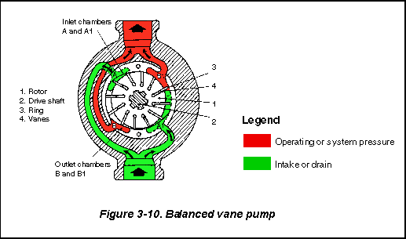
Observe the elliptical ring

Slide 66
Balanced Vane Pumps. In the balanced design (Figure 3-10), a pump has a stationary, elliptical cam ring and two sets of internal ports. A pumping chamber is formed between any two vanes twice in each revolution. The two inlets and outlets are 180 degrees apart. Back pressures against the edges of a rotor cancel each other. Recent design improvements that allow high operating speeds and pressures have made this pump the most universal in the mobile-equipment field.

Slide 67
Axial piston pump
Pressure 500 to 700 bar
Swash plate
Valve plate
Piston
Cylinder block

Slide 68
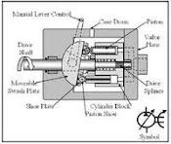

Slide 69
An axial piston pump has a number of pistons (usually an odd number) arranged in a circular array within a housing which is commonly referred to as a cylinder block, rotor or barrel. This cylinder block is driven to rotate about its axis of symmetry by an integral shaft that is, more or less, aligned with the pumping pistons (usually parallel but not necessarily).

Slide 70
Mating surfaces. One end of the cylinder block is convex and wears against a mating surface on a stationary valve plate. The inlet and outlet fluid of the pump pass through different parts of the sliding interface between the cylinder block and valve plate. The valve plate has two semi-circular ports that allow inlet of the operating fluid and exhaust of the outlet fluid respectively.

Slide 71
Reciprocating pistons. As the cylinder block rotates, the exposed ends of the pistons are constrained to follow the surface of the cam plane. Since the cam plane is at an angle to the axis of rotation, the pistons must reciprocate axially as they precess about the cylinder block axis. The axial motion of the pistons is sinusoidal

Slide 72
During the rising portion of the piston's reciprocation cycle, the piston moves toward the valve plate. Also, during this time, the fluid trapped between the buried end of the piston and the valve plate is vented to the pump's discharge port through one of the valve plate's semi-circular ports - the discharge port. As the piston moves toward the valve plate, fluid is pushed or displaced through the discharge port of the valve plate.

Slide 73
Effect of precession. When the piston is at the top of the reciprocation cycle (commonly referred to as top-dead-center or just TDC), the connection between the trapped fluid chamber and the pump's discharge port is closed. Shortly thereafter, that same chamber becomes open to the pump's inlet port.

Slide 74
As the piston continues to precess about the cylinder block axis, it moves away from the valve plate thereby increasing the volume of the trapped chamber. As this occurs, fluid enters the chamber from the pump's inlet to fill the void.

Slide 75
This process continues until the piston reaches the bottom of the reciprocation cycle - commonly referred to as bottom-dead-center or BDC. At BDC, the connection between the pumping chamber and inlet port is closed. Shortly thereafter, the chamber becomes open to the discharge port again and the pumping cycle starts over.

Slide 76
Variable displacement. In a variable displacement unit, if the vector normal to the cam plane (swash plate) is set parallel to the axis of rotation, there is no movement of the pistons in their cylinders. Thus there is no output. Movement of the swash plate controls pump output from zero to maximum.

Slide 77
Uses:
Despite the problems indicated above this type of pump can contain most of the necessary circuit controls integrally (the swash-plate angle control) to regulate flow and pressure, be very reliable and allow the rest of the hydraulic system to be very simple and inexpensive.
Axial reciprocating motors are also used to power many machines. They operate on the same principle as described above, except that the circulating fluid is provided under considerable pressure and the piston housing is made to rotate and provide shaft power to another machine. A common use of an axial reciprocating motor is to power small earthmoving plant such as skid loader machines. Another use is to drive the screws of torpedoes.

Slide 78
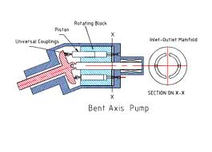
Bent axis pump

Slide 79
Advantages of piston type pumps:
High pressure up to 500 to 700 bar
High volumetric defficiency
Variable delivery
Wide viscosity range.
Quite operation.
limitations:
Cleanliness : piston pumps requires an externally clean hyd. System for satisfactory operation. as it has closely fitted parts.
Cost: as they are complex in design.

Slide 80
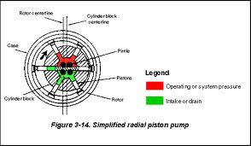
Radial piston pump
Pressure 500 bar

Slide 81
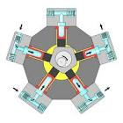
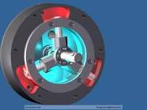
Radial piston pump

Slide 82
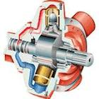
Radial piston pump

Slide 83
Advantages:
High range of pressure
High volumetric efficiency more than 90 %
variable delivery
high viscosity range i.e. handles different fluids.
Noiseless operation.
Disadvantages:
High cost
Cleaning difficulty.

Slide 84
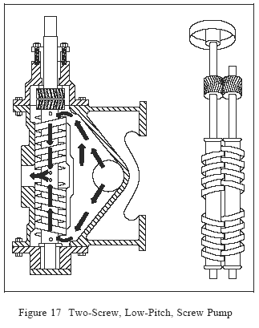
Screw pump:
When a pair of meshing screw are used increasing pressure of oil, it is known as screw pump.

Slide 85
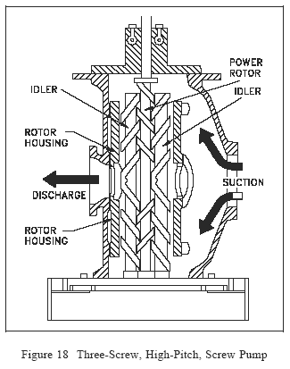

Slide 86
Two-Screw, Low-Pitch, Screw Pump
The two-screw, low-pitch, screw pump consists of two screws that mesh with close clearances, mounted on two parallel shafts. One screw has a right-handed thread, and the other screw has a left-handed thread. One shaft is the driving shaft and drives the other shaft through a set of herringbone timing gears.

Slide 87
The gears serve to maintain clearances between the screws as they turn and to promote quiet operation. The screws rotate in closely fitting duplex cylinders that have overlapping bores. All clearances are small, but there is no actual contact between the two screws or between the screws and the cylinder walls.

Slide 88
The complete assembly and the usual flow path are shown in Figure 17. Liquid is trapped at the outer end of each pair of screws. As the first space between the screw threads rotates away from the opposite screw, a one-turn, spiral-shaped quantity of liquid is enclosed when the end of the screw again meshes with the opposite screw. As the screw continues to rotate, the entrapped spiral turns of liquid slide along the cylinder toward the center discharge space while the next slug is being entrapped.

Slide 89
Each screw functions similarly, and each pair of screws discharges an equal quantity of liquid in opposed streams toward the center, thus eliminating hydraulic thrust. The removal of liquid from the suction end by the screws produces a reduction in pressure, which draws liquid through the suction line.

Slide 90
Advantages:
Reliable performance.
operating at very high speed
continuous discharge
Silent operation
Better hydraulic control.
Disadvantages:
Screw manufacturing is difficult
unsuitable for high viscosity oil
Low efficiency.

Slide 91
Comparison of gear pump and piston pump
Point | Gear pump | Piston pump
Mechanical element used | Gear pair | Piston and cylinder
Principle | Meshing of gears rotary motion | To and fro motion of piston
Pressure | Low | High
Construction | Simple and compact | Complex and requires more space.

Slide 92
Types | External, internal and gerotor | Axial piston and radial piston
Operation | Less noisy | More noisy
Pressure | 300-350 bar | 700 bar
Delivery | Continuous | Intermittent
Maintence | Simple | Difficult
Cost | Cheap | expensive

Slide 93
Flow rates of various pumps
Pump | Flow rate lit/min
Gear | 400-450
Vane | 200
Screw | 7500
Axial piston | 800-1000
Radial piston | 2000

Slide 94
THANKS!!

