Slide 1
Expt 1
STUDY OF GENERALIZED MEASUREMENT SYSTEM & ITS COMPONRNT WITH EXAMPLE OF BOURDON PRESSURE GAUGE.

Slide 2
FUNDAMENTAL MESURING PROCESS
STANDARD
MEASURAND
PROCESS OF COMPARISION
RESULT
INPUT
OUTPUT

Slide 3
TRANDUCED SIGNAL (ANALOGOUS TO INPUT
ANALOGOUS DRIVING SIGNAL
SENSOR TRANSUCER
SIGNAL CODITIONER
MEASURAND
INDICATOR
RECORDER
PROCESSOR
CONTROLLER
AUXILLARY POWER (NOT ALWAYS REQUIRED
AUXILLARY POWER (USUALLY REQUIRED
GENERALIZED MEASUREMENT SYSTEM

Slide 4
GENERAL ARRANGEMENT CONSISTS THREE STAGES
STAGE I A DETECTOR TRANDUCING OR SENSOR STAGE
STAGE II SIGNAL CONDITIONING STAGE
STAGE III TERMINATING OR READ OUT STAGE

Slide 5
STAGE I A DETECTOR TRANDUCING OR SENSOR STAGE
FUNCTION IS TO DETECT OR SENSE THE MEASURAND IDEALLY, IT SHOULD BE INSENSITIVE TO EVERY OTHER POSSIBLE INPUT.
E.G. * IF IT IS A PRESSURE PICKUP, IT SHOULD INSENSATIVE TO ACCELERATION
*IF IT IS A STRAIN GAUGE ,. IT SHOULD INSENSATIVE TO TEMP.
* IF IT IS A LINEAR ACCELEROMETER,. IT SHOULD INSENSATIVE TO ANGULAR ACCELERATION

Slide 6
STAGE II SIGNAL CONDITIONING STAGE
PURPOSE IS TO MODIFY THE TRANDUCED INFORMATION, SO THAT IT IS ACCEPTABLE TO THE TERMINATING STAGE.
IT MAY BE PERFORMING THE BASIC OPERATIONS SUCH AS FILTERING, INTERGRATION, DIFFERENTIATING OT TELEMETERING AS REQUIRED.
INCREASE EITHER AMPLITUDE OR POWER OF THE SIGNAL OR BOTH.

Slide 7
STAGE III TERMINATING OR READ OUT STAGE
PROVIDES THE INFORMATION SOUGHT IN THE FORM COMPREHENSIBLE TO ONE OF THE HUMAN SENSE OR TO A CONTROLLER.
PRESENTED AS
A RELATIVE DISPLACEMENT SUCH AS MOVEMENT OF INDICATING HAND, DISPLACEMENT OF OSCILLOSCOPE TRACE ETC.
IN DIGITAL FORM E.G. AUTOMOBILE ODOMETER, VOLTMETER, AMMETER. ETC.

Slide 8
STAGE I -SENSOR TRANDUCER
EXAMPLES ARE ---
MECHANICAL:
EG. CONTACTING SPINDLE, SPRING, ELASTIC DEVICES, DIAPHRAGMS,
BOURDON TUBE FOR PRESSURE,
PROVING RING FOR FORCE
EXAMPLES ARE ---
HRDRAULIC-PNEUMATIC
EG. BUOYANT FLOAT, VENTURY,ORIFICE,VANE, PROPELLER
OPTICAL:
PHOTOGRAPHIC FILM,
PHOTOELECTRIC CELL.
STAGE II- SIGNAL CONDITIONING
GEARING, CRANKS, SLIDES, CONNECTING LINKS, CAMS.
PIPING, VALVES, PLENUM CHAMBERS
MIRROR, LENSES, OPTICAL FIBERS, OPTICAL FILTERS

Slide 9
STAGE I -SENSOR TRANDUCER
ELECTRICAL:
RESISTANCE, CAPACITANCE,
PIEZOELECTRIC CRYSTALS,
THERMOCOUPLE ETC.
STAGE II- SIGNAL CONDITIONING
AMPLIFYING OR ATTENUATING SYSTEMS, FILTERS,
TELEMETERING SYSTEMS,
INTEGRATED CIRCUIT SYSTEMS.

Slide 10
STAGE III TERMINATING-READ OUT
INDICATORS
MOVING POINTER AND SCALES, LIGHT BEAM AND SCALES, ELECTRON BEAM AND SCALE, ELECTRON BEAM AND SCALE (CRO), LIQUID COLUMN.
DIGITAL TYPES:
ALPHANUMERIC READ OUTS.
RECORDERS:
DIGITAL PRINTING, DIRECT PHOTOGRAPHY, MAGNETIC RECORDING
PROCESSORS:
VARIOUS TYPES OF COMPUTING SYSTEMS, FEED READ OUT OR RECORDING DEVICES AND/OR CONTROLLING SYSTEMS.
CONTROLLERS : ALL TYPES

Slide 11
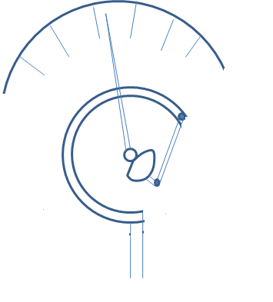
CALIBRATED SCALE
POINTER
CIRCULAR TUBE OF ELLIPTICAL C/S
RACHET AND PINION
CONNECTED TO PRESSURE PIPE
BOURDON TUBE PRESSURE GAUGE

Slide 12
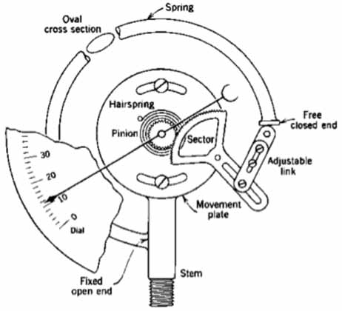
BOURDON TUBE PRESSURE GAUGE

Slide 13
GENERALIZED MEASUREMENT SYSTEM APPLIED TO
BOURDON TUBE PRESSURE GAUGE.
CIRCULAR TUBE: SERVES AS PRIMARY DETECTOR-TRANSDUCER.
CHANGING PRESSURE INTO NEAR LINEAR DISPLACEMENT
LINKAGE- GEAR ARRANGEMENT :
SERVES AS SECONDARY TRANSDUCER
LINEAR TO ROTARY MOTION AND AS AN AMPLIFIER. YIELDING MAGNIFIED OUTPUT
POINTER OVER CALIBRATED SCALE OR MOVING HAND :
SERVES AS A READ OUT DEVICE.

Slide 14
BOURDON TUBE
MECHANICAL LINKAGE
GEARING
POINTER AND DIAL
PRIMARY SENSING ELEMENT
VARIABLE CONVERSION ELEMENT
DATA TRANSMISSION ELEMENT
VARIABLE MANIPULATION ELEMENT
DATA PRESENTATION ELEMENT
P
PRESSURE
FORCE
DISPLACEMENT
LINEAR TO ANGULAR MOTION
BOURDON PRESSURE GAUGE MEASUREMENT SYSTEM

Slide 15
THANKS !!!

