Slide 1
STRAIN MEASUREMENT
STRAIN:
IT IS DEFORMATION IN MATERIAL WHEN IT IS SUBJECTED TO STRESS ( WHEN SUBJECTED TO LOAD).
STRAIN = CHANGE IN LENGTH
ORIGINAL LENGTH
STRESS:
LOAD CARRYING CAPACITY OF A MATERIAL WITHOUT EXCESSIVE DEFORMATION OR FAILURE IS CHARACTERISED BY A TERM STESS.
IT IS FORCE EXPERIENCED PER UNIT AREA AND EXPRESSED IN PRESSURE UNITS E.G. N/SQ.M

Slide 2
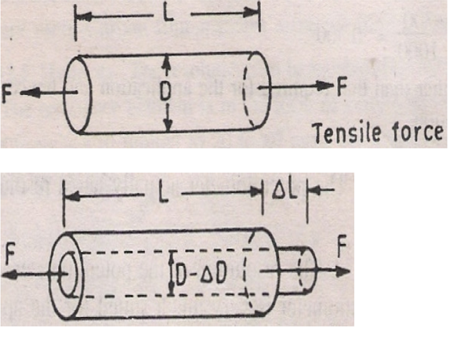
Changes in lateral and transverse dimension

Slide 3
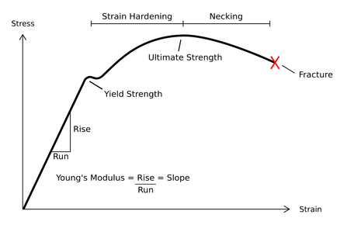
MODULUS OF
ELASTICITY OR
YOUNGS MODULUS
STRESS
STRAIN
=
STRESS STRAIN RELATIONSHIP

Slide 4
THIS MECHANICAL DEFORMATION IS MEASURED BY STRAIN GAUGE MATERIALS.
AXIAL
STRAIN = ΔL = NEW LENGTH – ORIGINAL LENGTH
L ORIGINAL LENGTH
LATERAL STRAIN = ΔD = NEW DIA - ORIGINAL DIA
D ORIGINAL DIA.
POISSON’S RATIO, μ = - LATERAL STRAIN
AXIAL STRAIN
- VE SIGN REFERS COMPRESSION RATHER THAN ELONGATION.

Slide 5
STRAIN GAUGES ARE + VE PASSIVE TRANSDUCER.
TRANDUCER MEANS WHICH CONVERTS FORCE OR PRESSURE INTO DISPLACEMENT.
DISPLACEMENT IN THE FORM OF CHANGE IN LENGH OR IN THE FORM OF CHANGE IN DIAMETER.
IF AN ELASTIC STRIP IS SUBJECTED TO TENSION I.E. IT IS POSITIVELY STRAINED, ITS LOGITUDINAL DIMENSION INCRESES AND TRANSVERSE DIMENSION DECRESES . MEANS LENTH INCRESES AND AREA DECRESES.
HERE RESISTANCE OF STRIP IS DIRECTLY PROPORTIONAL TO LENGTH AND INVERSLY PROPORTIONAL TO AREA.
RESISTANCE OF GAUGE INCRESES WITH POSITIVE STRAIN.

Slide 6
STRAIN GAUGES ARE USED FOR …..
TO ANALYZE DYNAMIC STRAIN IN COMPLEX STRUCTURES SUCHA AS BRIDGES, AUROMOBILES, ROADS ETC.
TO MEASURE TENSION, TORQUE, FORSE AND STRESSES IN STRUCTURES.
MEASUREMENT OF FORCE IN LOAD CELL.

Slide 7
CLASSIFICATION OF STRAIN GAUGES:
MECHANICAL GAUGES
MEASURES CHANGE IN LENGTH AND MAGNIFY IT USING VARIOUS ELEMENTS USED SUCH AS LEVERS, GEARS, RACK AND PINION MECHANISM ETC.
2. OPTICAL GAUGES:
MAGNIFICATION IS OBTAINED BY USE OF MIRRORS, PRISMS ETC. WHEN SUBJECTED TO STRAIN, MIRROR ROTATES AND REFLECT BEAM OF LIGHT.
3. ELECTRICAL STRAIN GAUGES
BASED ON MEASUREMENT OF CHANGE IN RESISTANCE, INDUCTANCE, CAPACITANCE ETC.
GENERALLY RESISTANCE TYPE ARE USED. STRAIN CHANGES RESISTANCE OF ONE OF THE ARM OF WHEATSTONE’S BRIDGE.

Slide 8
GAUGE FACTOR
GAUGE FACTOR IS DEFINED AS THE RATIO OF PER UNIT CHANGE IN RESISTANCE TO PER UNIT CHANGE IN LENGTH.
Working principle of strain gauge is that, the resistance of strain gauge wire is directly proportional to the mechanical stress applied on it.
ΔR
R
ΔL
L
G.F. =
= 1+ 2 μ
GAUGE FACTOR IS INDEPENDENT OF APPLIED STRAIN.

Slide 9
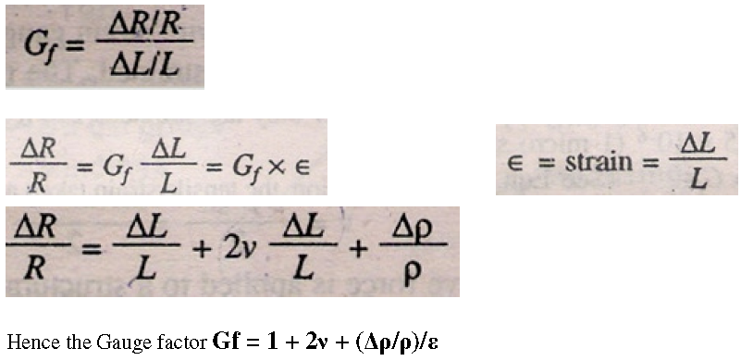

Slide 10
The strain is usually expressed in terms of microstrain. 1 microstrain = 1 μm/m. If the change in the value of resistivity of a material when strained is neglected, the gauge factor is : Gf = 1 + 2v The common value for Poisson's ratio for wires is 0.3.This gives a gauge factor of 1.6 for wire wound strain gauges. Poisson's ratio for all metals is between 0 & 0.5.This gives a value of 2

Slide 11
REQUIREMENTS OF STRAIN GAUGE :
IT SHOULD BE SMALL IN SIZE WITH NEGLIGIBLE MASS.
IT SHOULD BE HIGHLY SENSITIVE TO STRAIN.
IT SHOULD HAVE HIGH VALUE OF GAUGE FACTOR. I.E. VALUE
OF GAUGE FACTOR INDICATES LARGE CHANGE IN RESISTANCE
FOR A PARTICULAR STRAIN RSEULTING IN HIGH STRAIN.
IT SHOULD BE EASILY ATTACHABLE TO SPECIMEN.
IT SHOULD BE CAPABLE TO INDICATE STATIC, TRANSIENT AND
DYNAMIC STRAIN.
IT SHOULD BE CAPABLE OF REMOTE INDICATION AND
RECORDING.

Slide 12
IT SHOULD NOT BE SENSITIVE TO AMBIENT CONDITION SUCH AS TEMP. HUMIDITY, PRESSURE, VIBRATION ETC.
IT SHOULD BE INEXPENSIVE , EASILY AVAILABLE IN VARIOUS SIZES.
THE RESISTANCE OF STRAIN GAUGE SHOULD BE AS HIGH AS POSSIBLE SINCE THIS MINIMIZES UNDISIRABLE VARIATIONS IN RESISTANCES IN THE MEASUREMENT CIRCUIT.
IT SHOULD HAVE LOW RESISTANCE TEMPERATURE COEFFICIENT.
IT SHOULD NOT HAVE HYSTERIS EFFECTS IN THE RESPONSE.
IT SHOULD HAVE LINEAR CHARACTERISTICS. I.E. THE VARIATION IN RESISTANCE IS LINEAR FUNCTION OF STRAIN.

Slide 13
STRAIN GAUGE MATERIALS :
FOR FABRICATION OF STRAIN GAUGE, IT REQUIRES GRID MATERIAL, SUPPORTING OR BACKING MATERIAL AND BONDING MATERIAL.
GRID MATERIAL:
IT SHOULD HAVE HIGH SPECIFIC RESISTANCE, HIGH GAUGE FACTOR, HIGH ELECTRICAL STABILITY, LOW HYSTERISIS, AND HAVE GOOD SOLDERABILITY AND WELDABILITY.
COMMONLY USED MATERILS ARE ….
ADVANCE : IT IS 55 % CU, 45 % NI HAVING G.F. 2.
ISOELASTIC : 36 % NI, 8% CU, 4% MN, AND MO AND REST IS IRON. GF IS 3.5, USEFUL IN DYNAMIC MEASUREMENT.
NICHROME : IT IS NI-CR ALLOY WITH GF 2

Slide 14
4. MANGANIN : IT IS MN AND NI ALLOY HAVING GF 0.47. LOW TEMP. COEFFICIENT.
MONEL: MO + NI , GF 1.9, HIGH TEMP. COEFFICIENT.
NICKEL : IT HAS NEGATIVE GF -12. IT SHOWS REDUCED RESISTANCE THROUGH LENGTH INCRESES AND DIAMETER DECRESES .
BACKING MATERIAL:
GENERALLY THIN STRONG PAPER IS USED FOR BACKING.
IT MUST BE HAVING MINIMUM THICKNESS, HIGH MECHANICAL STRENGTH, HIGH DIELECTRIC STRENGTH, NON HYGROSCOPIC.

Slide 15
BINDING MATERIAL :
USUALLY DUCO CEMENT IS USED AS BINDING MATERIAL.
IT SHOULD HAVE…
HIGH STRENGTH
HIGH CREEP RESISTANCE
HIGH DIELECTRIC STRENGTH
GOOD ADHERENCE
FAST DRYING
EASE IN APPLICATION.

Slide 16
STRAIN GAUGES ARE CLASSIFIED AS…
UNBONDED TYPE
BONDED TYPE
A) WIRE TYPE BONDED STRAIN GAUGE
B) FOIL TYPE BONDED STRAIN GAUGE
C) SEMICONDUCTOR TYPE BONDED STRAIN GAUGE

Slide 17
Unbonded Metal Strain Gauge
An unbonded metal strain gauge is shown in Fig.2.
This gauge consists of a wire stretched between two points in an insulating medium such as air. The wires are of copper nickel, chrome nickel or nickel iron alloys. The flexture element is connected via a rod to a diaphragm which is used for sensing of pressure. The wires are tensioned to avoid buckling when they experience a compressive force

Slide 18
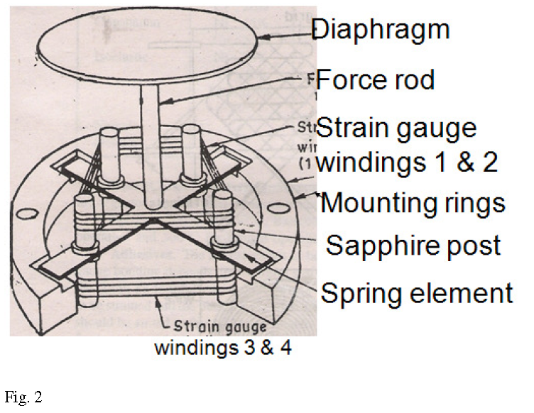
FORCE APPLIED
UNBONDED STRAIN GAUGE

Slide 19
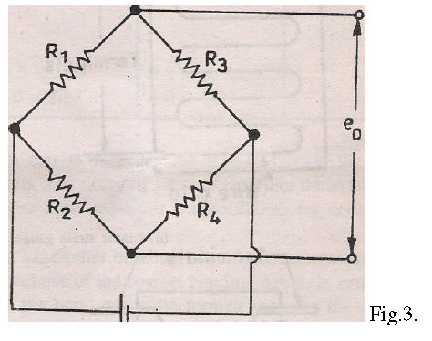
The unbonded metal wire gauges, used almost exclusively in transducer applications, employ preloaded resistance wires connected in a Wheatstone bridge as shown in
Fig.3.

Slide 20
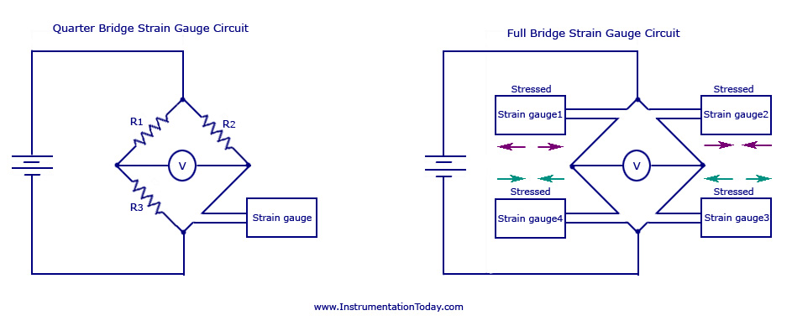

Slide 22
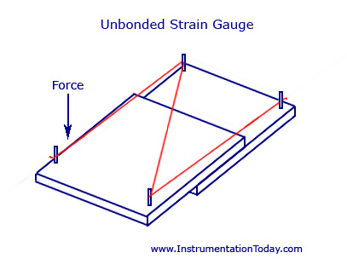

Slide 23
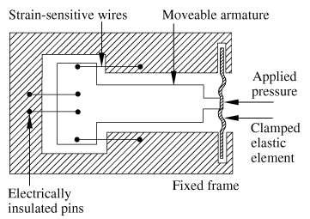
UNBONDED STRAIN GAUGE ARRANGEMENT
SUBJECTED TO COMPRESSION
SUBJECTED TO TENSION

Slide 24
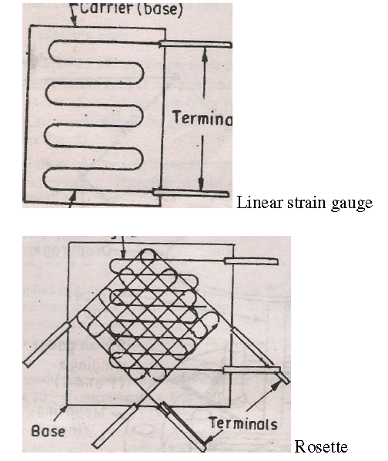
Some of the unbonded metal wire gauges are shown in Fig. 4

Slide 25
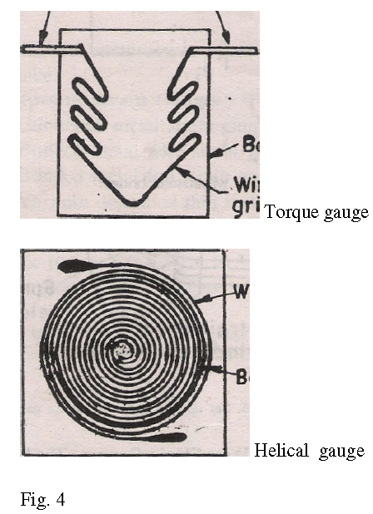

Slide 26
Strain gauges :
Strain gauges work on the principle that the resistance of a conductor or a semiconductor changes when strained. This property can be used for measurement of displacement, force and pressure. The resistivity of materials also changes with change of temperature thus causing a change of resistance. If a metal conductor is stretched or compressed, its resistance changes on account of the fact that both length and diameter of conductor change.

Slide 27
Also there is a change in the value of resistivity of the conductor when it is strained and this property is piezoresistive effect. Therefore, resistance strain gauges are also known as piezoresistive gauges.
The strain gauges are used for measurement of strain and associated stress in experimental stress analysis. Secondly, many other detectors and transducers, notably the load cells, torque meters, diaphragm type pressure gauges, temperature sensors, accelerometers and flow meters, employ strain gauges as secondary transducers.

Slide 28
ADVANTAGE OF UNBONDED STRAIN GAUGES :
IT IS SIMPLE IN CONSTRUCTION.
COST IS LOW
IT IS ACCURATE
DISADVANTAGES :
EFFECT OF HYSTERIS MAY AFFECT ITS PERFORMANCE.
CHANGE IN TEMP, AFFECTS ITS PERFORMANCE.
RESISTANCE IF ITS CONTACT LEADS DECRESES ITS PERFORMANCE.
APPLICATION :
USED FOR MEASUREMENT OF FORCE, STRAIN OR DISPLACEMENT ETC.

Slide 29
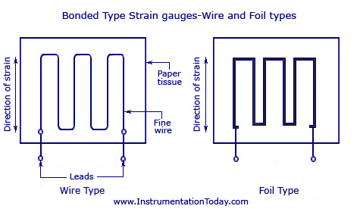
BONDED TYPE STRAIN GAUGE
A) WIRE TYPE BONDED STRAIN GAUGE
B) FOIL TYPE BONDED STRAIN GAUGE
C) SEMICONDUCTOR TYPE BONDED STRAIN GAUGE

Slide 31
A BONDED STRAIN GAUGE WILL BE EITHER A WIRE TYPE OR A FOIL TYPE AS SHOWN IN THE FIGURE.
IT IS CONNECTED TO A PAPER OR A THICK PLASTIC FILM SUPPORT.
THE MEASURING LEADS ARE SOLDERED OR WELDED TO THE GAUGE WIRE.
THE BONDED STRAIN GAUGE WITH THE PAPER BACKING IS CONNECTED TO THE ELASTIC MEMBER WHOSE STRAIN IS TO BE MEASURED.

Slide 32
FOIL TYPE GAUGES HAVE A MUCH GREATER HEAT DISSIPATION CAPACITY AS COMPARED WITH WIRE WOUND STRAIN GAUGES ON ACCOUNT OF THEIR GREATER SURFACE AREA FOR THE SAME VOLUME.
FOR THIS REASON, THEY CAN BE USED FOR HIGHER OPERATING TEMPERATURE RANGE. ALSO THE LARGE SURFACE AREA LEADS TO BETTER BONDING.
THE SENSING ELEMENTS OF FOIL GAUGES ARE FORMED FROM SHEETS LESS THAN 0.005 MM THICK BY PHOTOCOPYING PROCESS, WHICH ALLOW GREATER FLEXIBILITY WITH REGARD TO SHAPE.

Slide 33
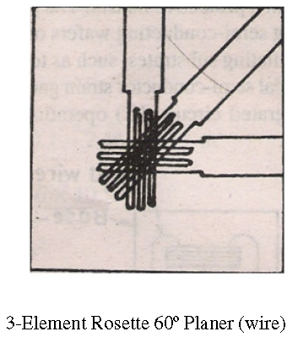
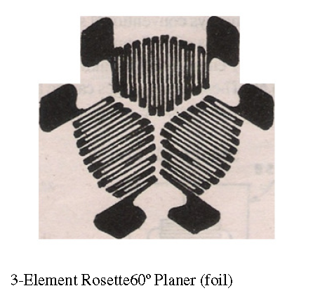
ROSETTES
IN ADDITION TO SINGLE ELEMENT STRAIN GAUGES, A COMBINATION OF STRAIN GAUGES CALLED "ROSETTES" ARE AVAILABLE IN MANY COMBINATIONS FOR SPECIFIC STRESS ANALYSIS OR TRANSDUCER APPLICATIONS.
DIFFERENT CONFIGURATIONS OF ROSETTES

Slide 34
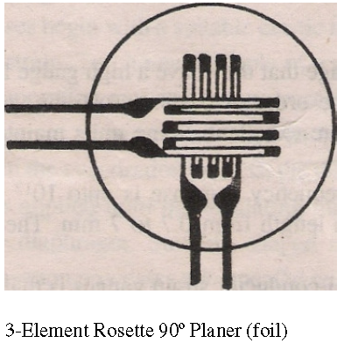
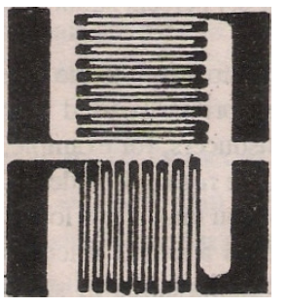

Slide 35
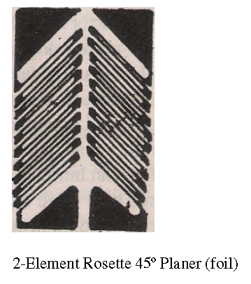

Slide 36
SEMICONDUCTOR STRAIN GAUGES
FOR A HIGH SENSITIVITY, A HIGH VALUE OF GAUGE FACTOR IS DESIRABLE.
A HIGH GAUGE FACTOR MEANS A RELATIVELY HIGHER CHANGE IN RESISTANCE WHICH CAN BE EASILY MEASURED WITH A GOOD DEGREE OF ACCURACY.
SEMICONDUCTOR STRAIN GAUGES ARE USED WHERE A VERY HIGH GAUGE FACTOR AND A SMALL ENVELOPE ARE REQUIRED. THEY DEPEND FOR THEIR ACTION UPON PIEZO-RESISTIVE EFFECT I.E. THE CHANGE IN THE VALUE OF THE RESISTANCE DUE TO CHANGE IN RESISTIVITY.
SEMI-CONDUCTING MATERIALS SUCH AS SILICON AND GERMANIUM ARE USED AS RESISTIVE MATERIALS.

Slide 37
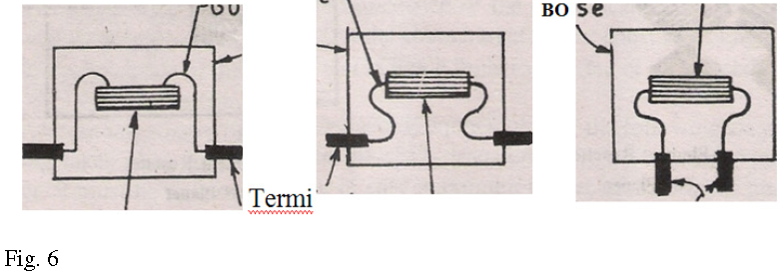
SEMICONDUCTOR STRAIN GAUGES

Slide 38
A TYPICAL STRAIN GAUGE CONSISTS OF A STRAIN SENSITIVE CRYSTAL MATERIAL AND LEADS THAT ARE SANDWICHED IN A PROTECTIVE MATRIX AS SHOWN IN FIG.6.
THE PRODUCTION OF THESE GAUGES EMPLOYS CONVENTIONAL SEMI-CONDUCTOR TECHNOLOGY USING SEMI-CONDUCTING WAFERS OR FILAMENTS WHICH HAVE A THICKNESS OF 0.05 MM AND BONDING THEM ON A SUITABLE INSULATING SUBSTRATES, SUCH AS TEFLON. GOLD LEADS ARE GENERALLY EMPLOYED FOR MAKING THE CONTACTS.

Slide 39
Advantages of semiconductor strain gauges:
high gauge factor of about 130. This allows measurement of very small strains of the order of 0.01 microstrain.
Hysteresis characteristics of semi-conductor strain gauges are excellent.
Semi-conductor strain gauges can be very small ranging in length from 0.7 to 7 mm. They are very useful for measurement of local strains.

Slide 40
Disadvantages :
The major and serious disadvantage of semiconductor strain gauges is that they are very sensitive to changes in temperature, Linearity of the semi-conductor strain gauge is poor , semi-conductor strain gauges are more expensive and difficult to attach to the object under study.

Slide 41
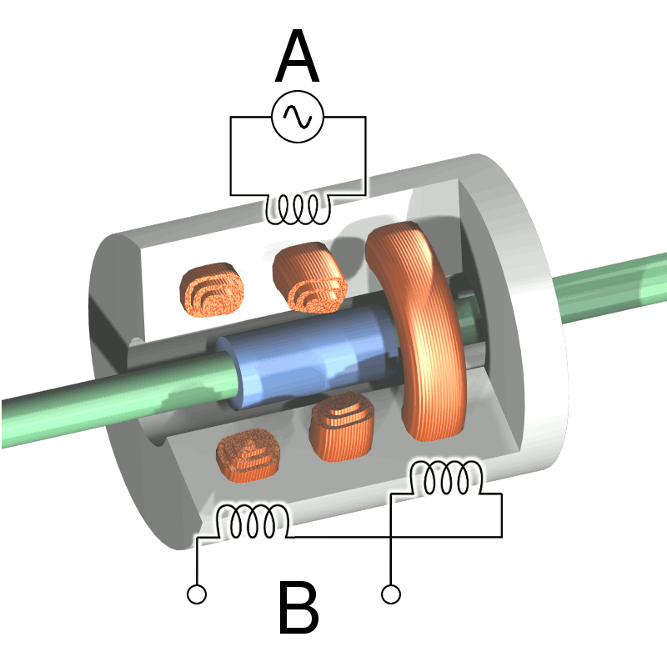
LINEAR VOLTAGE DIFFERENTIAL TRANSFORMER
(LVDT)
Soft iron core
Primary winding
movement
Secondary winding

Slide 42
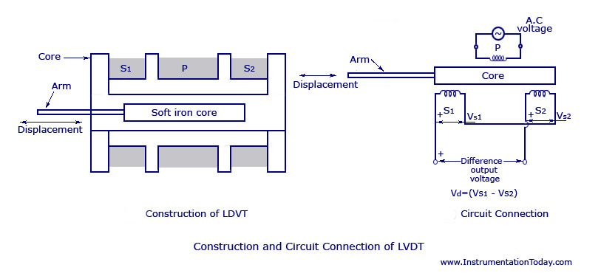
LVDT --USED FOR CONVERTING A LINEAR MOTION INTO AN ELECTRICAL SIGNAL.

Slide 43
Construction
THE DEVICE CONSISTS OF A PRIMARY WINDING (P) AND TWO SECONDARY WINDINGS NAMED S1 AND S2.
BOTH OF THEM ARE WOUND ON ONE CYLINDRICAL FORMER, SIDE BY SIDE, AND THEY HAVE EQUAL NUMBER OF TURNS.
THEIR ARRANGEMENT IS SUCH THAT THEY MAINTAIN SYMMETRY WITH EITHER SIDE OF THE PRIMARY WINDING (P).
A MOVABLE SOFT IRON CORE IS PLACED PARALLEL TO THE AXIS OF THE CYLINDRICAL FORMER.
AN ARM IS CONNECTED TO THE OTHER END OF THE SOFT IRON CORE AND IT MOVES ACCORDING TO THE DISPLACEMENT PRODUCED.

Slide 44
WORKING
AS SHOWN IN THE FIGURE ABOVE, AN AC VOLTAGE WITH A FREQUENCY BETWEEN (50-400) HZ IS SUPPLIED TO THE PRIMARY WINDING.
THUS, TWO VOLTAGES VS1 AND VS2 ARE OBTAINED AT THE TWO SECONDARY WINDINGS S1 AND S2 RESPECTIVELY. THE OUTPUT VOLTAGE WILL BE THE DIFFERENCE BETWEEN THE TWO VOLTAGES (VS1-VS2) AS THEY ARE COMBINED IN SERIES.
LET US CONSIDER THREE DIFFERENT POSITIONS OF THE SOFT IRON CORE INSIDE THE FORMER.

Slide 45
Null Position – This is also called the central position as the soft iron core will remain in the exact center of the former. Thus the linking magnetic flux produced in the two secondary windings will be equal. The voltage induced because of them will also be equal. Thus the resulting voltage VS1-VS2 = 0.
Right of Null Position – In this position, the linking flux at the winding S2 has a value more than the linking flux at the winding S1. Thus, the resulting voltage VS1-VS2 will be in phase with VS2.
Left of Null Position – In this position, the linking flux at the winding S2 has a value less than the linking flux at the winding S1. Thus, the resulting voltage VS1-VS2 will be in phase with VS1.

Slide 46
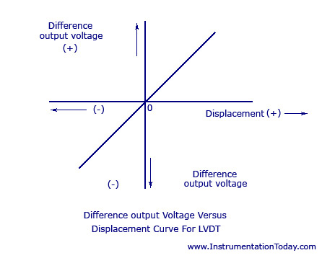
THE MAGNITUDE AND DISPLACEMENT CAN BE EASILY CALCULATED OR PLOTTED BY CALCULATING THE MAGNITUDE AND PHASE OF THE RESULTING VOLTAGE.

Slide 47
ADVANTAGES
1. MAINTAINS A LINEAR RELATIONSHIP BETWEEN THE VOLTAGE DIFFERENCE OUTPUT AND DISPLACEMENT FROM EACH POSITION OF THE CORE FOR A DISPLACEMENT OF ABOUT 4 MILLIMETER.
2. PRODUCES A HIGH RESOLUTION OF MORE THAN 10 MILLIMETER.
3.PRODUCES A HIGH SENSITIVITY OF MORE THAN 40 VOLTS/MILLIMETER.
4. SMALL IN SIZE AND WEIGHS LESS. IT IS RUGGED IN DESIGN AND CAN ALSO BE ASSIGNED EASILY.
5. PRODUCES LOW HYSTERESIS AND THUS HAS EASY REPEATABILITY.

Slide 48
DISADVANTAGES
THE WHOLE CIRCUIT IS TO BE SHIELDED AS THE ACCURACY CAN BE AFFETCED BY EXTERNAL MAGNETIC FIELD.
2. THE DISPLACEMENT MAY PRODUCE VIBRATIONS WHICH MAY AFFECT THE PERFORMANCE OF THE DEVICE.
3. PRODUCES OUTPUT WITH LESS POWER.
4. THE EFFICIENCY OF THE DEVICE IS EASILY AFFECTED BY TEMPERATURE. AN INCREASE IN TEMPERATURE CAUSES A PHASE SHIFT. THIS CAN BE DECREASED TO A CERTAIN EXTENT BY PLACING A CAPACITOR ACROSS EITHER ONE OF THE SECONDARY WINDINGS.
5. A DEMODULATOR WILL BE NEEDED TO OBTAIN A D.C OUTPUT.

Slide 49
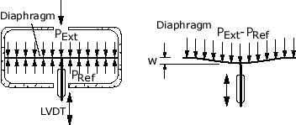
Applications
Although the LVDT is a displacement sensor, many other physical quantities can be sensed by converting displacement to the desired quantity via thoughtful arrangements. Several examples will be given.
1. Displacement
extensometers, temperature transducers, butterfly valve control, servo valve displacement sensing
2. Deflection of Beams, Strings, or Rings
load cells, force transducers, pressure transducers
Diaphragm Pressure Gage

Slide 50
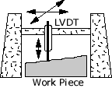
3. Thickness Variation of Work Pieces
dimension gages, thickness and profile measurements, product sorting by size
Profile Gage

Slide 51
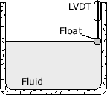
4. Fluid Level
fluid level and fluid flow measurement, position sensing in hydraulic cylinders
Fluid Level Gage

Slide 52
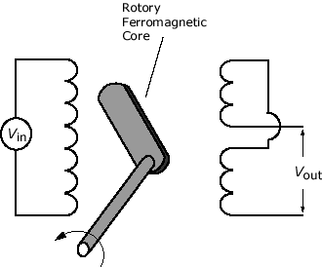
RVDT –
ROTARY VARIABLE DIFFERENTIAL TRANSFORMER
RVDT IS USED WHERE PRECISE ANGULAR MOVEMENT IS TO BE MEASURED.
LVDT IS FOR LINEAR MEASUREMENT WHILE RVDT IS FOR ANGULAR ONE.

Slide 53
CONSTRUCTION AND WORKING OF RVDT: RVDT IS ALMOST IDENTICAL IN THE CONSTRUCTION WITH LVDT.
THE FERRITE CORE IN LVDT IS REPLACED BY HEART OR CARDIODE SHAPED CORE.
THIS CORE IS MOUNTED ON THE SHAFT OR PLUNGER WHICH IS CAPABLE OF ROTATING. THIS ROTATIONAL MOVEMENT OF THE SHAFT CREATES THE IMBALANCE IN THE EXTERNAL CIRCUIT AND THIS IMBALANCE SIGNAL IS USED TO MEASURE THE ANGULAR DISPLACEMENT OF THE SHAFT.
RVDT GIVE LINEAR OUTPUT UP TO DISPLACEMENT OF +-40 DEGREE. THEN OUTPUT STARTS BECOMING NONLINEAR.

Slide 54
APPLICATIONS: * RVDT IN THE SIGNAL CONDITIONING AS RVDT
CONDITIONER.
* RVDT AS THE POSITION SENSOR.
EXAMPLES: * QUARTER TURN VALVE. * MAIL SORTERS. * FRACTIONAL SHAFT MEASUREMENTS. * ACTUATOR POSITION SENSING IN THE
AIRCRAFT. MARINE, CONSTRUCTIONAL AND AGRICULTURAL VEHICLES.

Slide 55
ADVANTAGES OF RVDT: * LOW COST. * SOLID AND ROBUST CONSTRUCTION MAKES IT
TO WORK IN DIFFERENT ENVIRONMENTS. * NO FRICTIONAL RESISTANCE, SO HIGH
ACCURACY OVER LONG TIME DURATION. * NEGLIGIBLE HYSTERESIS. * EXCELLENT REPRODUCIBILITY.
DISADVANTAGES OF RVDT: * CONTACT BETWEEN PLUNGER AND MEASURING
SURFACE IS ALWAYS NOT POSSIBLE. * RVDT PROVIDE LINEAR OUTPUT FOR ABOUT +-40
DEGREE WHICH LIMITS ITS USABILITY.

Slide 56
Thanks !!!!

