Slide 1
EXPT. 4
MEASUREMENT OF PRESSURE BY USING ANY ONE METHOD BOURDON PRESSURE, DIAPHRAGM PRESSURE GAUGE & McLEOD GAUGE
BOURDON PRESSURE
DIAPHRAGM PRESSURE GAUGE
McLEOD GAUGE

Slide 2
PRESSURE MEASUREMENT
LOW PRESSURE MEASUREMENT
HIGH PRESSURE MEASUREMENT
MCLEOD GAUGE
2. THERMAL CONDUCTIVITY GAUGE
I) THERMOCOUPLE VACCUM GAUGE
II) PIRANI GAUGE
3. IONIZATION GAUGE
MANOMETERS
2. ELECTRICAL RESISTANCE PRESSURE GAUGE
I) RESISTANCE TYPE
II) PHOTOELECTRIC TYPE
III) PIEZOELECTRIC TYPE
IV) VARIABLE CAPACITOR TYPE
3.ELASTIC PRESSURE GAUGES
I) BOURDON TUBE
II) DIAPHRAGM GAUGE
III) BELLOWS

Slide 3
MCLEOD VACUUM GAUGE:
BASIC PRINCIPLE OF MCLEOD VACUUM GAUGE:
A KNOWN VOLUME GAS IS COMPRESSED TO A SMALLER VOLUME WHOSE FINAL VALUE PROVIDES AN INDICATION OF THE APPLIED PRESSURE. THE GAS USED MUST OBEY BOYLE’S LAW GIVEN BY; P1V1=P2V2 WHERE, P1 = PRESSURE OF GAS AT INITIAL CONDITION (APPLIED PRESSURE). P2 = PRESSURE OF GAS AT FINAL CONDITION. V1 = VOLUME OF GAS AT INITIAL CONDITION. V2 = VOLUME OF GAS AT FINAL CONDITION. INITIAL CONDITION == BEFORE COMPRESSION. FINAL CONDITION == AFTER COMPRESSION.

Slide 4
A KNOWN VOLUME GAS (WITH LOW PRESSURE) IS COMPRESSED TO A SMALLER VOLUME (WITH HIGH PRESSURE), AND USING THE RESULTING VOLUME AND PRESSURE, THE INITIAL PRESSURE CAN BE CALCULATED.
THIS IS THE PRINCIPLE BEHIND THE MCLEOD GAUGE OPERATION.

Slide 5
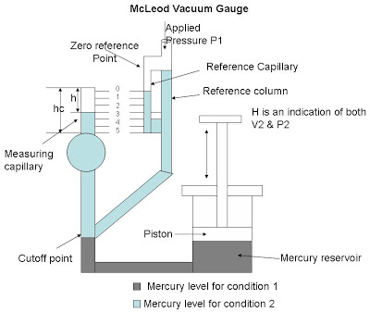
Description of McLeod Vacuum Gauge: The main parts of McLeod gauge are as follows:

Slide 6
A REFERENCE COLUMN WITH REFERENCE CAPILLARY TUBE.
THE REFERENCE CAPILLARY TUBE HAS A POINT CALLED ZERO REFERENCE POINT.
THIS REFERENCE COLUMN IS CONNECTED TO A BULB AND MEASURING CAPILLARY AND THE PLACE OF CONNECTION OF THE BULB WITH REFERENCE COLUMN IS CALLED AS CUT OFF POINT. (IT IS CALLED THE CUT OFF POINT, SINCE IF THE MERCURY LEVEL IS RAISED ABOVE THIS POINT, IT WILL CUT OFF THE ENTRY OF THE APPLIED PRESSURE TO THE BULB AND MEASURING CAPILLARY.
BELOW THE REFERENCE COLUMN AND THE BULB, THERE IS A MERCURY RESERVOIR OPERATED BY A PISTON.

Slide 7
OPERATION OF MCLEOD VACUUM GAUGE:
THE PRESSURE TO BE MEASURED (P1) IS APPLIED TO THE TOP OF THE REFERENCE COLUMN OF THE MCLEOD GAUGE AS SHOWN IN DIAGRAM.
THE MERCURY LEVEL IN THE GAUGE IS RAISED BY OPERATING THE PISTON TO FILL THE VOLUME AS SHOWN BY THE DARK SHADE IN THE DIAGRAM.
WHEN THIS IS THE CASE (CONDITION – 1), THE APPLIED PRESSURE FILLS THE BULB AND THE CAPILLARY. NOW AGAIN THE PISTON IS OPERATED SO THAT THE MERCURY LEVEL IN THE GAUGE INCREASES.

Slide 8
WHEN THE MERCURY LEVEL REACHES THE CUTOFF POINT, A KNOWN VOLUME OF GAS (V1) IS TRAPPED IN THE BULB AND MEASURING CAPILLARY TUBE.
THE MERCURY LEVEL IS FURTHER RAISED BY OPERATING THE PISTON SO THE TRAPPED GAS IN THE BULB AND MEASURING CAPILLARY TUBE ARE COMPRESSED.
THIS IS DONE UNTIL THE MERCURY LEVEL REACHES THE “ZERO REFERENCE POINT” MARKED ON THE REFERENCE CAPILLARY (CONDITION – 2). IN THIS CONDITION, THE VOLUME OF THE GAS IN THE MEASURING CAPILLARY TUBE IS READ DIRECTLY BY A SCALE BESIDES IT.
THAT IS, THE DIFFERENCE IN HEIGHT ‘H’ OF THE MEASURING CAPILLARY AND THE REFERENCE CAPILLARY BECOMES A MEASURE OF THE VOLUME (V2) AND PRESSURE (P2) OF THE TRAPPED GAS.

Slide 9
Now as V1,V2 and P2 are known, the applied pressure P1 can be calculated using Boyle’s Law given by; P1V1 = P2V2 Let the volume of the bulb from the cutoff point up to the beginning of the measuring capillary tube = V Let area of cross – section of the measuring capillary tube = a Let height of measuring capillary tube = hc. Therefore, Initial Volume of gas entrapped in the bulb plus measuring capillary tube =
V1 = V+a*hc. When the mercury has been forced upwards to reach the zero reference point in the reference capillary, the final volume of the gas = V2= ah. Where, h = height of the compressed gas in the measuring capillary tube P1 = Applied pressure of the gas unknown. P2 = Pressure of gas at final condition, that is, after compression = P1+h

Slide 10
We have, P1V1 = P2V2 (Boyle’s Law) Therefore, P1V1= (P1+h)ah P1V1 = P1ah + ah^2 P1V1-P1ah = ah^2 P1 = ah^2/(V1-ah) Since ah is very small when compared to V1, it can be neglected. Therefore, P1 = ah^2/V1 Thus the applied pressure is calculated using the McLeod Gauge.

Slide 11
APPLICATIONS
THE MCLEOD GAUGE IS USED TO MEASURE VACUUM PRESSURE. ADVANTAGES OF THE MCLEOD GAUGE:
IT IS INDEPENDENT OF THE GAS COMPOSITION.
IT SERVES AS A REFERENCE STANDARD TO CALIBRATE OTHER LOW PRESSURE GAUGES.
A LINEAR RELATIONSHIP EXISTS BETWEEN THE APPLIED PRESSURE AND H
THERE IS NO NEED TO APPLY CORRECTIONS TO THE MCLEOD GAUGE READINGS.
LIMITATIONS OF MCLEOD GAUGE:
THE GAS WHOSE PRESSURE IS TO BE MEASURED SHOULD OBEY THE BOYLE’S LAW
MOISTURE TRAPS MUST BE PROVIDED TO AVOID ANY CONSIDERABLE VAPOR INTO THE GAUGE.
IT MEASURE ONLY ON A SAMPLING BASIS.
IT CANNOT GIVE A CONTINUOUS OUTPUT.

Slide 12
DIAPHRAGM PRESSURE GAUGE
A DIAPHRAGM PRESSURE TRANSDUCER IS USED FOR LOW PRESSURE MEASUREMENT.
THEY ARE COMMERCIALLY AVAILABLE IN TWO TYPES –
METALLIC AND NON-METALLIC.
METALLIC DIAPHRAGMS ARE KNOWN TO HAVE GOOD SPRING CHARACTERISTICS AND
NON-METALLIC TYPES HAVE NO ELASTIC CHARACTERISTICS. THUS, NON-METALLIC TYPES ARE USED RARELY, AND ARE USUALLY OPPOSED BY A CALIBRATED COIL SPRING OR ANY OTHER ELASTIC TYPE GAUGE. THE NON-METALLIC TYPES ARE ALSO CALLED SLACK DIAPHRAGM.

Slide 13
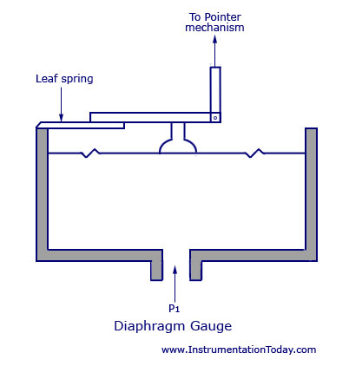
DIAPHRAGM GAUGE

Slide 14
WORKING
WHEN A FORCE ACTS AGAINST A THIN STRETCHED DIAPHRAGM, IT CAUSES A DEFLECTION OF THE DIAPHRAGM WITH ITS CENTRE DEFLECTING THE MOST.
SINCE THE ELASTIC LIMIT HAS TO BE MAINTAINED, THE DEFLECTION OF THE DIAPHRAGM MUST BE KEPT IN A RESTRICTED MANNER.
THIS CAN BE DONE BY CASCADING MANY DIAPHRAGM CAPSULES AS SHOWN IN THE FIGURE NEXT PAGE.

Slide 15
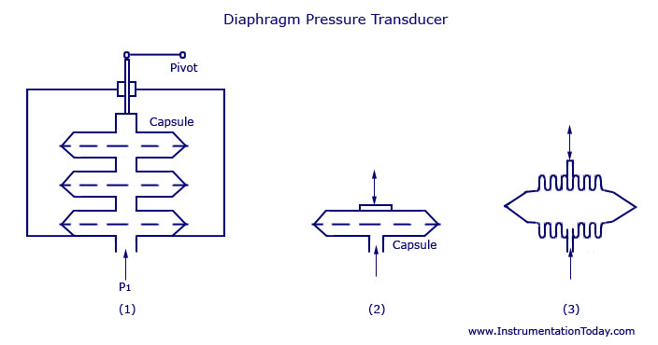
DIAPHRAGM PRESSURE TRANSDUCER
CORRUGATED DIAGPHRAGM CAPSULE
CASCEDING OF CAPSULE
PRSSURE CAPSULE

Slide 16
A MAIN CAPSULE IS DESIGNED BY JOINING TWO DIAPHRAGMS AT THE PERIPHERY.
A PRESSURE INLET LINE IS PROVIDED AT THE CENTRAL POSITION.
WHEN THE PRESSURE ENTERS THE CAPSULE, THE DEFLECTION WILL BE THE SUM OF DEFLECTIONS OF ALL THE INDIVIDUAL CAPSULES.
CORRUGATED DESIGNS HELP IN PROVIDING A LINEAR DEFLECTION AND ALSO INCREASE THE MEMBER STRENGTH.
THE TOTAL AMOUNT OF DEFLECTION FOR A GIVEN PRESSURE DIFFERENTIAL IS KNOWN BY THE FOLLOWING FACTORS:
NUMBER AND DEPTH OF CORRUGATION
NUMBER OF CAPSULES
CAPSULE DIAMETER
SHELL THICKNESS
MATERIAL CHARACTERISTICS
MATERIALS USED FOR THE METAL DIAPHRAGMS ARE THE SAME AS THOSE USED FOR BOURDON TUBE.

Slide 17
NON-METALLIC OR SLACK DIAPHRAGMS ARE USED FOR MEASURING VERY SMALL PRESSURES.
THE COMMONLY USED MATERIALS FOR MAKING THE DIAPHRAGM ARE POLYTHENE, NEOPRENE, ANIMAL MEMBRANE, SILK, AND SYNTHETIC MATERIALS.
DUE TO THEIR NON-ELASTIC CHARACTERISTICS, THE DEVICE WILL HAVE TO BE OPPOSED WITH EXTERNAL SPRINGS FOR CALIBRATION AND PRECISE OPERATION.
THE COMMON RANGE FOR PRESSURE MEASUREMENT VARIES BETWEEN 50 PA TO 0.1 MPA.

Slide 18
THE BEST EXAMPLE FOR A SLACK DIAPHRAGM IS THE DRAFT GAUGE. THEY ARE USED IN BOILERS FOR INDICATION OF THE BOILER DRAFT.
THE DEVICE CAN CONTROL BOTH COMBUSTION AND FLUE. WITH THE DRAFT, USUALLY OF PRESSURE LESS THAN THE ATMOSPHERE, CONNECTED, THE POWER DIAPHRAGM MOVES TO THE LEFT AND ITS MOTION IS TRANSMITTED THROUGH THE SEALING DIAPHRAGM, SEALED LINK AND POINTER DRIVE TO THE POINTER.
THE POWER DIAPHRAGM IS BALANCED WITH THE HELP OF A CALIBRATED LEAF SPRING.
THE EFFECTIVE LENGTH OF THE SPRING AND HENCE THE RANGE IS DETERMINED BY THE RANGE ADJUSTING SCREW. BY ADJUSTING THE ZERO ADJUSTMENT SCREW, THE RIGHT HAND END OF THE POWER DIAPHRAGM SUPPORT LINK AS ALSO THE FREE END OF THE LEAF SPRING, IS ADJUSTED FOR ZERO ADJUSTMENT THROUGH THE CRADLE.

Slide 19
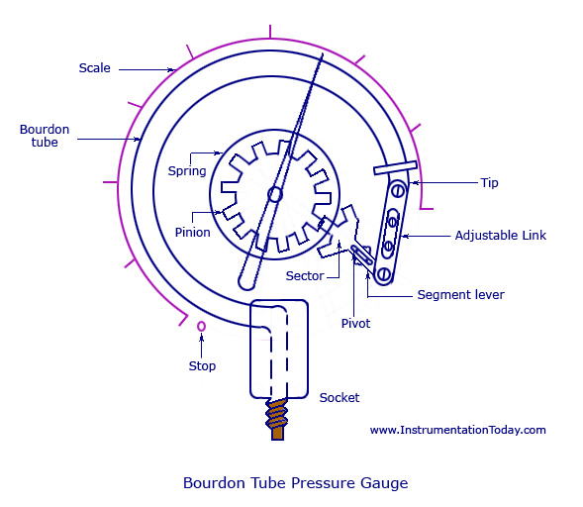
BOURDON TUBE PRESSURE GAUGE

Slide 20
THE COMMONLY USED MATERIALS ARE
PHOSPHOR-BRONZE, SILICON-BRONZE,
BERYLLIUM-COPPER, INCONEL, AND OTHER C-CR-NI-MO ALLOYS ETC.

Slide 22
WORKING
AS THE FLUID PRESSURE ENTERS THE BOURDON TUBE, IT TRIES TO BE REFORMED AND BECAUSE OF A FREE TIP AVAILABLE, THIS ACTION CAUSES THE TIP TO TRAVEL IN FREE SPACE AND THE TUBE UNWINDS.
THE SIMULTANEOUS ACTIONS OF BENDING AND TENSION DUE TO THE INTERNAL PRESSURE MAKE A NON-LINEAR MOVEMENT OF THE FREE TIP. THIS TRAVEL IS SUITABLE GUIDED AND AMPLIFIED FOR THE MEASUREMENT OF THE INTERNAL PRESSURE.
BUT THE MAIN REQUIREMENT OF THE DEVICE IS THAT WHENEVER THE SAME PRESSURE IS APPLIED, THE MOVEMENT OF THE TIP SHOULD BE THE SAME AND ON WITHDRAWAL OF THE PRESSURE THE TIP SHOULD RETURN TO THE INITIAL POINT.

Slide 23
A LOT OF COMPOUND STRESSES ORIGINATE IN THE TUBE AS SOON AS THE PRESSURE IS APPLIED. THIS MAKES THE TRAVEL OF THE TIP TO BE NON-LINEAR IN NATURE.
IF THE TIP TRAVEL IS CONSIDERABLY SMALL, THE STRESSES CAN BE CONSIDERED TO PRODUCE A LINEAR MOTION THAT IS PARALLEL TO THE AXIS OF THE LINK. THE SMALL LINEAR TIP MOVEMENT IS MATCHED WITH A ROTATIONAL POINTER MOVEMENT. THIS IS KNOWN AS MULTIPLICATION, WHICH CAN BE ADJUSTED BY ADJUSTING THE LENGTH OF THE LEVER. FOR THE SAME AMOUNT OF TIP TRAVEL, A SHORTER LEVER GIVES LARGER ROTATION.
THE APPROXIMATELY LINEAR MOTION OF THE TIP WHEN CONVERTED TO A CIRCULAR MOTION WITH THE LINK-LEVER AND PINION ATTACHMENT, A ONE-TO-ONE CORRESPONDENCE BETWEEN THEM MAY NOT OCCUR AND DISTORTION RESULTS. THIS IS KNOWN AS ANGULARITY WHICH CAN BE MINIMIZED BY ADJUSTING THE LENGTH OF THE LINK.

Slide 24
OTHER THAN C-TYPE, BOURDON GAUGES CAN ALSO BE CONSTRUCTED IN THE FORM OF A HELIX OR A SPIRAL.
THE TYPES ARE VARIED FOR SPECIFIC USES AND SPACE ACCOMMODATIONS, FOR BETTER LINEARITY AND LARGER SENSITIVITY. FOR THOROUGH REPEATABILITY, THE BOURDON TUBES MATERIALS MUST HAVE GOOD ELASTIC OR SPRING CHARACTERISTICS.
THE SURROUNDING IN WHICH THE PROCESS IS CARRIED OUT IS ALSO IMPORTANT AS CORROSIVE ATMOSPHERE OR FLUID WOULD REQUIRE A MATERIAL WHICH IS CORROSION PROOF.
THE COMMONLY USED MATERIALS ARE PHOSPHOR-BRONZE, SILICON-BRONZE, BERYLLIUM-COPPER, INCONEL, AND OTHER C-CR-NI-MO ALLOYS, AND SO ON.

Slide 25
IN THE CASE OF FORMING PROCESSES, EMPIRICAL RELATIONS ARE KNOWN TO CHOOSE THE TUBE SIZE, SHAPE AND THICKNESS AND THE RADIUS OF THE C-TUBE. BECAUSE OF THE INTERNAL PRESSURE, THE NEAR ELLIPTIC OR RATHER THE FLATTENED SECTION OF THE TUBE TRIES TO EXPAND AS SHOWN BY THE DOTTED LINE IN THE FIGURE BELOW (A).
THE SAME EXPANSION LENGTHWISE IS SHOWN IN FIGURE (B).
THE ARRANGEMENT OF THE TUBE, HOWEVER FORCES AN EXPANSION ON THE OUTER SURFACE AND A COMPRESSION ON THE INNER SURFACE, THUS ALLOWING THE TUBE TO UNWIND. THIS IS SHOWN IN FIGURE (C).

Slide 26
LIKE ALL ELASTIC ELEMENTS A BOURDON TUBE ALSO HAS SOME HYSTERESIS IN A GIVEN PRESSURE CYCLE. BY PROPER CHOICE OF MATERIAL AND ITS HEAT TREATMENT, THIS MAY BE KEPT TO WITHIN 0.1 AND 0.5 PERCENT OF THE MAXIMUM PRESSURE CYCLE. SENSITIVITY OF THE TIP MOVEMENT OF A BOURDON ELEMENT WITHOUT RESTRAINT CAN BE AS HIGH AS 0.01 PERCENT OF FULL RANGE PRESSURE REDUCING TO 0.1 PERCENT WITH RESTRAINT AT THE CENTRAL PIVOT.

Slide 27
THANKS !!!

