Slide 1
Flow Measurement
Syllabus:
6.1 Definition of Flow, Different types of
Flows, Classification of Fluid Flow.
6.2 Measurement Techniques Inferential &
Positive Flow Meters,
Cup & Vane Anemometers,
Turbine Meter,
Hot Wire Anemometer,
Ultrasonic Flow Meter,

Slide 2
Classification of fluid flow:
Steady and unsteady flow
uniform and non uniform flow
laminar and turbulent flow
rotational and irrotational flow
compressible and incompressible flow

Slide 3
1. Steady and unsteady flow:
Steady flow The flow is said to be steady when flow characteristics such as velocity, pressure, density , temp. do not change with time.
unsteady flow : characteristics such as velocity, pressure, density , temp. changes with time.
2. uniform and nonuniform flow:
Uniform flow : velocity and other characteristics are constant over a distance of pipe section.
i.e. rate of change of these characteristics w.r.t. distance is zero.

Slide 4
nonuniform flow: characteristics changes with respect to distance.
3. laminar and turbulent flow
Laminar flow : in the stream the path of individual particle does not cross each other. Particles moves in laminar way.
turbulent flow : in the stream the path of individual particle cross each other. Particles moves in laminar way.

Slide 5
4. rotational and irrotational flow:
rotational flow : Fluid particles rotate about their own mass center while flowing.
irrotational flow:
Fluid particles does not rotate about their own mass center while flowing. They retain their original orientation while flowing.

Slide 6
5. compressible and incompressible flow
Compressible flow: volume and density of the fluid changes during flow. Gas can be compressed.
incompressible flow: volume and density of the fluid does not changes during flow.

Slide 7
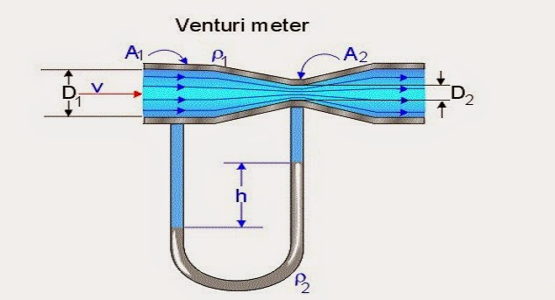
EXPT. NO.5
Measurement of flow by rotameter or venturimeter.
D1=30 cm
D2=15 cm
Observed reading h= 18 cm
1. Find the rate of flow through given venturimeter as shown in fig. above. (Assume Cd = 0.85 for venturimeter.)
Given:
D1=0.3 m
D2 = 0.15 m
Cd =0.85
H of mercury column = 0.18 m

Slide 8
H =Hm Sm - 1
In m of water Sw
= 0.18 ( 13.6 – 1 )/1 = 2.268 m
As Hm observed is = 0.18 m
Sm= 13.6 sp.gr of mercury
Sw= 1 sp.gr. Of water
1
h = 2.268 m
And a1= 3.14*(0.3)² = 0.07065 sq.m
And a2 = 0.0176 sq.m
Bys ubstituting above Q act = 0.10343 m³
or = 103.43 lit/sec.

Slide 9
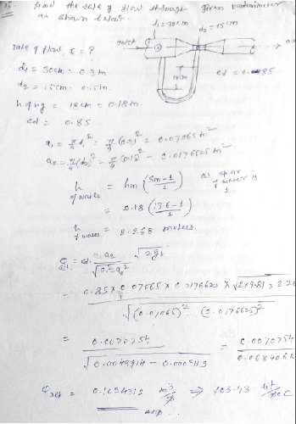

Slide 10
VARIES METHODS ARE USED FOR FLOW MEASUREMENT ARE…
INFERENTIAL TYPE FLOW METER:
IN THIS METHOD THE FLOW IS NOT DIRECTLY MEASURED, BUT IT IS INFERRED FROM MEASUREMENTS OF OTHER PARAMETERS RELATED TO FLOW.
PARAMETERS SUCH AS PRESSURE, TEMP. FORCE, DISPLACEMENT, VELOCITY ETC.
INFERENTIAL METHODS ARE AS FOLLOWS:
VARIABLE HEAD OR DIFFERENTIAL METHOD.
E.G. ORIFICE PLATE, VENTURIMETER, PITOT TUBE, FLOW NOZZLE ETC.
B) ROTAMETER OR VARIABLE AREA METER.
C) MAGNETIC METER
D) TURBINE METER.

Slide 11
2. POSITIVE DISPLACEMENT METHOD.
THESE ARE VOLUME TYPE METERS, WHICH CAPTURE AND RELEASE A FIXED VOLUME OF LIQUID IN A STROKE.
THESE METERS COUNTS NO. OF STROKES OR CYCLES OF OPERATION AND GIVES THE VOLUME HANDLED.
POSITIVE DISPLACEMENT DIVICES ARE…
RECIPROCATING PISTON
SEMI ROTARY PISTON
NUTATING DISC.

Slide 12
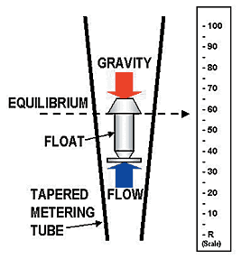
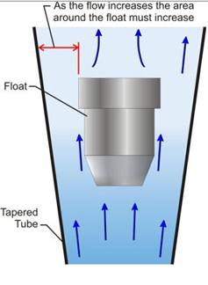
ROTAMETER
MEASURES FLOWRATE IN M³/SEC OR IN LIT/SEC.

Slide 13
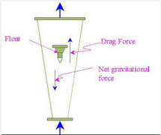
A ROTAMETER IS A DEVICE THAT MEASURES THE FLOW RATE OF LIQUID OR GAS IN A CLOSED TUBE.
IT BELONGS TO A CLASS OF METERS CALLED VARIABLE AREA METERS, WHICH MEASURE FLOW RATE BY ALLOWING THE CROSS-SECTIONAL AREA THE FLUID TRAVELS THROUGH, TO VARY, CAUSING A MEASURABLE EFFECT.

Slide 14
Advantages:
A rotameter requires no external power or fuel, it uses only the inherent properties of the fluid, along with gravity, to measure flow rate.
A rotameter is also a relatively simple device that can be mass manufactured out of cheap materials, allowing for its widespread use.
Since the area of the flow passage increases as the float moves up the tube, the scale is approximately linear.
Clear glass is used which is highly resistant to thermal shock and chemical action.

Slide 15
Disadvantages:
* Due to its use of gravity, a rotameter must always be vertically oriented and right way up, with the fluid flowing upward.
Due to its reliance on the ability of the fluid or gas to displace the float, graduations on a given rotameter will only be accurate for a given substance at a given temperature.
The main property of importance is the density of the fluid; however, viscosity may also be significant. Floats are ideally designed to be insensitive to viscosity; however, this is seldom verifiable from manufacturers' specifications.
Either separate rotameters for different densities and viscosities may be used, or multiple scales on the same rotameter can be used.

Slide 16
* Due to the direct flow indication the resolution is relatively poor compared to other measurement principles. Readoutuncertainty gets worse near the bottom of the scale. Oscillations of the float and parallax may further increase the uncertainty of the measurement.
Since the float must be read through the flowing medium, some fluids may obscure the reading. A transducer may be required for electronically measuring the position of the float.
Rotameters are not easily adapted for reading by machine; although magnetic floats that drive a follower outside the tube are available.
Rotameters are not generally manufactured in sizes greater than 6 inches/150 mm, but bypass designs are sometimes used on very large pipes.

Slide 17
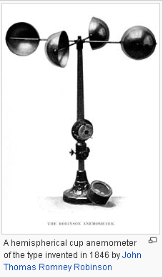
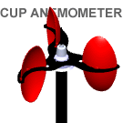
CUP AND VANE ANEMOMETERS:
Cup anemometer
USED TO MEASURE THE WIND SPEED.

Slide 18
A SIMPLE TYPE OF ANEMOMETER WAS INVENTED IN 1845 BY DR. JOHN THOMAS ROMNEY ROBINSON, OFARMAGH OBSERVATORY.
IT CONSISTED OF FOUR HEMISPHERICAL CUPS, EACH MOUNTED ON ONE END OF FOUR HORIZONTAL ARMS, WHICH IN TURN WERE MOUNTED AT EQUAL ANGLES TO EACH OTHER ON A VERTICAL SHAFT.
THE AIR FLOW PAST THE CUPS IN ANY HORIZONTAL DIRECTION TURNED THE SHAFT IN A MANNER THAT WAS PROPORTIONAL TO THE WIND SPEED.

Slide 19
THEREFORE, COUNTING THE TURNS OF THE SHAFT OVER A SET TIME PERIOD PRODUCED THE AVERAGE WIND SPEED FOR A WIDE RANGE OF SPEEDS.
ON AN ANEMOMETER WITH FOUR CUPS, IT IS EASY TO SEE THAT SINCE THE CUPS ARE ARRANGED SYMMETRICALLY ON THE END OF THE ARMS, THE WIND ALWAYS HAS THE HOLLOW OF ONE CUP PRESENTED TO IT AND IS BLOWING ON THE BACK OF THE CUP ON THE OPPOSITE END OF THE CROSS.

Slide 20
THE THREE CUP ANEMOMETER DEVELOPED BY THE CANADIAN JOHN PATTERSON IN 1926 AND SUBSEQUENT CUP IMPROVEMENTS BY BREVOORT & JOINER OF THE USA IN 1935.
A CUPWHEEL DESIGN WHICH WAS LINEAR AND HAD AN ERROR OF LESS THAN 3% UP TO 60 MPH (97 KM/H). PATTERSON FOUND THAT EACH CUP PRODUCED MAXIMUM TORQUE WHEN IT WAS AT 45 DEGREES TO THE WIND FLOW. THE THREE CUP ANEMOMETER ALSO HAD A MORE CONSTANT TORQUE AND RESPONDED MORE QUICKLY TO GUSTS THAN THE FOUR CUP ANEMOMETER.

Slide 21
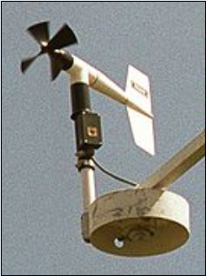
Vane anemometer :
ONE OF THE OTHER FORMS OF MECHANICAL VELOCITY ANEMOMETER IS THE VANE ANEMOMETER.
IT MAY BE DESCRIBED AS A WINDMILL OR A PROPELLER ANEMOMETER. CONTRARY TO THE ROBINSON ANEMOMETER, WHERE THE AXIS OF ROTATION IS VERTICAL, THE AXIS ON THE VANE ANEMOMETER MUST BE PARALLEL TO THE DIRECTION OF THE WIND AND THEREFORE HORIZONTAL.
Vane anemometer

Slide 22
FURTHERMORE, SINCE THE WIND VARIES IN DIRECTION AND THE AXIS HAS TO FOLLOW ITS CHANGES, A WIND VANE OR SOME OTHER CONTRIVANCE TO FULFILL THE SAME PURPOSE MUST BE EMPLOYED.
AN VANE ANEMOMETER THUS COMBINES A PROPELLER AND A TAIL ON THE SAME AXIS TO OBTAIN ACCURATE AND PRECISE WIND SPEED AND DIRECTION MEASUREMENTS FROM THE SAME INSTRUMENT.
THE SPEED OF THE FAN IS MEASURED BY A REV COUNTER AND CONVERTED TO A WINDSPEED BY AN ELECTRONIC CHIP. HENCE, VOLUMETRIC FLOWRATE MAY BE CALCULATED IF THE CROSS-SECTIONAL AREA IS KNOWN.

Slide 23
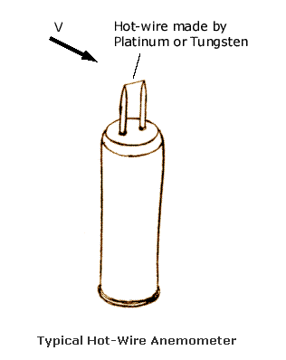
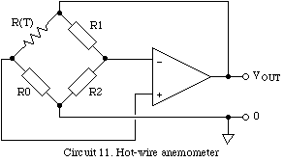
Hot wire anemometer
Hot wire anemometer
RESISTANCE OF PLATINUM OR TUNGSTEN WIRE VHANGES AS PER CHANGE IN TEMP. OF WIRE. IT FORMS ONE OF THE ARM OF WHEATSTONE’S BRIDGE.

Slide 24
THE HOT-WIRE ANEMOMETER MEASURES A FLUID VELOCITY BY NOTING THE HEAT CONVECTED AWAY BY THE FLUID.
THE CORE OF THE ANEMOMETER IS AN EXPOSED HOT WIRE EITHER HEATED UP BY A CONSTANT CURRENT OR MAINTAINED AT A CONSTANT TEMPERATURE IN EITHER CASE, THE HEAT LOST TO FLUID CONVECTION IS A FUNCTION OF THE FLUID VELOCITY.

Slide 25
BY MEASURING THE CHANGE IN WIRE TEMPERATURE UNDER CONSTANT CURRENT OR THE CURRENT REQUIRED TO MAINTAIN A CONSTANT WIRE TEMPERATURE, THE HEAT LOST CAN BE OBTAINED. THE HEAT LOST CAN THEN BE CONVERTED INTO A FLUID VELOCITY IN ACCORDANCE WITH CONVECTIVE THEORY.

Slide 26
METHODS OF MEASURING FLUID FLOW:
CONSTANT CURRENT TYPE
CONSTANT TEMP. TYPE.
CONSTANT CURRENT TYPE:
IN CONSTANT CURRENT TYPE, THE HEATING CURRENT I.E. VOLTAGE ACROSS THE BRIDGE MAINTAINED CONSTANT.
INITIALLY CIRCUIT IS ADJUSTED SUCH THAT THE GALVANOMETER READS ZERO WHEN PROBE WIRE LIES ON STATIONARY AIR.
WHEN AIR FLOWS, THE HOT WIRE COOLS AND CHANGES ITS RESISTANCE. HENCE DEFLECTS GALVANOMETER. WHICH IS ALREADY CALIBRATED TO GET FLOW VELOCITY.

Slide 27
CONSTANT TEMP. TYPE.
IN THIS OPERATING RESISTANCE OF WIRE HENCE THE TEMP. OF THE WIRE IS MAINTAINED CONSTANT.
THE HOT WIRE WILL BE COOLED WHEN IT COMES IN CONTACT WITH MOVING AIR, THE EXTERNAL VOLTAGE IS APPLIED TO KEEP TEMP. CONSTANT.
THE BRIDGE VOLTAGE IS VARIED TO BRING THE GALVANOMETER READING TO ZERO; THE READING OF VOLT METER IS RECORDED AND CORELATED WITH FLUID VELOCITY.

Slide 28
ADVANTAGES:
FOR MEASURMENT OF STEADY VELOCITIES THE CONSTANT TEMP. TYPE IS OFTEN USED.
MAIN APPLICATION IS FOR MEASUREMENT OF RAPIDLY FLUCTUATIONG VELOCITY.
MAJORITY OF APPLICATION IS IN GAS FLOW METERS.
DISADVANTAGES:
FINE WIRE HAS LIMITED PHYSICAL STRENGTH.
DUE TO DIRT ACCUMULATION CALIBRATION OF INSRUMENT CHANGES.

Slide 29
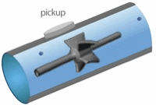
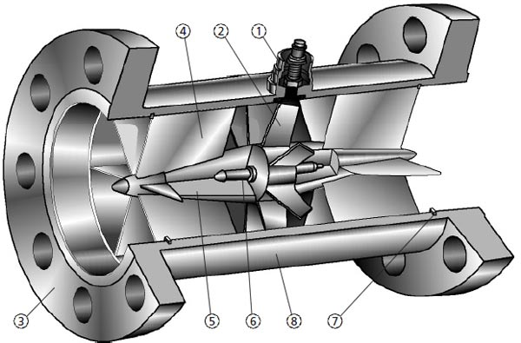
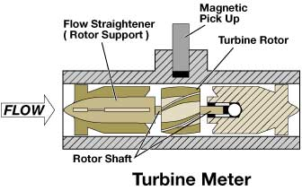
TURBINE METER
TURBINE METER

Slide 30
HOW TURBINE FLOWMETERS WORK
TURBINE FLOWMETERS USE THE MECHANICAL ENERGY OF THE FLUID TO ROTATE A “PINWHEEL” (ROTOR) IN THE FLOW STREAM.
BLADES ON THE ROTOR ARE ANGLED TO TRANSFORM ENERGY FROM THE FLOW STREAM INTO ROTATIONAL ENERGY. THE ROTOR SHAFT SPINS ON BEARINGS. WHEN THE FLUID MOVES FASTER, THE ROTOR SPINS PROPORTIONALLY FASTER. TURBINE FLOWMETERS NOW CONSTITUTE 7% OF THE WORLD MARKET.

Slide 31
SHAFT ROTATION CAN BE SENSED MECHANICALLY OR BY DETECTING THE MOVEMENT OF THE BLADES. BLADE MOVEMENT IS OFTEN DETECTED MAGNETICALLY, WITH EACH BLADE OR EMBEDDED PIECE OF METAL GENERATING A PULSE.
TURBINE FLOWMETER SENSORS ARE TYPICALLY LOCATED EXTERNAL TO THE FLOWING STREAM TO AVOID MATERIAL OF CONSTRUCTION CONSTRAINTS THAT WOULD RESULT IF WETTED SENSORS WERE USED. WHEN THE FLUID MOVES FASTER, MORE PULSES ARE GENERATED.

Slide 32
THE TRANSMITTER PROCESSES THE PULSE SIGNAL TO DETERMINE THE FLOW OF THE FLUID. TRANSMITTERS AND SENSING SYSTEMS ARE AVAILABLE TO SENSE FLOW IN BOTH THE FORWARD AND REVERSE FLOW DIRECTIONS.

Slide 33
THIS FLOWMETER CAN BE APPLIED TO SANITARY, RELATIVELY CLEAN, AND CORROSIVE LIQUIDS IN SIZES UP TO APPROXIMATELY 24 INCHES.
SMALLER TURBINE FLOWMETERS CAN BE INSTALLED DIRECTLY IN THE PIPING, BUT THE SIZE AND WEIGHT OF LARGER TURBINE FLOWMETERS MAY REQUIRE THE INSTALLATION OF SUBSTANTIAL CONCRETE FOUNDATIONS AND SUPPORTS.
THE FLOW OF CORROSIVE LIQUIDS CAN BE MEASURED WITH PROPER ATTENTION TO THE MATERIALS OF CONSTRUCTION OF ALL WETTED PARTS, SUCH AS THE BODY, ROTOR, BEARINGS, AND FITTINGS.
APPLICATIONS FOR TURBINE FLOWMETERS ARE FOUND IN THE WATER, PETROLEUM, AND CHEMICAL INDUSTRIES.

Slide 34
ADVANTAGES:
VERY GOOD ACCURACY + OR - 1 % OVER DESIGN RANGE.
IT HAS LOW PRESSURE DROP.
ANALOGUES AND DIGITAL READING CAN BE OBTAINED.
IT GIVES FAST RESPONSE.
MEDIUM INITIAL SETUP COST.
DISADVANTAGES:
BEARING MAINTENANCE IS THE PROBLEM
ACCURACY DROPS AT LOW FLOW RATE.
IT IS USED FOR CLEAN FLUID ONLY.
IT REQUIRES INLINE MOUNTING.

Slide 35
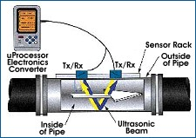
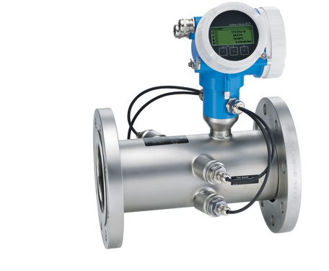
Ultrasonic flow meter
Ultrasonic flow meter
Ultrasonic flow meter fitted in pipe line

Slide 36
HOW ULTRASONIC FLOWMETERS WORK
ULTRASONIC FLOWMETERS USE SOUND WAVES TO DETERMINE THE VELOCITY OF A FLUID FLOWING IN A PIPE. AT NO FLOW CONDITIONS, THE FREQUENCIES OF AN ULTRASONIC WAVE TRANSMITTED INTO A PIPE AND ITS REFLECTIONS FROM THE FLUID ARE THE SAME.
UNDER FLOWING CONDITIONS, THE FREQUENCY OF THE REFLECTED WAVE IS DIFFERENT DUE TO THE DOPPLER EFFECT. WHEN THE FLUID MOVES FASTER, THE FREQUENCY SHIFT INCREASES LINEARLY. THE TRANSMITTER PROCESSES SIGNALS FROM THE TRANSMITTED WAVE AND ITS REFLECTIONS TO DETERMINE THE FLOW RATE.

Slide 37
TRANSIT TIME ULTRASONIC FLOWMETERS SEND AND RECEIVE ULTRASONIC WAVES BETWEEN TRANSDUCERS IN BOTH THE UPSTREAM AND DOWNSTREAM DIRECTIONS IN THE PIPE. AT NO FLOW CONDITIONS, IT TAKES THE SAME TIME TO TRAVEL UPSTREAM AND DOWNSTREAM BETWEEN THE TRANSDUCERS.

Slide 38
UNDER FLOWING CONDITIONS, THE UPSTREAM WAVE WILL TRAVEL SLOWER AND TAKE MORE TIME THAN THE (FASTER) DOWNSTREAM WAVE. WHEN THE FLUID MOVES FASTER, THE DIFFERENCE BETWEEN THE UPSTREAM AND DOWNSTREAM TIMES INCREASES. THE TRANSMITTER PROCESSES UPSTREAM AND DOWNSTREAM TIMES TO DETERMINE THE FLOW RATE.

Slide 39
ADVANTAGES:
IT OFFERS NEGLIGIBLE OBSTRUCTION TO THE FLOW.
IT HAS +- 2% ACCURACY OF FULL SCALE VALUE.
IT HAS LINEAR RELATIONSHIP WITH VELOCITY AND OUTPUT.
THE OUTPUT IS INSENSITIVE TO VATRIATION IN VISCOCITY, DENSITY AND TEMP.
IT CAN BE USED IN BIDIREDTIONAL FLOW.
NO MOVING PARTS, LOW MAINTENANCE COST.
7. IT CAN BE USED FOR CORROSIVE OR SLURRY FLOW MEASUREMENT.
DISADVANTRAGES:
IT IS COSTLY, HENCE LIMITED APPLICATION ONLY./
SKILLED OPERATOR REQUIRED.

Slide 40
THANKS !!!

