Slide 1
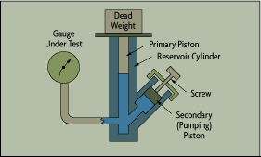
EXPT. 3
CALIBRATION OF PRESSURE GAUGE USING DEAD WEIGHT TESTER
DEAD WEIGHT PRESSURE GAUGE TESTER

Slide 2
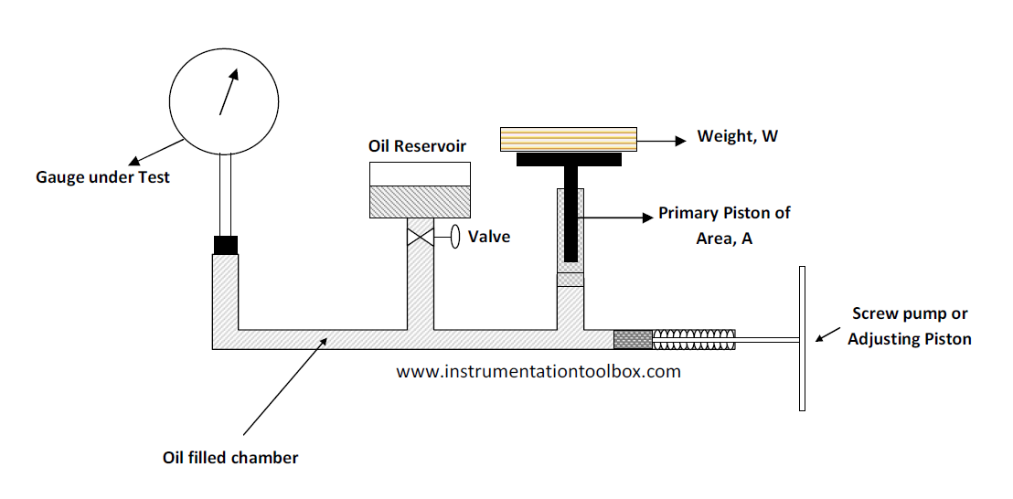
IT WORKS ON THE PRICIPLE OF PASCALS LAW
PASCALS LAW:
IT STATES THAT IN ANY SYSTEM UNDER EQUILIBRUM CONDITION (OR STATIC CONDITION) THE FORCE EXERTED BY LIQUID IS SAME IN ALL DIRECTION.

Slide 3
PROCEDURE OF CALIBRATION:
CONECT THER PRESSURE GAGE TO TESTER, ENSURE ZERO READING.
REFERENCE STANDARD WEIGHT IS KEPT ON THE PLUNGER.
WHICH EXERTS FORCE PER UNIT AREA. I.E. IN KG/SQ.CM
3. TURN THE HANDLE SO THAT THE KNOWN WEIGHT FLOATS FREELY.
4. ALLOW SOME TIME TO STABILIZE THE SYSTEM. SO THAT IT WILL BE IN EQUILIBRIUM STATE.
5. AFTER EQUILIBRIUM STATE MARK THE SCALE .
OR READINGS OF PRESSURE GAGE AND KNOWN WEIGHTS CAN BE NOTED.
NOTE THE ERROR IF ANY.

Slide 4
THANKS !!!!

