Slide 1
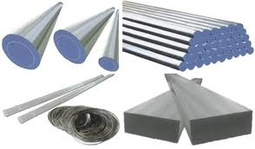
TOOL STEELS
SYLLABUS: COLD WORK TOOLS STEEL, HOT WORK TOOL STEEL, HIGH SPEED STEEL –HSS
HIGH CARBON HIGH CROMIUM STEEL – HCHC
OIL HARDENING NON SHRINKING DIE STEEL- OHNS

Slide 2
TOOL STEEL:
THESE ARE HIGH QUALITY SPECIAL STEELS USED FOR CUTTING AND FORMING PURPOSES.
CLASSIFIED ACCORDING TO---
AS PER QUENCHING MEDIA USED
WATER HARDENING STEELS
OIL HARDENING STEELS
AIR HARDENING STEELS
2. AS PER ALLOY CONTENT
CARBON TOOL STEELS
LOW ALLOY TOOL STEELS
MEDIUM ALLOY STEELS

Slide 3
3. AS PER APPLICATION OF TOOL STEEL—
SHOCK RESISTING STEELS
HOT WORK STEELS
COLD WORK STEELS
HIGH SPEED STEELS
HIGH CARBON HIGH CROMIUM STEEL – HCHC
OIL HARDENING NON SHRINKING DIE STEEL-
OHNS

Slide 4
SELECTION OF TOOL STEEL OR
REQUIREMENTS OF TOOL STEEL OR
CHARACTERISTICS OF TOOL STEEL
COMPARATIVE PROPERTIES:
RED HARDNESS, WEAR RESISTANCE, MACHINABILITY, RESISTANCE TO DECARBURIZATION, DEPTH OF HARDENING ETC. HAVE PRIME CONSIDARATIONS IN TOOL STEELS.
2. NON DEFORMING PROPERTIES:
DISTORTION OBTAINED IN HARDENING. STEELS EXPAND OR CONTRACT DURING HEATING AND QUENCHING.
THE EXTENT TO WHICH DIMENSIONS CHANGES ARE IMPORTANT.

Slide 5
3. DEPTH OF HARDENING:
HARDENABILITY OF STEEL IS RELEATED.
HARDENABILITY INCRESES WITH INCRESING
ALLOYING CONTENT.
BUT COBALT DECRESES HARDENABILITY .
4. TOUGHNESS:
REFERS TO RESIST BREAKING RATHER THAN ABILITY TO ABSORB ENERGY DURING DEFORMATION.
SLIGHT PALSTIC DEFORMATION MAKES THE STEEL UNFIT FOR PURPOSE. SHALLOW HARDENED STEELS WITH RELATIVELY SOFT TOUGH CORE ARE RATED GOOD IN TOUGHNESS.

Slide 6
5. WEAR RESISTANCE:
RESISTANCE TO ABRASION OR RESISTANCE TO LOSS OF DIMENSIONAL TOLERANCES.
HARD UNDISSOLVED CARBID PARTICLES SHOWS HIGH WEAR RESISTANCE.
6. RED HARDNESS:
CALLED HOT HARDNESS. i.e. RESISTANCE OF MATERIAL TO TEMPERING.
TOOL MATERIAL MUST BE OPERATE UPTO A TEMP. OF 482 0C.
HARD STABLE CARBIDES IMPROVES THE RESISTANCE TO SOFTENING AT ELEVATED TEMP.

Slide 7
7. MACHINABILITY:
ABILITY TO CUT FREELY AND HAVE GOOD FINISHING AFTER CUTTING.
HARD MATERIALS ARE DIFFICULT TO MACHINE.
MANUFACTURING OF TOOLS AND DIES IS IMPORTANT.
MACHINABILITY AND GENERAL WORKABILITY OF TOOL STEELS DECRESES WITH INCREASING CARBON AND ALLOY CONTENT, THE PRESENCE OF CARBON IN COMBINATION WITH STRONG CARBIDE FORMING ELEMENTS SUCH AS V, W, Cr, Mo. THE CARBIDES WHICH ARE OUT OF SOLUTION AFTER ANNEALING.
FACTORS AFFECTING MACHINABILITY: HARDNESS IN THE ANNEALED CONDITION, MICROSTRUCTURE AND QUANTITY OF EXCESS CARBIDES.

Slide 8
8. RESISTANCE TO DECARBURIZATION:
DECARBURIZATION USUALLY OCCURS WHEN STEELS ARE HEATED ABOVE 704 0C, THEY ARE LIKELY TO LOSE SOME OF THEIR SURFACE CARBON, WHICH RESULTS IN SOFT SURFACE.
DECARBURIZATION MAY BE RESTRICTED IF HEATED IN A PROTECHTIVE ATMOSPHERE.

Slide 9
INTRODUCTION
TOOL STEEL are high quality steels made to controlled chemical composition and processed to develop properties useful for working and shaping of other materials.
The Carbon content in them is between 0.1 -1.6% . Tool steel also contain alloying elements like, Chromium, Molybdenum and Vanadium.
Tool steel offers better durability, strength, corrosion resistance and temperature stability, as compared to the Construction & Engg. Steel.
These are used in applications such as Blanking, die forging, forming, extrusion and plastic molding etc..

Slide 10
TYPES
TOOL STEEL
SHOCK-RESISTING TOOL STEELS
Oil-hardened
COLD-WORKED TOOL STEELS
Air-hardened
HOT-WORKED TOOL STEELS
High Carbon, High Chromium
HIGH-SPEED
TOOL STEELS
WATER-HARDENED TOOL STEELS

Slide 11
TYPES
SHOCK-RESISTING TOOL STEELS
COLD-WORKED TOOL STEELS
Chromium-based
HOT-WORKED TOOL STEELS
Tungsten-based
HIGH-SPEED
TOOL STEELS
Molybdenum-based
WATER-HARDENED TOOL STEELS

Slide 12
TYPES
SHOCK-RESISTING TOOL STEELS
COLD-WORKED TOOL STEELS
HOT-WORKED TOOL STEELS
Tungsten-based
HIGH-SPEED
TOOL STEELS
WATER-HARDENED TOOL STEELS
Molybdenum-based

Slide 13
SHOCK-RESISTING TOOL STEELS
Carbon content = 0.5-0.6%. Alloying elements – Cr, W , Mo.
These are characterized by good toughness, hardness and improved hardenability. These steels are generally, water or oil- hardened.
“Low temperature Tempering” is carried out where, toughness and hardness of the tool steel are of prime importance, otherwise “High temperature Tempering” is preferred.
Silicon-manganese steels (0.55% C, 2.0% Si, 1.0 % Mn) are included in this group. Due to their high Si-content, decarburization and grain coarsening takes place in these type of steels.

Slide 14
SHOCK-RESISTING TOOL STEELS
HEAT TREATMENT PROCEDURE (in general) :-
Annealing : Slow & uniform heating in the range of 790-800°C followed by furnace cooling at rate of 8-15°C/hr.
Stress relieving : Heat to 650- 675°C and furnace cooling.
Hardening :
Preheating – warming to about 650°C & holding for 20 minutes/ 25mm.
Austenitizing – heating to 900-950°C & holding again for 20minutes/25mm.
Tempering : Heating to 205-650°C, holding for 30 minutes/25mm and then, air cooling.

Slide 15
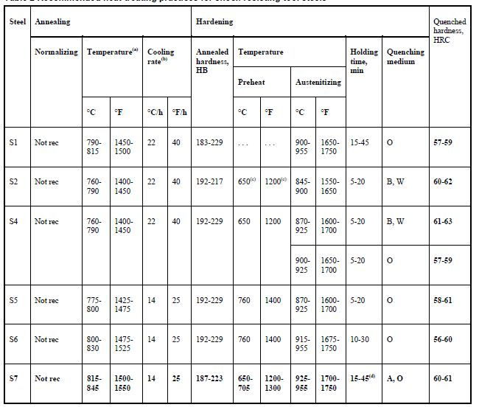

Slide 16
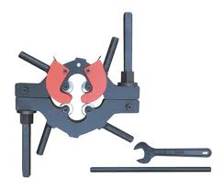
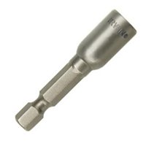
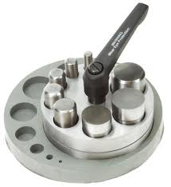
SHOCK-RESISTING TOOL STEELS
ROTARY PIPE CUTTER
Applications:
Chisels
Pneumatic chisels
Punches
Shear blades
Scarring Tools
River sets
Driver bits.
GOLD SET MAGNETIC NUT SETTER
SWANSTORM DISC CUTTER

Slide 17
HOT-WORKED TOOL STEELS
Die steels
Carbon content = 0.3-0.5% . These steels are used for high temperature metal forming operation (except cutting), where the temperature is around 200-800°C.
These are characterized by high hot yield strength, high red hardness , wear resistance, toughness, erosion resistance, resistance to softening at elevated temperatures, good thermal conductivity
These are divided into 3 groups depending on the principle alloying elements:
Chromium based [H11- H19]
Tungsten based [H20- H26]
Molybdenum based [H41- H43]

Slide 18
Chromium Based
HOT WORK TOOL STEEL
Contains Chromium (>=3.25%), and small amounts of Vanadium, Tungsten and Molybdenum.
These are characterized by high red hardness & high hardenability.
Oil quenching is reqd. when dimensional stability is not of prime importance. Tempering temperature for these steels varies from 550-675°C.
Applications:
Hot dies for extrusion, forging, mandrels, punches.
Highly stressed structural parts of supersonic aircrafts.
Hot work steels.

Slide 19
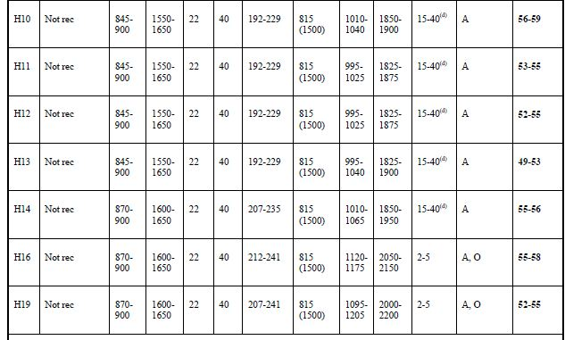

Slide 20
Tungsten Based
HOT WORK TOOL STEEL
Contains tungsten (=9.00%) & Chromium (2.0 -12.0%), and low Carbon %.
These are characterized by resistance to high temperature softening.
Tempering temperature for these steels varies from 550-675°C.
Applications:
Punches .
Mandrels .
Extrusion dies for Brass, Steel & Nickel alloys.

Slide 21
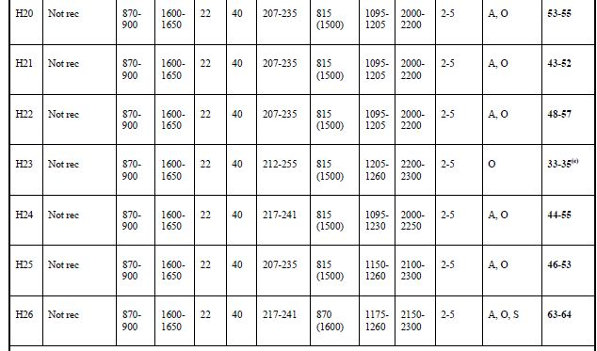

Slide 22
Molybdenum Based
HOT WORK TOOL STEEL
Contains Molybdenum (8.00%) & Chromium (4.0 -12.0%), and some tungsten and Vanadium.
These are characterized by high toughness & high heat check resistance.
Tempering temperature for these steels varies from 550-650°C.
resistance to decarburization.

Slide 24
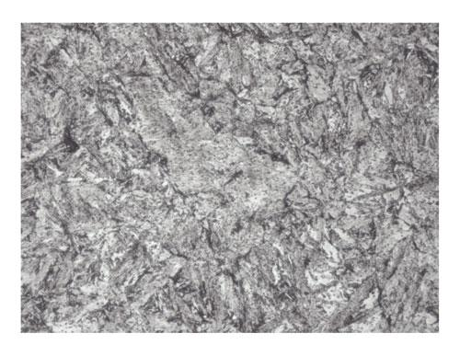
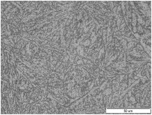
HOT WORK TOOL STEEL
Microstructure of H-13 TOOL STEEL (1000x)
Microstructure of
Annealed H-13 TOOL STEEL

Slide 25
COLD-WORKED TOOL STEELS
Die steel
ALSO CALLED AS OHNS – OIL HARDENED NON SHRINKING STEEL
These steels are used for making tools for cold work applications, when the tool surface temperature does not rise more than 200°c.
These are characterized by high abrasion & wear resistance, higher toughness and high impact resistance.
These steels are also called “Non- distorting Steels”, as they show little change in dimension during heat treatment.
These are divided into 3 groups:
Oil hardening Steels [GRADE ‘O’]
Air hardening Steels [GRADE ‘A’]
High Carbon, High Chromium Steels [GRADE ‘D’]

Slide 26
Oil- hardening Steels
COLD WORK TOOL STEEL
These are hardened by oil-quenching & contain high carbon with manganese, chromium & molybdenum.
These are characterized by high machinability, wear resistance & non-distorting properties.
Tempering temperature for these steels varies from 100-425°C.
Applications:
Taps .
Blanking & forging dies.
Threading dies.
Expansion reamers.

Slide 27
CONTD.
APPLICATIONS : OHNS i.e.
OIL HARDENED NON SHRINKING DIE STEEL
BLANKING & STAMPING DIES
PUNCHES
ROTARY SHEAR BLADES
THREAD CUTTING TOOLS
MILLING CUTTERS
REAMERS
MEASURING TOOLS
GAUGING TOOLS
BROACHES
CHASERS ETC.

Slide 28
OHNS
OHNS: ALL GRADES OF OHNS i.e. OIL HARDENED NON SHRINKING STEEL CAN BE ROLLED FOR HARDNESS AND GOOD CUTTING PERFORMANCE.
GRADES:
AS PER AISI- AMERICAN IRON AND STEEL INSTITUTE.
AISI | C | Si | Mn | Cr | W | V | Co | Mo | Ni
01 | 0.95 | - | 1.0 | 0.5 | 0.5 | 0.1 | - | - | -
02 | 0.90 | 0.20 | 1.9 | 0.3 | - | 0.10 | - | 0.10 | -

Slide 29
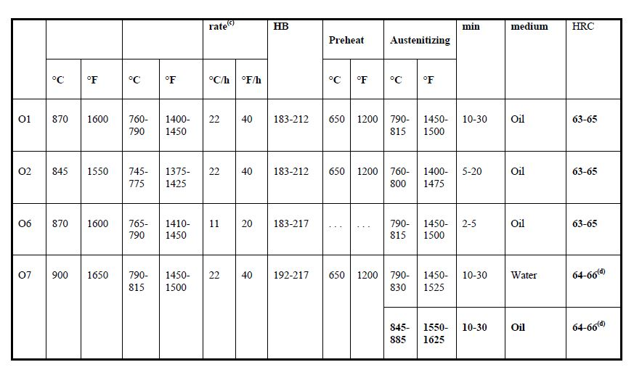

Slide 30
Air- hardening Steels
COLD WORK TOOL STEEL
These are hardened by air-quenching and contain Carbon (1.0%) with manganese, chromium & molybdenum & tungsten.
These are characterized by high wear resistance & high hardenability, fair red hardness, good toughness & resistance to decarburization.
Tempering temperature for these steels varies from 150-425°C.
Applications:
Knives .
Blanking & trimming dies.
Coining dies.

Slide 31
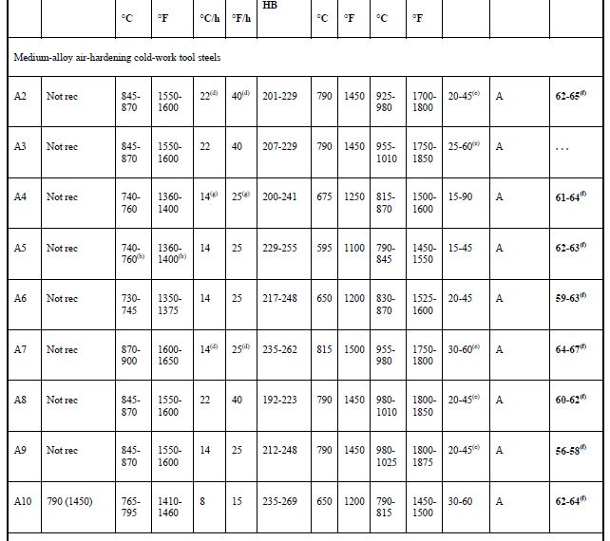

Slide 32
High carbon, high Chromium Steels
HCHC
These are hardened by oil- or air- hardening & contain Carbon (1.4-2.3%) & Chromium (12-14%), with molybdenum, cobalt, vanadium. GRADES D3 AND D2
Vanadium prevents these steels form showing Grain coarsening (upto 1040°C). Chromium imparts non-deforming properties. Tempering of these steels results in high hardness, wear & abrasion resistance.
Tempering temperature for these steels varies from 150-375°C.
Applications:
Mandrel for tube rolling by Pilger rolls .
Blanking & piercing dies, Coining dies, Drawing dies.

Slide 33
HCHC
APPLICATIONS :
THREAD ROLLING DIES
HOBS
COLD EXTRUSION TOOLS AND DIES
PUNCHES
DRAW PLATES
CUTTERS
PRESSURE CASTING MOULDS
REAMERS
FINISHING ROLLS ETC.

Slide 34
HCHC
GRADES OF HCHC STEEL
GRADE | C | Si | Mn | Cr | W | V | Co | Mo | Ni
D3 | 2.0 | 0.3 | 0.3 | 12.00 | - | - | - | - | -
D2 | 1.7 | 0.3 | 0.3 | 12.00 | 0.5 | 0.1 | - | 0.6 | -

Slide 35
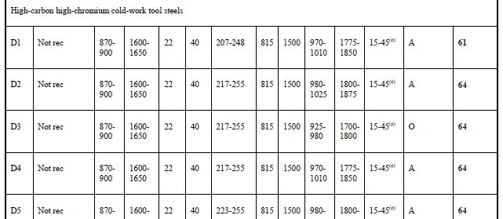

Slide 36
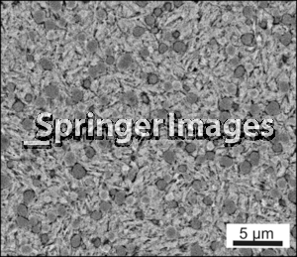
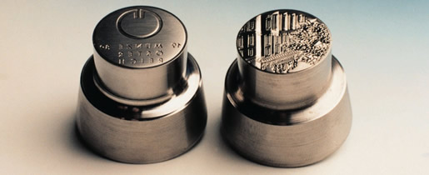
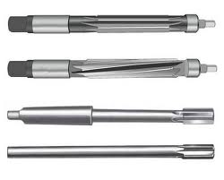
HCHC
COINING DIES
Microstructure of
As-Tempered COLD WORK TOOL STEEL (1000x)
EXPANSION REAMERS

Slide 37
HIGH SPEED TOOL STEELS
HSS
These are high alloyed tool steels developed initially to do high speed metal cutting. Now, they used in a wide variety of machining operations.
These are characterized by high hardness (60-65 HRC at 600-650°C), high red hardness, wear resistance, reasonable toughness and good hardenability.
They contain 0.6 % carbon, 4% Chromium, 5-12% Cobalt.
Carbon imparts hardness of at-least 60 HRC of martensite formed. Chromium increase hardenability & corrosion resistance. Cobalt increases the thermal conductivity, melting point, red hardness & wear resistance of high speed steels.

Slide 38
HSS
These are divided into two groups depending upon the principal alloying elements & the composition:
Molybdenum High speed steel [GRADE ‘M’]
(contain Molybdenum, Tungsten, Chromium, Vanadium & sometimes cobalt).
Tungsten High Speed steels [GRADE ‘T’]
(contain high amount of tungsten with chromium, vanadium and some cobalt.)
Applications :
End mills, drills, lathe tools, planar tools.
Punches, reamers,
Routers, taps, saws.
Broaches, chasers, and hobs.

Slide 39
W-BASE HSS:
18-4-1 GRADE IS WIDELY USED
W- TUNSTEN
V-
VANADIUM
Cr- CROMIUM
18-4-1 (T1 GRADE) HSS: IS AUSTENITIZED AT 1280 0C, SALT QUENCHED TO 608 0C, AIR COOLED AND DOUBLE TEMPERED AT 540 0C.
MICROSTRUCTURE SHOWS WHITE SPOTS OF UNDISSOLVED CARBIDES IN A MATRIX OF TEMPERED MARTENSITE.
THE PRESENCE OF WEAR RESISTANT CARBIDES IN A HARD HEAT RESISTANT MATRIX MAKES THESE STEELS SUITABLE FOR CUTTING TOOL APPLICATIONS.

Slide 40
APPLICATIONS OF HSS:
TOOL BITS
DRILLS
REAMERS
BROACHES
TAPS
MILLING CUTTERS
HOBS
SAWS
WOOD WORKING TOOLS.

Slide 41
HSS
2 minutes
(1200°C)
AUSTENITIZING
20 minutes QUENCHING
Tempering 1
(1 hr)
4-5 hrs
(850°C)
Tempering 2
(1 hr)
608 0C
540 0C
Temperature (°C)
Time
Typical heat treatment cycle for HSS

Slide 42
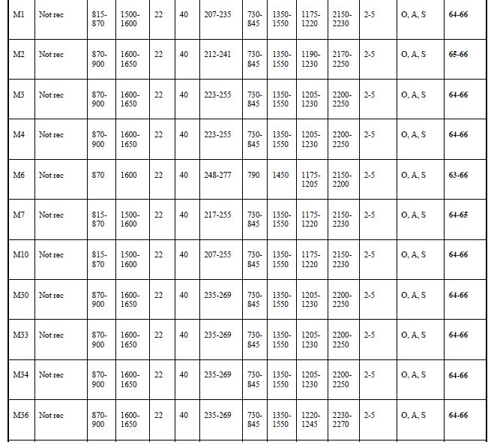

Slide 43
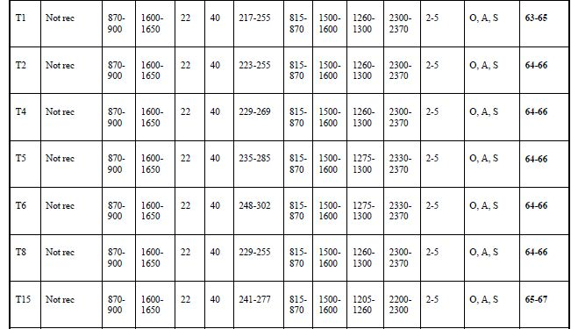

Slide 44
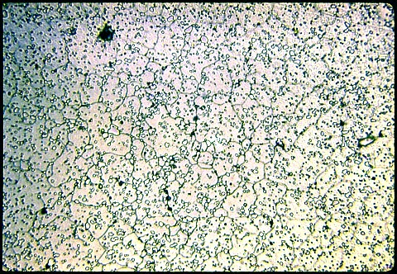
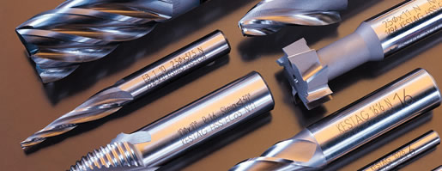
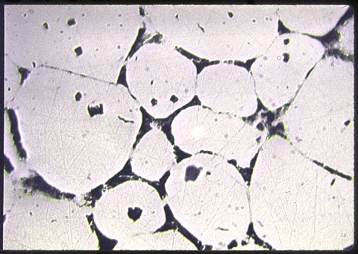
HSS
Microstructure of
oil- quenched HSS (500x)
MILL CUTTERS
Microstructure of
oil- quenched
18-4-1 type HSS
W-Cr-V

Slide 45
WATER-HARDENED TOOL STEELS
These steels contain carbon in the range of 0.9-1.0% along with Cr, V, Mo.
These are characterized by high tensile strength & hardness levels but low ductility & toughness values.
In order to improve machinability, these steels are given “Spheroidizing annealing treatment”.
Presence of Cr improves both hardness & hardenability and Vanadium checks the tendency of grain coarsening.
Tempering temperatures are in the range 170-220°C.

Slide 46
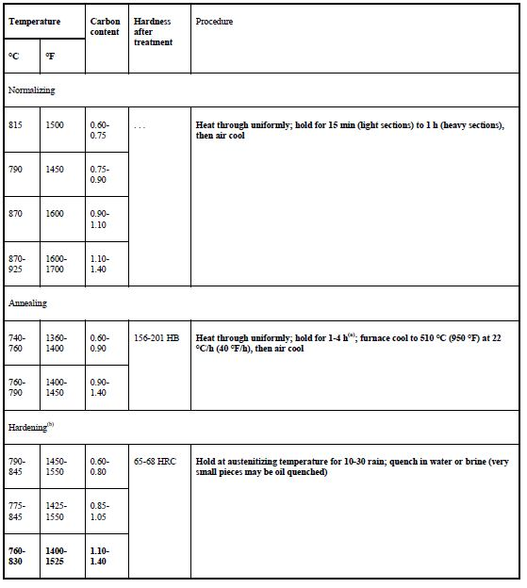

Slide 47
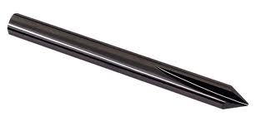
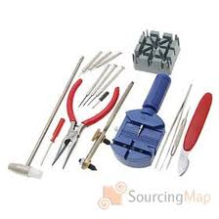
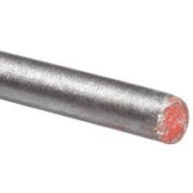
Water hardened tool steel
Applications :
Heavy forging hammers, hand hammers.
Forging dies, bending dies, cutting dies.
Large blanking tools, boring tools.
Chisels, scissors, knife blades.
Milling cutters, lathe centre.
Watch maker’s tools.
Engraving tools.
ENGRAVING TOOL
DRILL ROD OF
W1 TOOL STEEL
WATCH MAKER’S TOOLS

Slide 48
THANK YOU

