Slide 1
HARDENABILITY
ABILITY OF STEEL TO GET HARDENED BY FORMING 100% MARTENSITIC STRUCTURE EVEN AT A SLOWER COOLING RATE.
HARDENABILITY DEPENDS UPON FOLLOWING FACTORS,
1.COMPOSITION OF STEEL : FOR PLAIN CARBON STEELS,AS PERCENTAGE OF CARBON INCREASES,TTT DIAGRAM SHIFTS IN THE RIGHTWARDS DIRECTION,THEREBY CRITICAL RATE OF COOLING BECOMES SLOWER AND HARDENABILITY OF STEEL INCREASES.
ON THE CONTRARY IF % OF CARBON DECREASES THEN TTT DIAGRAM SHIFTS IN THE LEFTWARDS THEREBY DECREASING HARDENABILITY OF STEEL.

Slide 2
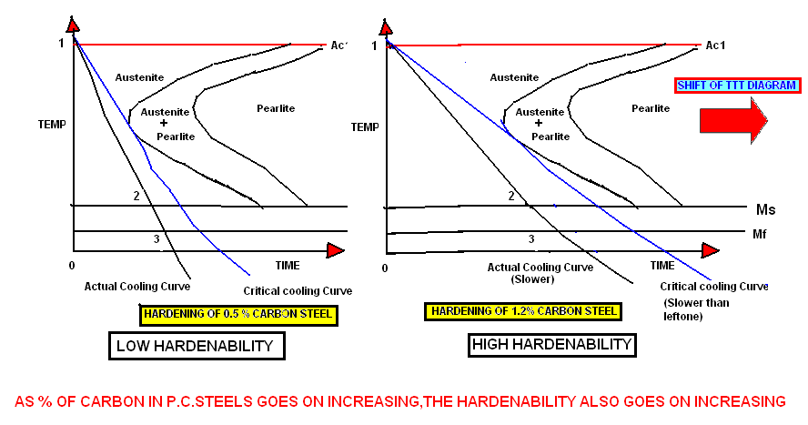

Slide 3
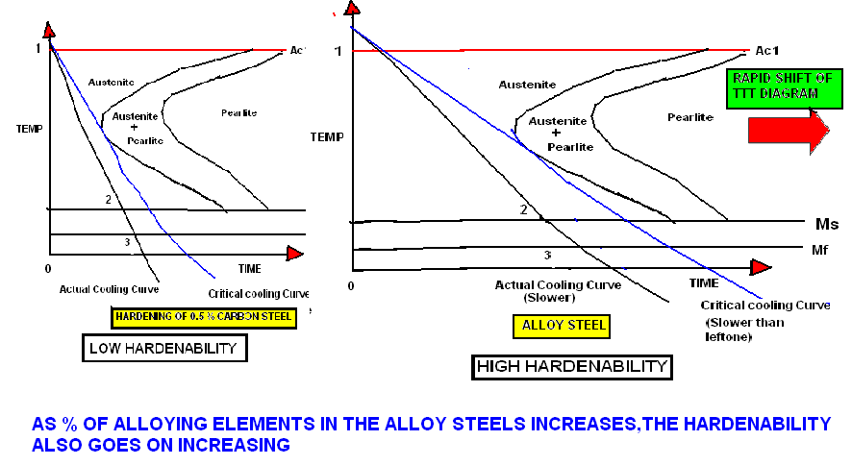

Slide 4
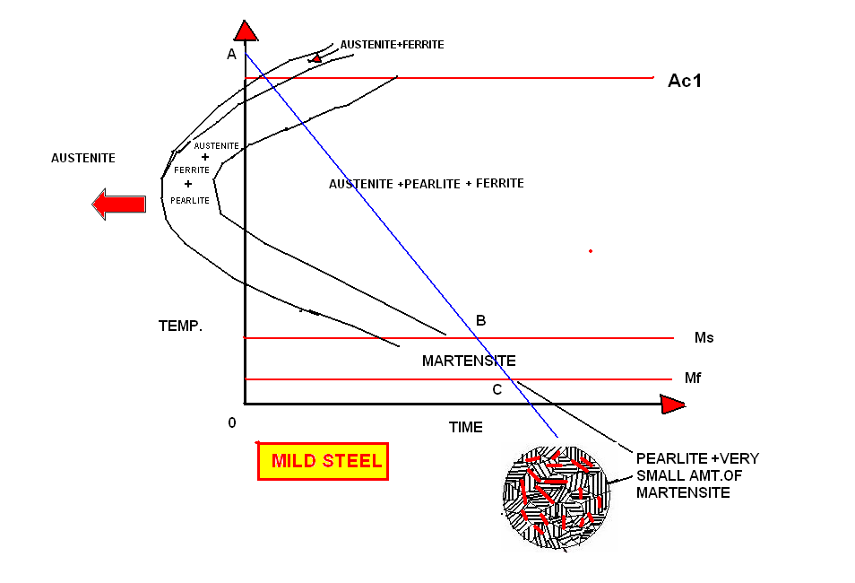
MILD STEEL CANNOT BE HARDENED COMPLETELY DUE TO LESS CARBON

Slide 5
IN PLAIN CARBON STEELS ,AS PERCENTAGE OF CARBON GOES ON INCREASING,THE TTT DIAGRAM SHIFTS IN RIGHTWARDS DIRECTION AND HARDENABILITY ALSO GOES ON INCREASING & VICE VERSA.
IN ALLOY STEELS ,AS PERCENTAGE OF ALLOYING ELEMENTS GOES ON INCREASING, INCREASING,THE TTT DIAGRAM SHIFTS IN RIGHTWARDS DIRECTION AND HARDENABILITY ALSO GOES ON INCREASING & VICE VERSA.
IN GENERAL ALLOY STEELS HAVE MORE HARDENABILITY THAN PLAIN CARBON STEELS.

Slide 6
2.AUSTENITIC GRAIN SIZE:
WITH INCREASE IN AUSTENITE GRAIN SIZE BEFORE QUENCHING , HARDENABILITY INCREASES.
DEPTH OF HARDENING IS MORE IN COARSE GRAINED STEEL THAN FINE GRAINED STEEL.
WITH CORASE GRAIN OF AUSTENITE THERE IS LESS TENDANCY OF NUCLEATION OF AUSTENITE TO PEARLITE & MORE POSSIBLITY OF FORMATION OF AUSTENITE TO MARTENSITE TRANSFORMATION.
WITH DECREASE IN AUSTENITE GRAIN SIZE BEFORE QUENCHING , HARDENABILITY DECREASES.
WITH FINE GRAIN OF AUSTENITE THERE IS MORE TENDANCY OF NUCLEATION OF AUSTENITE TO PEARLITE & MORE POSSIBLITY OF FORMATION OF AUSTENITE TO PEARLITE TRANSFORMATION.

Slide 7
3.HOMOGENEITY OF AUSTENITE:
NON HOMOGENITY OF AUSTENITE TENDS TO DECREASE HARDENABILTY OF STEEL.
NON HOMOGENEITY OF AUSTENITE OCCURS DUE TO INCOMPLETE DISSOLUTION OF CARBIDES IN AUSTENITE.
4.UNDISSOLVED CARBIDES IN THE AUSTENITE:
FORMATION OF IRON CARBIDES AND ALLOY CARBIDES LEADS TO REDUCTION IN ALLOYING ELEMENT CONTENT AND CARBON CONTENT AND LEADS TO DECREASE IN HARDENABILITY OF STEEL.
SOME OF THE CARBIDE FORMING ELEMENTS TENDS TO REDUCE GRAIN SIZE AND LOWERS HARDENABILTY.
5.NON-METALLIC INCLUSIONS IN STEEL:THE NON METALLIC INCLUSIONS IN THE STEEL REDUCE HARDENABILITY AS THEY INCREASE INHOMOGENEITY OF AUSTENITE.

Slide 8
MEASUREMENT OF HARDENABILITY
JOMNY END QUENCH TEST
IS USED TO MEASURE HARDENABILITY OF STEEL.
HERE STANDARD JOMNY SPECIMEN IS PREPARED AND END OF THE STEEL SPECIMEN IS QUENCHED WITH WATER JET.
AFTER THIS THE POINTS ARE MARKED FROM QUENCHED END AT AN INTERVAL OF 1.6 MM.
HARDNESS IS MEASURED FROM THE END AT THESE MARKED POINTS.
CURVE IS PLOTTED BETWEEN HARDNESS Vs DISTANCE FROM QUENCHED END CALLED AS “HARDENABILITY CURVE”.
AT A POINT THE CURVE RAPIDLY DROPS DOWN INDICATING THE SECTION IN THE STEEL SPECIMEN WITH 50% MARTENSITE AND 50% PEARLITE. THE DIATANCE OF THIS SECTION FROM THE END IS MEASURED.THIS IS “JOMNY DISTANCE”.EXPRESSED IN mm OR POINTS. LESS IS DIATANCE ,LESS IS HARDENABILTY & VICE VERSA.

Slide 9
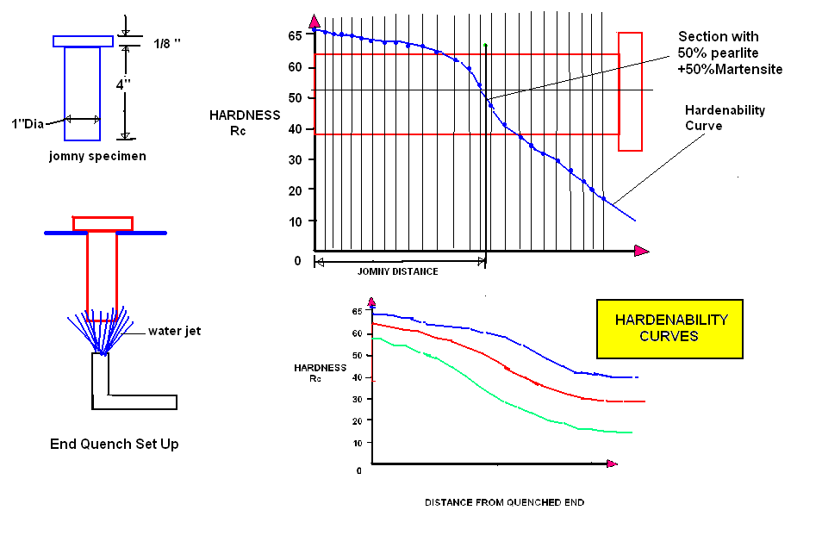

Slide 10
QUENCHING MEDIUMS FOR HARDENING
WATER: GIVES FAST RATE OF COOLING.USED FOR LOW CARBON P.C.STEELS.DUE TO FAST COOLING RATE ,MORE POSSIBLITY OF QUENCHING CRACKS.
OIL:GIVES SLOWER COOLING RATES AS COMPARED TO WATER.USED FOR LOW,MEDIUM ALLOY STEELS.LESS DANGER OF QUENCHING CRACKS.
AIR:GIVE SLOWEST COOLING RATES.USED FOR HIGHLY ALLOYED STEELS AS THEY HAVE HIGH HARDENABILITY.NO QUECNCHING CRACKS AND DEFORMATION WITH AIR QUENCHING.

Slide 11
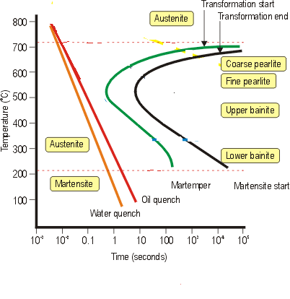
WATER AND OIL QUENCHING

Slide 12
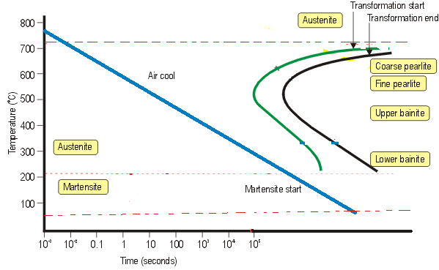
AIR COOLING DURING HARDENING FOR HIGH ALLOY
STEELS

Slide 13
THANKS !!!

