Slide 1
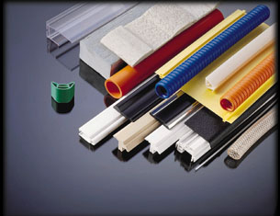
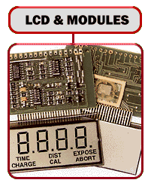
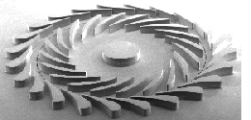
NON METALLIC MATERIALS

Slide 2
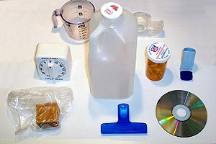
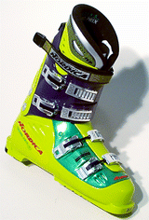
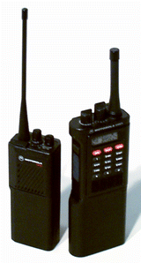
Household items made of various kinds of plastic.

Slide 3
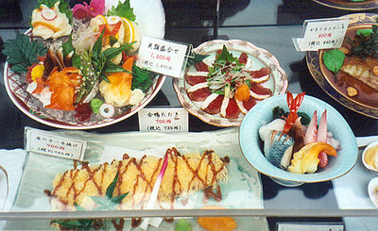
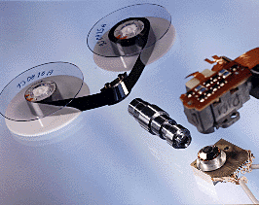
Molded plastic food replicas

Slide 4
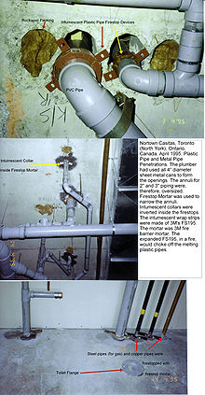
PVC

Slide 5
Classified as-
POLYMER
PLASTIC
(THERMOPLASTIC AND THEROSETTING )
RUBBER
MATERIALS SUCH AS –
CERAMIC, ASBESTOS, CORK, THERMOCOLE,GLASSWOOL, CERMET ETC.
COMPOSITE MATERIALS.

Slide 6
Polymers-
Polymers are organic materials having carbon as common element in their makeup.
They have large molecules which are formed by repeated linking ( i.e. polymerization) of individual molecules called monomers(single unit).

Slide 7
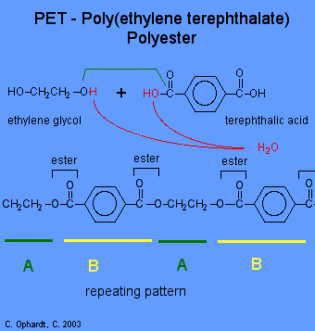
POLYMERIZATION

Slide 8
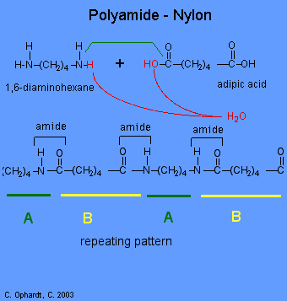

Slide 9
Addition Polymers :
Polymers are long chain giant organic molecules are assembled from many smaller molecules called monomers.
Polymers consist of many repeating monomer units in long chains. A polymer is analogous to a necklace made from many small beads (monomers).

Slide 10
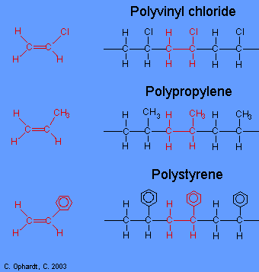

Slide 11
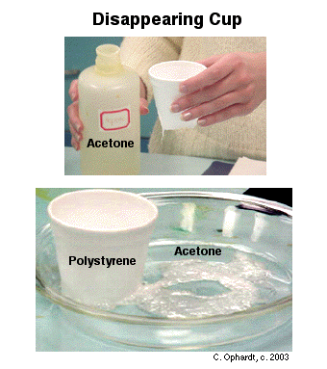

Slide 12
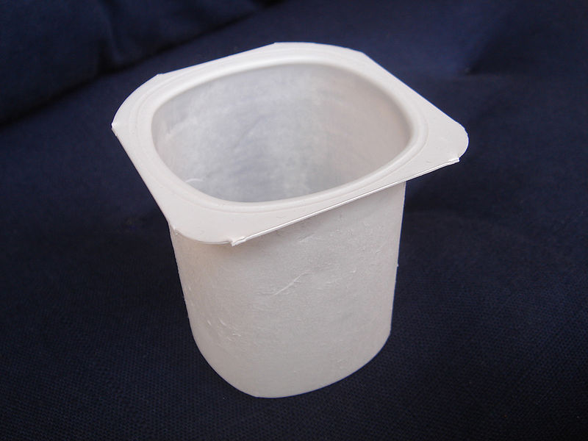
A polystyrene yogurt container

Slide 13
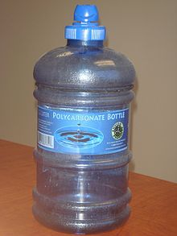
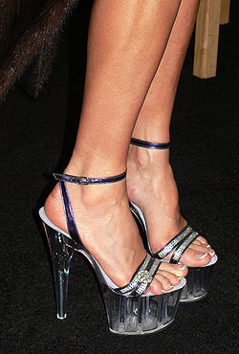
A bottle made from polycarbonate
High heel shoes made of Lucite

Slide 14
{ Like bcc, fcc unit cell, which does not involve any chemical reaction but monomers have chemical reaction }

Slide 15
Natural polymers –
The naturally occurring polymers include protein, cellulose, resin, starch, shellac and lignin.
They are commonly found in leather, fur, wool, silk, rubber etc.

Slide 16
Synthetic polymers –
Polyethylene
Polystyrene
Nylon
Terylene
Etc.

Slide 17
Characteristics of polymers-
Good corrosion resistence
low density
Low coefficient of friction
Good moldability
Excellent surface finish
But poor mechanical properties and temperature resistance.

Slide 18
Plastics-
Plastic is an organic polymer which is easily shaped by the application of heat and pressure.
They are less brittle than glass but can be made equally made transparent and smooth.
They resist corrosion and action of chemicals.

Slide 19
Properties of plastics-
Light in weight
Good corrosion resistance
Good resistance to acid, base and moisture.
Low thermal and electrical conductivity
Wide range of colors
Low modulus of rigidity.

Slide 20
Types of plastic materials
Thermoplastic mtrls.
Thermosetting mtrls
elastomers

Slide 21
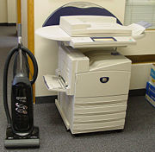
Plastics have become an indispensable part of our technological society.

Slide 22
DIFFERENT MONOMERS
Polymer Monomer
Polyethylene ---ch2---
Use- in packaging as electrical insulator, bottles and films.

Slide 23
Polymer Monomer
Polypropylene
Use- stronger, stiffer than polyethylene
H H
| |
--C---C—
| |
H CH3

Slide 24
Polymer Monomer
Polyvinyl
chloride
PVC
Use-pipes, pipe fitting, plumbing, consumer durables.
H H
| |
--C---C—
| |
H Cl

Slide 25
Polymer Monomer
Polytetra
fluroethylene
PTFE
Use- called as teflon.
Non-stick cooking ware,
*Able to withstand very high temperature.
* Extremely low adhesion and friction .
F
|
--C--
|
F

Slide 26
Polymer Monomer
Polymethyl
Methacrylate
PMMA
Use- Automobile wind screen and aircraft windows
It is transparent
High resistance to corrosion.
H COOCH3
| |
--C-------C—
| |
H CH3

Slide 27
H H
| |
--C-------C—
| |
H R
The monomer
The radical R
Can be an element. E.g.
H, Cl OR another radical e.g. ch3

Slide 28
THERMOPLASTIC :
Thermoplastics are the linear polymers without any cross linking in their structure.
They become soft when heated,
And easily deformed to their desired shape.
They become hard on cooling.
This type of plastic can be heated and cooled at any no. of times.

Slide 29
Only they should not be heated above decomposition temp.
These are weaker, softer and less brittle as compared to thermosetting plastics.

Slide 30
Examples of thermoplastics are
Polyethylene PE
Polypropylene PP
Polyvinyl chloride PVC
Polystyrene PS
Polytetrafluroethylene PTFE
Nylon
Acrylic (polymethyl methacrylate) PMMA
Polycorbonate PC
Polyethylene terepthalate PET

Slide 31
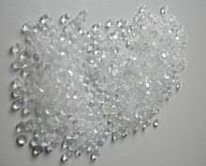
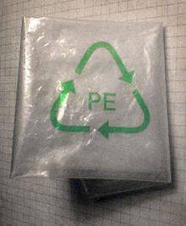
Granulated polyethylene
A bag manufactured from polyethylene.

Slide 32
THERMOSETTING PLASTICS-
These have three dimensional network of primary bond with covalent cross links predominating between chains.
They become soft during their first heating and become very hard during cooling.
They do not soften during subsequent heating rather become harder due to completion of cross linking.

Slide 33
These can not be recycled and do not have resale of scrap value.
Examples-
Phenol formaldehyde (Bakelite)PF
Urea formaldehyde UF
Melamine formaldehyde MF
Polyesters
Epoxies
Silicones
Rubber

Slide 34
ELASTOMERS (RUBBER)-
NATURAL RUBBER MADE FROM LATEX.
All Polymers are long chain like fibers with a back bone of carbon atoms joined together by covalent bonds and the individual fibers are joined together by weak secondary bond( van der waals and hydrogen bonds ) and the covalent cross link bonds.

Slide 35
The secondary bonds in elastomers are in melted condition at room temperature, thus they virtually seem as if elastic.
The weak secondary bond with the bonding of the crosslinks provide them shape memory by virtue of which they return to their original shape after the deforming load is being removed.

Slide 36
Rubber types are
Neoprene rubber
Styrene butadiene rubber SBR
Silicone rubber

Slide 37
COMPARISION OF THERMOPLASTIC AND THERMOSETTING PLASTIC

Slide 38
THERMOPLASTIC They are formed by addition polymerization only. |  |  | THERMOSETTING PLASTIC They are formed by condensation polymerization.
They consists of long-chain linear polymers with negligible cross-links |  |  | They have three-dimensional network structure.

Slide 39
They soften on heating readily, because secondary forces between the individual chain can break easily by heat or pressure or both. |  |  | They cross-links and bonds retain their strength on heating and hence , They do not soften on heating. On prolonged heating , however , charring of polymers is caused.

Slide 40
By reheating to a suitable temperature , They can be softened , reshaped and thus reused . |  | They retain their structure and shape even on heating. Hence they cannot be reshaped and reused.
They are , usually , soft, weak and less brittle. |  | They are usually hard, strong and brittle.
They can be reclaimed from wastes. |  | They can not be reclaimed from wastes.

Slide 41
They are usually soluble in some orga41nic solvents. | Due to strong bonds and cross links , they are insoluble in almost all organic solvents.

Slide 42
DIFFERENT
THERMOPLASTICS

Slide 43
Polystyrene (PS)
Packaging foam, food containers, disposable cups, plates, cutlery, CD and cassette boxes.

Slide 44
Polycarbonate (PC)
Compact discs, eyeglasses, riot shields, security windows, traffic lights, lenses.
Polyethylene (PE)
Wide range of inexpensive uses including supermarket bags, plastic bottles.

Slide 45
Acrylonitrile Butadiene Styrene (ABS):
These are tough, hard and rigid.
Good chemical &heat resistance.
Easy in processing & machining.
unaffected by water, inorganic salts, alkalis and many acids.
they are soluble in ketones, aldehydes and esters.

Slide 46
Polycarbonate/Acrylonitrile Butadiene Styrene (PC/ABS)
Use:
A blend of PC and ABS that creates a stronger plastic. Used in car interior and exterior parts, and mobile phone bodies.
ABS:
Electronic equipment cases (e.g., computer monitors, printers, keyboards), drainage pipe.

Slide 47
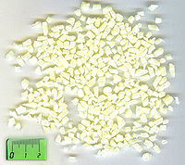
ABS commonly used for telephone bodies, safety helmets, TV casing, radios, control panels etc.
ABS polymer grains

Slide 48
Polypropylene PP
Characteristics/properties:
It is a light weight material.
High tensile strength.
Excellent insulating substance.
Does not get affected by moisture.
Unaffected by chemicals like alkaline substances, acids, degreasing agents, electrolytic attacks etc.

Slide 49
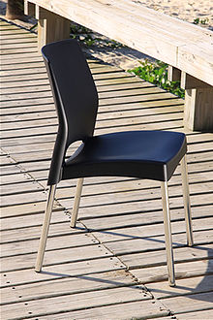
A chair made with a polypropylene seat

Slide 50
Polypropylene PP
Uses:
Food containers, appliances, car fenders (bumpers), battery cases, plastic pressure pipe systems.
Spray bottles, nozzle.
As fiber for durable carpet.
Films and sheets for packaging.

Slide 51
Polyethylene terephthalate (PET)
Carbonated drinks bottles, jars, plastic film, microwavable packaging.
Polyester (PES)
Fibers, textiles.

Slide 52

A PET soft drink bottle.

Slide 53
Polyvinyl chloride (PVC)
Plumbing pipes and guttering, shower curtains, window frames, flooring.
Polyurethanes (PU)
Cushioning foams, thermal insulation foams, surface coatings, printing rollers. (Currently 6th or 7th most commonly used plastic material, for instance the most commonly used plastic found in cars).

Slide 54
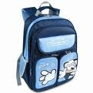
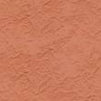
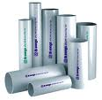
Made of 420D PVC
IN KOREA -PVC MATERIALS
PVC MATERIALS:

Slide 55
Polytetrafluoroethylene (PTFE)
(Teflon):
Heat-resistant, low-friction coatings, used in things like non-stick surfaces for frying pans, plumber's tape and water slides. It is more commonly known as Teflon.

Slide 56
Polytetrafluoroethylene or teflon
It can be fabricated into desired shape by hot pressing and sintering.
Prop:
* Excellent resistance to most of the chemicals and solvents.
Low coefficient of friction.
good heat resistance and non-sticking properties.
it is transparent in nature.

Slide 57
Applications:
Chemical processing and petrochemical sectors :
used for vessel lining, seals,
spacers, gaskets etc.
Laboratory applications :
tubing, piping, containers due to
resistance to chemicals.
Electrical industry:
as insulator.
Semiconductor sector:
an insulator in capacitors and in
the chip manufacturing processes.

Slide 58
Nylons ( polyamides):
Produced by series of condensation reactions between amine and organic acids.
Prop:
High elongation
excellent abrasion resistance
Melts instead of burning
high resistance to many chemicals
Good electrical insulation properties.

Slide 59
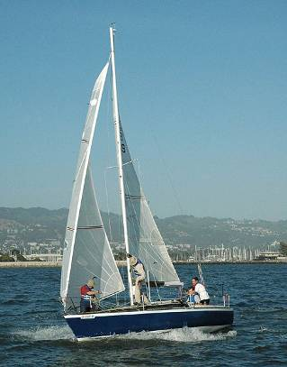
Colorful nylon spinaker

Slide 60
Applications:
Nylon fabrics used in carpets, musical strings, ropes etc.
Solid nylon used for gears, screws, bearings, tyres etc.
Polyamides (PA) (Nylons)
Fibers, toothbrush bristles, fishing line, under-the-hood car engine moldings.

Slide 61
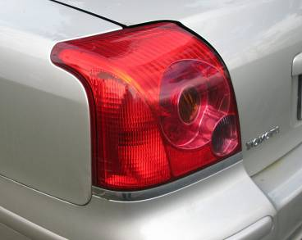
Acrylic (Polymethyl methacrylate)
(PMMA)
Notable for excellent optical properties.
Transmitting 92 % of incident light.
attacked by concentrated acid but not by alkalies.
It is highly resistant to weathering.
Acrylic lens

Slide 62
Acrylic (Polymethyl methacrylate )(PMMA)
Use:
Contact lenses, glazing (best known in this form by its various trade names around the world; e.g., Perspex, Oroglas, Plexiglas), aglets, fluorescent light diffusers, rear light covers for vehicles.
Name plates, sink, bath, hopital equipments etc.

Slide 63
THERMOSETTING
PLASTICS

Slide 64
EPOXIES:
Epoxy or polyepoxide is a thermosetting material formed from reaction of an epoxide “resin” with polyamine “hardener”.
It has wide range applications including fiber reinforced plastic material and general purpose adhesives.

Slide 65
Properties:
It has good adhesive and
electrical properties.
very tough and excellent
hardness
high heat resistance.
Good corrosion resistance
good thermal shock resistance
Good resistance to solvents and
chemicals.

Slide 66
Use:
Used as adhesive , protective coatings.
Electrical moldings
Used with fiber glass laminates.

Slide 67
Phenolics or
(phenol formaldehydes PF ) OR BAKELITE :
High modulus, relatively heat resistant, and excellent fire resistant polymer.
Used for insulating parts in electrical fixtures, paper laminated products (e.g., Formica), thermally insulation foams.

Slide 68
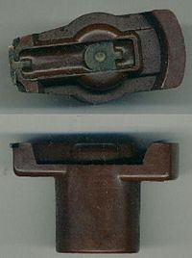
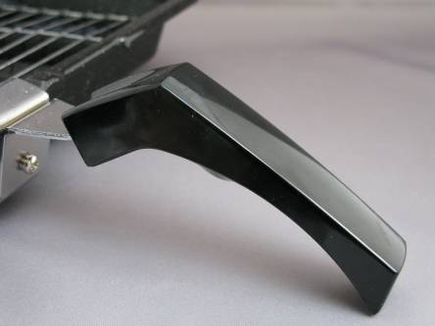
Phenol formaldehyde
Bakelite distributor rotor.

Slide 69
It is a thermosetting plastic, with the familiar trade name Bakelite, that can be molded by heat and pressure when mixed with a filler-like wood flour or can be cast in its unfilled liquid form or cast as foam (e.g., Oasis).
Problems include the probability of moldings naturally being dark colors (red, green, brown), and as thermoset it is difficult to recycle.

Slide 70
MELAMINE:
Melamine is combined with formaldehyde to produce melamine resin, a very durable thermosetting plastic used in formica and melamine foam.

Slide 71
Properties:
High heat and moisture resistance
more resistance to chemcial
scratch free and more expensive
high dimensional stability
High hardness
It is affected by ultra violet light

Slide 72
Applications:
Floor tiles
Kitchenware
Fire retardant fabrics
Commercial filters
Glue for plywood
Swithces and plugs
surface coatings and laminates.

Slide 73
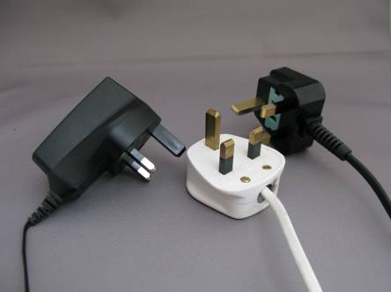
Urea-formaldehyde (UF)
One of the aminoplasts and used as a multi-colorable alternative to phenolics. Used as a wood adhesive (for plywood, chipboard, hardboard) and electrical switch housings.
Urea-formaldehyde (UF)

Slide 74
Melamine formaldehyde (MF)
One of the aminoplasts, and used as a multi-colorable alternative to phenolics, for instance in moldings (e.g., break-resistance alternatives to ceramic cups, plates and bowls for children) and the decorated top surface layer of the paper laminates (e.g., Formica).

Slide 75
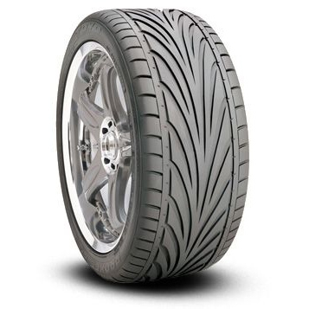
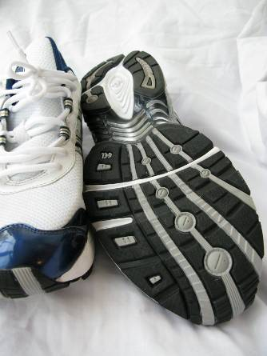
ELASTOMERS :
MADE FROM RUBBER

Slide 76
ELASTOMERS :
NATURAL RUBBER
ENGINEERING ELASTOMERS
BUTADIENE RUBBER (BR)
ACRYLONITRILE BUTADIENE RUBBER (ABR )
BUTYL RUBBER
SILICONE RUBBER

Slide 77
NATURAL RUBBER NR
The outstanding strength of natural rubber has maintained its position as the preferred material in many engineering applications. It has a long fatigue life and high strength even without reinforcing fillers. Other than for thin sections it can be used to approximately 100C, and sometimes above.

Slide 78
It can maintain flexibility down to -60C if compounded for the purpose. It has good creep and stress relaxation resistance and is low cost. Its chief disadvantage is its poor oil resistance and its lack of resistance to oxygen and ozone, although these latter disadvantages can be ameliorated by chemical protection.

Slide 79
NITRILE RUBBER NBR
At temperatures up to 100C, or with special compounding up to 120C, nitrile rubber provides an economic material having a high resistance to aliphatic hydrocarbon oils and fuels. Different grades are available - the higher the acrylonitrile (ACN) content, the higher the oil resistance but the poorer is the low temperature flexibility.

Slide 80
It has high resilience and high wear resistance but only moderate strength. It has limited weathering resistance, and poor aromatic oil resistance. It can generally be used down to about -30C, but special grades can operate at lower temperatures.

Slide 81
APPLICATIONS:
MOTOR BELTS
GASKETS
OIL DEALS
LPG HOSES
GLOVES AND APRONS
WIRE AND CABLE COATINGS.

Slide 82
BUTYL RUBBER IIR
This rubber has very high impermeability to gases and is hence used for the inner tubes of pneumatic tyres, and in vacuum and high pressure applications. It has an unusually broad loss peak so that, despite having a glass transition temperature as low as -65C, it displays high damping at ambient temperatures It has good ozone, weathering, heat, and chemical resistance. Not suitable for use in contact with mineral oils.

Slide 83
STYRENE BUTADIENE RUBBER SBR
This is the highest volume general purpose synthetic rubber. It is very weak unless reinforcing fillers are incorporated. With suitable fillers it is a strong rubber although not approaching natural rubber or polychloroprene. Otherwise it has similar chemical and physical properties to natural rubber, with generally better abrasion resistance but poorer fatigue resistance.

Slide 84
STYRENE BUTADIENE RUBBER SBR
APPLICATIONS:
AUTOMOBILE TYRES
FOOT WEAR
CABLE INSLATION
HOSE PIPE AND CONVEYOR BELTS
MOULDED ARTICLES
FLOOR TILES AND MECHANICAL GOODS

Slide 85
BUTADIENE RUBBER BR
This material has a very low glass transition temperature in the region -75C to -100C. This results in very low hysterisis and good flexibility at ambient temperatures and these properties are maintained to temperatures well below zero. It has high abrasion resistance in severe conditions. Mainly used in tyres in blends with natural rubber and SBR.

Slide 86
SILICONE RUBBER:
IT IS UNIQUE SYNTHETIC RUBBER WHICH IS MADE FROM CROSS LINKED POLYMER THAT IS REINFORCED WITH SILICA.
PERFECT BALANCE OF MECHANICAL AND CHEMICAL PROPERTIES.
PROPERTIES:
WIDE TEMP. RANGE 250 C TO -80 C
BETTER WATER AND OIL RESISTANCE
TENSILE STRENGTH AND TEAR STRENGTH ARE SUPERIOR THAN CONVENTIONAL RUBBER.

Slide 87
RESISTANCE TO STEAM
GLOWS IN THE DARK
ELECTRICALLY CONDUCTIVE
LOW SMOKE EMISSION AND FLAME RETARDENT.

Slide 88
APPLICATIONS:
THIS RUBBER CAN BE EXTRUDED IN TUBES, STRIPS, SOLID CORDS
SUITABLE FOR CASTING LOW MELT ALLOYS LIKE LEAD, TIN ETC.
USED IN SUGICAL DEVICES, GASKETS, SEALS, INSULATION WIRE, TUBES, CABLES ETC.

Slide 89
PROPERTIES AND APPLICATIONS OF SOME ENGG. MATERIALS.
CERAMIC
ABRASIVE
ADHESIVE
ASBESTOS
CORK
THERMOCOLE
GLASSWOOL

Slide 90
CERAMIC:
THESE CONTAINING PHASES OF METALLIC AND NON METALLIC ELEMENTS.
SERAMIC CRSTALS ARE FORMED BY EITHER A PURE IONIC BOND, A PURE COVALENT BOND OR BY BOND THAT POSSES THE IONIC AS WELL AS COVALENT CHARACTERISTICS.
EXAMPLES OF CERAMIC ARE SILICA, GLASS, REFRACTORY, SILICON CARBIDE ETC.

Slide 91
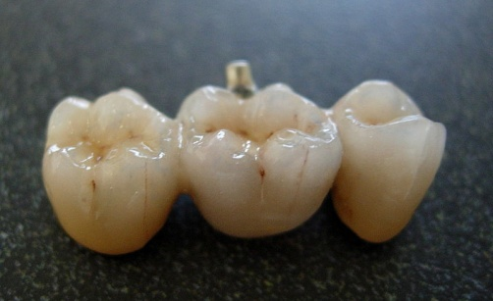
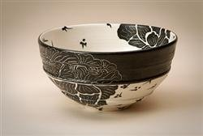
Fixed partial denture, or "bridge
ceramic boul

Slide 92
Ceramic as a cutting tool
Tungsten carbide inserts

Slide 93
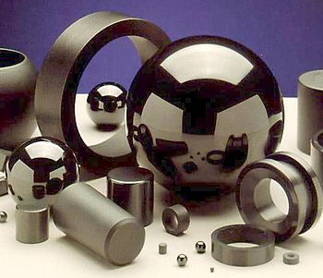
Ceramic application
Bearing components made from 100% silicon nitride Si₃N₄

Slide 94
PROPERTIES OF CERAMIC:
THEY ARE HARD BRITTLE MATERIALS
RESISTANT TO CORROSION AND HIGH TEMP. STRENGTH.
RESISTANT TO PLATIC DEFORMATION
BAD CONDUCTORS OF ELECTRICITY
POSSES VERY LOW THERMAL CONDCTIVITY
HIGHLY RESISTANT TO ALL CHEMCIALS EXPECT YDROFLUORIC ACID.

Slide 95
APPLICATIONS OF CERAMIC:
AEROSPACE :
SPACE SHUTTLE TILES, THERMAL BARRIERS, HIGH TEMP. GLASS WINDOWS, FUEL CELLS.
AUTOMOTIVE:
CATALYTIC CONVERTERS, AIRBAG SENSORS, CERAMIC ROTORS, SPARK PLUGS ETC.
MEDICAL:
ORTHOPAEDIC JOINT REPLACEMENT, DENTAL RESTORATION, BONE IMPLANTS.

Slide 96
CONSUMER USES:
GLASSWARE,POTTERY, DINNERWARE, CERAMIC TILES, SANITARY WARE, CRUCIBLE, JAR ETC.
BRICKS, CEMENT,LAB EQUIPMENTS, CHEMICAL INDUSTRIES. ETC.

Slide 97
Ceramics are used in an array of applications:
Compressive strength makes ceramics good structural materials (e.g., bricks in houses, stone blocks in the pyramids)
High voltage insulators and spark plugs are made from ceramics due to its electrical conductivity properties

Slide 98
Good thermal insulation has ceramic tiles used in ovens and as exterior tiles on the Shuttle orbiter Some ceramics are transparent to radar and other electromagnetic waves and are used in radomes and transmitters

Slide 99
Hardness, abrasion resistance, imperviousness to high temperatures and extremely caustic conditions allow ceramics to be used in special applications where no other material can be used

Slide 100
Chemical inertness makes ceramics ideal for biomedical applications like orthopaedic prostheses and dental implants
Glass-ceramics, due to their high temperature capabilities, leads to uses in optical equipment and fiber insulation

Slide 101
In general, advanced ceramics have the following inherent properties:
Hard (wear resistant)
Resistant to plastic deformation
Resistant to high temperatures
Good corrosion resistance
Low thermal conductivity
Low electrical conductivity

Slide 102
However, some ceramics exhibit high thermal conductivity and/or high electrical conductivity.
The combination of these properties means that ceramics can provide:
High wear resistance with low density
Wear resistance in corrosive environments
Corrosion resistance at high temperatures

Slide 103
ABRASIVES:
COMM0N EXAMPLES ARE
ALUMINIUM OXIDE, SILICON CARBIDE, ZIRCONIA CARBIDE,CERAMIC, EMERY,SAND, GLASS POWDER ETC.
ABRASIVES ARE USED FOR GRINDING, CUTTING, SCRATCHING, RUBBING ETC.
GRINDING WHEELS,
ABRASIVE BELTS ETC.

Slide 104
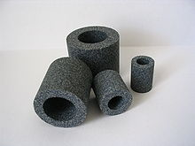
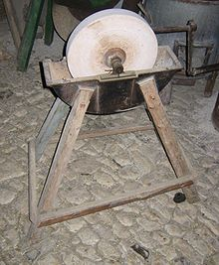
Assorted grinding wheels as examples of bonded abrasives.
A grinding wheel with a reservoir to hold water as a lubricant and coolant.

Slide 105
ABRASIVE PARTICLES ARE HELD TOGETHER BY A BONDING MATERIAL COMPRISE THE CUTTING AGENTS IN GRINDING WHEELS.
CLASSIFIED AS
NATURAL ARTIFICIAL(SYNTHETIC )
ABRASIVES ABRASIVES
E.G. DIAMOND, E.G. SILICON CARBIDE
EMERY, SAND, ALUMINA AND
GRANITE, QUARTZ, BORON CARBIDE.
ETC SYNTHETIC DIAMOND

Slide 106
PROPERTIES OF ABRASIVES :
HIGH TEMP. RESISTANCE.
HIGH ELECTRICAL RESISTIVITY(ALTHOUGH SOME CERAMICS ARE SUPERCONDUCTORS
HIGH HARDNESS
GOOD CHEMICAL AND CORROSION RESISTANCE.
LOW COST OF RAW MATERIALS AND FABRICATION FOR SOME CERAMICS.
GOOD APPEARANCE CONTROL THROUGH SURFACE TREATMENTS, COLORIATION ETC.

Slide 107
ASBESTOS :
ASBESTOS IS A FIBROUS MATERIAL THAT IS USED PRIMARILY AS A FORE PROOFING AND INSULATION MATERIAL IN BUILDINGS, HOMES AND INDUSTRIAL APPLICATIONS.
IT IS A GROUP OF MINERALS, OCCUR NATURALLY AS MASSES OF STRONG FLEXIBLE FIBERS THAT CAN BE SEPARATED IN TO THIN THREADS.
SILICA IS COMBINED WITH SUCH BASES AS MAGNESIUM, IRON, CALCIUM, SODIUM AND ALUMINIUM.

Slide 108
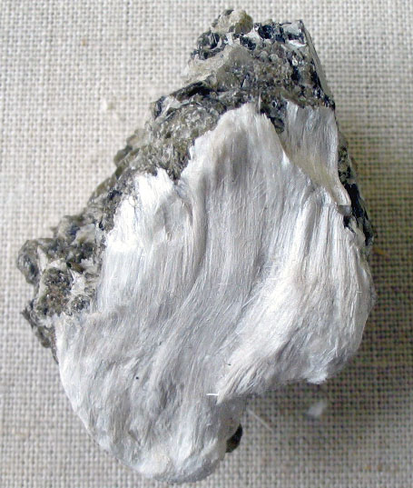
ASBESTOS IS A GENERAL TERM USED TO DESCRIBE SIX FIBROUS MATERIALS, NAMELY:
CHRYSOTILE
AMOSITE
CROCIDOLITE
ANTHOPHYLITE
ACTINOLITR
TERMOLITE
Fibrous asbestos on muscovite

Slide 109
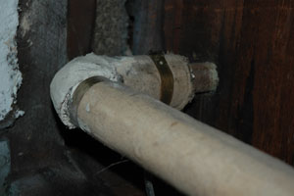
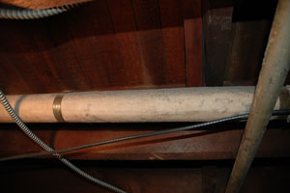
Basement heating pipe leading into living area.

Slide 110
ASBESTOS PROPERTIES :
IT HAS INSULATING PROPERTIES AND RESISTANCE TO ALL ATMOSPHERIC AGENS AND POLLUTANTS.
DOES NOT REACT WITH OTHER CHEMICALS.
IT IS FIRE RESISTANT.
ALKALINE, ACID AND FIRE RESISTANT.
HAS NO DETACTABLE SMELL.
HARD, IT IS AMAZING RESISTANT TO SCRATCH.

Slide 111
ASBESTOS APPLICATIONS:
CEMENT PIPES, CEMENT WALL BOARDS.
BOILER INSULATION, FIRE PROFFING MATERIALS, INSULATORS.
BRAKE SHOES
COOLING TOERS
VINYL WALL COVERINGS, VINYL TILES.
PIPE INSULATION
PUTTIES, ADHESIVES
FIRE PROOF TEXTILES
GASKETS ETC.

Slide 112
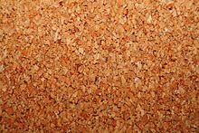
CORK:
CORK IS A CUTER BARK OF A OAK TREE FOUND IN SPAIN,PORTUGAL AND AFRICA.IT IS USED IN COMPOSITE FORM AND MELDED IN BLOCKS UNDER HEAT AND PRESSURE.
Untreated cork panel

Slide 113
PROPERTIES OF CORK:
IT HAS GOOD STABILITY AND IS VERY LIGHT WEIGHT.
CORK IS IMPERMEABLE TO BOTH LIQUIDS AND GASSES ,GIVING IT SUPERIOR SEALING CAPABILITIES.
IT HAS LOW CODUCTIVITY OF HEAT.
IT HAS ABILITY TO ABSORB SOUND AND VIBRATIONS.
IT HAS HIGH COEFFICIENT OF FRICTION.

Slide 114
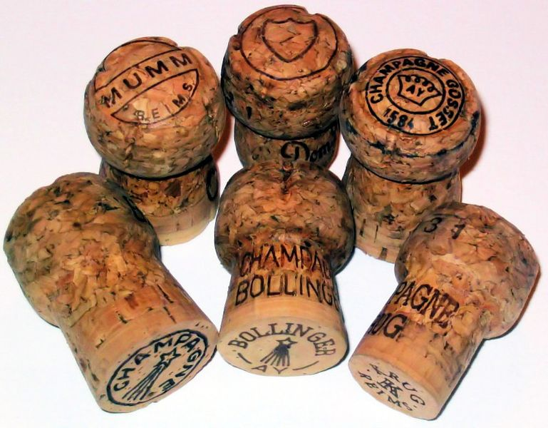
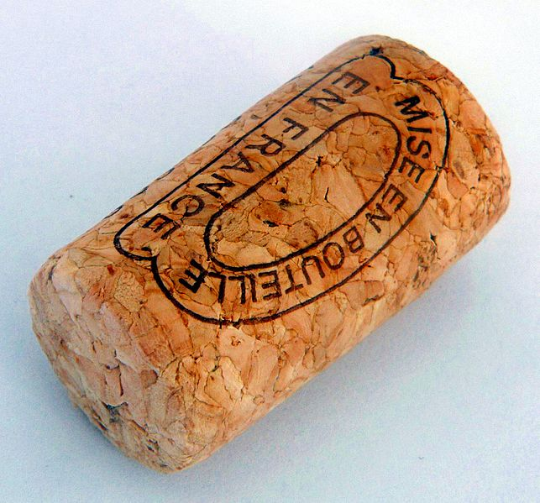
IT HAS SHOWN A REMARKABLY HIGH TOLERANCE TO HEAT .
GOOD INSULATOR.
In these champagne corks, the base is a single piece, while the crown is composed of granules.
A cork stopper for a wine bottle

Slide 115
APPLICATIONS OF CORK:
USE FOR WINE BOTTLE CLOSURES.
FISHING FLOATS.
HANDLES OF VARIOUS PARTS.
FLOOR TITLES.
FREEZER CABINETS.
ROOT INSULATIONS AND INSULATIONS FOR COLD STORAGE.

Slide 116
THERMOCOLE:
THERMOCOLE IS A RESTRUCTURED CHEMICAL BONDING OF POLYSTYRENE (A SYNTHETIC PETROLEUM PRODUCT) MOLECULES AND DEVELOPED INTO SUBSTANCE NAMED STETCH POLYSTYRENE. THESE THERMOPLASTICS GRANULES ARE EXPANDED GRANULES BECOME MUCH LARGER IN SIZE BUT REMAIN VERY LIGHT.

Slide 117
THERMOCOLE HAS GOOD RESISTANCE FOR COLD AND HEAT BUT SINCE IT IS A PETROLEUM PRODUCT,IT DISSOLVES IN ANY SOLVENT OF PETROLEUM.

Slide 118
PROPERTIES:
IT HAS EXCELLENT INSULATING PROPERTIES.
IT CAN BE CUT EASILY WITH SIMPLES TOOLS LIKE KNIFE OR A SAW.
IT HAS A HIGH RESISTANT TO MOISTURE ,ADEQUATE STRUCTURAL STRENGTH.
IT HAS EXCELLENT DIMENSSIONAL STABILITY, MAKES IT EASY TO USE.

Slide 119
IT HAS SNOW WHITE COLOUR AND IS ODOURLESS.
IT HAS FUNGUS RESISTANCE.

Slide 120
APPLICATIONS:
PACKAGING.
VARIOUS DECORATIVE ARTICLES.
INSULATORS AND MATERIALS FOR PATTERN MAKING.
MOULDED PACKAGING FOR ELECTRICAL AND ELECTRONICS ITEM TO PROTECT FROM SHOCK.

Slide 121
*GLASS WOOL:.
GLASS WOOL IS AN INSULATING MATERIAL MADE FROM FIBREGLASS ,ARRANGED INTO A TEXTURE SIMILLAR TO WOOL. GLASS IS MADE BY DIRECT MELTING. AIR OR STEAM JETS ARE USED,BUT THE CONDITIONS SUCH THAT ATTENUATION IS MORE VIOLENT AND HAPHAZARD. GLASS WOOL IS PRODUCED IN SHORTER FIBRES IN A WIDER RANGE OF DIAMETER ,

Slide 122
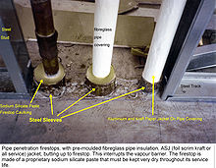
WITH DIFFERENT THERMAL AND MECHANICAL PROPERTIES.
Fiberglass pipe covering with ASJ (All Service Jacket)

Slide 123
PROPERTIES:
IT HAS GOOD THERMAL AND COLD INSULATING PROPERTIES.
EXCELLENT FIRE RESISTANTANCE PROPERTIES.
IT HAS LOW DENSITY.
IT IS NON-COMBUSTIBLE , NON-TOXIC AND RESISTANT TO CORROSION.
LOW THERMAL CONDUCTIVITY.
STABLE CHEMICAL PROPERTIES AND LOW MOISTURE ABSORPTION RATE.

Slide 124
APPLICATIONS:
GLASS WOOL PROVIDES EXCELLENT THERMAL INSULATIONS.
SHEETS AND PANELS CAN BE USED TO INSULATE FLATE SURFACES SUCH AS CELLING TILES , CERTAIN WALLS AND DUCTING.
IT IS ALSO USED TO INSULATE PIPING AND FOR SOUNDPROOFING.
USED IN BLANKETS ,BLOCKS AND BOARDS.

Slide 125
THANKS !!

