Slide 1
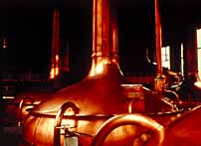
NON FERROUS METALS AND ALLOYS
IN THIS CHAPTER WE HAVE TO STUDY-
COPPER AND ITS ALLOYS
ALUMINIUM AND ITS ALLOYS
BEARING MATERIALS
Copper's anti-bacterial and corrosion resistant properties help make it ideal for vessels.

Slide 2
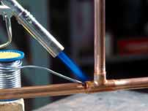
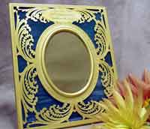
Brass can be polished up to give an attractive gold finish.
. Brazing copper pipes to make a strong joint.

Slide 3
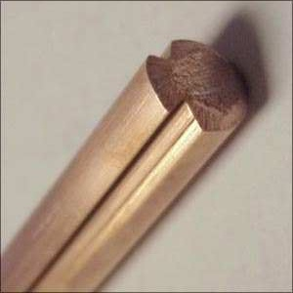
PROPERTIES OF COPPER
strength
color
Corrosion resistance
Easy to machine
Wear resistance

Slide 4
AT THE END OF CHAPTER YOU WILL BE ABLE TO ANSWER THE FOLLOWING QUESTIONS…..
WHAT ARE THE PROPERTIES OF COPPER.?
WHAT ARE THE PROPERTIES OF ALUMINIUM?
3. WHAT ARE DIFFERENT FORMS OF COPPER?

Slide 5
4. CLASSIFY COPPER ALLOYS.
5. STATE THE CHEMICAL COMPOSITION OF MUNTZ METAL.
6. STATE THE APPLICATION OF NEVAL BRASS.
7. STATE THE PROPERTIES AND APPLICATIONS OF DURALUMIN.
8. WHAT IS DURALUMIN?
9. EXPLAIN GAMMA ( γ ) ALLOY WITH REFERENCE TO CHEMICAL COMPSITION AND PROPERIES.

Slide 6
10. STATE THE CHARACTERISTICS OF BEARING MATERIALS.
11. WHAT IS BABBITS OR WHITE METAL?
12. WHAT ARE APPLICATIONS OF GAMMA ALLOY?

Slide 7
NON FERROUS MATERIALS ARE MADE UP OF
CU, AL, MG, NI, PB,ZN. AND
CD,MO, CO, ZIRCONIUM, BERILLIUM, TITANIUM, TANTALUM, GOLD, SILVER, PLATINUM TO A LESSER EXTENT.

Slide 8
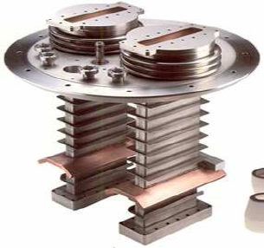
IN GENERAL WHAT ARE APPLICATIONS OF CU?
ELECTRICAL CONDUCTOR
CONDENSER TUBES,
SURGICAL AND DENTAL
INSTRUMENTS,
HEATER, ARCHITECTURAL USE,
RELAYS ETC.
COPPER PLATING

Slide 9
WHAT ARE THE PROPERTIES OF COPPER?
HIGHLY DUCTILE AND POSSES FCC CRISTAL STRUCTURE.
DENSITY IS 8920 KG/CU.M
MELTING POINT 1083 0C
HIGHER THERMAL & ELECTRICAL PROPERTIES.
CORROSION RESISTANCE.
NON MAGNETIC AND PLEASING COLOR.

Slide 10
IT CAB NE WELDED, BRAZED AND SOLDERED. I.E. EASE OF FABRICATION.
GOOD MACHINABILITY.
EASILY FINISHED BY PLATING.
. Brazing copper pipes to make a strong joint.

Slide 11
PROPERTIES OF COPPER
A good electrical conductor
A good thermal conductor
Corrosion resistant
antibacterial
Easily joined
ductile
tough
Non magnetic
Attractive colour
Easy to alloy
Recyclable.

Slide 12
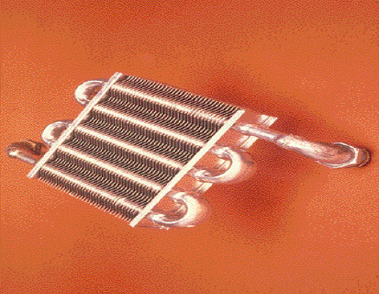
Phosphorus deoxidized copper used in pressure vessels or plumbing tubes for electrical purposes

Slide 13
DIFFERENT FORMS OF COPPER—
1. ELECTROLYTIC TOUCH PITCH CU
[ETP]
2. OXYGEN FREE HIGH CONDUCTIVITY
CU [ OHFC]
3. ARSENICAL CU
4. FREE CUTTING CU

Slide 14
1. ELECTROLYTIC TOUCH PITCH CU
[ETP]
ETP CONTAINS 0.02 TO 0.05% OXYGEN WHICH IS COMBINED WITH CU AS THE COMPOUND CUPROUS OXIDE CU2O,FURTHER STRENGTH IS INCREASED.
USED FOR ROOFING, GUTTERS RADIATORS, GASKETS, KETTLES, PRESSURE VESSELS, DISTALLRY ETC.

Slide 15
2. OXYGEN FREE HIGH CONDUCTIVITY COPPER
OHFC
USED IN ELECTRONIC TUBES, ELECTRONIC COMPONENTS AND SIMILAR APPLICATIONS AS IT MAKES A PERFECT SEAL TO GLASS.
3. ARSENICAL COPPER
CONTAINS 0.3% ARSENIC HAS IMPROVED RESISTANCE TO SPECIAL CORROSIVE ENVORONMENT.

Slide 16
USED FOR CONDENSER AND HEAT EXCHANGER APPLICATIONS.
4. FREE CUTTING COPPER
WITH 0.6% TELLURIUM HAS EXCELLENT MACHINING PROPERTIES.
USED FOR BOLTS, STUDS, WELDING TIPS, CONTACT PINS, SWITCH GEARS, RELAYS AND PRECISION ELECTRICAL EQUIPMENTS.

Slide 17
COPPER ALLOYS
BRASS (ALLOY OF CU AND ZN)
MUNTZ METAL
NAVAL BRASS
CARTRIDGE BRASS
ADMIRALTY BRASS

Slide 18
2.BRONZES (ALLOY OF CU AND TIN)
* TIN BRONZES
* SILICON BRONZES
* AL BRONZES
* BERILLIUM BRONZES
3. CUPRANICKELS (ALLOY OF CU & NI)
4. NICKEL SILVERS
( ALLOY CU, NI AND ZINC.)

Slide 19
BRASSES:
MUNTZ METAL- 60% CU & 40% ZN
HAS HIGH STRENGTH AND EXCELLENT HOT WORKING PROPERTIES.
USED FOR
SHEETS FOR SHIP SHEATHING,
CONDENSER HEADS,
PERFORATED METALS,
ARCHITECTURAL WORK,
VALVE STEMS, BRAZING RODS,
CONDENSER TUBES.ETC.

Slide 20
2. NAVEL BRASS:
CU 60%, ZN 39%,0.75 % SN (TIN)
IT HAS INCREASED RESISTANCE TO SALT WATER CORROSION.
USED:
CONDENSER PLATES, WELDING RODS, PROPELLER SHAFTS, PISTON RODS, VALVE STEMS.
LEADED NAVAL BRASS WITH 1.75% LEAD (PB) USED FOR MARINE HARDWARE.

Slide 21
CARTRIDGE BRASS (70 : 30 BRASS ) :
Cu - 70% , Zn – 30%
PROPERTIES :
IT HAS HIGH CONDUCTIVITY AND
MALLEABILTY.
IT HAS GOOD COLD WORKING
PROPERTIES.
IT HAS GOOD CORROSION RESISTANCE.
IT IS SOFT MATERIAL.

Slide 22
APPLICATION :
IT IS USED FOR CARTRIDGE CASES.
IT IS USED FOR AMMUNITION CASES.
IT IS USED FOR SPRINGS.
IT IS USED FOR RADIATOR FINS.
ADMIRALTY BRASS (71:28:1)
CU:ZN: TIN
THE ADMIRATY BRASS TUBES ARE RENOWNED FOR THEIR CHARACTERISTICS OF SUPERIOR CORROSION RESISTANCE IN A MODERATELY

Slide 23
POLLUTED RIVER WATER AND CLEAN SEA WATER, BOTH STAGNANT
AND SLOW MOVING WATER.
THE MOST COMMON AND WROUGHT FORM IS TUBE FOR HEAT EXCHANGE EQUIPMENT.
THESE TUBES ARE EXTENSIVLY USED IN VARIOUS APPLICATIONS INCLUDING;
EVAPORATERS , CONDENSATE COOLERS, HEATERS, VENT CONDENSERS , WATER HEATERS, GENERATOR, AIR COOLERS ,

Slide 24
TURBINE OIL COOLERS FOR PETROCHEMICAL, SHIP-BUILDING POWER PLANTS, DISTILATION PLANTS ETC.
*CC Cu-71% , Zn-28% , TIN-1%
PROPERTIES:
IT HAS HIGH DUCTILITY AND MALLEABILITY.
IT HAS GOOD COLD WORKING PROPERTIES.

Slide 25
IT HAS BETTER CORROSION RESISTANCE
DUE TO ADDITION OF TIN.
THEY ARE EASY FOR BENDING AND JOINING.
THEY ARE LIGHT IN WEIGHT.
APPLICATIONS:
IT IS USED FOR CONDENSER TUBES.
IT IS USED IN HEAT EXCHANGER.
IT IS USED IN MARINE APPLICATIONS.

Slide 26
BRONZES:
GUN METAL
10%SN (TIN),2%ZN,REST CU (88%)
HIGH STRENGTH, TOUGHNESS NAD SEA WATER CORROSION RESISTANCE
USED:
SHIP BUILDING, BUSHES, NUTS, BOLTS AND PUMP PARTS.

Slide 27
2. TIN BRONZES
GENERALLY REFFERED AS PHOSPHUR BRONZES.
CC: PHOSPHUR 0.01 TO 0.5%,
TIN 1 TO 11% , REST CU
PROP:
HIGH STRENGTH, TOUGHNESS, CORROSION RESISTANCE,
LOW COEFFICIENT OF FRICTION,
FREEDOM FROM SEASON CRACKING.

Slide 28
USED: FOR DIAPHRAGMS,BELLOWS, LOCK WASHERS, COTTER PINS, BUSHING, CLUTCH DISCS AND SPRINGS.
3. SI BRONZES: LESS THAN 5% SI,
STRONGEST OF THE WORK HARDENABLE COPPER ALLOYS.
USE:
TANKS, PRESSURE VESSELS,MARINE CONSTRUCTIONS, AND HYDRAULIC PRESSURE LINES.

Slide 29
3. AL BRONZES:
4 TO 11% ALUMINIUM AND OTHER ELEMENTS SUCH AS FE, NI, MN, SI ARE ADDED.
FE (0.5 TO 5%)- INCRESE STRENGTH AND
HARDNESS
NI (UPTO 5%) - --------””--------------------
SI ( UPTO 2%) – IMPROVES
MACHINABILITY

Slide 30
USE:
HEAT TREATED AL BRONZES ARE USED FOR
GEARS, PROPELLER HUBS,
BLADES, PUMP PARTS,
BEARING, NON SPARKING TOOLS,
DRAWING AND FORMING DIES.

Slide 31
4. CUPRANICKELS: (CU +NI)
UPTO 30% NICKEL.
LESS SUSEPTIBLE TO HEAT TREATMENT AND PROPERTIES ARE ALTERED BY COLD WORKING.
HIGH RESISTANCE TO CORROSION FATIGUE.
HIGH RESISTANCE TO CORROSIVE AND EROSIVE ACTION OF RAPIDLY MOVING SEA WATER.

Slide 32
USE:
CONDENSER, EVAPORATOR, HEAT EXCHANGER TUBES FOR NAVEL VESSELS AND COASTAL POWER PLANTS.
5. NI ALLOYS:
CU 50 TO 70 %,
NI 5 -30%,
ZN 5 – 40%

Slide 33
PLEASING SILVER-BLUE WHITE COLOR, GOOD CORROSION TO FOOD CHEMICALS,WATER AND ATMOSPHERE.
USE:
RIVETS, SCREWS, TABLE FLATWARE,
ZIPPERS, COSTUME JEWELLERY,
NAME PLATES ,
SPRINGS AND CONTACTS IN TELEPHONE EQUIPMENTS,
SURGICAL AND DENTAL EQUIPMENTS ETC.

Slide 34
ALUMINIUM ALLOYS

Slide 35
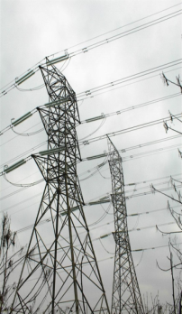
ALUMINIUM ALLOYS :
CLASSIFIED AS
CAST
AL ALLOYS
WROUGHT
AL ALLOYS
HEAT TREATABLE
HEAT TREATABLE
NON HEAT TEREATABLE
NON HEAT TEREATABLE
BY CASTING METHOD
BY FORGING, PRESSONG ETC.

Slide 36
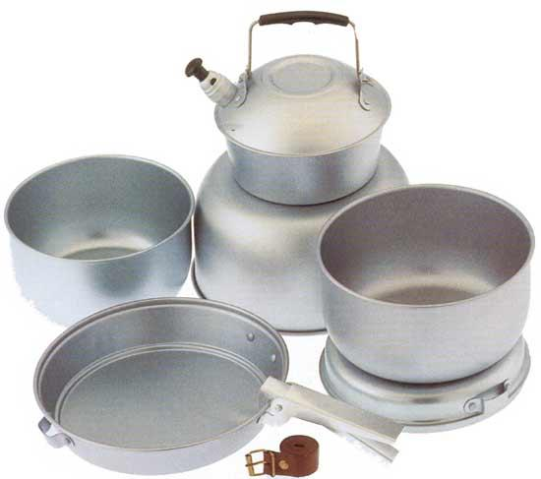
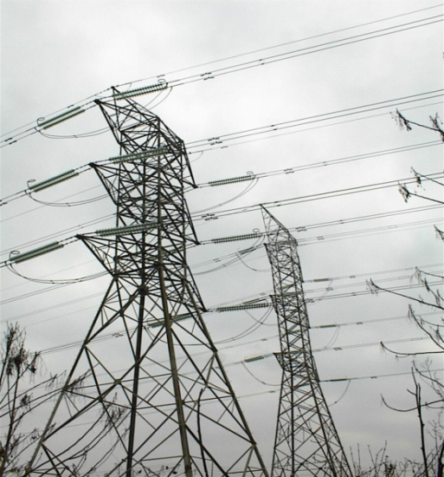
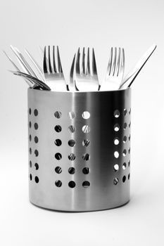
USES OF AL ALLOY
HOUSEHOLD UTENSILS
ALUMINUM IN POWERLINES
PACKAGING
FOILS

Slide 37
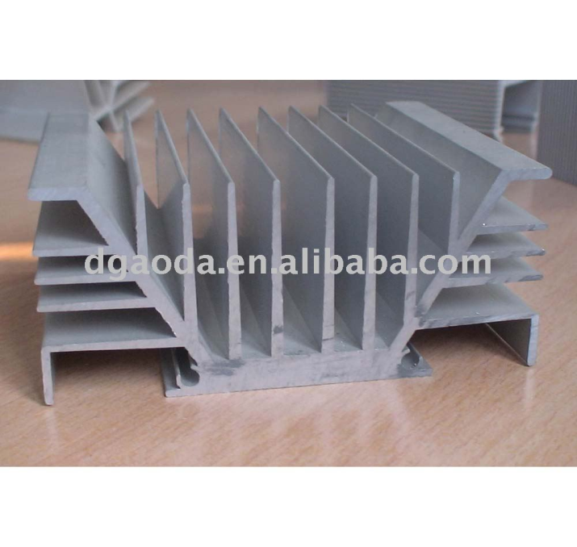
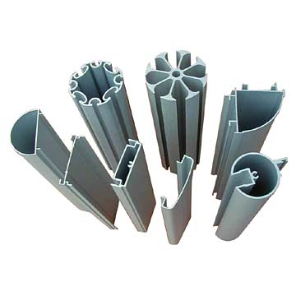
USED IN AEROPLANES.
HEAT SINK
AS SCREEN PROFILE

Slide 38
PROPERTIES OF ALUMINUM
LIGHT WEIGHT:
THE WEIGHT OF ALUMINUM IS ABOUT 1/3 OF THE WEIGHT OF STEEL, BRASS OR COPPER OF EQUAL VOLUME.
STRENGTH:
THE STRENGTH OF ALUMINUM IS SUCH THAT IT CAN STAND HEAVY PRESSURES AND LOADS. WHEN IT IS ALLOYED PROPERLY, IT CAN HAVE THE STRENGTH OF STEEL.

Slide 39
ELECTRICAL CONDUCTIVITY:
THE CONDUCTIVITY OF ALUMINUM IS TWICE AS COMPARED TO THE CONDUCTIVITY OF COPPER.
THERMAL CONDUCTIVITY:
IT CAN QUICKLY SPREAD HEAT OR COOLING ENERGY IN AN EVEN AND QUICK MANNER.
NON-TOXIC:
ALUMINUM IS NON-TOXIC AND THIS PROPERTY MAKES IT IDEAL FOR PACKING COOKING MATERIAL.

Slide 40
REFLECTIVITY:
IT REFLECTS LIGHT AS WELL AS OTHER FORMS OF RADIANT ENERGY.
DUCTILITY:
ALUMINUM IS DUCTILE AND THUS, CAN BE DRAWN INTO WIRES.
IT CAN BE MODIFIED BY ALLOYING IT WITH METALS THAT MAKE IT MALLEABLE, CONDUCTIVE AND RESILIENT THAN ALUMINUM ALONE.
FINISHING:
A VARIETY OF COATINGS AND FINISHES CAN BE USED OVER ALUMINUM SUCH AS PAINTS, LACQUER, ORGANIC COATINGS, OR PORCELAIN.

Slide 41
COSTING:
Aluminum is quite cheaper and economical, all in all, it is cost effective.
RECYCLABLE
Aluminum can be easily recycled into many aluminum products.
CORROSION:
It corrodes less so it is used in the construction of many buildings.
DURABILITY:
Aluminum has a great amount of durability.

Slide 42
PROPERTIES OF AL ALLOYS:
LIGHT IN WEIGHT.
ITS DENSITY IS 1/3 rd THAT OF STEEL AND
COPPER
BETTER STRENGTH TO WEIGHT RATIO
EXTREMELY DUCTILE AND SOFT
GOOD MALLEABILITY & FORMABILITY
GOOD CORROSION RESISTANCE
HIGH ELECTRICAL AND THERMAL
CONDUCTIVITY.

Slide 43
NON TOXIC, NON MAGNETIC AND
NON SPARKING.
MELTING POINT 658 0c
DENSITY 2700 KG/CU.M
TENSILE STRENGTH 13000 PSI
GOOD MACHINABILITY AND
WORKABILITY.
ULTRA PURE FORM OF AL USED FOR
PHOTOGRAPHIC REFLECTORS.
ACTS AS DEOXIDIZER IN STEEL MAKING.

Slide 44
IT CAN BE CAST, ROLLED TO ANY DESIRED
THICKNESS E.G. IN AL FOIL.
IT CAN BE STAMPED,DRAWN, SPUN,
HAMMERED, FORGED AND EXTRUDED.
ALSO USED IN COOKING UTENSILS,
ARCHITECTURAL COMPONENTS, FOOD AND
CHEMICAL HANDLING, STORAGE
EQUIPMENTS, WELDED ASSEMBLIES ETC.

Slide 45
IT CAN BE CAST, ROLLED TO ANY DESIRED
THICKNESS E.G. IN AL FOIL
IT CAN BE STAMPED,DRAWN, SPUN,
HAMMERED, FORGED AND EXTRUDED.
ALSO USED IN COOKING UTENSILS,
ARCHITECTURAL COMPONENTS, FOOD AND
CHEMICAL HANDLING, STORAGE
EQUIPMENTS, WELDED ASSEMBLIES ETC.

Slide 46
POPULAR AL ALLOYS:
DURALUMIN AND GAMMA ALLOY
DURALUMIN:
TS 400 N/MM2
IT IS AN AL-CU-MG ALLOY
IN WROUGHT CONDITION USED FOR FORGING, STAMPING, BARS, SHEETS,
TUBES AND RIVETS.

Slide 47
THE ADDITION OF MG TO ALUMINIUM COPPER ALLOYS ACCELERATES AND INTENSIFIES PRESIPITATION HARDENING.
THESE ARE FIRST PRECIPITATION HARDENING ALLOY DISCOVERED BY ALFRED WILIM IN 1911. AND LEAD TO PRODUCTION OF ALLOY KNOWN AS DURALUMIN.
DESIGNATED AS 2017 IN SERIES.

Slide 48
MODIFIED FORM OF DURALUMIN-
4 % CU, 0.4-0.6 % MG, 0.7 % MN
IS WIDELY USED.
FURTHER HIGH STRENGTH ALLOY DEVELOPED WITH
4.4%CU, 0.5%MG, 0.09%SI, 0.8%MN.
DESIGNATED AS 2014
SI INCRESES THE RESPONSE TO HARDENING DURING ARTIFICIAL AGEING WIDELY USED FOR AIRCRAFT BODYWORK.

Slide 49
THE HEAT TREATMENT USED WITH SUCH ALLOY IS SOLUTION TREATMENT AT 480 0c.THEN QUENCHING THEN PRECIPITATION HARDENING AT ROOM TEMP. FOR FOUR DAYS OR AT 165 0c FOR TEN HOURS.
THE PRESENSE OF COPPER, HOWEVER REDUCES THE CORROSION RESISTANCE, THUS THE ALLOY IS OFTEN CLADDED WITH THIN LAYER OF PURE ALUMINIUM.

Slide 50
AL-MG-SI ALLOYS WIDELY USED AS
ATRUCTURAL ALLOYS WITH MEDIUM STRENGTH
AND GOOD WELDABILITY.
TYPICAL APPLICATIONS ARE TRUCK AND
MARINE STRUCTURES, PIPES RAILINGS &
FURNITURE.

Slide 51
AGEING/ PRECIPITATION HARDENING
SOLUTION HEAT TREATMENT AT 480 0c
TEMP.
0c
QUENCHING
A1
AGEING. (165 0C)
TIME,T

Slide 52
GAMMA (γ) ALLOY :
CC: 3.5-4.5%CU, 1.8-2.3%NI,
1.2-1.7MG, REST IS ALUMINIUM
* TENSILE STRENGTH 350 N/SQ.MM
THESE ARE TITANIUM –ALUMINIUM ALLOY
TITANIUM HAS HIGH MELTING POINT 3035 0f
(1168 0c)
RETAINS STRENGTH AT ELEVATED
TEMPERATURES.

Slide 53
HAVE LOW DENSITY.
DENSITY OF Ti IS 0.16 Lb/Cb,In.
DENSITY OF STEEL IS 0.28 Lb/Cb,In.
STRUCTURES HAVE HIGH STRENGTH TO
WEIGHT RATIO.
EXCELLENT CORROSION
RESISTANCE UPTO 1000 0f.
Ti HAS CLOSED HEXAGONAL PACKED
STRUCTURES.
MOSTLY USED IN COMPONENTS OF AERO
ENGINES.

Slide 54
USE:
CHEMICAL PROCESS PIPEING, VALVES
AND TANKS, AIRCRAFT FIREWALLS, TAIL
PIPES AND COMPRESSOR CASES.
AL IS MOST EFFECTIVE STRENGTHNER.
TI-5 AL-2.5 SN ALLOY USED IN AIRCRAFT
TAILPIPE ASSEMBLIES, MISSILE FUEL
TANKS AND STRUCTURAL PARTS
OPERATING UPTO 1100 0f.

Slide 55
HINDALIUM:
IT IS AN ALLOY OF AL, Mg, Mn AND Si. PRODUCED BY HINDUSTAN ALUMINIUM CORPORATION LTD.
IT IS PRODUCED IN SHEETS OF 16 GAUGE WHICH ARE USED FOR UTENSIL MANUFACTURING.
COST OF HINDALIUM IS 1/3 rd OF STAINLESS STEEL.

Slide 56
HINDALIUM PROPERTIES:
STRONG AND HARD.
NON REACTIVE WITH FOOD ACIDS.
GOOD SURFACE FINISH.
SCRATCH RESISTANT.
COST IS LOWER THAN STAINLESS STEEL.
APPLICATIONS:
USED FOR COOKING UTENSILS

Slide 57
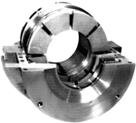
BEARING METALS:
SUPPORT TO ROTATING PARTS
PROVIDED BY BEARINGS.
PROPERTIES OF BEARING METALS:
HAVE GOOD CORROSION RESISTANCE.
HIGH FATIGUE STRENGTH.
HIGH COMPRESSIVE STRENGTH.
SHOULD BE HARD AND WEAR RESISTANCE FOR LONGER LIFE.

Slide 58
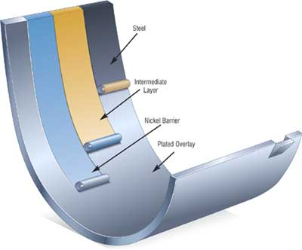
STEEL
INTERMEDIATE LAYER
NICKEL BARRIER
PLATED OVERLAY
KINGSBURY RADIAL AND THRUST PAD BEARING
LAYERS OF JOURNAL BEARING STRUCTURE

Slide 59
5. THE AFFINITY BETWEEN THE SHAFT AND
BEARING MATERIAL SHOULD BE MINIMUM.
6. ANTIFRICTION AND GOOD LUBRICATING
PROPERTIS.
7. HIGH THERMAL CONDUCTIVITY.
8. SHOULD HAVE ANTICEASEING PROPERTIES.

Slide 60
WHITE BEARING METALS.
( BABBITS ):
THESE ARE TIN BASE OR LEAD BASE ALLOYS.
TIN BASE BEARINGS HAVE BETTER QUALITY, HEAVY DUTY WHITE METALS
ARE KNOWN AS BABBITS (SNSB)
TIN (Sn)
ANTIMONY. (Sb)

Slide 61
BABBIT CONTAINS 3.5-15% ANTIMONY.
IT COMBINES CHEMICALLY WITH SOME OF THE
TIN, GIVING RISE TO AN INTERMETTALIC
COMPOUND SBSN. I.E. ANTIMONY- TIN.
THIS FORMS CUBIC CRISTALS.WHICH ARE HARD
AND HAVE LOW FRICTION PROPERTIES.
THIS CONSTITUTES THE NECESSARY BEARING
SURFACE IN WHITE METALS.

Slide 62
THE LEAD RICH WHITE METALS ARE INTENDED FOR LOWER DUTY AS THEY CAN WITHSTAND LIMITED PRESSURE.

Slide 63
BABBITT
METAL OR BEARING METAL, IS ANY OF SEVERAL alloys USED FOR THE bearing surface IN A plain bearing.
THE ORIGINAL BABBITT METAL WAS INVENTED IN 1839 BY ISAAC.
(BABBITT METAL—AS WITH “diesel engine").
IT IS PREFERRED OVER THE TERM “ white metal", WHICH ALSO REFERS TO BEARING METAL, BECAUSE "WHITE METAL" IS AN AMBIGUOUS TERM WITH VARIOUS MEANINGS.

Slide 64
BABBITT METAL IS MOST COMMONLY USED AS A THIN SURFACE LAYER IN A COMPLEX, MULTI-METAL STRUCTURE, BUT ITS ORIGINAL USE WAS AS A cast in place BULK BEARING MATERIAL.
BABBITT METAL IS CHARACTERIZED BY ITS RESISTANCE TO galling.

Slide 65
BABBITT METAL IS SOFT AND EASILY DAMAGED, WHICH SUGGESTS THAT IT MIGHT BE UNSUITABLE FOR A bearing SURFACE.
HOWEVER, ITS STRUCTURE IS MADE UP OF SMALL HARD crystals DISPERSED IN A SOFTER METAL, WHICH MAKES IT A metal matrix composite.

Slide 66
AS THE BEARING WEARS, THE SOFTER METAL ERODES SOMEWHAT, WHICH CREATES PATHS FOR LUBRICANT BETWEEN THE HARD HIGH SPOTS THAT PROVIDE THE ACTUAL BEARING SURFACE.
WHEN TIN IS USED AS THE SOFTER METAL, FRICTION CAUSES THE TIN TO MELT AND FUNCTION AS A LUBRICANT, WHICH PROTECTS THE BEARING FROM WEAR WHEN OTHER LUBRICANTS ARE ABSENT.

Slide 67
THERE ARE MANY BABBITT ALLOYS IN ADDITION TO BABBITT'S ORIGINAL.
SOME COMMON COMPOSITIONS ARE:
90% tin, 10% cu
89% tin, 7% antimony, 4% copper
80% lead, 15% antimony, 5% tin
76% copper, 24% lead
75% lead, 10% tin
67% copper, 28% tin, 5% lead
INTERNAL COMBUSTION MOTORS USE BABBITT METAL WHICH IS PRIMARILY TIN-BASED BECAUSE IT CAN WITHSTAND THE POUNDING. LEAD-BASED

Slide 68
* COPPER BASE BEARING METALS :
THESE ARE MADE BY POWDER METALLURGY
TECHNIQUE.
INCLUDES
PLAIN TIN BRONZES (10-15% TIN)
PHOSPHUR BRONZES
(10-13% TIN, 0.3-10% PHOSPHUR REST CU)
TIN AND CU COMBINES TO FORM HARD
INTERMETALLIC COMPOUNDS AS CU31SN7

Slide 69
AND REMAINDER OF THE TIN DISSOLVES IN THE COPPER TO FORM TOUGH SOLID SOLUTION.
SINTERED BRONZES BY MIXING
90%CU & 10% TIN POWDER
ARE OF SELF LUBRICATING TYPE.
SOMETIMES GRAPHITE IS ADDED. THE
MIXTURE IS THEN COMPACTED AT HIGH
PRESSURE IN A SUITABLE SHAPED DIE.

Slide 70
AND IS THEN SINTERED AT A TEMP. WHICH
CAUSES THE TIN TO MELT AND SO ALLOYED
WITH COPPER.
SINTERED BRONZES RETAINS ITS POROSITY
USED TO STORE LUBRICANTS.
THE BEARING IS IMMERSED IN LUBRICATING
OIL ,IS THEN DEPRESSURISED BY VACCUM
TREATMENT SO THE OIL WILL BE FORCED IN
TO THE PORES.

Slide 71
SELF LUBRICATING SINTERED BEARING ARE WIDELY USED IN
AUTOMOBILE INDUSTRIES
VACCUM CLEANERS,
WASHING MACHINE
EXTRACTOR FANS
ETC.

Slide 72
LEADED BRONZES USED IN MANUFACTURE
OF MAIN BEARINGS IN AERO-ENGINES
FOR AUTOMOBILES AND DIESEL
CRANKSHAFT BEARINGS.
THEY HAVE VERY HIGH WEAR RESISTANCE & GOOD THERMAL CONDUCTIVITY.

Slide 73
THANKS !!

