Slide 1
FUNDAMENTALS
OF
STEELS

Slide 2
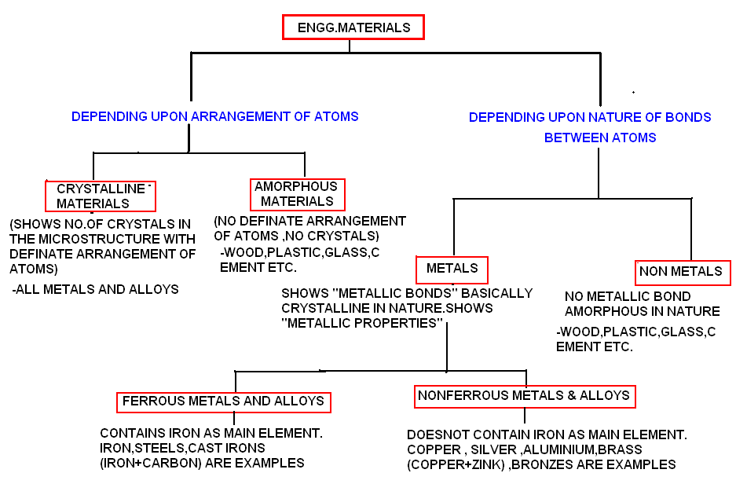
CLASSIFICATION OF ENGG.MATERIALS

Slide 3
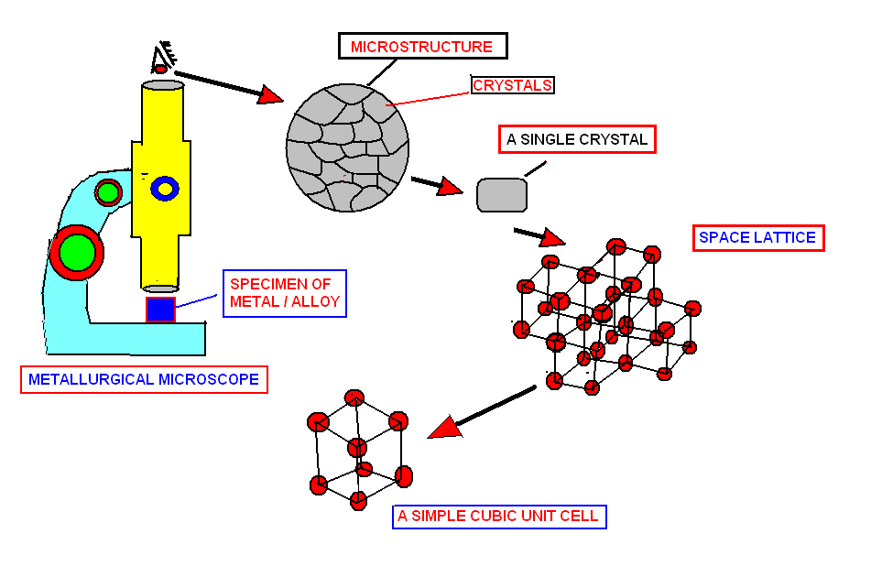
CRYSTALLINE MATERIALS

Slide 4
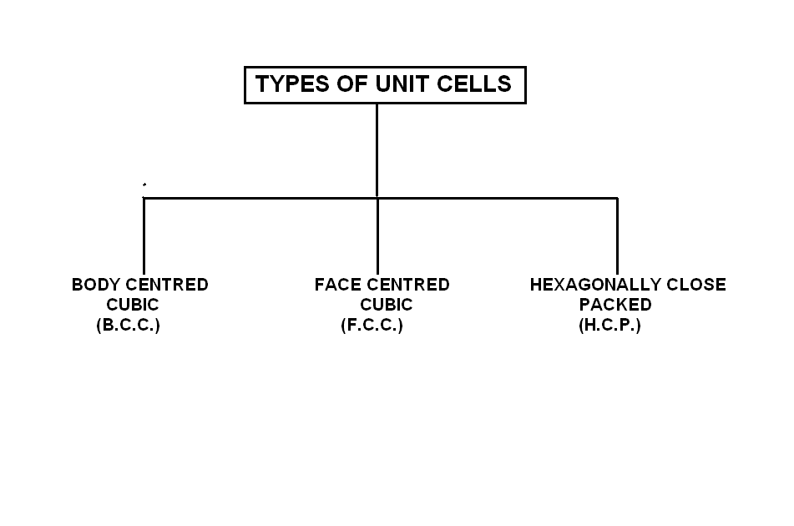

Slide 5
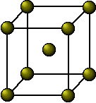
BODY CENTRED CUBIC UNIT CELL (BCC)
EXAMPLES : Iron, Chromium, Molybdenum, Vanadium,Sodium.

Slide 6
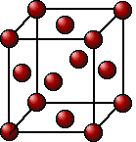
FACE CENTRED CUBIC UNIT CELL (FCC)
EXAMPLES : Iron,Aluminium,Gold,Silver,Lead,Platinum

Slide 7
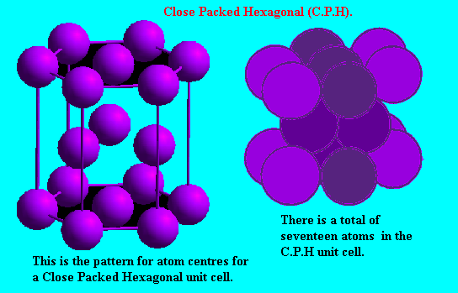
HEXAGONALLY CLOSE PACKED (HCP) UNIT CELL
EXAMPLES : Magnesium, Beryllium, Zinc, Cadmium

Slide 8
Phase is a form of material having characteristic structure and properties.
More precisely: form of material with identifiable composition (chemistry), definable structure, and distinctive boundaries (interfaces) which separate it from other phases.

Slide 9
PURE METAL
PURE METAL IS CRYSTALLINE IN NATURE.
BONDS BETWEEN ATOMS OF PURE METAL ARE “METALLIC BONDS”. DUE TO WHICH PURE METALS EXHIBITS “METALLIC PROPERTIES” AS UNDER,
DEFINATE MELTING TEMPERATURE.
DEFINATE THERMAL CONDUCTIVITY.
DEFINATE ELECTRICAL CONDUCTIVITY.
DEFINATE COLOR.
DEFINATE LUSTURE.

Slide 10
ALLOY
AN ALLOY IS A MACROSCOPICALLY HOMOGENIOUS MIXURE OF ATOMS OF TWO OR MORE ELEMENTS RIGHT DOWN TO ATOMIC LEVEL ,ONE OF THE ELEMENT SHOULD BE ESSENTIALLY A METAL AND MIXURE SHOWS METALLIC PROPERTIES.
EXAMPLES:
1.STEEL: AN ALLOY OF IRON +CARBON.
2. CAST IRON: AN ALLOY OF IRON +CARBON
2.BRASS:AN ALLOY OF COPPER +ZINC.

Slide 11
SOLID SOLUTION
SOLID SOLUTION IS MICROSCOPICALLY HOMOGENIOUS MIXURE OF ATOMS OF TWO OR MORE ELEMENTS RIGHT DOWN TO ATOMIC LEVEL ,ONE OF THE ELEMENT SHOULD BE ESSENTIALLY A METAL AND MIXURE SHOWS METALLIC PROPERTIES.
“ALL SOLID SOLUTIONS ARE ALLOYS BUT ALL ALLOYS MAY NOT BE SOLID SOLUTIONS”

Slide 12
TYPES OF SOLID SOLUTIONS
1. SUBSTITUTIONAL SOLID SOLUTION:
HERE THE ATOMS OF TWO ELEMENTS ARE NEARLY SAME IN SIZE & SUBSTITUTES EACH OTHERS POSITION IN SPACE LATTICE.
THEY HAVE NEARLY SAME SIZE
SAME ELECTROCHEMICAL NATURE
SOLUTION HAS LOWER VALANCY.

Slide 13
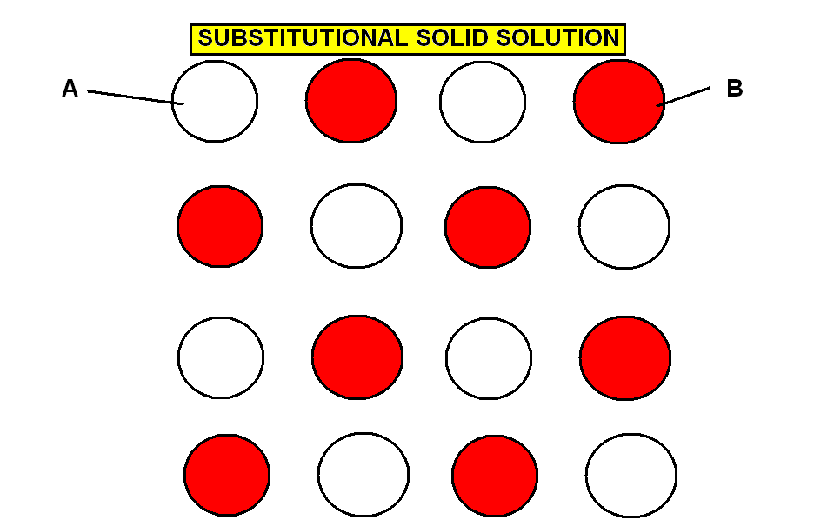

Slide 14
2.INTERSTITIAL SOLID SOLUTION:
HERE ONE ELEMENT ATOM IS LARGER IN DIAMETER AND OTHER ELEMENT ATOM IS SMALLER IN DIAMETER.
IN A COMBINED LATTICE SMALL DIAMETER ATOMS OCCUPY THE SPACES BETWEEN LARGE ATOMS OR INTRICES.
EXAMPLE:
STEEL :INTERSTITIAL SOLID SOLUTION OF IRON AND CARBON.

Slide 15
2.INTERSTITIAL SOLID SOLUTION:
CAST IRON:INTERSTITIAL SOLID SOLUTION OF IRON AND CARBON.
HERE IRON ATOMS ARE LARGE IN SIZE AND NUMBER AND BASIC SPACE LATTICE IS OF IRON.
CARBON ATOMS ARE SMALL IN DIAMETER AND OCCUPIES INTERSTITIAL SPACE BETWEEN TWO LARGER IRON ATOMS.

Slide 16
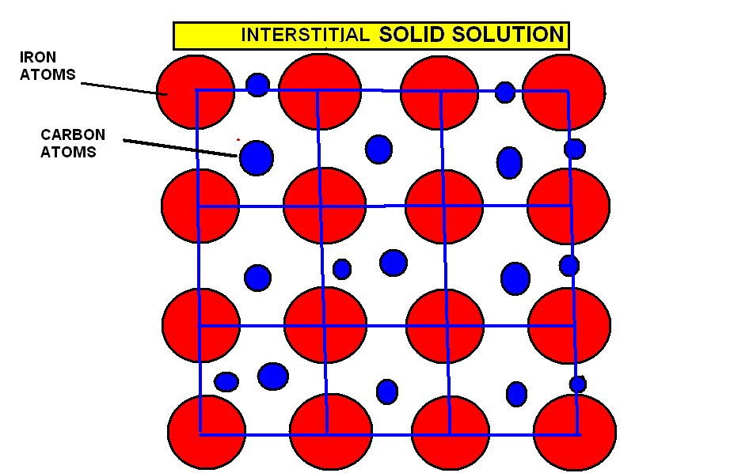

Slide 17
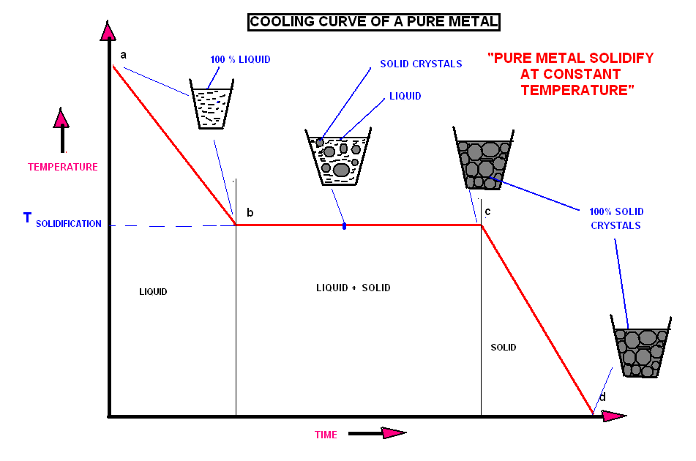

Slide 18
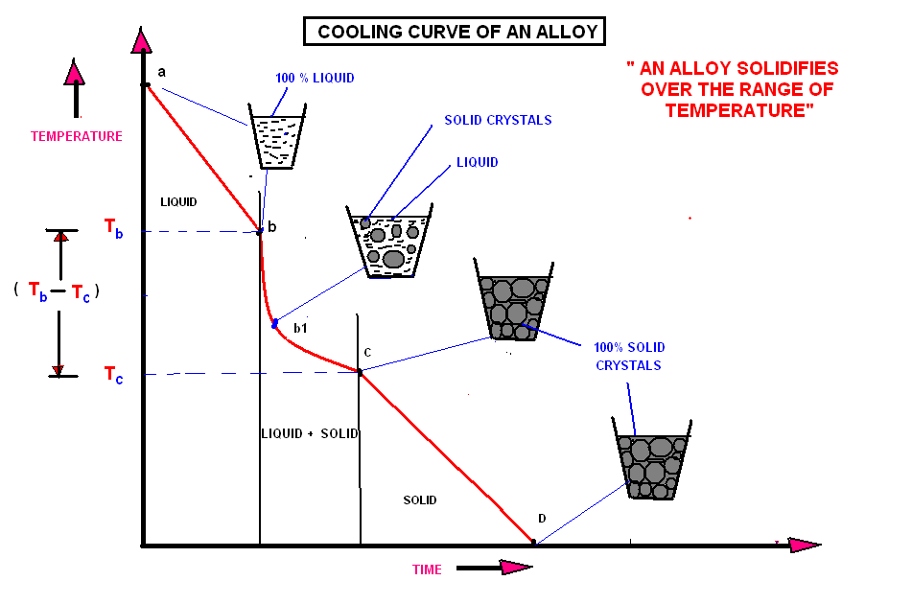

Slide 19
BINARY EQUILIBRIUM DIAGRAM
DRAWN BETWEEN TEMPERATURE AND COMPOSITION.
DEFINES AN ALLOY SYSTEM BETWEEN TWO METALS / ELEMENTS.
GIVES CHANGES IN THE STRUCTURE OF AN ALLOY WITH TEMPERATURE.
GIVES RELATIVE AMOUNTS OF PHASES IN AN ALLOY AT APARTICULAR TEMPERATURE

Slide 20
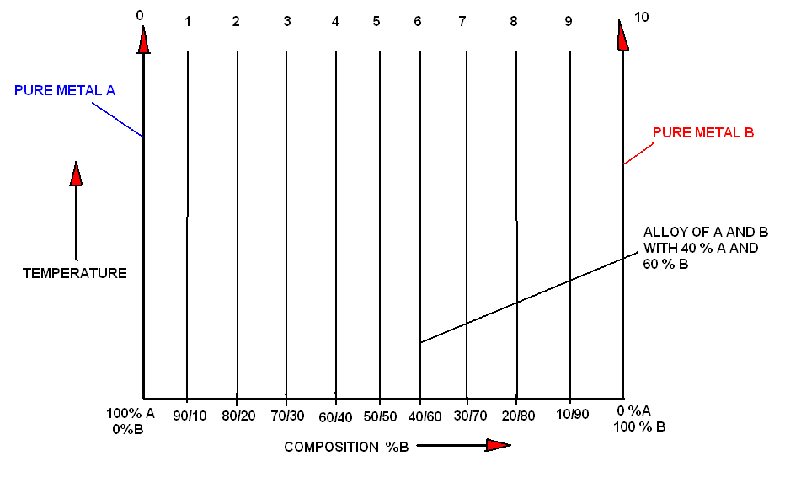
BINARY EQUILIBRIUM DIAGRAM

Slide 21
ISOMORPHOUS SYSTEM
ALLOY SYSTEM OF TWO METALS A AND B WHICH ARE COMPLETELY SOLUBLE IN THE LIQUID STAGE AS WELL AS IN SOLID STAGE.
BOTH THE TYPE OF METALS HAVE SAME UNIT CELLS AND SPACE LATTICE
EXAMPLES; Cu-Ni, Au-Ag, Mo-W.

Slide 22
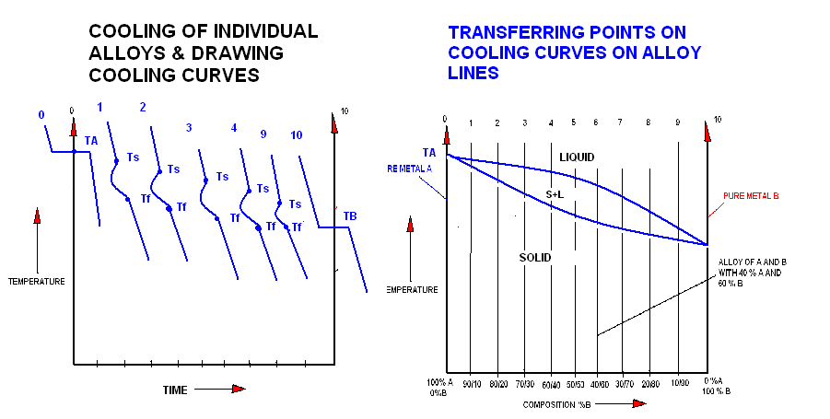

Slide 23
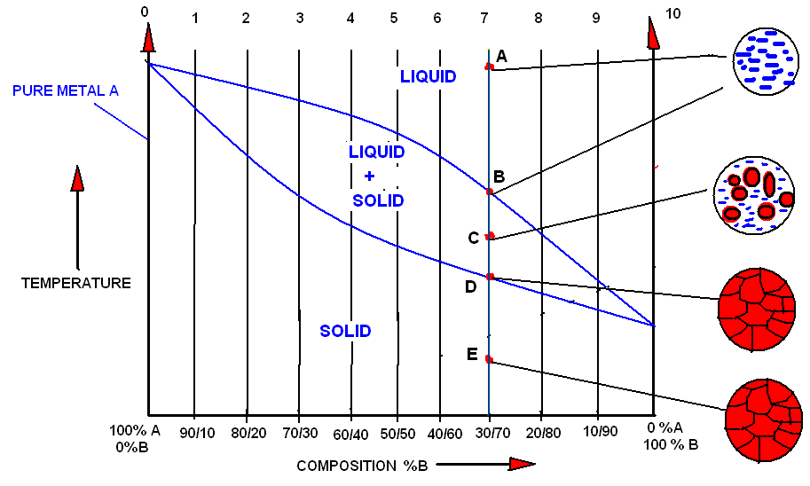

Slide 24
EUTECTIC SYSTEM
IT IS THE ALLOY SYSTEM BETWEEN TWO METALS A AND B WHICH ARE COMPLETELY SOLUBLE IN LIQUID STAGE BUT COMPLETELY INSOLIBLE IN SOLID STAGE AND SHOWING EUTECTIC REACTION.
EXAMPLES:Pb-As ,Bi-Cd,Th-Ti

Slide 25
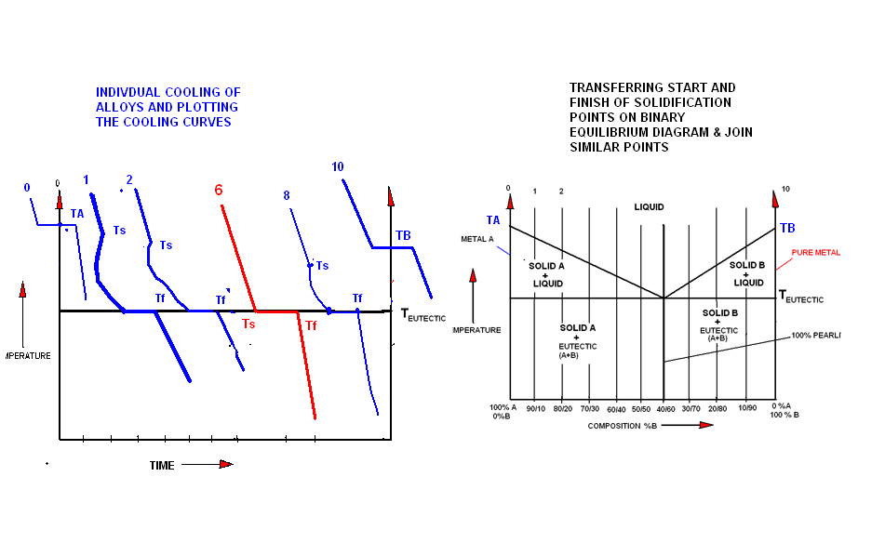

Slide 26
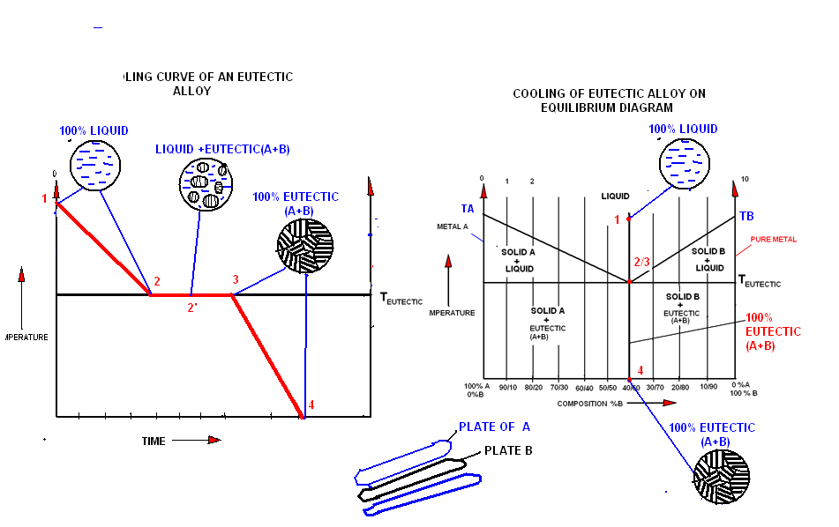
1OO% LIQUID
100 % EUTECTIC

Slide 27
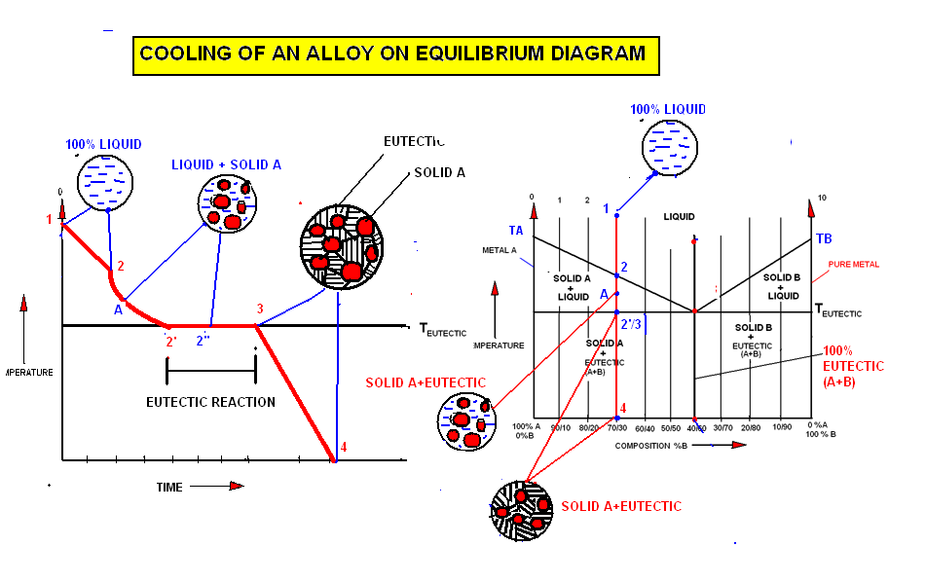

Slide 28
COOLING CURVE FOR
PURE IRON
MOLTEN IRON
1535
δ
DELTA IRON BCC
1400
ŗ
GAMMA IRON FCC
TEMP.
⁰C
910
α
ALPHA IRON BCC
NON MAGNETIC
768
ALPHA IRON BCC
MAGNETIC
α
TIME
FIG. SHOWS TRANSFORMATION OF DIFF. STRUCTURES AT CONSTANT TEMPERATURES.

Slide 29
ALLOTROPY AND POLYMORPHISM
POLYMORPHISM IS THE PROPERTY OF A MATERIAL TO EXIST MORE THAN ONE CRYSTAL LATTICE IN THE SOLID STATE.
E.g. CRISTAL STRUCTURE CHANGE FROM BCC (ALPHA IRON )TO FCC (GAMMA IRON ) AND AGAIN IN BCC (DELTA IRON) AS IN PURE IRON .
ALLOTROPY : IF THE ABOVE CHANGE IN STRUCTURE IS REVERSIBLE , THEN THIS POLYMORPHIC CHANGE IS KNOWN AS ALLOTROPY .

Slide 30
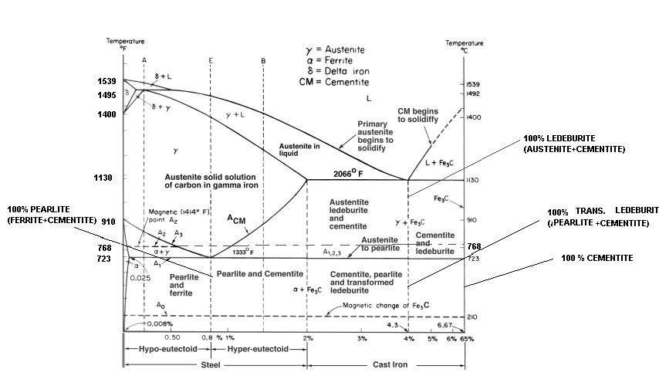
IRON CARBON DIAGRAM

Slide 31
On this diagram three horizontal lines are observed. At 723 ⁰c,1140 ⁰c and 1495 ⁰c.
At these temperatures following reactions occurs.
Eutectoid reaction. (At 723 ⁰c)
0.025 %c 0.8 6.67
723 ⁰c.
Austenite ferrite + cementite
i.e. ( pearlite )
(88%) + ( 12%)
Pearlite shows alternate plates of ferrire and cementite.

Slide 32
Percentage of each phase can be found by applying lever rule .
0.025 %c 0.8 6.67
% ferrite = ( 6.67- 0.8 ) / ( 6.67- 0.025 ) * 100
= 88 %
% cementite = (0.8 - 0.025) / (6.67- 0.025)*100
=12%
This
88% ferrite + 12% cementite = 100 pearlitre.

Slide 33
2.Eutectic reaction:
1140 ⁰c.
Ledeburite austenite + cementite
.ŗ + fe₃c
2.0 4.3 6.67
And below 723 ⁰c. This austenite transforms to ferrite + cementite.
And some of the ledeburite transformed as it is, called as transformed ledeburite.

Slide 34
3. Peritectic reation:
1495 ⁰c.
Austenite delta iron + liquid (molten metal )
ŗ δ + L
0.1 0.18 0.5
This reaction is not important for commertial heat treatment processes.

Slide 35
Ferrite: α- alpha solid solution
It is an interstitial solid solution of carbon dissolved in α-iron.(BCC- structure.). Maximum solubility of carbon is 0.008 % at room temp. and this solubility limit increases up to 0.025 % at 723 ⁰c (LCT-lower critical temp. or a1,2,3.)
Ferrite is soft and ductile, magnetic in nature. It is the softest structure that appears on the fe-c diagram.
Hardness- 50-100 BHN , less than Rockwell B 90 , TS= 40000 PSI, elongation 40% in 2 inch.

Slide 36
Cementite :
called as iron carbide, CM, fe₃c. Cementite contains 6.67 % C by wt. It is a intermetallic stable carbide compound. Crystal structure is orthorhombic. Very very hard and brittle interstitial compound.
Low TS @ 500 PSI. but high compressive strength.
It is the hardest structure on the diagram.
1400 BHN, ferromagnetic below 210 ⁰c & in the form of round particles.
It is the hardest phase on the diagram.

Slide 37
Austenite :ŗ –gamma solid solution.
It is an interstitial solid solution of carbon dissolved in ŗ gamma iron ( FCC structure). solubility of C is 0.8% at 723 ⁰c and this limit increases up to 2 % at 1140 ⁰c.
Austenite is stable only above 723 ⁰c. As temp. drops below a1, it transforms in other phases.(i.e. in ferrite, pearlite ). It is not useful for part manufacturing at this temp. range ( it is stable from 723 to 1400 ⁰c). Rather it can be transformed in different phases. On fast cooling autenite transform to martensite phase.

Slide 38
But it can be retained at room temp. by the addition of alloying elements.
E.g. Ni helps in retaining austenite at normal temp.
Hardness Rockwell C 40, and has high toughness.
TS 150000 PSI,
elongation 10% in 2 in.
it is non magnetic.
Austenitic stainless steel (18/8, 18% Cr ,8% Ni) shows austenite phase retained at room temp. which is non magnetic.

Slide 39
Pearlite:
austenite transforms to pearlite on very slow cooling.
In an eutectoid steel ( 0.8%C steel) austenite transform to pearlite at 723 ⁰c.
Eutectoid reaction-
723 ⁰c.
Austenite Pearlite
i.e. ( ferrite + cementite )
(88%) + ( 12%)
Pearlite shows alternate plates of ferrire and cementite.

Slide 40
Pearlite has high TS, better hardness, and toughness. TS 120000 psi, elongation 20% in 2 in. Rockwell C 20-60, Rc B 90-100,
250-300 BHN.
Medium pearlite is called as sorbite or troostite.
Fine pearlite is called as bainite. On faster cooling these phases are observed.

Slide 41
Ledeburite:
It is an eutectic mixture of austenite and cementite contains 4.3% C at 1140 ⁰c.
Eutectic reaction:
1140 ⁰c.
Ledeburite austenite + cementite
.ŗ + fe₃c
And below 723 ⁰c. This austenite transforms to ferrite + cementite.
And some of the ledeburite transformed as it is, called as transformed ledeburite.

Slide 42
ferrite
Pearlite.
austenite
HIGH TS, YS, HARD AND TOUGH
ON RETENTION TO ROOM TEMP. SHOWS BETTER TOUGHNESS AND STRENGTH.
SOFT AND DUCTILE
CEMENTITE : VERY HARD BUT VERY BRITTLE

Slide 43
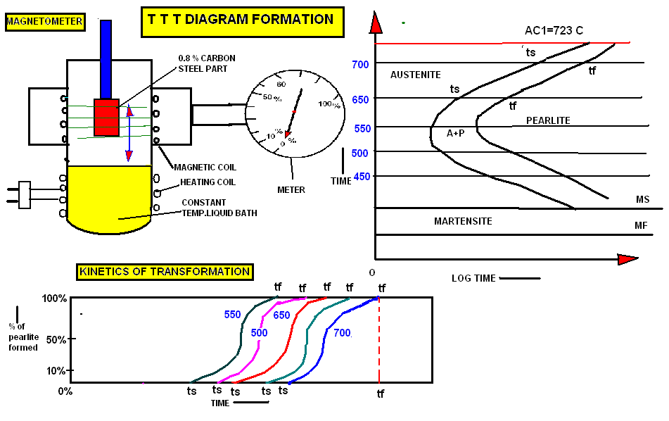

Slide 44
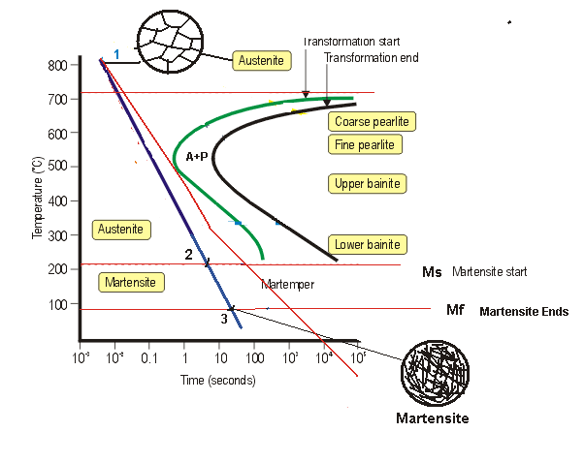
ISOTHERMAL TANSFORMATION DIAG.
Rc 20
Rc 30
Rc 40
Rc 45-60
Rc 64
TTT DIAGRAM FOR 0.8% CARBON STEEL

Slide 45
IRON CARBON DIAGRAM

Slide 46

MARTENSITE STRUCTURE
NEEDLES OF MARTENSITE

Slide 47
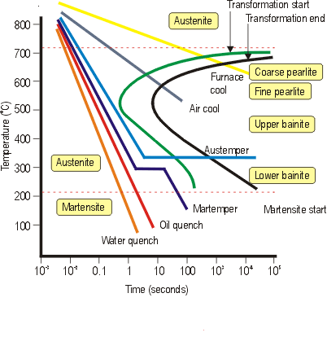

Slide 48
T T T i.e. TRANSFORMATION ON TIME AND
TEMPERATURE
Ms- MARTENSITIC START TEMP.
Mf- MARTENSITIC FINISH TEMP.
BAINITE : TRANSFORMATION BETWEEN 510 TO 220 ⁰C
i.e. BETWEEN NOSE OF THE DIAGRAM AND Ms TEMP.
MARTENSITE TRANSFORMATION START BELOW 220 ⁰C AND COMPLETE TRANSFORMATION OCCRS UP TO -150 ⁰C. ABOUT 90 % TRANSFOMATION POSSIBLE UP TO 90 ⁰C.
MARTENSITE TRANSFORMATION START AND ENDING TEMPERATURES LOWERS AS % C INCRESES OR DUE TO ADDITION OF ALLOYING ELEMENTS.

Slide 49
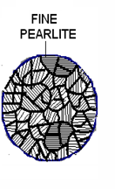
BAINITE :
STRUCTURE SHOWS
DARK ETCHING AGGREGATES
OF FERRITE AND CEMENTITE,
CALLED BAINITE.
THIS TRANSFORMATION OCCURS IN ISOTHERMAL BATHS MAINTAIND IN THE RANGE OF NOSE OF TTT DIAGRAM TO Ms TEMPERATUE. i.e. FROM A TEMP. 550 TO 220 ⁰C.
AT UPPER TEMP. IT RESEMBLES FINE GRAINED PEARLITE ,CALLED UPPER OR FEATHERY BAINITE OR TROOSTITE.

Slide 50
AT LOWER TEMP. IT APPEARS AS BLACK NEEDLE LIKE STRUCTURE , CALLED LOWER OR ACCICULAR BAINITE.
THE MEDIUM GRAINED PEARLITE TRANSFORMED ABOVE NOSE OF THE DIAGRAM MAY CALLED AS SORBITE.
TRANSFORMATION OF BAINITE IS CALLED AS AUSTEMPERING PROCESS.
THE SUPERIORITY OF AUSTEMPERING SHOWS UP IN SUCH PROPERTIES AS REDUCTION OF AREA IN TENSION,

Slide 51
RESISTANCE TO IMPACT, AND SLOW BEND TEST. AS A RSULT IT HAS GREATER DUCTILITY AND TOUGHNESS ALONG WITH HIGH HARDNESS. & ALSO HAVE LESS DISTORTION AND DANGER OF QUENCHING CRACKS.
BHN 350-450.

Slide 52
PROPERTY COMPARISON OF AUSTEMPERING (BAINITE STRUCTURE)WITH CONVENTIONAL QUENCHING.
AUSTEMPERING (BAINITE)
50
259000
5.0
46.4
GREATER THAN 150 ⁰ WITHOUT RUPTURE.
CONVENTIONAL QUENCH & TEMPER METHOD.
49.8
259000
3.75
14
RUPTURE AT 45 ⁰ BEND.
PROPERTY
ROCKWELL C
UTS PSI
ELONGATION IN 2 IN.
IMPACT FT-LB.
FREE BEND TEST.

Slide 53
MARTENSITE: (martempering process)
Heating to proper austinitizing temp, quenching rapidly in liquid salt bath held just above Ms temp. (210 ⁰c ) and holding for period of time (for uniform heating of component) and before transformation of bainite it is cooled in air, then reheated to desired tempering temp. ( about 450 ⁰c) and cooled in air. martempering minimizes residuals stresses, and reduces danger of distortion and cracking.

Slide 54
Due to higher cooling rate , insufficient time is allowed for the carbon to diffuse out of
solution , although some movement of the iron atoms takes place , the structure can not become BCC , while the carbon is trapped in solution , resultant structure called martensite. Which is the supersaturated solid solution of carbon trapped in a body centered tetragonal structure .

Slide 55
The highly distorted structure is the prime reason for the high hardness of martensite.
The hardness of martensite increases with increase in carbon percent.
Rc 60 at 0.40 % c
and Rc 65 at 0.8% c.

Slide 56
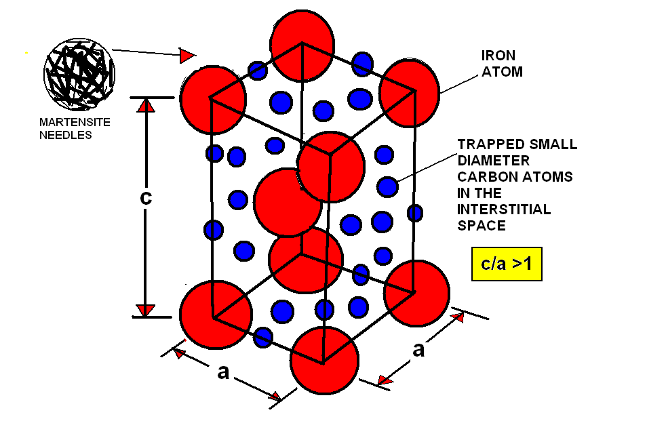
BODY CENTER TETRAGONAL UNIT CELL OF MARTENSITE

Slide 57
Thanks!!

