Slide 1
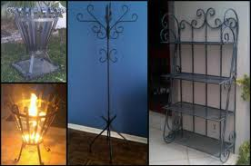
CAST IRON
AS PER SYLLABUS WE HAVE TO STUDY FOLLOWING TYPES
WHITE CI
GRAY CI
NODULAR CI
MALLEABLE CI
MADE OF WROUGHT IRON

Slide 2
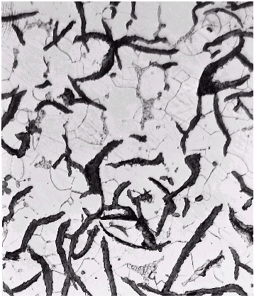
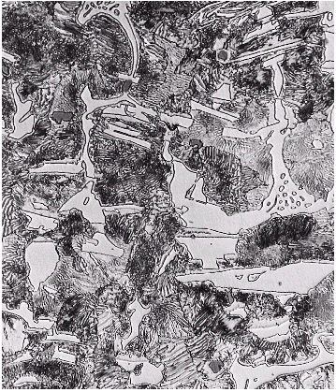
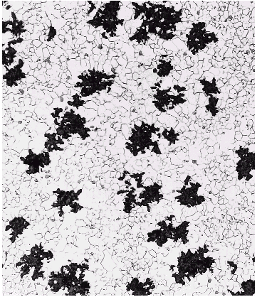
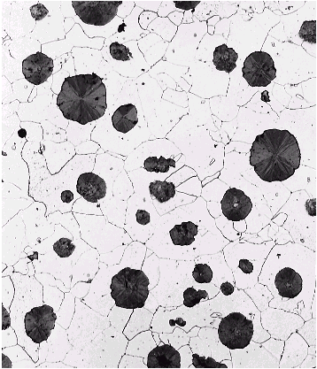
White iron
Gray iron
Ductile iron
Malleable iron

Slide 3
AT THE END OF TOPIC YOU WILL BE ABLE TO ANSWER THE FOLLOWING QUESTIONS.
STATE THE TYPES OF CAST IRONS.
STATE THE CHEMICAL COMPOSITION OF WHITE CAST IRON
STATE THE PROPERTIES AND APPLICATIONS OF GRAY CAST IRON.
EXPLAIN NODULAR CAST IRON WITH REF. TO COMPOSITION, PROPERTIES AND APPLICATIONS.

Slide 4
DRAW FLOW PROCESS DIAGRAM FOR MALLEABLE CAST IRON.
COMPARE WHITE CI WITH GRAY CI.
DRAW MICROSTRUCTURE OF THE FOLLOWING
1. GRAY CI 2. WHITE CI 3. NODULAR CI
STATE THE APPLICATIONS OF NODULAR CI.

Slide 5
PRINCIPAL FERROUS METALS ARE--------
PIG IRON
WROUGHT IRON
CAST IRON
CARBON STEEL
ALLOY STEEL
TOOL STEEL
STAINLESS STEEL
SPRING STEEL

Slide 6
Overview of cast iron
Iron with 1.7 to 4.5% carbon and 0.5 to 3% silicon
Lower melting point and more fluid than steel (better castability)
Low cost material usually produced by sand casting
A wide range of properties, depending on composition & cooling rate
  Strength
  Hardness
  Ductility
  Thermal conductivity
  Damping capacity

Slide 7
Iron carbon diagram
Iron carbon diagram
Carbon
Steel
Cast Iron
δ
Liquid
γ+ L
γ+ L
L + Fe₃C
L + Fe₃C
Austenite
Austenite
910˚C
910˚C
γ + Fe₃C
γ + Fe₃C
α + γ
α + γ
723˚C
723˚C
α
α
α + Fe₃C
α + Fe₃C
0%
0%
0.8%
0.8%
~2%
~2%
3%

Slide 8
Effect of cooling rate
Slow cooling favours the formation of graphite & low hardness
Rapid cooling promotes carbides with high hardness
Thick sections cool slowly, while thin sections cool quickly
Sand moulds cool slowly, but metal chills can be used to increase cooling rate & promote white iron.

Slide 9
TYPES OF CAST IRON
CAST IRON
GRAY CI
WHITE CI
NODULAR CI
SPHEROIDAL CI
DUCTILE CI
CHILLED CI
MEEHA NITE CI
ALLOY CI
MALLEABLE CI
WHITE HEART
BLACK HEART

Slide 10
PIG IRON:
PRODUCED IN BLAST FURNACE.
MINERALS AND ORES ARE CARBONATES, HYDRATES OR OXIDES OF THE METAL.
ORES FOUND MOSTLY IN BIHAR, ORISSA, MP, KARNATAKA, TAMILNADU ETC.
IRON ORES ARE…..
HEMATITE (RED)- CRYSTALLINE OR GRANULAR Fe2O3
HEMATITE (BROWN)- DENSE, EARTHY, 2Fe2O33H2O
MAGNETITE- STEEL GRAY OR BLACK, Fe3O4
SIDERITE- CRYSTALLINE GRAY, FeCO3

Slide 11
FLOW DIAGRAM FOR PIG IRON
IRON ORE +CHAR COAL +FLUX
I.E. CHARGE
BLAST FURNACE
SMELTING PROCESS OR REDUCTION PROCESS
PIG IRON

Slide 12
CHARGE:-
IRON ORE + COOKING COAL + FLUX
COAL CONTAINS PHOSPHROUS & SULPHURE
FLUX – LIME STONE OR DOLOMITE
FLUX ADDED TO LOWER MELTING PT. OF ORE & TO PROMOTE REMOVAL OF ASH, SULPHURE & RESIDUE OF BURNT FUEL.
THIS CHARGE ON HEATING IN BLAST FURNACE GIVES PIG IRON.

Slide 13
PIG IRON HAVE 3 TO 4 % OF CARBON
SMALL AMOUNT OF SULPHUR---FROM THE COKE
SI, MN, P & MOST OF SULPHUR –FROM ORES
PIG IRON SUCH PRODUCED IS VERY HARD & BRITTLE AND IS NOT SUITABLE FOR MAKING USEFUL ARTICLES.
IT IS THEN REMELTED AND REFINED IN CUPOLA FURNACE OR IN ELECTRIC FURNACE WITH DEFINITE AMT. OF LIME STONE, STEEL SCRAP AND SPOILED CASTINGS TO PRODUCE OTHER TYPES OF IRON AND STEEL.

Slide 14
EFFECT OF ELEMENTS ON CAST IRON OR STEEL
Si-
PRESENT UPTO 2.5%
PROMOTES FORMATION OF FREE GRAPHITE
ACTS AS A STRONG GRAPHATIZER
PROMOTES FORMATION OF GRAPHITE FLAKES
IT PRODUCES SOUND CASTINGS, FREE FROM BLOW HOLES AS IT HAS HIGH AFFINITY FOR OXYGEN.
DEPRESSSES SOLIDIFYING TEMP.
INCRESES FLUDITY OF IRON.
IN WROUGHT IRON, SMALL AMOUNT OF Si MAKES IT HARD, BRITTLE AND UNFORGEBLE.

Slide 15
Mn-
TENDS TO HARDEN CI BY ENCOURAGING FORMATION OF CARBIDE. LIKE IRON CARBIDE Fe3C
KEPT BELOW 0.75%
IT CONTROLS HARMFUL EFFECTS OF SULPHUR BY FORMING MnS.
SULPHUR-
REGARDED AS HARMFUL IN CAST IRON.
LOWERS THE VISCOSITY OF MELT(DEVIATES FLUDITY)
TENDS TO MAKE IT HARD AND BRITTLE
KEPT BELOW 0.1% FOR MOST FOUNDRY PURPOSES.
PROMOTES AMOUNT OF COMBINED CARBON, FORMS FeS.
IN WROUGHT IRON , IT PRODUCES RED-SHORTNESS. IT BECOMES BRITTLE AND UNWORKABLE.

Slide 16
PHOSPHROUS-
INCRESES FLUDITY BUT INDUCES BRITTLENESS
LIMITED UPTO 1%
IN WROUGHT IRON, EVEN 0.1% P MAKES AND LIABLE TO CRACK i.e. COLD – SHORTNESS.
REDUCING COLD WORKING PROPERTIES BUT MALLEABELE AND WORKABLE AT RED HEAT.
Ni-
ACTS AS GRAPHATIZER BUT HALF OF SILICON
HELPS TO REFINE THE SIZE IF GRAINS AND GRAPHITE
ADDITION UPTO 0.25-2.0%
14-30% Ni ADDED IN GRAY IRONS TO RESIST HEAT AND CORROSION AND HAVE LOW EXPANSIVITY.
8% Ni ADDED IN STAINLES STEEL.

Slide 17
Cr—
ACTS AS A CARBIDE STABILIZER
INTENSIFIES CHILLING OF CAST IRON
INCRESES STRENGTH, HARDNESS AND WEAR RESISTANCE
REFINES GRAIN STRUCTURE
RESISTS CORROSION
ADDITION GENERALLY 0.15-3%
BUT UPTO 35% Cr IS ADDED IN ALLOY STEEL
18% Cr IS ADDED IN STAINLESS STEEL
Cu-
PROMOTES FORMATION OF GRAPHITE
0.02-2.5% Cu IS ADDED

Slide 18
CHEMICAL COMPOSITION
MATERIAL | CARBON | Si | Mn | SULPHUR | P
PIG IRON | 3.00-4.00 | 0.5-3.00 | 0.1-1.0 | 0.02-0.1 | 0.03-2.00
GRAY CI | 2.5-3.75 | 1.00-2.5 | 0.4-1.0 | 0.06-0.12 | 0.1-1.00
MALLEABLE CI | 2.2-3.6 | 0.4-1.1 | 0.1-0.4 | 0.03-0.3 | 0.1-0.2
WHITE CI | 1.75-2.3 | 0.8-1.2 | 0.1-0.4 | 0.12-0.35 | 0.05-0.2
WROUGHT IRON | 0.02-0.03 | 0.1-0.2 | 0.02-0.1 | 0.02-0.04 | 0.05-0.2
CARBON STEEEL | 0.05-2.00 | 0.05-0.3 | 0.3-1.00 | 0.02-0.2 | 0.02-0.15

Slide 19
FLOW DIAG. FOR GRAY CI AND WHITE CI
PIG IRON
CUPOLA FURNACE
REFINEMENT PROCESS
SOLIDIFYING BY COOLING SLOWING
SOLIDIFYONG BY RAPID COOLING
GRAY CI
WHITE CI

Slide 20
ON RAPID COOLING --- MARTENSITE AND CEMENTITE PHASE TRANSFORMED
ON SLOW COOLING--- FERRITE , PEARLITE AND CEMENTITE TRANSFORMED .
IN CAST IRONS INSTEAD OF PEARLITE AND CEMENTITE THE CARBON IS IN THE FORMS OF FLAKES, GLOBULES, SPHEROIDS ETC.

Slide 21
GRAY CI:-
DULL GRAY CRYSTALLINE OR GRANULAR STRUCTURE , IT GIVES GLISTERING EFFECT DUE TO REFLECTION OF LIGHTBY GRAPHITE FLAKES. FRACTURE SHOWS BLACK SPOTS.
CONTAINS CARBON IN THE FORM OF GRAPHITE FLAKES.
SILICOIN ENCOURGES FORMATION OF GRAPHITE.
IT IS BTITTLE MAY BROKEN BY HAMMER BLOW. 150-200 BHN
IT IS CHEAP, HAVING LOW MELTING POINT -1150 TO 1200 OC
EASILY MACHINED.

Slide 22
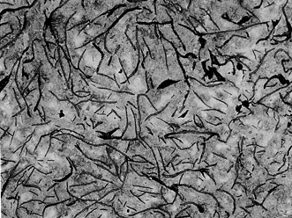
GRAY CI:-
MICROSTRUCTURE
GRAPHITE FLAKES

Slide 23
GRAY CI:-
PROPERTIES:
GOOD MACHINABILITY
EXCELLENT DAMPING CAPACITY
HIGH WEAR RESISTANCE
RAPIDLY CAST INTO DESIRED SHAPES
POSSES HIGH FLUDITY
LOW DUCTILITY AND LOW IMPACT
STRENGTH
UTS- 120-300 N/SQ,MM
COMPRESSIVE STRENGTH- 600-750 N/SQ,MM
HARDNESS-150-240 BHN
MELTING TEMP-1200 0C

Slide 24
GRAY CI-
APPLICATIONS-
M/C TOOL STRUCTURES,
BEDWAYS, FRAME,
GUIDE WAYS,
UNDER GROUND PIPES,
MAN HOLE COVERS,
TUNNEL SEGMENTS,
CYLINDER BLOCKS,
IC ENGINE HEADS ETC.
GRAY CI:-
Engines-
  Cylinder blocks, liners,
Brake drums, clutch plates
Pressure pipe fittings
Machinery beds
Furnace parts, ingot and glass moulds.

Slide 25
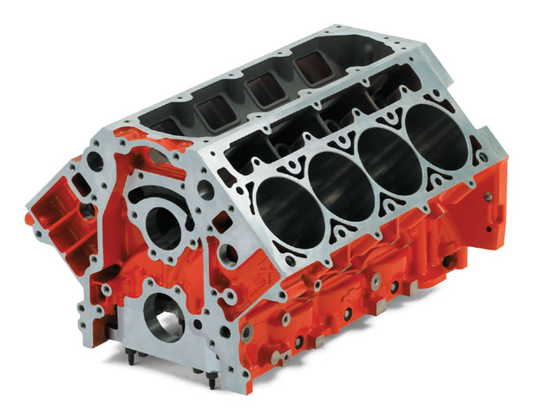
GRAY CI-
APPLICATIONS-
How do the properties of cast iron make it such an ideal material for this application?
CYLINDER BLOCK

Slide 26
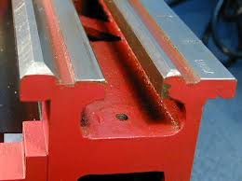
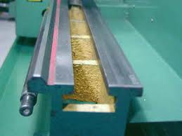
lathe bed ways.
HIGH COMPRESSIVE STRENGTH, HARDENED AND MADE WEAR RESISTANT.

Slide 27
WHITE CI-
CARBON EXCLUSIVELY PRESENT IN THE FORM OF CEMENTITE AND MARTENSITE.
Mn ENCOURAGES FORMATION OF CARBIDES.
VERY HARD AND BRITTLE 400-600 BHN
IT HAS LIMITED APPLICATIONS.
HIGH WEAR RESISTANT
CAN NOT MACHINED.
WIDELY USED TO PRODUCE WROUGHT IRON AND MALLEABLE CI.

Slide 28
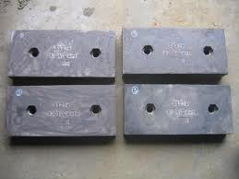
White ci--
APP:
WEAR RESISTING COMPONENTS AS
EXTRUSION DIES
CEMENT MIXER LINERS
JCB BUCKET TEETHS
PLOUGH TOOTH
BALL MILLS
FOUNDARY
DRAWING DIES etc.
HIGH CROME WHITE IRON FOUNDARY

Slide 29
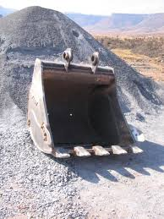
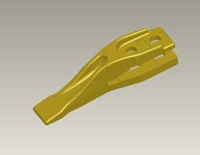
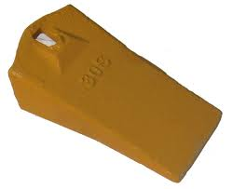
Excavator Bucket
Excavator Bucket Teeth,
WHITE CAST IRON- VERY HARD AND WEAR REISTANT

Slide 30
White ci—
MICROSTRUCTURE
White iron
< 1 wt% Si
pearlite + cementite
very hard and brittle

Slide 31
MALLEABLE CI—
WHITE CI IS HARD AND BRITTLE , UNSUITABLE FOR APPLICATIONS.
WHITE CI
MALLEABLIZING
TWO METHODS
Fe3C 3Fe+C
WHITE HEART IRON
BLACK HEART IRON
USED FOR THIN WALLED COMPONENTS
USED FOR THICK WALLED COMPONENTS

Slide 32
MALLEABLIZING—i.e.
WHITE HEART PROCESS-
CASTING OF WHITE CI PACKED INTO STEEL OR IRON BOXES AND SURROUNDED BY NEW HEAMATITE ORE. BOXES HEATED UPTO 950-1000 0C FOR FIVE DAYS. DUE TO THIS CARBON IS OXIDIZED OUT OF CASTING AND REMAINDER IS DISPERSED IN FINELY DEVIDED FORM THROUGHT OUT THE STRUCTURE. THIS PROCESS OF DECARBURIZATION IS CALLED MALLEABLIZING.

Slide 33
WHITE HEART IRON-
CHEMICAL COMPOSITION-
C- 3.2-3.6, Si-0.4-1.1, Mn-0.1-0.4, S-0.1-0.3, P- 0.1
APPLICATIONS:
HINGES
DOOR KEYS
SPANNERS
GEAR EHEELS
CRANKS
LEAVERS
COMPONENTS OF SEWING AND TEXTILE
MACHINES.

Slide 34
BLACK HEART PROCESS: BLACK HEART IRON
WHITE CI CASTINGS HEATED TO A TEMP. OF 1000
0C FOR 2-3 DAYS IN A NEUTRAL ATMOSPHERE, WHICH DOES NOT GIVE OFF OXYGEN. E.g. IN QUARTZ SAND OR PROTECHTIVE GAS. TEMPERATURE SO CONTROLLED THAT CEMENTITE DECOMPOSED INTO TEMPER CARBON. THE RESULTING GRAPHITE IS IN BALL LIKE FORM.
FINAL CASTINGS ARE LESS BRITTLE AND MORE TOUGH. USED FOR THICK WALLED COMPONENTS. AND MACHINED BY MEANS OF CUTTING TOOLS.

Slide 35
BLACK HEART CI
CHEMICAL COMPOSITION
C- 2.2-2.8, SI-0.8-1.5, Mn-0.25-0.6, P<0.18, S-0.05
APPLICATIONS:
CONVEYOR CHAIN LINES
UNIVERSAL JOINT YOKE
AUTOMOTIVE INDUSTRY
CRANK SHAFT
SPROKET ETC.

Slide 36
BLACK HEART CI
MICROSTRUCTURE
Uniformly dispersed graphite
Ferrite, pearlite or tempered martensite matrix
Ferritic castings require 2 stage anneal.
Pearlitic castings - 1st stage only

Slide 37
S.G IRON:
(SPHEROIDAL GRAPHITE IRON OR NODULAR CI OR DUCTILE CI)
FLOW SHEET OF THE PROCESS
CHARGE: PIG IRON, CAST IRON SCRAP, STEEL SCRAP, FOUNDRY RETURNS, PETROLIUM COKE, Fe-Si ALLOY,
COMPOSITION IS ADJUSTED TO CARBON EQUIVELENT 4.1 % OF MOLTEN IRON WITH Si 1.5-1.8 %
CONTD.

Slide 38
MELTING
DESULPHURISATION
NODULISING WITH Fe-Si-Mg ALLOY
RESIDUAL Mg 0.03-.006%
Mg ADDED AS INNOCULENT OTHER ARE CERIUM,CALCIUM ETC.
Mg PROMOTES NODULISING.
Si FOR GRAPHITIZING , IT IS A STRONG GRAPHITAZER AND REDUCE BLOW HOLES AND TO INCREASE FLIDITY OF IRON.
POST INOCULATION WITH Fe-Si ALLOY ( TO GIVE 0.6 % Si, VERY MUCH ESSENTIAL TO BREAK CEMENTITE FORMED DURING Mg TREATMENT)

Slide 39
CASTING
COMPOSITION OD CASTING 3.5-3.8 % C
2.4-2.7 % Si
< 0.02 % S
CHEMICAL COMPOSITION
FETTLING
CLEANING OF BURRS, ANY IRREGULARITIES ETC. SAND PARTICLES ARE FORCED ON CASTING.
HEAT TREATMENT

Slide 40
S.G. IRON:
PROPERTIES:
EXCELLENT COMBINATION OF STRENGTH AND
DUCTILITY. TS 330 N/SQ.M
HIGH FLUDITY, GIVES SOUND CATINGS.
WIDELY USED IN CAST PARTS WHERE DENSITY AND
PRESSURE TIGHTNESS IS HIGHLY DESIRABLE.

Slide 41
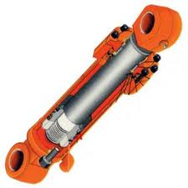
S.G IRON
APPLICTIONS:
HYDRAULIC CYLINDERS
VALVES
PIPE AND PIPE FITTINGS
CYLINDER HEAD FOR COMPRESSORS
DIESEL ENGINES
ROLLS FOR ROLLING MILLS
HYDRAULIC CYLINDER MADE OF DUCTILE IRON

Slide 42

S.G IRON
APPLICTIONS:
Valve body
Shafts which take tension
Pump housings
Gears
Engine blocks
VALVE BODY
Ductile Iron can be really strengthened by austempering. That way the spherical graphite lives in a bainite matrix.

Slide 43
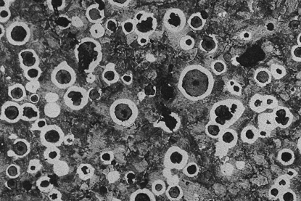
S.G IRON
MICROSTRUCTURE
GLOBULES OR NODULES
Graphite spheres surrounded by ferrite
Usually some pearlite
May be some cementite
Can be hardened to martensite by heat treatment

Slide 44
Weldability
White cast iron - not weldable
  Small attachments only
Grey cast iron - low weldability
  Welding largely restricted to salvage and repair
Ductile and malleable irons - good weldability (inferior to structural steel)
  Welding increasingly used during manufacture

Slide 45
IDENTIFY THE MICROSTRUCTURE---
Gray iron
graphite flakes
weak & brittle under tension
stronger under compression
excellent vibrational dampening
wear resistant
Ductile iron
add Mg or Ce
graphite in nodules not flakes
matrix often pearlite - better ductility

Slide 46
IDENTIFY THE MICROSTRUCTURE---
White iron
<1wt% Si so harder but brittle
more cementite
Malleable iron
heat treat at 800-900ºC
graphite in rosettes
more ductile

Slide 47
THANKS !!

