Slide 1
Pressure Measurement
Syllabus:
5.1 Definition & Units of Pressure, Terminology
of Pressure Measurement.
5.2 Low Pressure Measurement, McLeod
Gauge, Thermal Conductivity Gauge,
Ionization Gauge
5.3 High Pressure Measurement Manometers,
Electrical Resistance Pressure Gauge

Slide 2
Definition
Force per unit area
Normal force exerted by the medium (usually fluid) on unit area.
Mathematically,
Pressure, P= F/A
where, F- force exerted
A- Unit area
Unit of Pressure
High pressures are often expressed in units of atmosphere or Pascal or pounds force per square inch(psi) or mm Hg of manometer

Slide 3
Unit of Pressure
OR
Units of Vacuum measurement are Torr and micrometer of mercury

Slide 4
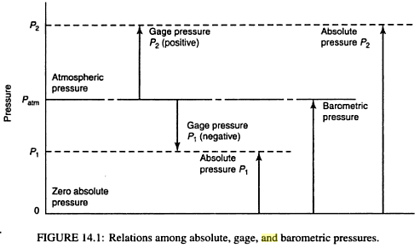
Relations of different Pressures
At Gauge pressure p2, P_{abs} =P_{atm}+ P_{gauge or =} P_{gauge =} P_{abs} -P_{atm}
At vaccum pressure p1, P_{abs} = P_{atm}- P_{gauge or} P_{gauge} = P_{atm}- P_{abs}

Slide 5
Methods of Pressures Measurement

Slide 6
PRESSURE MEASUREMENT
LOW PRESSURE MEASUREMENT
HIGH PRESSURE MEASUREMENT
MCLEOD GAUGE
2. THERMAL CONDUCTIVITY GAUGE
I) THERMOCOUPLE VACCUM GAUGE
II) PIRANI GAUGE
3. IONIZATION GAUGE
MANOMETERS
2. ELECTRICAL RESISTANCE PRESSURE GAUGE
I) RESISTANCE TYPE
II) PHOTOELECTRIC TYPE
III) PIEZOELECTRIC TYPE
IV) VARIABLE CAPACITOR TYPE
3.ELASTIC PRESSURE GAUGES
I) BOURDON TUBE
II) DIAPHRAGM GAUGE
III) BELLOWS

Slide 7
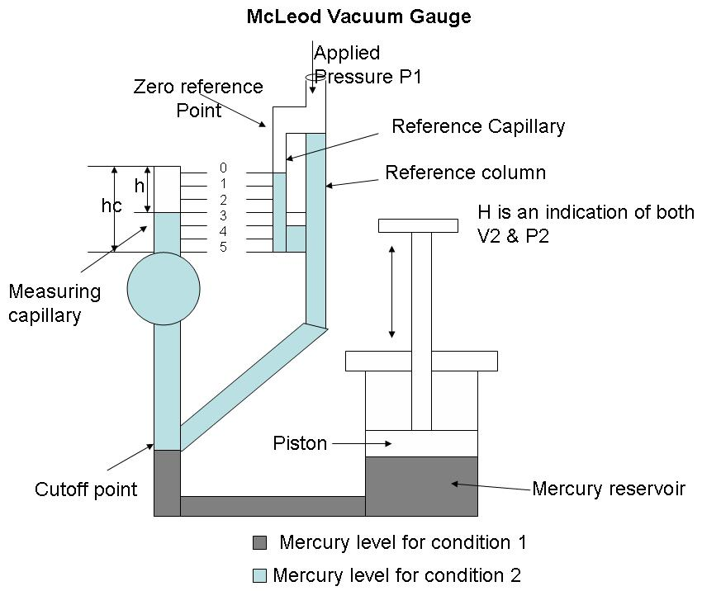
Description of McLeod Vacuum Gauge: The main parts of McLeod gauge are as follows:

Slide 8
MCLEOD VACUUM GAUGE:
BASIC PRINCIPLE OF MCLEOD VACUUM GAUGE:
A KNOWN VOLUME GAS IS COMPRESSED TO A SMALLER VOLUME WHOSE FINAL VALUE PROVIDES AN INDICATION OF THE APPLIED PRESSURE. THE GAS USED MUST OBEY BOYLE’S LAW GIVEN BY; P1V1=P2V2 WHERE, P1 = PRESSURE OF GAS AT INITIAL CONDITION (APPLIED PRESSURE). P2 = PRESSURE OF GAS AT FINAL CONDITION. V1 = VOLUME OF GAS AT INITIAL CONDITION. V2 = VOLUME OF GAS AT FINAL CONDITION. INITIAL CONDITION == BEFORE COMPRESSION. FINAL CONDITION == AFTER COMPRESSION.

Slide 9
A KNOWN VOLUME GAS (WITH LOW PRESSURE) IS COMPRESSED TO A SMALLER VOLUME (WITH HIGH PRESSURE), AND USING THE RESULTING VOLUME AND PRESSURE, THE INITIAL PRESSURE CAN BE CALCULATED.
THIS IS THE PRINCIPLE BEHIND THE MCLEOD GAUGE OPERATION.

Slide 10
A REFERENCE COLUMN WITH REFERENCE CAPILLARY TUBE.
THE REFERENCE CAPILLARY TUBE HAS A POINT CALLED ZERO REFERENCE POINT.
THIS REFERENCE COLUMN IS CONNECTED TO A BULB AND MEASURING CAPILLARY AND THE PLACE OF CONNECTION OF THE BULB WITH REFERENCE COLUMN IS CALLED AS CUT OFF POINT. (IT IS CALLED THE CUT OFF POINT, SINCE IF THE MERCURY LEVEL IS RAISED ABOVE THIS POINT, IT WILL CUT OFF THE ENTRY OF THE APPLIED PRESSURE TO THE BULB AND MEASURING CAPILLARY.
BELOW THE REFERENCE COLUMN AND THE BULB, THERE IS A MERCURY RESERVOIR OPERATED BY A PISTON.

Slide 11
OPERATION OF MCLEOD VACUUM GAUGE:
THE PRESSURE TO BE MEASURED (P1) IS APPLIED TO THE TOP OF THE REFERENCE COLUMN OF THE MCLEOD GAUGE AS SHOWN IN DIAGRAM.
THE MERCURY LEVEL IN THE GAUGE IS RAISED BY OPERATING THE PISTON TO FILL THE VOLUME AS SHOWN BY THE DARK SHADE IN THE DIAGRAM.
WHEN THIS IS THE CASE (CONDITION – 1), THE APPLIED PRESSURE FILLS THE BULB AND THE CAPILLARY. NOW AGAIN THE PISTON IS OPERATED SO THAT THE MERCURY LEVEL IN THE GAUGE INCREASES.

Slide 12
WHEN THE MERCURY LEVEL REACHES THE CUTOFF POINT, A KNOWN VOLUME OF GAS (V1) IS TRAPPED IN THE BULB AND MEASURING CAPILLARY TUBE.
THE MERCURY LEVEL IS FURTHER RAISED BY OPERATING THE PISTON SO THE TRAPPED GAS IN THE BULB AND MEASURING CAPILLARY TUBE ARE COMPRESSED.
THIS IS DONE UNTIL THE MERCURY LEVEL REACHES THE “ZERO REFERENCE POINT” MARKED ON THE REFERENCE CAPILLARY (CONDITION – 2). IN THIS CONDITION, THE VOLUME OF THE GAS IN THE MEASURING CAPILLARY TUBE IS READ DIRECTLY BY A SCALE BESIDES IT.
THAT IS, THE DIFFERENCE IN HEIGHT ‘H’ OF THE MEASURING CAPILLARY AND THE REFERENCE CAPILLARY BECOMES A MEASURE OF THE VOLUME (V2) AND PRESSURE (P2) OF THE TRAPPED GAS.

Slide 13
Now as V1,V2 and P2 are known, the applied pressure P1 can be calculated using Boyle’s Law given by; P1V1 = P2V2 Let the volume of the bulb from the cutoff point up to the beginning of the measuring capillary tube = V Let area of cross – section of the measuring capillary tube = a Let height of measuring capillary tube = hc. Therefore, Initial Volume of gas entrapped in the bulb plus measuring capillary tube =
V1 = V+a*hc. When the mercury has been forced upwards to reach the zero reference point in the reference capillary, the final volume of the gas = V2= ah. Where, h = height of the compressed gas in the measuring capillary tube P1 = Applied pressure of the gas unknown. P2 = Pressure of gas at final condition, that is, after compression = P1+h

Slide 14
We have, P1V1 = P2V2 (Boyle’s Law) Therefore, P1V1= (P1+h)ah P1V1 = P1ah + ah^2 P1V1-P1ah = ah^2 P1 = ah^2/(V1-ah) Since ah is very small when compared to V1, it can be neglected. Therefore, P1 = ah^2/V1 Thus the applied pressure is calculated using the McLeod Gauge.

Slide 15
APPLICATIONS
THE MCLEOD GAUGE IS USED TO MEASURE VACUUM PRESSURE. ADVANTAGES OF THE MCLEOD GAUGE:
IT IS INDEPENDENT OF THE GAS COMPOSITION.
IT SERVES AS A REFERENCE STANDARD TO CALIBRATE OTHER LOW
PRESSURE GAUGES.
A LINEAR RELATIONSHIP EXISTS BETWEEN THE APPLIED PRESSURE AND H
THERE IS NO NEED TO APPLY CORRECTIONS TO THE MCLEOD GAUGE
READINGS.
LIMITATIONS OF MCLEOD GAUGE:
THE GAS WHOSE PRESSURE IS TO BE MEASURED SHOULD OBEY THE BOYLE’S LAW
MOISTURE TRAPS MUST BE PROVIDED TO AVOID ANY CONSIDERABLE
VAPOR INTO THE GAUGE.
IT MEASURE ONLY ON A SAMPLING BASIS.
IT CANNOT GIVE A CONTINUOUS OUTPUT.

Slide 16
Pirani Gauge
- The operation of pirani gauge depends on variation of the thermal conductivity of a gas with pressure.
-For pressures down to about 1 mm Hg the thermal conductivity is independent of pressure.
-Below 1 mm Hg approximately linear relationship exists between pressure and the thermal conductivity.
- At very low pressures the amount of heat conducted becomes very small.

Slide 17
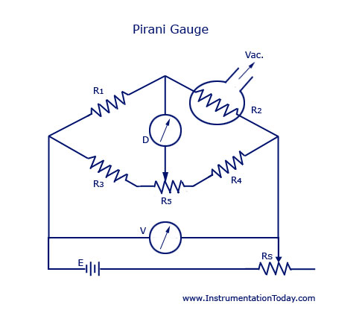
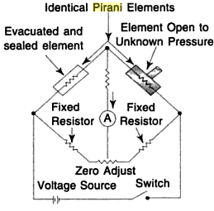
Pirani Gauge
Features of Pirani Gauges
Useful for pressure measurement ranging from 10⁻¹ to 10⁻³ mm of Hg
It is rugged in construction
Less costly
- Usually more accurate than thermocouple gauges
WHEATSTONE’S BRIDGE

Slide 18
BASIC PRINCIPLE OF PIRANI GAUGE
A CONDUCTING WIRE GETS HEATED WHEN ELECTRIC CURRENT FLOWS THROUGH IT.
THE RATE AT WHICH HEAT IS DISSIPATED FROM THIS WIRE DEPENDS ON THE CONDUCTIVITY OF THE SURROUNDING MEDIA.
THE CONDUCTIVITY OF THE SURROUNDING MEDIA INTURN DEPENDS ON THE DENSISTY OF THE SURROUNDING MEDIA (THAT IS, LOWER PRESSURE OF THE SURROUNDING MEDIA, LOWER WILL BE ITS DENSITY).
IF THE DENSITY OF THE SURROUNDING MEDIA IS LOW, ITS CONDUCTIVITY ALSO WILL BE LOW CAUSING THE WIRE TO BECOME HOTTER FOR A GIVEN CURRENT FLOW, AND VICE VERSA.

Slide 19
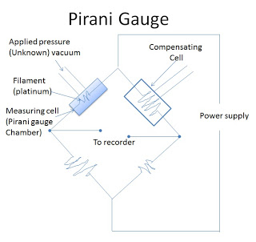
A PIRANI GAUGE CHAMBER WHICH ENCLOSES A PLATINUM FILAMENT.
A COMPENSATING CELL TO MINIMIZE VARIATION CAUSED DUE TO AMBIENT TEMPERATURE CHANGES.
3. THE PIRANI GAUGE CHAMBER AND THE COMPENSATING CELL IS HOUSED ON A WHEAT STONE BRIDGE CIRCUIT AS SHOWN IN DIAGRAM.
The arrangement forms
wheatstone’s bridge
Note: [higher pressure – higher density – higher conductivity – reduced filament temperature – less resistance of filament] and vice versa.

Slide 20
OPERATION OF PIRANI GAUGE
A CONSTANT CURRENT IS PASSED THROUGH THE FILAMENT IN THE PIRANI GAUGE CHAMBER.
DUE TO THIS CURRENT, THE FILAMENT GETS HEATED AND ASSUMES A RESISTANCE WHICH IS MEASURED USING THE BRIDGE.
NOW THE PRESSURE TO BE MEASURED (APPLIED PRESSURE) IS CONNECTED TO THE PIRANI GAUGE CHAMBER. DUE TO THE APPLIED PRESSURE THE DENSITY OF THE SURROUNDING OF THE PIRANI GAUGE FILAMENT CHANGES. DUE TO THIS CHANGE IN DENSITY OF THE SURROUNDING OF THE FILAMENT ITS CONDUCTIVITY CHANGES CAUSING THE TEMPERATURE OF THE FILAMENT TO CHANGE.
WHEN THE TEMPERATURE OF THE FILAMENT CHANGES, THE RESISTANCE OF THE FILAMENT ALSO CHANGES.
NOW THE CHANGE IN RESISTANCE OF THE FILAMENT IS DETERMINED USING THE BRIDGE.
THIS CHANGE IN RESISTANCE OF THE PIRANI GAUGE FILAMENT BECOMES A MEASURE OF THE APPLIED PRESSURE WHEN CALIBRATED.

Slide 21
APPLICATIONS OF PIRANI GAUGE
USED TO MEASURE LOW VACUUM AND ULTRA HIGH VACUUM PRESSURES.
ADVANTAGES OF PIRANI GAUGE
THEY ARE RUGGED AND INEXPENSIVE
GIVE ACCURATE RESULTS
GOOD RESPONSE TO PRESSURE CHANGES.
RELATION BETWEEN PRESSURE AND RESISTANCE IS LINEAR FOR THE RANGE
OF USE.
READINGS CAN BE TAKEN FROM A DISTANCE.
LIMITATIONS OF PIRANI GAUGE
PIRANI GAUGE MUST BE CHECKED FREQUENTLY.
PIRANI GAUGE MUST BE CALIBRATED FROM DIFFERENT GASES.
ELECTRIC POWER IS A MUST FOR ITS OPERATION.

Slide 22
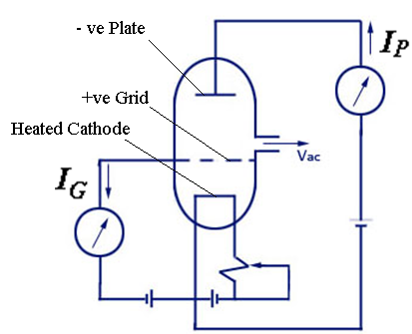
Ionization Type vacuum Gauge
Ionization is the process of removing electron from an atom producing a free electron and positively charged ion.
It may be produced by the collision of high speed electrons from the atom
Pressure of gas is proportional
where,
Ip-Plate current
I_{G} –Grid current
S – sensitivity of the gauge. Depends upon tube geometry, nature of gas and operating voltage.
It is useful to measure pressure ranging from
10⁻³ to 10⁻⁸ mm of Hg

Slide 23
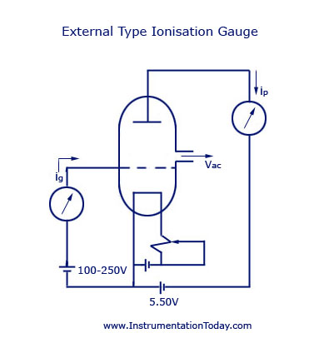
WORKING of ionisation gauge:
THE CONSTRUCTION OF A HOT CATHODE TYPE IONIZATION GAUGE CONSISTS OF A BASIC VACUUM TRIODE.
THE FIGURE OF AN EXTERNAL CONTROL TYPE HOT CATHODE GAUGE IS SHOWN BELOW.
Triode
Consists cathod, anode, grid.

Slide 24
THE GRID IS MAINTAINED AT A LARGE POSITIVE POTENTIAL WITH RESPECT TO THE CATHODE AND THE PLATE.
THE PLATE IS AT A NEGATIVE POTENTIAL WITH RESPECT TO THE CATHODE.
THIS METHOD IS ALSO KNOWN AS THE EXTERNAL CONTROL TYPE IONIZATION GAUGE AS THE POSITIVE ION COLLECTOR IS EXTERNAL TO THE ELECTRON COLLECTOR GRID WITH REFERENCE TO THE CATHODE.
THE POSITIVE IONS AVAILABLE BETWEEN THE GRID AND THE CATHODE WILL BE DRAWN BY THE CATHODE, AND THOSE BETWEEN THE GRID AND THE PLATE WILL BE COLLECTED BY THE PLATE.

Slide 25
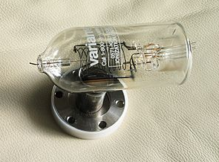
ADVANTAGES:
USED FOR WIDE RANGE OF PRESSURE 10 ⁻³ TO 10 ⁻¹¹ MM OF Hg.
IT GIVES FAST RESPONSE TO PRESSURE CHANGE.
Tubulated hot-cathode ionization gauge.
DISADVANTAGES:
HIGH COST AND COMPLEX ELECTRICAL CIRCUIT.
ITS CALIBRATION VARIES WITH THE GAS.
DECOMPOSITION OF THE GAS MAY TAKES PLACE BY HOT
FILAMENT.
ITS FILAMENT BURN QUICKLY IF IT IS EXPOSED TO AIR.
IT IS REQUIRED TO PROTECT GAUGE BY CUT OUT IN ORDER
TO PROTECT IN THE CASE OF SYSTEM LEAK OR BREAK.

Slide 26
High pressure measurement

Slide 27
High pressure measurement
MANOMETERS
2. ELECTRICAL RESISTANCE PRESSURE GAUGE
I) RESISTANCE TYPE
II) PHOTOELECTRIC TYPE
III) PIEZOELECTRIC TYPE
IV) VARIABLE CAPACITOR TYPE
3.ELASTIC PRESSURE GAUGES
I) BOURDON TUBE
II) DIAPHRAGM GAUGE
III) BELLOWS

Slide 28
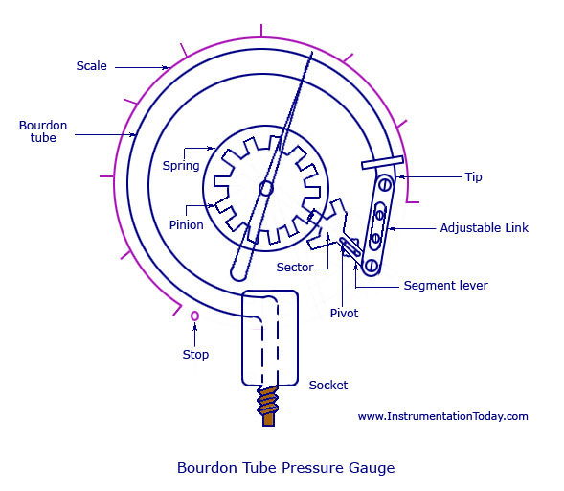
Elastic pressure gauges
BOURDON TUBE PRESSURE GAUGE

Slide 29
THE COMMONLY USED MATERIALS ARE
PHOSPHOR-BRONZE, SILICON-BRONZE,
BERYLLIUM-COPPER, INCONEL, AND OTHER C-CR-NI-MO ALLOYS ETC.

Slide 31
WORKING
AS THE FLUID PRESSURE ENTERS THE BOURDON TUBE, IT TRIES TO BE REFORMED AND BECAUSE OF A FREE TIP AVAILABLE, THIS ACTION CAUSES THE TIP TO TRAVEL IN FREE SPACE AND THE TUBE UNWINDS.
THE SIMULTANEOUS ACTIONS OF BENDING AND TENSION DUE TO THE INTERNAL PRESSURE MAKE A NON-LINEAR MOVEMENT OF THE FREE TIP. THIS TRAVEL IS SUITABLE GUIDED AND AMPLIFIED FOR THE MEASUREMENT OF THE INTERNAL PRESSURE.
BUT THE MAIN REQUIREMENT OF THE DEVICE IS THAT WHENEVER THE SAME PRESSURE IS APPLIED, THE MOVEMENT OF THE TIP SHOULD BE THE SAME AND ON WITHDRAWAL OF THE PRESSURE THE TIP SHOULD RETURN TO THE INITIAL POINT.

Slide 32
A LOT OF COMPOUND STRESSES ORIGINATE IN THE TUBE AS SOON AS THE PRESSURE IS APPLIED. THIS MAKES THE TRAVEL OF THE TIP TO BE NON-LINEAR IN NATURE.
IF THE TIP TRAVEL IS CONSIDERABLY SMALL, THE STRESSES CAN BE CONSIDERED TO PRODUCE A LINEAR MOTION THAT IS PARALLEL TO THE AXIS OF THE LINK. THE SMALL LINEAR TIP MOVEMENT IS MATCHED WITH A ROTATIONAL POINTER MOVEMENT. THIS IS KNOWN AS MULTIPLICATION, WHICH CAN BE ADJUSTED BY ADJUSTING THE LENGTH OF THE LEVER. FOR THE SAME AMOUNT OF TIP TRAVEL, A SHORTER LEVER GIVES LARGER ROTATION.
THE APPROXIMATELY LINEAR MOTION OF THE TIP WHEN CONVERTED TO A CIRCULAR MOTION WITH THE LINK-LEVER AND PINION ATTACHMENT, A ONE-TO-ONE CORRESPONDENCE BETWEEN THEM MAY NOT OCCUR AND DISTORTION RESULTS. THIS IS KNOWN AS ANGULARITY WHICH CAN BE MINIMIZED BY ADJUSTING THE LENGTH OF THE LINK.

Slide 33
OTHER THAN C-TYPE, BOURDON GAUGES CAN ALSO BE CONSTRUCTED IN THE FORM OF A HELIX OR A SPIRAL.
THE TYPES ARE VARIED FOR SPECIFIC USES AND SPACE ACCOMMODATIONS, FOR BETTER LINEARITY AND LARGER SENSITIVITY. FOR THOROUGH REPEATABILITY, THE BOURDON TUBES MATERIALS MUST HAVE GOOD ELASTIC OR SPRING CHARACTERISTICS.
THE SURROUNDING IN WHICH THE PROCESS IS CARRIED OUT IS ALSO IMPORTANT AS CORROSIVE ATMOSPHERE OR FLUID WOULD REQUIRE A MATERIAL WHICH IS CORROSION PROOF.
THE COMMONLY USED MATERIALS ARE PHOSPHOR-BRONZE, SILICON-BRONZE, BERYLLIUM-COPPER, INCONEL, AND OTHER C-CR-NI-MO ALLOYS, AND SO ON.

Slide 34
IN THE CASE OF FORMING PROCESSES, EMPIRICAL RELATIONS ARE KNOWN TO CHOOSE THE TUBE SIZE, SHAPE AND THICKNESS AND THE RADIUS OF THE C-TUBE. BECAUSE OF THE INTERNAL PRESSURE, THE NEAR ELLIPTIC OR RATHER THE FLATTENED SECTION OF THE TUBE TRIES TO EXPAND AS SHOWN BY THE DOTTED LINE IN THE FIGURE BELOW (A).
THE SAME EXPANSION LENGTHWISE IS SHOWN IN FIGURE (B).
THE ARRANGEMENT OF THE TUBE, HOWEVER FORCES AN EXPANSION ON THE OUTER SURFACE AND A COMPRESSION ON THE INNER SURFACE, THUS ALLOWING THE TUBE TO UNWIND. THIS IS SHOWN IN FIGURE (C).

Slide 35
LIKE ALL ELASTIC ELEMENTS A BOURDON TUBE ALSO HAS SOME HYSTERESIS IN A GIVEN PRESSURE CYCLE. BY PROPER CHOICE OF MATERIAL AND ITS HEAT TREATMENT, THIS MAY BE KEPT TO WITHIN 0.1 AND 0.5 PERCENT OF THE MAXIMUM PRESSURE CYCLE. SENSITIVITY OF THE TIP MOVEMENT OF A BOURDON ELEMENT WITHOUT RESTRAINT CAN BE AS HIGH AS 0.01 PERCENT OF FULL RANGE PRESSURE REDUCING TO 0.1 PERCENT WITH RESTRAINT AT THE CENTRAL PIVOT.

Slide 36
DIAPHRAGM PRESSURE GAUGE
A DIAPHRAGM PRESSURE TRANSDUCER IS USED FOR LOW PRESSURE MEASUREMENT.
THEY ARE COMMERCIALLY AVAILABLE IN TWO TYPES –
METALLIC AND NON-METALLIC.
METALLIC DIAPHRAGMS ARE KNOWN TO HAVE GOOD SPRING CHARACTERISTICS AND
NON-METALLIC TYPES HAVE NO ELASTIC CHARACTERISTICS. THUS, NON-METALLIC TYPES ARE USED RARELY, AND ARE USUALLY OPPOSED BY A CALIBRATED COIL SPRING OR ANY OTHER ELASTIC TYPE GAUGE. THE NON-METALLIC TYPES ARE ALSO CALLED SLACK DIAPHRAGM.

Slide 37
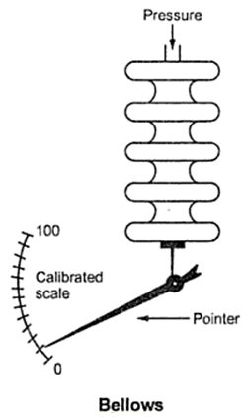
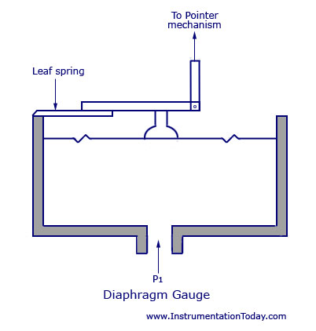
DIAPHRAGM GAUGE

Slide 38
WORKING
WHEN A FORCE ACTS AGAINST A THIN STRETCHED DIAPHRAGM, IT CAUSES A DEFLECTION OF THE DIAPHRAGM WITH ITS CENTRE DEFLECTING THE MOST.
SINCE THE ELASTIC LIMIT HAS TO BE MAINTAINED, THE DEFLECTION OF THE DIAPHRAGM MUST BE KEPT IN A RESTRICTED MANNER.
THIS CAN BE DONE BY CASCADING MANY DIAPHRAGM CAPSULES AS SHOWN IN THE FIGURE NEXT PAGE.

Slide 39
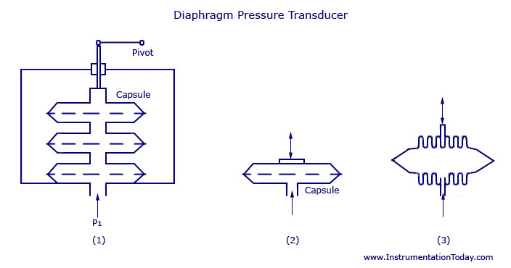
DIAPHRAGM PRESSURE TRANSDUCER
CORRUGATED DIAGPHRAGM CAPSULE
CASCEDING OF CAPSULE
PRSSURE CAPSULE

Slide 40
A MAIN CAPSULE IS DESIGNED BY JOINING TWO DIAPHRAGMS AT THE PERIPHERY.
A PRESSURE INLET LINE IS PROVIDED AT THE CENTRAL POSITION.
WHEN THE PRESSURE ENTERS THE CAPSULE, THE DEFLECTION WILL BE THE SUM OF DEFLECTIONS OF ALL THE INDIVIDUAL CAPSULES.
CORRUGATED DESIGNS HELP IN PROVIDING A LINEAR DEFLECTION AND ALSO INCREASE THE MEMBER STRENGTH.
THE TOTAL AMOUNT OF DEFLECTION FOR A GIVEN PRESSURE DIFFERENTIAL IS KNOWN BY THE FOLLOWING FACTORS:
NUMBER AND DEPTH OF CORRUGATION
NUMBER OF CAPSULES
CAPSULE DIAMETER
SHELL THICKNESS
MATERIAL CHARACTERISTICS
MATERIALS USED FOR THE METAL DIAPHRAGMS ARE THE SAME AS THOSE USED FOR BOURDON TUBE.

Slide 41
NON-METALLIC OR SLACK DIAPHRAGMS ARE USED FOR MEASURING VERY SMALL PRESSURES.
THE COMMONLY USED MATERIALS FOR MAKING THE DIAPHRAGM ARE POLYTHENE, NEOPRENE, ANIMAL MEMBRANE, SILK, AND SYNTHETIC MATERIALS.
DUE TO THEIR NON-ELASTIC CHARACTERISTICS, THE DEVICE WILL HAVE TO BE OPPOSED WITH EXTERNAL SPRINGS FOR CALIBRATION AND PRECISE OPERATION.
THE COMMON RANGE FOR PRESSURE MEASUREMENT VARIES BETWEEN 50 PA TO 0.1 MPA.

Slide 42
THE BEST EXAMPLE FOR A SLACK DIAPHRAGM IS THE DRAFT GAUGE. THEY ARE USED IN BOILERS FOR INDICATION OF THE BOILER DRAFT.
THE DEVICE CAN CONTROL BOTH COMBUSTION AND FLUE. WITH THE DRAFT, USUALLY OF PRESSURE LESS THAN THE ATMOSPHERE, CONNECTED, THE POWER DIAPHRAGM MOVES TO THE LEFT AND ITS MOTION IS TRANSMITTED THROUGH THE SEALING DIAPHRAGM, SEALED LINK AND POINTER DRIVE TO THE POINTER.
THE POWER DIAPHRAGM IS BALANCED WITH THE HELP OF A CALIBRATED LEAF SPRING.
THE EFFECTIVE LENGTH OF THE SPRING AND HENCE THE RANGE IS DETERMINED BY THE RANGE ADJUSTING SCREW. BY ADJUSTING THE ZERO ADJUSTMENT SCREW, THE RIGHT HAND END OF THE POWER DIAPHRAGM SUPPORT LINK AS ALSO THE FREE END OF THE LEAF SPRING, IS ADJUSTED FOR ZERO ADJUSTMENT THROUGH THE CRADLE.

Slide 43
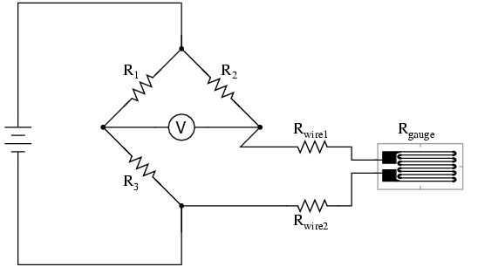
ELECTRICAL RESISTANCE PRESSSURE GAUGE.
RESISTANCE OF WIRE CHANGES AS PER PRESSURE. THIS WIRE IS ONE ARM OF WHEATSTONES BRIDGE.
WHEATSTONES BRIDGE.
USED FOR HIGH PRESSURE MEASUREMENT.

Slide 44
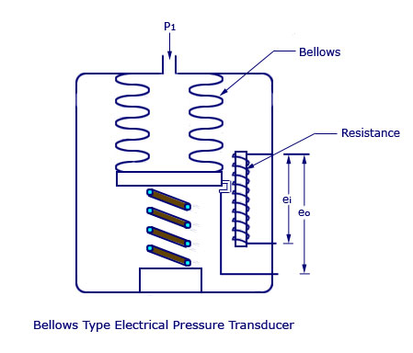
RESISTANCE CHANGES AS PER MOVEMENT OF BELLOWS AS PER PRESSURE.

Slide 45
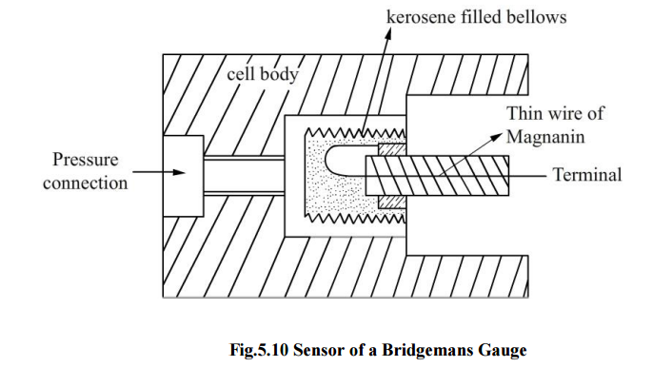
ELECTRICAL RESISTANCE PRESSSURE GAUGE.

Slide 46
ELECTRICAL RESISTANCE GAUGES – PRINCIPLE OF OPERATION BOURDON TUBE OR STRAIN GAUGE CAN BE USED FOR HIGH PRESSURES.
VERY HIGH PRESSURES (SAY ABOVE 1000BARS) MAY BE MEASURED BY MEANS OF ELECTRICAL RESISTANCE GAUGES WHICH ARE KNOWN AS BRIDGEMAN GAUGE.
BY WAY OF PRINCIPLE OF OPERATION, THEY MAKE USE OF RESISTANCE CHANGE BROUGHT ABOUT BY DIRECT APPLICATION OF PRESSURE TO THE CONDUCTOR ITSELF.

Slide 47
REFERRING TO THE FIGURE, THE SENSING ELEMENT IS THE THIN WIRE OF MAGNANIN (84 CU + 12 MN + 4 NI) OR AN ALLOY OF GOLD AND CHROMIUM (2.1%) WHICH IS LOOSELY WOUND.
WHEN PRESSURE IS APPLIED, BULK COMPRESSION EFFECTS PRODUCE A CHANGE IN RESISTANCE WHICH MAY BE CALIBRATED AGAINST PRESSURE. THE GENERAL RELATION BETWEEN ELECTRICAL AND MECHANICAL MAY BE DERIVED AS FOLLOWS:

Slide 48
R= ρL/A = ρL/CD²
WHERE,
R = Resistance, ohms
L = Length of conductors
A = Area = CD2
where D is the diameter of the circular conductor
and C a constant
ρ = Resistivity ohm cm

Slide 49
Manometer
TYPES:
U-Tube Manometer
Well Type Manometer
Enlarged-Leg Manometer
Inclined Tube Manometer
Micromanometer

Slide 50
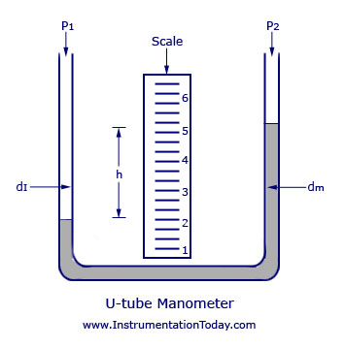
U-Tube Manometer
the differential pressure .
can be obtained by the relation
p1-p2 = h (dm-d1)
WHERE,
h – height is height of liquid column
dm – density of manometric fluid
d1- density of working fluid
P1-Pressure acting in limb 1
P2- P1-Pressure acting in limb 1

Slide 51
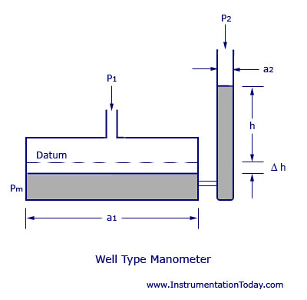
Well Type Manometer
THE MAIN DIFFERENCE BETWEEN A U-TUBE MANOMETER AND A WELL TYPE MANOMETER IS THAT THE U-TUBE IS SUBSTITUTED BY A LARGE WELL SUCH THAT THE VARIATION IN THE LEVEL IN THE WELL WILL BE NEGLIGIBLE AND INSTEAD OF MEASURING A DIFFERENTIAL HEIGHT, A SINGLE HEIGHT IN THE REMAINING COLUMN IS MEASURED.

Slide 52
IF a1 AND a2 ARE THE AREAS OF THE WELL AND THE CAPILLARY,
AND IF (H1-H2)=h IS THE DIFFERENCE IN HEIGHT IN THE WELL DUE TO THE PRESSURE DIFFERENCE (P1-P2) AS SHOWN, AT BALANCE, THEN
p1-p2 = dm.h (1+a2/a1)

Slide 53
Inclined Tube Manometer
THE INCLINED TUBE MANOMETER IS AN ENLARGED LEG MANOMETER WITH ITS MEASURING LEG INCLINED TO THE VERTICAL AXIS BY AN ANGLE B. THIS IS DONE TO EXPAND THE SCALE AND THEREBY TO INCREASE THE SENSITIVITY. THE DIFFERENTIAL PRESSURE CAN BE WRITTEN BY THE EQUATION,
p1-p2 = dm.h.Cosb (1+a2/a1)
The factor cosb expands the scale of the instrument. When b is quite large, h can be increased such that (h.cosb) remains constant.

Slide 54
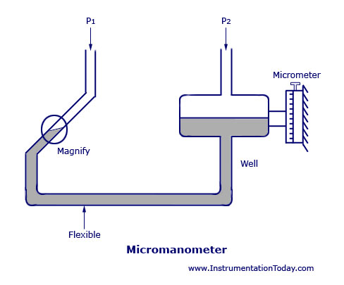
Micromanometer
THE MICROMANOMETER IS ANOTHER VARIATION OF LIQUID COLUMN MANOMETERS THAT IS BASED ON THE PRINCIPLE OF INCLINED TUBE MANOMETER AND IS USED FOR THE MEASUREMENT OF EXTREMELY SMALL DIFFERENCES OF PRESSURE.

Slide 55
THE MENISCUS OF THE INCLINED TUBE IS AT A REFERENCE LEVEL AS SHOWN IN THE FIGURE ,
VIEWING THROUGH A MAGNIFIER PROVIDED WITH CROSS HAIR LINE. THIS IS DONE FOR THE CONDITION, P1=P2. THE ADJUSTMENT IS DONE BY MOVING THE WELL UP AND DOWN A MICROMETER.
FOR THE CONDITION P1 NOT EQUAL TO P2, THE SHIFT IN THE MENISCUS POSITION IS RESTORED TO ZERO BY RAISING OR LOWERING THE WELL AS BEFORE AND THE DIFFERENCE BETWEEN THESE TWO READINGS GIVES THE PRESSURE DIFFERENCE IN TERMS OF HEIGHT.

Slide 56
Thanks !!!

