Slide 1
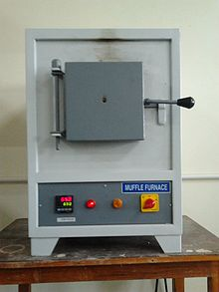
MUFFLE FURNACE

Slide 2
STEEL PRODUCTS ARE HEAT TREATED AFTER FORMING IN ORDER TO ESTABLISH DESIRED MECHANICAL PROPERTIES.
A MUFFLE OR RETORT FURNACE IS USED FOR THE HEAT TREATING PROCESS WHEN A CONTROLLED ATMOSPHERE IS NEEDED.
THE ATMOSPHERE MAY BE CONTROLLED TO PREVENT OXIDATION OR TO ENHANCE SURFACE HARDNESS.
AN INFRARED THERMOMETER IS USED TO MONITOR THE PROCESS TEMPERATURES TO ASSURE CONSISTENT PRODUCT QUALITIES AND EFFICIENT PROCESS OPERATION.

Slide 3
LABORATORY FURNACES ARE ALSO CALLED AS
BENCH TYPE FRUNACES,
ASHING FURNACES, MUFFLE FURNACES,
CHAMBER FURNACES.
WORKING PRINCIPLE OF LABORATORY FURNACES IS TO HEAT THE FURNACE BY HEATING RESISTANCES WHICH WORK BY ELECTRICITY.
LABORATORY FURNACES ( MUFFLE FURNACES – ASHING FURNACES ) ARE USED TO HEAT TESTING SPECIMENS OR SMALL PIECES UP TO HIGH TEMPERATURES SUCH AS OVER 1000C. MOST OF THE TIME, PURPOSE IS TO PERFORM HIGH TEMPERATURE TESTS.

Slide 4
IN THIS FURNACE THE MATERIAL TO BE HEATED DOES NOT COME IN THE CONTACT WITH THE FUEL OR FLAMES.
A MUFFLE IS A CHAMBER MADE OF REFRACTORY MATERIAL AND IS SURROUNDED BY FLAMES AND HOT GASES ON ALL SIDES.
THE PRODUCTS OF COMBUSTION ARE REMOVED THROUGH A DOOR PROVIDED IN THE FURNACE.

Slide 5
MUFFLE FURNACE IS USED FOR THE EXTRACTION OFZINC, PREPARATION OF RED LEAD, PB₃O₄ AND FOR TESTING THE PURITY OF PRECIOUS METALS LIKE SILVER AND GOLD.
IN AN ELECTRIC MUFFLE FURNACE THE CHAMBER IS SURROUNDED BY RESISTANCE COILS.

Slide 6
MUFFLE FURNACE IS ONE OF IMPORTANT LABORATORY EQUIPMENT WHICH IS WIDELY USED IN VARIOUS INDUSTRIES.
THERE ARE NUMBER OF APPLICATIONS IN WHICH A MUFFLE FURNACE IS USED.
E.G.
FOR DRYING ENAMEL COATS,
HEATING CERAMIC PRODUCTS,
GLASS WORKING ETC

Slide 7
MUFFLE FURNACE IS GENERALLY MADE OF CERAMIC FIBER WOOL INSULATION AND COMES IN DIFFERENT CONFIGURATIONS SUCH AS
BOX FURNACE,
BENCH-TOP FURNACE,
PORTABLE,
INDUSTRIAL OVENS AND MORE.

Slide 8
FURTHERMORE A MUFFLE FURNACE CAN BE CHOSEN AS PER FUEL TYPE FOR EXAMPLE THERE ARE VARIOUS MUFFLE FURNACES WHICH CAN BE RUN BY GAS AND ELECTRICITY.

Slide 9
LET’S TAKE A TOUR OF ONE MUFFLE FURNACE WHICH IS MANUFACTURED BY BIONICS SCIENTIFIC.
BIONICS SCIENTIFIC IS A LEADING MUFFLE FURNACE MANUFACTURER IN INDIA AND OFFERS MUFFLE FURNACE FOR
LABORATORIES,
SCIENTIFIC LABS, AND UNIVERSITIES
AND FOR VARIOUS INDUSTRIES.

Slide 10
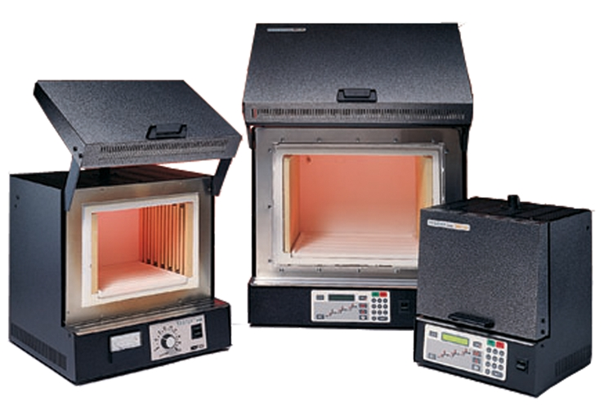
BIONICS SCIENTIFIC. MUFFLE FURNACE
TEMP. LIMIT 1800 ⁰C
LID
HEAT CHAMBER
HEATING COIL
TEMP.SETTING KNOB
CONTROL PANEL

Slide 11
THE OUTER CASE OR CABINET OF THIS MUFFLE FURNACE IS MADE OF THICK PCRC (paints and coatings resourse centre) SHEET WITH THICK PERFORATED SHEET ON THE BOTTOM.
THE CASE IS PAINTED WITH STOVE ENAMLE THAT KEEPS THE UNIT RUST FREE.

Slide 12
FOR HEATING ELEMENTS CLASS A-1 HEATING WIRES ARE USED IN COIL FORM AND EMBEDDED IN HIGH GRADE REFRACTORY CEMENT AND BACKED BY HIGH TEMPERATURE CERWOOL INSULATION. THIS HELPS IN KEEPING THE UNIT SAFE FROM LOSS OF ENERGY AND ALSO ENSURES UNIFORM DISTRIBUTION OF HEAT.

Slide 13
THE DOOR COMES WITH STRONG LID WHICH CAN BE USED TO OPEN AND CLOSE THE UNIT AT ANY TEMPERATURE.
THE TEMPERATURE CONTROL UNIT COMPRISES OF REGULATOR CONTROL IN FRONT OF THE UNIT WITH PILOT LAMPS. THE UNIT IS SUPPLIED WITH STRONG MAIN LEAD, THERMAL FUSE.
THE UNIT IS RUN ON 220 VOLTS AC.

Slide 14
MUFFLE FURNACE APPLICATION
TO ANALYSIS
THE VOLATILE, ASH, MOISTURE, ASH FUSION AND ELEMENTS IN COAL AND COKE.
TO SINTERING, MELTING METAL, CERAMIC, SILVER, GOLD AND OTHER MATERIALS.
FUSING GLASS, CREATING ENAMEL COATINGS, CERAMICS AND SOLDERING AND BRAZING ARTICLES. BAKE POTTERY AND PORCELAIN POTS, PLATES AND OTHER ARTICLES.

Slide 15
Main Specification of Muffle Furnace
Max. Temp |  | 900-1700 DEG .C | Muffle Furnace Features Furnace Chamber * Chamber is made of advanced Ceramic Fibers, which is more efficient than refractory brick. * Ceramic fibers can speed up the heating rate, reduce the heating consumption. Sinfo Muffle furnace can heating to 1000JOULE in 15 mins. * Sinfo Muffle furnace is half weight of the tradition furnace. But the heating rate is twice higher than tradition ones. Temp. Controller * Sinfo adopts LCD touch screen temperature control system(TTC System) Shell 1. Muffle furnace are used double shell to avoid over high temperature. We designed radiator fan on the ultra-temp furnace. 2. Shell are paint by special high thermostability paint. Color can keep well even at high temperature environment.
Insulation Time |  | 0-999 min
Accuracy | Control | 99.9%
 | Temp | 0.5%;
 | Time | < 30s
Heating Rate |  | 20-25 JOULE/min
Heating Element |  | FeCrAl Wire Silicon Carbide Tube MoSi2 Rod
Control System |  | Programmable Controller LCD Digital Controller
Power |  | 3~4kw
Power Supply |  | 120V/220V/380V
Chamber Size |  | (Customized)

Slide 16
BENEFITS
MORE CONSISTENT PRODUCT PROPERTIES. FASTER HEATING RATES. REDUCED FUEL CONSUMPTION. MORE STABLE OPERATING CONDITIONS.

Slide 17
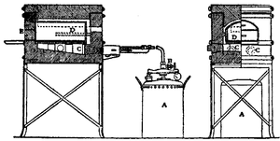
AN AUTOMATIC OIL MUFFLE FURNACE
OIL VAPORISE WHEN VALVE B IS OPEN
MUFFLE D
PETROLIUM CONTAINED IN TANK A
UNDER PRESSURE

Slide 18
AN AUTOMATIC OIL MUFFLE FURNACE, CIRCA 1910. PETROLEUM IS CONTAINED IN TANK A, AND IS KEPT UNDER PRESSURE BY PUMPING AT INTERVALS WITH THE WOODEN HANDLE, SO THAT WHEN THE VALVE B IS OPENED, THE OIL IS VAPORIZED BY PASSING THROUGH A HEATING COIL AT THE FURNACE ENTRANCE, AND WHEN IGNITED BURNS FIERCELY AS A GAS FLAME.

Slide 19
THIS PASSES INTO THE FURNACE THROUGH THE TWO HOLES, C, C, AND PLAYS UNDER AND UP AROUND THE MUFFLE D, STANDING ON A FIRECLAY SLAB. THE DOORWAY IS CLOSED BY TWO FIRECLAY BLOCKS AT E.

Slide 20
THANKS !!!

