Slide 1
STUDY OF MICROSTRUCTURE
We have to study microstructure of the following ……
PURE IRON,
0.2, 0.4, 0.8, 1.2 CARBON STEELS.
WHITE, GRAY, MALLEABLE AND NODULAR
CAST IRON.
HARDENED STEELS

Slide 2
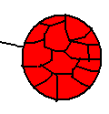
Pure iron
Grains of ferrite
Soft, ductile, mild having low strength.
Can not harden by heat treatments
Shows allotropic changes. Bcc, fcc bcc tec.
Grain boundries
Eutectoid steel
0.8 % carbon
Alternate plates of alfa ferrite and cementite
i.e pearlite
Hard and tough, having high strength
Harden by heat treatment.

Slide 3
0.2 and 0.4 %c steels
are hypoeutectoid steels
Show pearlite + alfa ferrite in structure
Pearlite
i.e. alternate plates of alfa ferrite 88% and cementite 12%
Ferrite
collected at boundries
1.2 % c steels
is a hypereutectoid steel
Shows pearlite + cementite in microstructure
pearlite
Cementite
collected at boundries

Slide 4
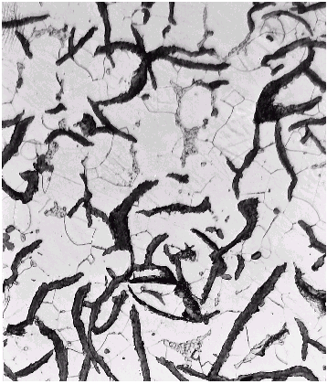
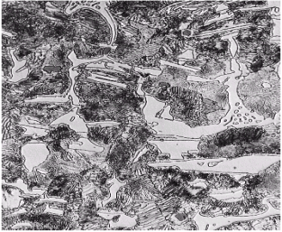
Gray cast iron
Graphite flakes
App– machine bases, engine frames, drainage pipe, fly wheels, pump housings etc.
Carbon is in the form of graphite flakes, resulting structure is soft and ductile in comparison with white cast iron
White cast iron
cementite
App– excavator bucket teeth, wearing plates, concrete mixers, road rollers, mill liners, grinding balls, dies and extrusion nozzles etc.
White portion of the structure is of cementite,
Very hard and brittle.
Wear resistant and has high compressive strength.

Slide 5
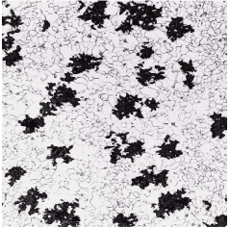
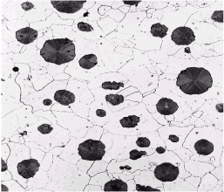
Malleable cast iron
Carbon is accumulated
Called as bulls eye structure
Hardness is reduced
App--Used for thin walled and small components, hinges, door kies, spanners, crank, levers, parts of sewing and textile machines.
Ductile iron, nodular ci,
Or spheroidal graphite cast iron
Nodules or globules of carbon
Carbon is converted in the form of nodules
Soft and ductile
Low hardness
App– paper industries machineries, internal combustion engines,
power transmission equipments,
valve and fittings,
pumps and compressor parts.

Slide 6
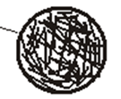
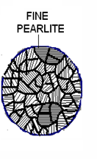
Hardened steel
Needles of martensite
martensite
Resulting steel is very hard and tough.
Transformed by martempering process or by conventional quenching. Followed by tempering to relieve internal stresses.
bainite
Transformed by austempering process i.e. by isothermal cooling , bath is maintained at nose temp. of TTT diagram.
Hard and tough
No need of tempering.

Slide 7
Thanks !!!

