Slide 1
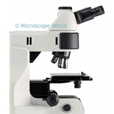
METALLURGICAL MICROSCOPE

Slide 2
METALLURGICAL MICROSCOPE IS THE OPTICAL MICROSCOPE, DIFFERING FROM OTHER MICROSCOPES IN THE METHOD OF THE SPECIMEN ILLUMINATION.
SINCE METALS ARE OPAQUE SUBSTANCES THEY MUST BE ILLUMINATED BY FRONTAL LIGHTING, THEREFORE THE SOURCE OF LIGHT IS LOCATED WITHIN THE MICROSCOPE TUBE.
THIS IS ACHIEVED BY PLAIN GLASS REFLECTOR, INSTALLED IN THE TUBE.

Slide 3
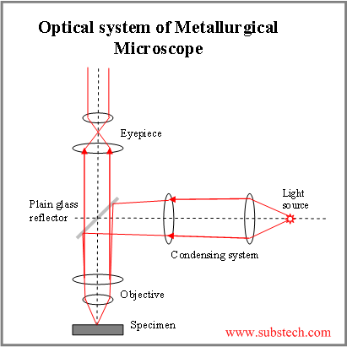
THE OPTICAL SCHEME OF METALLURGICAL MICROSCOPE IS SHOWN IN THE PICTURE.

Slide 4
THE IMAGE QUALITY AND ITS RESOLVING POWER ARE MAINLY DETERMINED BY THE QUALITY OF THE OBJECTIVE.
THE OBJECTIVE MAGNIFICATION DEPENDS ON ITS FOCAL LENGTH (THE SHORTER FOCAL LENGTH, THE HIGHER MAGNIFICATION).
THE EYEPIECE IS THE LENS NEAREST THE EYE. THE IMAGE IS MAGNIFIED BY EYEPIECE IN X6, X8 OR X10.

Slide 5
THE TOTAL MAGNIFICATION OF THE MICROSCOPE MAY BE CALCULATED BY THE FORMULA:
M = L*E/ F
WHERE
L- THE DISTANCE FROM BACK OF OBJECTIVE TO EYEPIECE;
F – THE FOCAL LENGTH OF THE OBJECTIVE;
E- THE MAGNIFYING POWER OF THE EYEPIECE.
THE COMMON MAGNIFICATION OF METALLURGICAL MICROSCOPE IS IN THE RANGE X50 – X1000.

Slide 6
BRIGHT FIELD ILLUMINATION IS USED FOR PRODUCING IMAGES WITH BRIGHT BACKGROUND AND DARK NON-FLAT STRUCTURE FEATURES (PORES, EDGES, ETCHED GRAIN BOUNDARIES).
DARK FIELD ILLUMINATION IS USED FOR PRODUCING IMAGES WITH DARK BACKGROUND AND BRIGHT NON-FLAT STRUCTURE FEATURES (PORES, EDGES, ETCHED GRAIN BOUNDARIES).

Slide 7
POLARIZED LIGHT IS USED FOR VIEWING METALS WITH NON-CUBIC CRYSTALLINE STRUCTURE (MAGNESIUM, ALPHA-TITANIUM|, ZINC AND OTHERS), RESPONDING TO CROSS-POLARIZED LIGHT. POLARIZED LIGHT IS CREATED BY POLARIZER, LOCATED BEFORE THE ILLUMINATOR AND ANALYZER, PLACED BEFORE THE EYEPIECE.
NOMARSKY PRISM IS USED FOR DIFFERENTIAL INTERFERENCE CONTRAST SYSTEM (DIC), ENABLING TO OBSERVE FEATURES NOT VISIBLE IN BRIGHT FIELD.

Slide 8
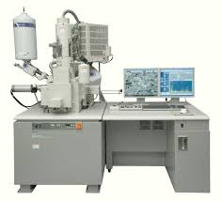
ELECTRON MICROSCOPE

Slide 9
SCANNING ELECTRON MICROSCOPES (SEM) USE FOCUSED BEAM OF ELECTRONS, SCANNING IN VACUUM THE SPECIMEN SURFACE, IMAGING ONE POINT AT A TIME.THE INTERACTION OF THE ELECTRON BEAM WITH EVERY POINT OF THE SPECIMEN SURFACE IS REGISTERED, FORMING THE ENTIRE IMAGE.
SINCE THE WAVELENGTH OF THE ELECTRON BEAM IS MUCH LOWER THAN WAVELENGTH OF THE VISIBLE LIGHT, THE MAGNIFICATION OF SAME IS MUCH HIGHER (THOUSANDS OF TIMES), THAN THAT OF OPTICAL MICROSCOPES.

Slide 10
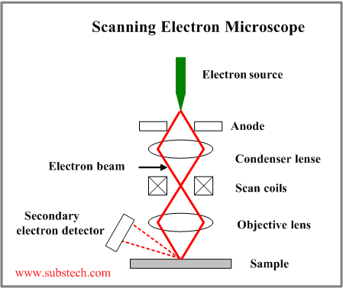
Resolution of SEM is about 1nm to 20 nm.

Slide 11
ELECTRONS IN THE ELECTRON GUN ARE EMITTED FROM THE CATHODE AND ACCELERATED BY THE ANODE TO THE ENERGY 1 – 50 KEV.
THE ELECTRON BEAM IS CONDENSED BY THE CONDENSER LENSES (ONE OR TWO).
MAGNETIC FIELD, PRODUCED BY THE SCAN COILS DEFLECTS THE ELECTRON BEAM BACK AND FORTH.
THE ELECTRON BEAM, FOCUSED BY THE OBJECTIVE LENS TO VERY FINE SPOT (1-5 NM), SCANS THE SAMPLE SURFACE IN A RASTER PATTERN.

Slide 12
PRIMARY ELECTRONS INTERACT WITH THE ATOMS OF THE SAMPLE SURFACE, CAUSING EMISSIONS OF THE SECONDARY ELECTRONS, WHICH ARE DETECTED, PRODUCING THE IMAGE.
THE BACK SCATTERED ELECTRONS OF THE ELECTRON BEAM MAY ALSO BE DETECTED.
THE BACK SCATTERED ELECTRON IMAGE IS USED FOR CONTRASTING THE SAMPLE REGIONS, HAVING DIFFERENT CHEMICAL COMPOSITIONS.

Slide 13
Metallographic examination – introduction
METALLOGRAPHY RELATES TO THE METHODS OF STUDYING STRUCTURE OF METALS AND ALLOYS:
MACRO- (MACROGRAPHY, MACROSTRUCTURE) EXAMINATION IS A METHOD OF EXAMINATION OF LARGE REGIONS OF THE SPECIMEN SURFACE OR FRACTURED SECTION, ALLOWING TO DETERMINE CHARACTER OF THE STRUCTURE, DEFECTS AND SEGREGATION OF ALLOYING ELEMENTS WITH THE NAKED EYE OR UNDER LOW MAGNIFICATION.

Slide 14
OPTICAL MICRO- (MICRO-STRUCTURE) EXAMINATION IS A METHOD OF STUDYING OF MICRO-STRUCTURE CONSTITUENS (GRAINS, PHASES, NON-METALLIC AND INTERMETALLIC INCLUSIONS, MICRO-PORES, MICRO-CRACKS, FRUCTURES, ETC.), BY MEANS OF THE METALLURGICAL MICROSCOPE.
SCANNING ELECTRON MICROSCOPE EXAMINATION IS A METHOD OF STUDYING OF MICRO-STRUCTURE CONSTITUENS (GRAINS, PHASES, NON-METALLIC AND INTERMETALLIC INCLUSIONS, MICRO-PORES, MICRO-CRACKS, FRUCTURES, ETC.), BY MEANS OF THE SCANNING ELECTRON MICROSCOPE.

Slide 15
THANKS !!!

