Slide 1
CAST IRON AND STEELS
IDENTIFY MATERIALS AS PER COMPONENT PARTS

Slide 2
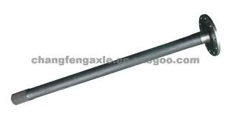
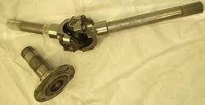
Shafts: medium to high c steel with alloying elements Cr, Ni, Co.
Auto part axle shaft
Axles: medium to high c steel with alloying elements Cr, Ni, Co.
Shaft with universal joint

Slide 3
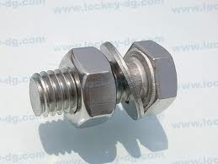
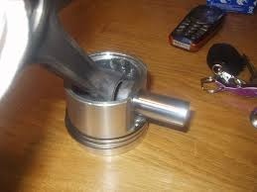
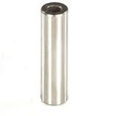
Low to medium carbon steel
Low alloy steel
Nut bolt assembly
Medium to high c steel
Medium alloy steel
Gudgeon pin

Slide 4
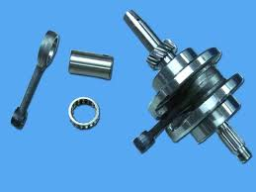
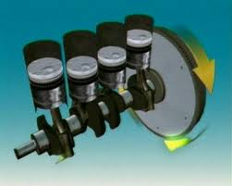
High alloy steel
Alloying elements as
Co, Ni, V, Cr
Crank shaft
Cast steel or stellites
Medium to high c alloy steel
Connecting rod

Slide 5
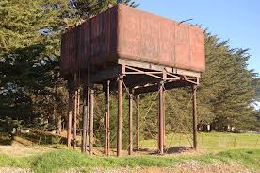
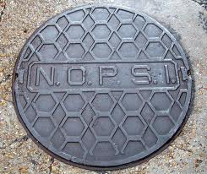
Gray cast iron or
Wrought iron
Water tank
Gray cast iron or
Wrought iron
Manhole cover

Slide 6
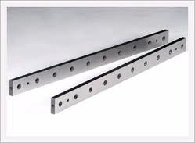
High c steel
Alloy steel
Shear blades
Hss- high speed steel 18-4-1
W-Cr-V
Milling cutter

Slide 7
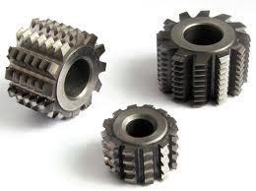
HSS
Gear hobs
Low carbon medium alloy steel
Alloying elements Ti, Cr, Co, Mo
bonnet
car bodies : low carbon low alloy steel

Slide 8
Gray cast iron
Bed ways
stainless steel
Utensils

Slide 9
Low grade material axle shaft:
SAE 1541M alloy steel composition consisting essentially of 0.40-0.48% carbon, 1.35-1.61% maganese, 0.16-0.30% silicon, 0-0.23% chromium and the balance iron and other materials not affecting hardenability of the steel, especially adapted for forming axle shafts in the 1.70-2.05" diameter range to be used as drive axles with an axle load carrying capacity between 30,000 and 44,000 pounds.

Slide 10
Thanks !!!

