Slide 1
Crystal lattice structure
unit cell
packing factor

Slide 2
In crystallography, atomic packing factor (APF) or packing fraction is the fraction of volume in a crystal structure that is occupied by atoms. It is dimensionless and always less than unity.
For practical purposes, the APF of a crystal structure is determined by assuming that atoms are rigid spheres. The radius of the spheres is taken to be the maximal value such that the atoms do not overlap. For one-component crystals (those that contain only one type of atom).

Slide 3
the APF is represented mathematically by
APF= Natoms x Vatoms
V crystal

Slide 4
where N_{atoms} is the number of atoms in the unit cell, V_{atom} is the volume of an atom, and V_{unit cell} is the volume occupied by the unit cell.
It can be proven mathematically that for one-component structures, the most dense arrangement of atoms has an APF of about 0.74. In reality, this number can be higher due to specific intermolecular factors. For multiple-component structures, the APF can exceed 0.74.

Slide 5
About 14 types of crystal structures observed in metals
Atleast three can be studied.
crystal structure
BCC - Body-centered cubic
FCC - Face-centered cubic
HCP - Hexagonal close-packed

Slide 6
BCC STRUCTURE OBSERVED IN ---
Barium, Cr, columbium, iron, Mo,
tantalum, tungsten, vanadium etc.
FCC STRUCTURE OBSERVED IN--
Al, calcium, Cu, gold, lead, nickel,
platinum , silver etc.
HCP STRUCTURE OBSERVED IN --
beryllium, cadmium, cobalt, Mg, zinc,
zirconium etc.

Slide 7
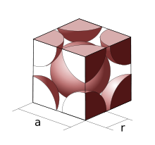
Body-centered cubic crystal structure
BCC structure-- Barium, Cr, columbium, iron, Mo,
tantalum, tungsten, vanadium etc.
The primitive unit cell for the body-centered cubic (BCC) crystal structure contains several fractions taken from nine atoms: one on each corner of the cube and one atom in the center. Because the volume of each corner atom is shared between adjacent cells, each BCC cell contains two atoms.
Note a and r as dimensions

Slide 8
Each corner atom touches the center atom. A line that is drawn from one corner of the cube through the center and to the other corner passes through 4r, where r is the radius of an atom. By geometry, the length of the diagonal is a√3. Therefore, the length of each side of the BCC structure can be related to the radius of the atom by

Slide 9
Knowing this and the formula for the volume of a sphere, it becomes possible to calculate the APF as follows:

Slide 10
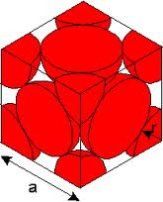
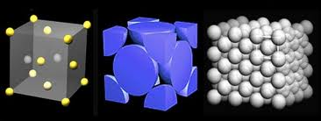
Face-centered cubic
This type of crystal structure is known as cubic close packing (ccp).-- Al, calcium, Cu, gold, lead, nickel,
platinum , silver etc.

Slide 11
A FCC or Face Centered cubic unit cell has 4 atoms. It is calculated like this. There are 8 corners of the unit cell and each corner has one atom.But each atom is shared by 8 unit cells. So. total no. of atoms at corners= 1/8 *8=1 atom . Also, there are 6 faces which have one electron in the centre of it. Each such electron is shared between 2 unit cells. This gives the total no. of atoms at the centre of faces of unit cell=1/2 * 6 = 3 atoms. Adding the two, we get four atoms in an unit cell 1+3=4 atoms.

Slide 12
The unit cell of the ccp arrangement is the face-centered cubic (fcc) unit cell. This is not immediately obvious as the closely packed layers are parallel to the {111} planes of the fcc unit cell. There are four different orientations of the close-packed layers.
The packing efficiency could be worked out by calculating the total volume of the spheres and dividing that by the volume of the cell as follows:

Slide 13
The 74% packing efficiency is the maximum density possible in unit cells constructed of spheres of only one size. Most crystalline forms of metallic elements are hcp, fcc, or bcc (body-centered cubic). The coordination number of hcp and fcc is 12 and its atomic packing factor (APF) is the number mentioned above, 0.74. The APF of bcc is 0.68 for comparison.

Slide 14
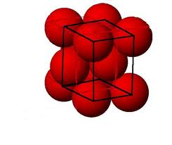
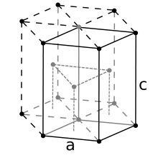
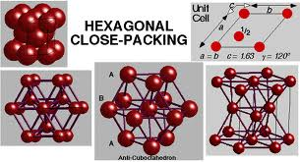
Hexagonal close-packed crystal structure
HCPstructure-- beryllium, cadmium, cobalt, Mg, zinc,
zirconium etc.
For the hexagonal close-packed (HCP) structure the derivation is similar. Here the unit cell is a hexagonal prism containing six atoms. Let a be the side length of its base and c be its height.
Looks as BCC

Slide 15
It consists of three layers of atoms.
The bottom layer has six corner atoms and one face
centred atom.
The middle layer has three full atoms.
The upper layer has six corner atoms and one face
centred atom.
Each and every corner atom contributes 1/6 of its part to
one unit cell.
The number of total atoms contributed by the corner
atoms of both top and bottom layers is 1/6 × 12 = 2.

Slide 16
The face centred atom contributes 1/2 of its part to one unit cell.
Since there are 2 face centred atoms, one in the top and the other in the bottom layers, the number of atoms contributed by face centred atoms is
1/2× 2 = 1.
Besides these atoms, there are 3 full atoms in the middle layer.
Total number of atoms present in an HCP unit cell is
2+1+3 = 6.

Slide 17
It is then possible to calculate the APF as follows:

Slide 18
THANKS !!

